Slide 1


356815008
344663000
52040792
312511520
361059264
359477000
377606032
373748880
Telco Global API Alliance – CAMARA
New Version of pathways for a clear, consistent and usable API design.
07.09.2022

Slide 2









Motivation
The purpose of this document is to define best practices based on standardization, normalization and usability homogenization to create a common API design in CAMARA.
Co-work with the same criteria, means that all the people involved in make grow CAMARA defines APIs in the same “language” of information exchange, making focus in the developer usability.
This developer usability motivates us to upgrade API Guidelines in this new versión 2.
Version 2 contains usability changes in some important points as:
Error Types
Common Structures
Filtering and sorting
Architecture Headers

Slide 3
Main Improvements (I)
Description of key points upgraded on the API Guidelines v2.
Error Responses
New Errors structures defined focusing on simplify and make them more usable for developers following steps of the other big API exposers as Google, AWS…
A JSON error structure is proposed below:
{
"code": "INVALID_ARGUMENT",
"message": "A human readable description of what the event represent"
}
Exception Code | Type | Text Message
INVALID_ARGUMENT | syntax | A specified resource duplicate entry found
CONFLICT | syntax | Specified resource duplicate entry found
OUT_OF_RANGE … | syntax …. | Client specified an invalid range …

Slide 4
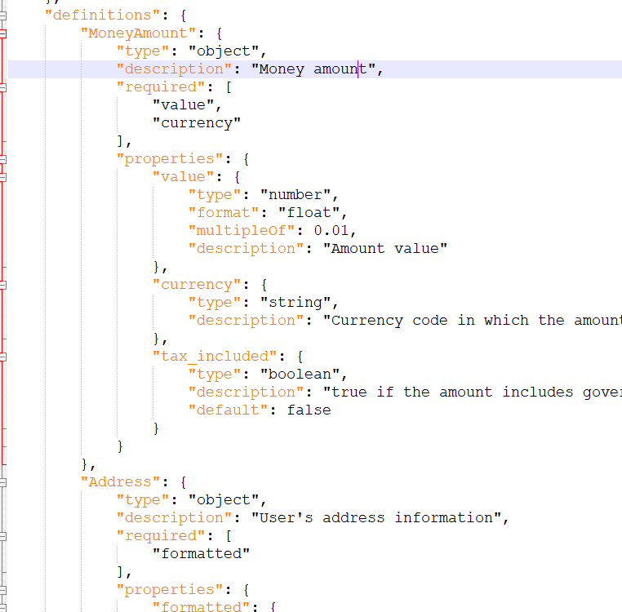
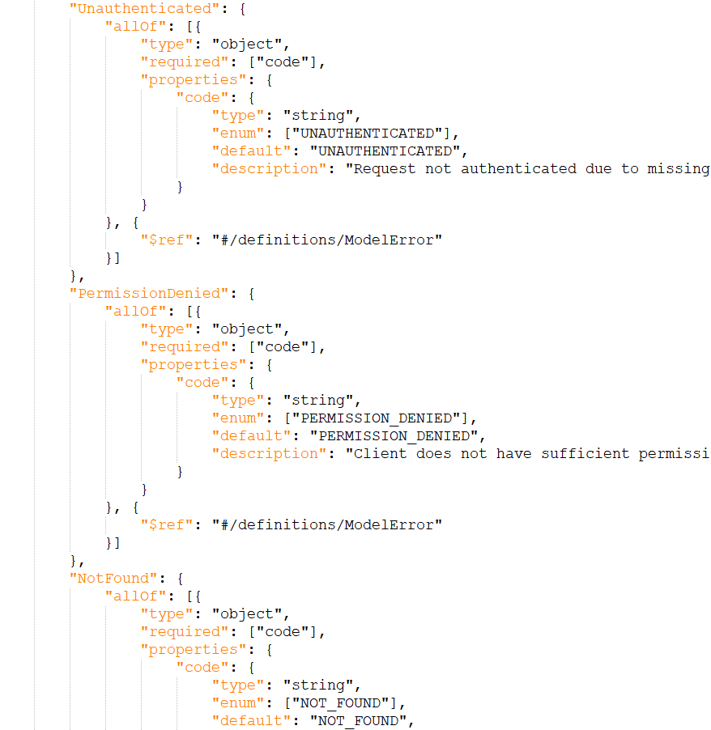
Main Improvements (II)
Common Data Types
In order to have an homogeneous design and usability in all CAMARA APIs some jSON common structures are proposed to avoid the use of different structures to return the same information.
This first proposal should be a live document, growing with more common structures:

Slide 5
Main Improvements (III)
Filtering, Sorting and Pagination
Exposing a resources collection through a single URI can cause applications to fetch large amounts of data when only a subset of the information is required. Based on our exposing experience, consumptions and performance, we upgrade the guidelines as follow:
Pagination
per_page: Number of resources requested to be provided in the response
page: requested index to indicate the start of the resources to be provided in the response
seek: Index of last result read to create the next/previous number of results. Required use for pagination in systems with more than 1000 records.
Sorting
order_by : Contains the names of the attributes on which the sort is performed, with comma separated if there is more than one criteria.
order: By default, sorting is done in descending order . If you may want to specify which sort criteria you need to use “asc” or “desc” as query value.

Slide 6
Main Improvements (IV)
Architecture Headers
In order to standardize the observability and traceability process, common headers providing E2E monitoring are proposed:
Name | Description | Type | Pattern | Longitude | Required | Example
X-Correlator | Service correlator to v. | String | UUID (8-4-4-4-12) | Máx. 36 | Yes. | b4333c46-49c0-4f62-80d7-f0ef930f1c46
Authorization | Contains Access token. | String | JWT | N/A | Yes | Bearer eyJhbGciOiJIUzI1NiIsIn...
X-Application-Version | consumer Client versión indentificator. | String | N/A |  | No | Fornite-client-release-1234-v-14.3
Content-Language | Describe the language(s) intended for the audience. | String | ISO 639-1 |  | No | es
Accept-Language | Indicates the natural language and locale that the client prefers. | String | N/A |  | No
“X-” headers are proposed by Telefonica for E2E Observability and monitorization.
X-Application-Version: This header is focused on ensure that CAMARA APIs exposers have the information of consumer Client version, making easier the correlation of errors/warning in the E2E flow.
Authorization is the standard header to inform the token or key needed to consume the API service
Rest of headers are based on HTTP standard headers table and its purpose is the same of standard definition.

Slide 7

Q&A

