Slide 1
Architecture discussion and API classification
Telefónica SA
Jose Ordonez-Lucena / Juan Carlos García

Slide 2
The document presents a proposal for organizing the API families, linking them to the existing Cloud/NaaS reference architectures
Razón social
00.00.2015

Slide 3
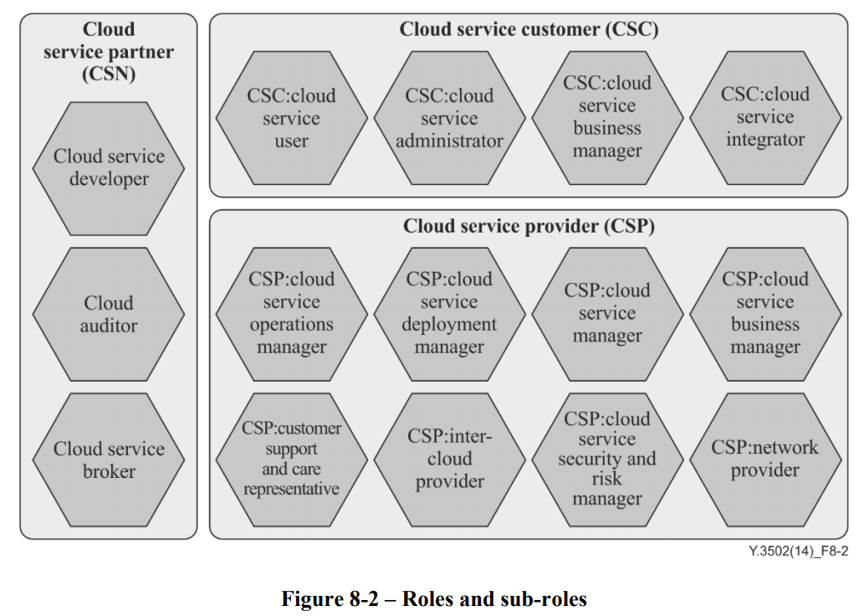
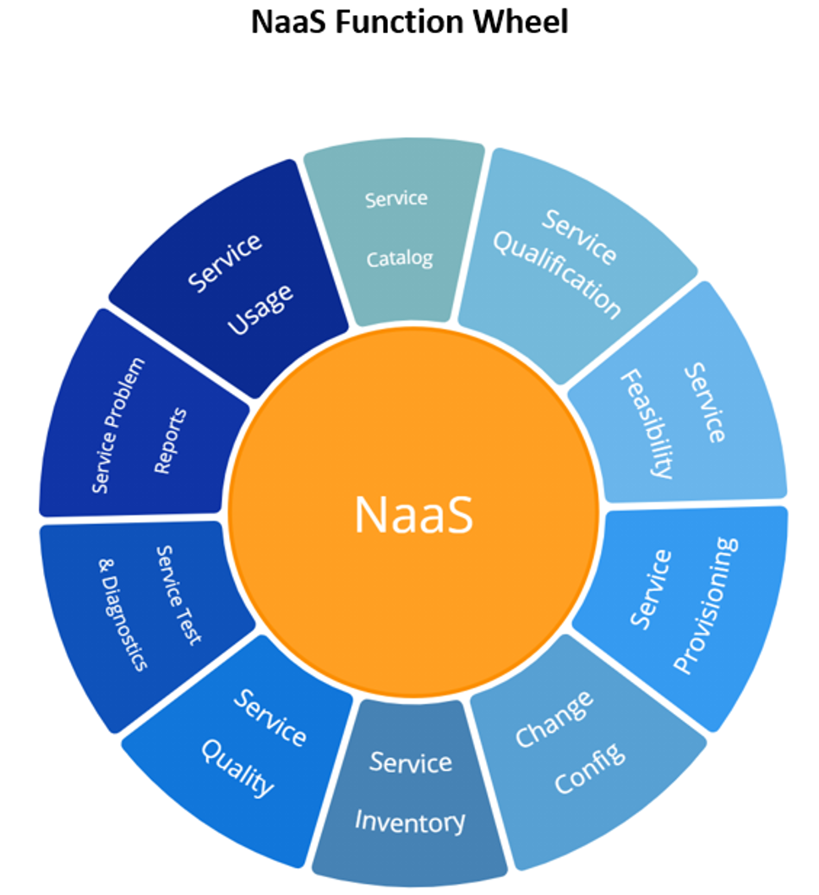
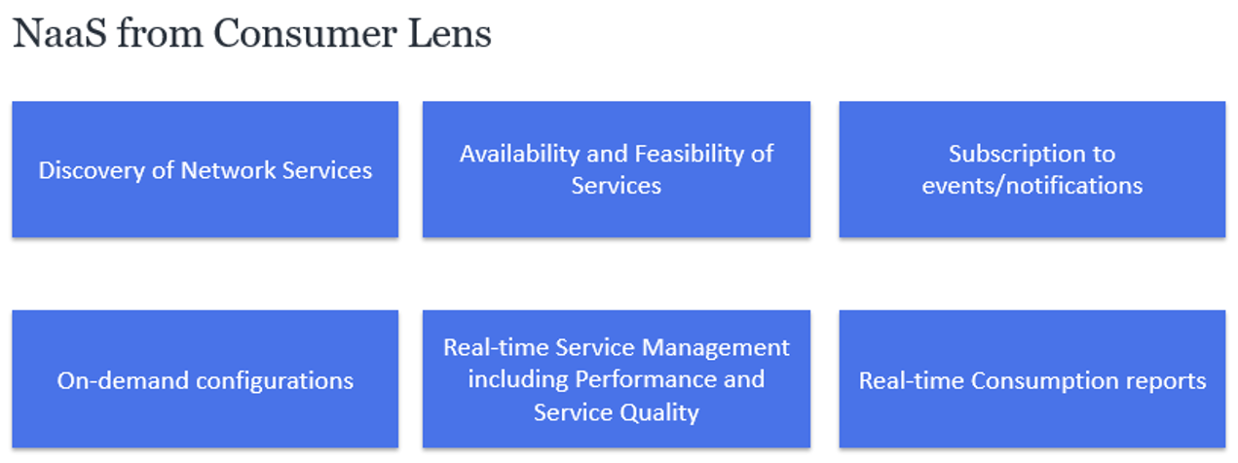
The Reference Architectures
Our understanding is that the APIs are developed to implement NaaS services in the current and future Cloud platforms. For this reason, they should use as reference architectures:
ITU-T Y.3502 Cloud Computing Reference Architecture
ITU-T Y.3515 Cloud Computing – Functional Architecture of Network as a Service
For the management and administration APIs, we consider relevant to use as a reference:
TMF 909 Network as a Service (NaaS) Management REST API Specification. V3.0.1 Nov 2019
IG1224 NaaS Service Fulfillment Guidelines (TM Forum Exploratory Report). March 2021

Slide 4
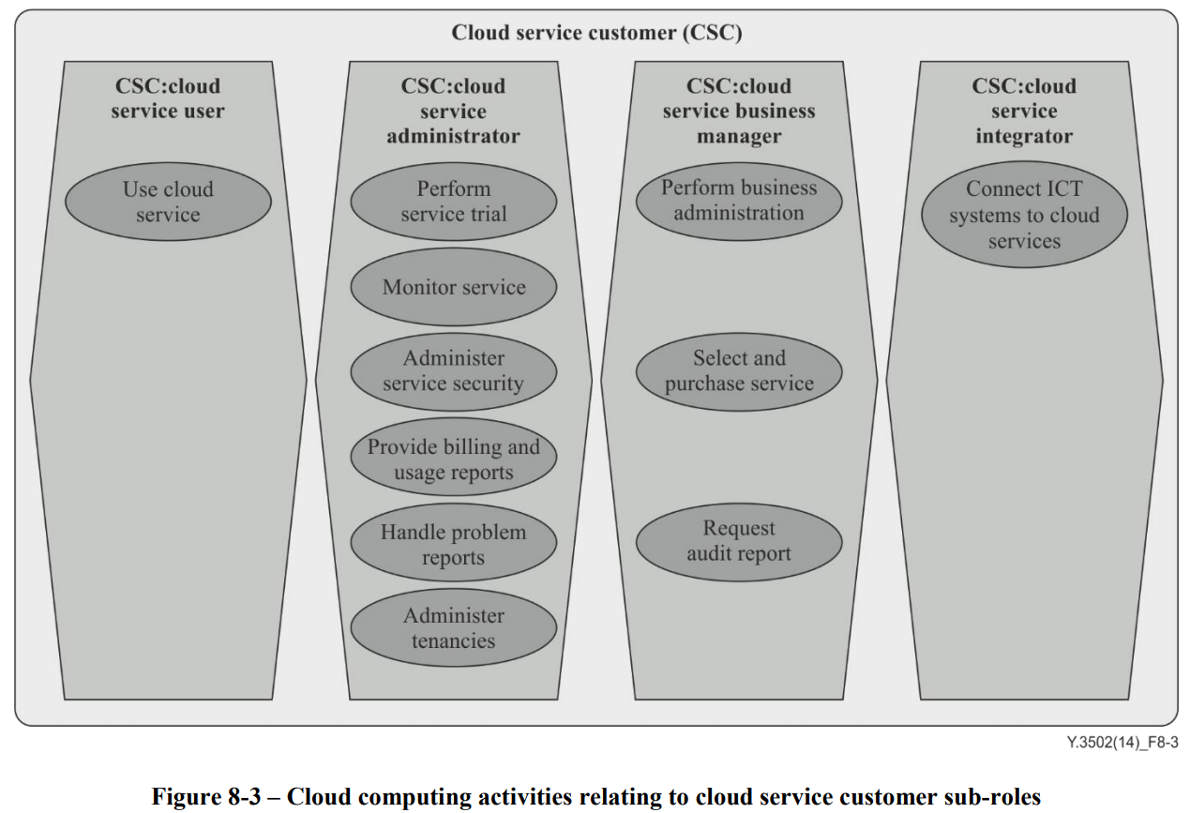
The Reference Architectures: ITU-T
Our understanding is that the Project should not define architectures but use the standard ones already defined for the Cloud and IT Systems (ITU-T and TM Forum) and focus on the design, development and testing aiming at a wide implementation across the industry.
The use of existing reference architectures can facilitate, by reusing, the work of defining API categories and will facilitate the integration of the developed APIs into the existing and future commercial systems/platforms that will implement the defined NaaS services, and its management and administration from the systems of our customers.
The APIs the Project will develop will help our customers (Cloud Service Customers in ITU-T terminology) in the different activities they need to perform as:
User: actual user of the Service
Administrator: management of the Service: monitor, administer Security, billing and usage reports, problem reports, etc.
Business manager: business administration (), select and purchase Service, request Audit report…
Our proposal would be to make a first classification of the APIs in these 3 customer sub-roles.

Slide 5
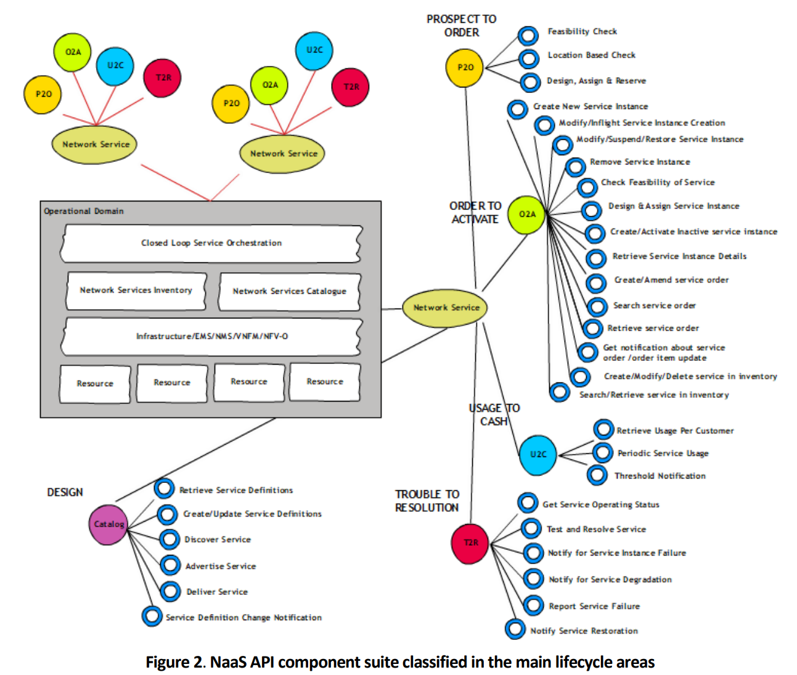
The Reference Architectures: TM Forum
In the case of TM Forum, we could follow its terminology to further categorize the APIs for administration (OAM) and business management following the main lifecycle areas:
P2O: Prospect to Order
O2A: Order to Activate
U2C: Usage to Cash
T2R: Trouble to Resolution
Design
Our proposal would be to make a selection or customization (and simplification) of the APIs defined by TM Forum.
Note: not all the APIs defined by TMForum apply to our case. We have to select or customize the suite of APIs based on the characteristics of our NaaS services

Slide 6
Fitting API familities into the ITU-T Cloud Refence Architecture (CRA)
Grouping of APIs into ITU-T Cloud Reference Architecture, based on who (which customer sub-role) may consume them.
Cloud Service Customer
CSC:User
CSC:Administrator
CSC:Business Manager
Quality on Demand
Network Status
Device Status
Edge Discovery/instance
Traffic Influence
Localization/geofencing
Emergency
(Future: Network Slicing)
Accounting (usage), Charging
Operation Related Data
CFS Catalog and Inventory (includes Edge Discovery/nodes)
Advanced OAM
Device configuration
API subscription
Device registration
Other Business Related Data (subscriber data, customer profile, SLAs…)
Billing

Slide 7
Fitting API familities into the TM Forum NaaS framework
Grouping of “administration” (CSC: Administrator) APIs and “business management” (CSC: Business Manager) APIs into the TM Forum NaaS framework, based on customer activities they support.
CSC:Administrator, CSC:Business Manager
Design
CFS Catalog and Inventory. It includes:
Catalog of APIs
Inventory of Edge nodes where they are available.
Prospect to Order (P2O)
CFS Catalog and Inventory (includes Edge Discovery/nodes)
API subscription
Order to Activate (O2A)
Device registration
Usage to Cash (U2C)
Accounting (usage), Charging and Billing
Other Business Related Data
Trouble to Resolution (T2R)
Operation Related Data
Advanced OAM
Device configuration

