Slide 1
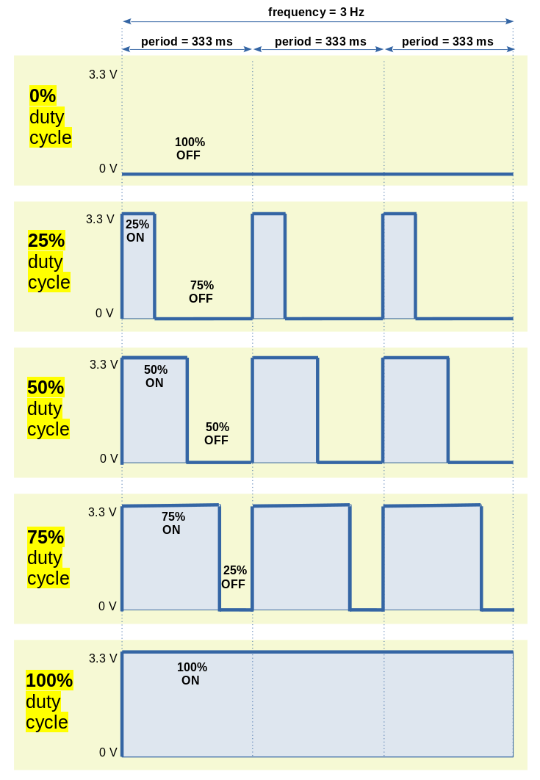
frequency = 3 Hz
period = 333 ms
period = 333 ms
period = 333 ms
3.3 V
0 V
0% duty cycle
100%
OFF
25% duty cycle
3.3 V
0 V
25%
ON
75% OFF
3.3 V
0 V
50%
ON
50% duty cycle
50% OFF
3.3 V
0 V
75%
ON
75% duty cycle
25% OFF
3.3 V
0 V
100%
ON
100% duty cycle

