Slide 1
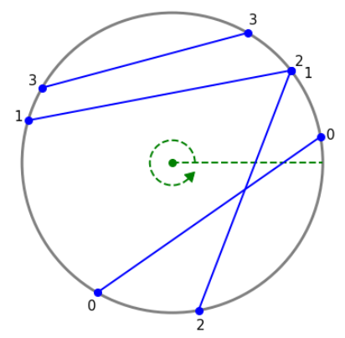
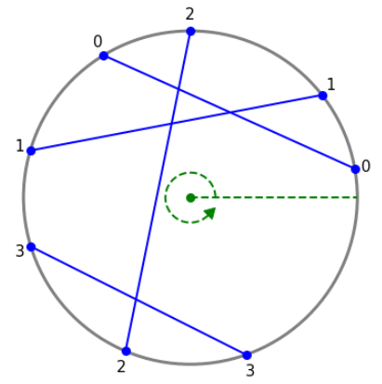
Two chords have same endpoint
NOT GOOD aka BAD 👎
Good 👍

Slide 2
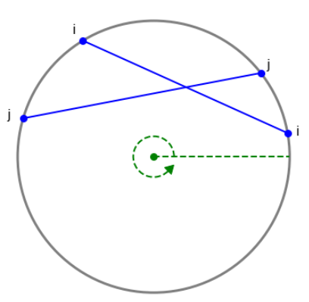
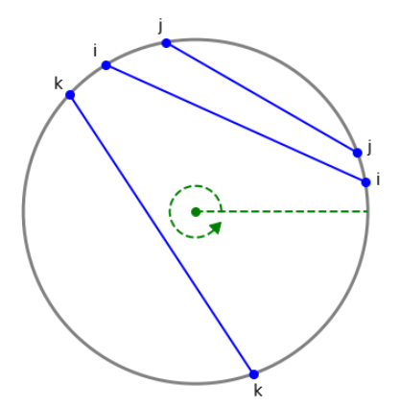
[i, j, j, i]
[i, j, i, j]
[i, i, k, k]
Intersection
No intersection

Slide 3
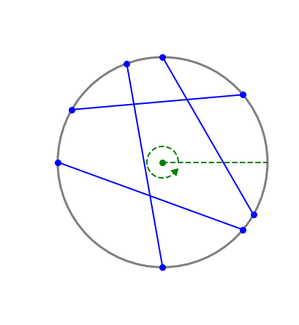
n = 4 leafs, none are open yet
T
0
0
0
0
0
0
0
0
1
2
3
leafs

Slide 4
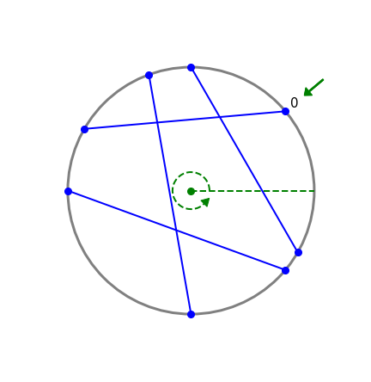
Open leaf 0: increment sizes of leaf 0 and its ancestors
T
+1
1
+1
1
0
+1
1
0
0
0
0
1
2
3
leafs

Slide 5
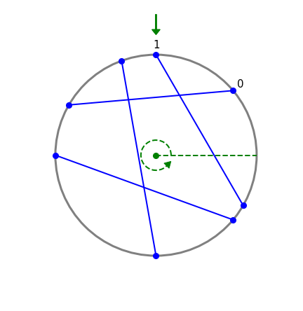
Open leaf 1: increment sizes of leaf 1 and its ancestors
T
+1
2
+1
2
0
+1
1
1
0
0
0
1
2
3
leafs

Slide 6
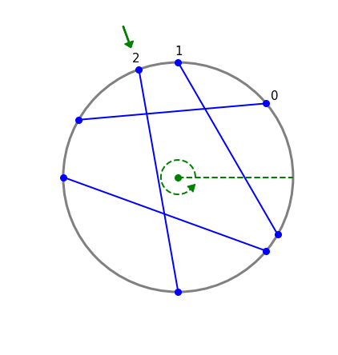
Open leaf 2: increment sizes of leaf 2 and its ancestors
T
+1
3
+1
2
1
+1
1
1
1
0
0
1
2
3
leafs

Slide 7
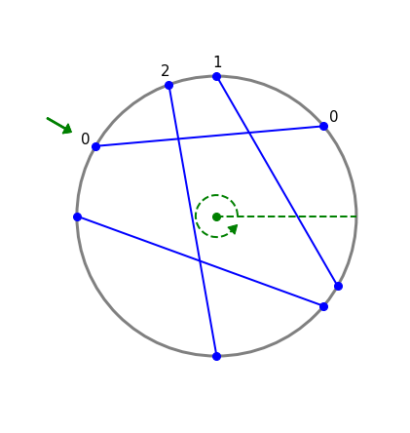
Close leaf 0: count higher-numbered open chords
I = 0+o₁+o₂+o₃
T
3
2
1
1
1
1
0
0
1
2
3
leafs

Slide 8
Close leaf 0: count higher-numbered open chords
I = 1+o₁+o₂+o₃
T
3
2
1
Leaf 0 is a left child: add sibling’s size to o₀
1
1
1
0
0
1
2
3
leafs

Slide 9
Close leaf 0: count higher-numbered open chords
I = 2+o₁+o₂+o₃
T
3
Leaf 0’s parent is a left child: add sibling’s size to o₀
2
1
1
1
1
0
0
1
2
3
leafs

Slide 10
Close leaf 0: count higher-numbered open chords
I = 2+o₁+o₂+o₃
T
Reached root
3
2
1
1
1
1
0
0
1
2
3
leafs

Slide 11
Close leaf 0: decrement sizes of leaf 0 and its ancestors
I = 2+o₁+o₂+o₃
T
-1
2
-1
1
1
-1
0
1
1
0
0
1
2
3
leafs

Slide 12
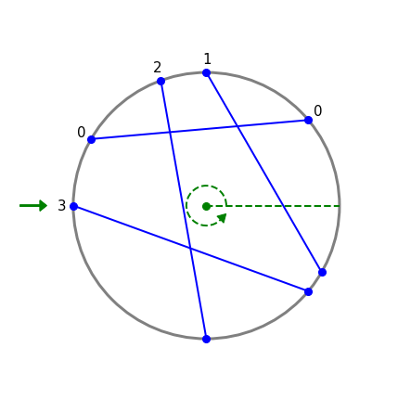
Open leaf 3: increment sizes of leaf 3 and its ancestors
I = 2+o₁+o₂+o₃
T
3
+1
+1
1
2
0
1
1
1
+1
0
1
2
3
leafs

Slide 13
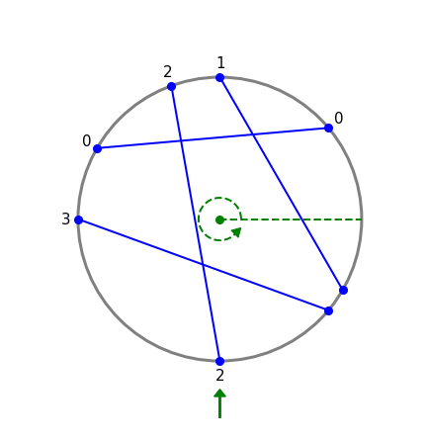
Close leaf 2: count higher-numbered open chords
I = 2+o₁+0+o₃
T
3
1
2
0
1
1
1
0
1
2
3
leafs

Slide 14
Close leaf 2: count higher-numbered open chords
I = 2+o₁+1+o₃
T
3
1
2
Leaf 2 is a left child: add sibling’s size to o₂
0
1
1
1
0
1
2
3
leafs

Slide 15
Close leaf 2: count higher-numbered open chords
I = 2+o₁+1+o₃
T
3
Leaf 2’s parent is a right child: do nothing
1
2
0
1
1
1
0
1
2
3
leafs

Slide 16
Close leaf 2: count higher-numbered open chords
I = 2+o₁+1+o₃
T
2
Reached root
1
2
0
1
1
1
0
1
2
3
leafs

Slide 17
Close leaf 2: decrement sizes of leaf 2 and its ancestors
I = 2+o₁+1+o₃
T
-1
2
1
-1
1
0
1
-1
0
1
0
1
2
3
leafs

Slide 18
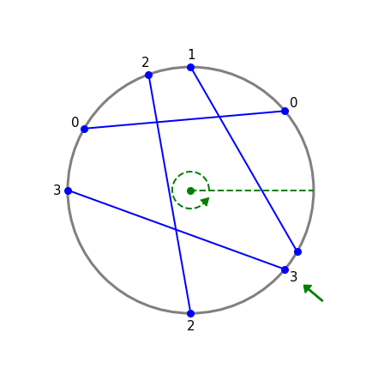
Close leaf 3: count higher-numbered open chords
I = 2+o₁+1+0
T
2
1
1
0
1
0
1
0
1
2
3
leafs

Slide 19
Close leaf 3: count higher-numbered open chords
I = 2+o₁+1+0
T
2
1
1
Leaf 3 is a right child: do nothing
0
1
0
1
0
1
2
3
leafs

Slide 20
Close leaf 3: count higher-numbered open chords
I = 2+o₁+1+0
T
2
Leaf 3’s parent is a right child: do nothing
1
1
0
1
0
1
0
1
2
3
leafs

Slide 21
Close leaf 3: count higher-numbered open chords
I = 2+o₁+1+0
T
2
Reached root
1
1
0
1
0
1
0
1
2
3
leafs

Slide 22
Close leaf 3: decrement sizes of leaf 3 and its ancestors
I = 2+o₁+1+0
T
1
-1
-1
1
0
-1
0
1
0
0
0
1
2
3
leafs

Slide 23
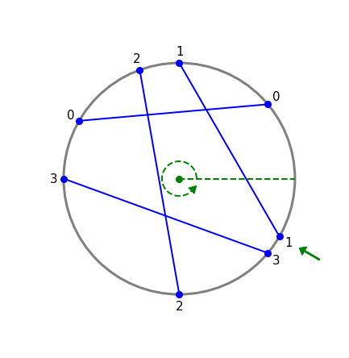
Close leaf 1: count higher-numbered open chords
I = 2+0+1+0
T
1
1
0
0
1
0
0
0
1
2
3
leafs

Slide 24
Close leaf 1: count higher-numbered open chords
I = 2+0+1+0
T
1
1
0
Leaf 1 is a right child: do nothing
0
1
0
0
0
1
2
3
leafs

Slide 25
Close leaf 1: count higher-numbered open chords
I = 2+0+1+0
T
1
Leaf 1’s parent is a left child: add sibling’s size to o₁
1
0
0
1
0
0
0
1
2
3
leafs

Slide 26
Close leaf 1: count higher-numbered open chords
I = 2+0+1+0
T
Reached root
1
1
0
0
1
0
0
0
1
2
3
leafs

Slide 27
Close leaf 1: decrement sizes of leaf 1 and its ancestors
I = 2+0+1+0
T
-1
1
-1
1
0
-1
0
0
0
0
0
1
2
3
leafs

Slide 28
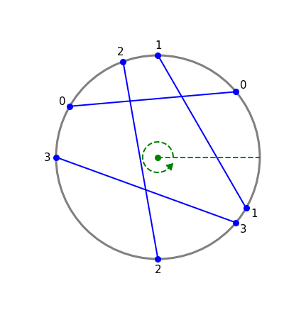
End of algorithm
I = 2+0+1+0
= 3 intersections
T
1
1
0
0
0
0
0
0
1
2
3
leafs

