Slide 1
Starting
Mark Fernandes

Slide 2
library(datasets)

Slide 3
R Markdown basic Document

Slide 4
Bring in data and display summary stats
data(iris) summary(iris)
## Sepal.Length Sepal.Width Petal.Length Petal.Width ## Min. :4.300 Min. :2.000 Min. :1.000 Min. :0.100 ## 1st Qu.:5.100 1st Qu.:2.800 1st Qu.:1.600 1st Qu.:0.300 ## Median :5.800 Median :3.000 Median :4.350 Median :1.300 ## Mean :5.843 Mean :3.057 Mean :3.758 Mean :1.199 ## 3rd Qu.:6.400 3rd Qu.:3.300 3rd Qu.:5.100 3rd Qu.:1.800 ## Max. :7.900 Max. :4.400 Max. :6.900 Max. :2.500 ## Species ## setosa :50 ## versicolor:50 ## virginica :50 ## ## ##

Slide 5
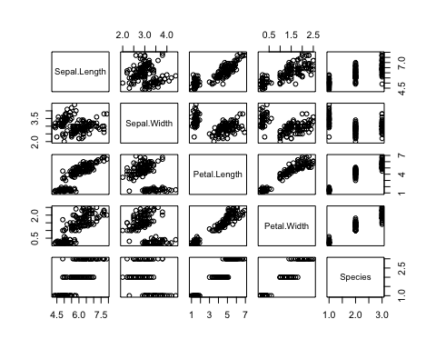
Plot every possible relationship
plot(iris)

Slide 6
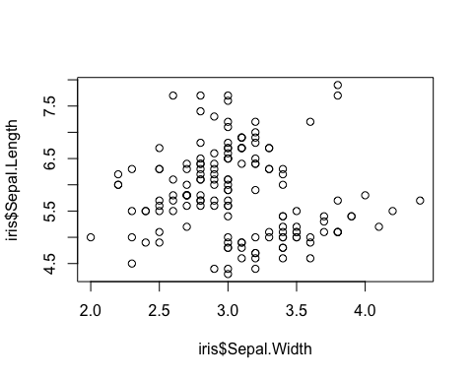
explore possible relationship between sepal width & length
plot(iris$Sepal.Width, iris$Sepal.Length)

Slide 7
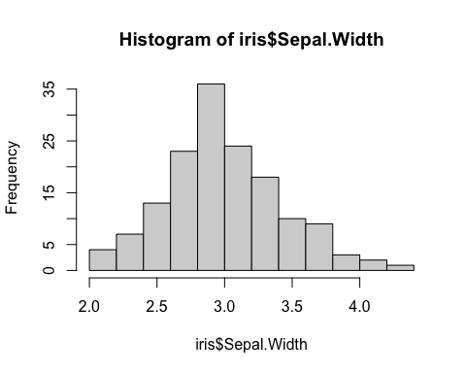
hist(iris$Sepal.Width)

Slide 8
# Greater Sepal width seems to be associated smaller Sepal length

Slide 9
Based on this RPubs page https://rpubs.com/moeransm/intro-iris

