Slide 1
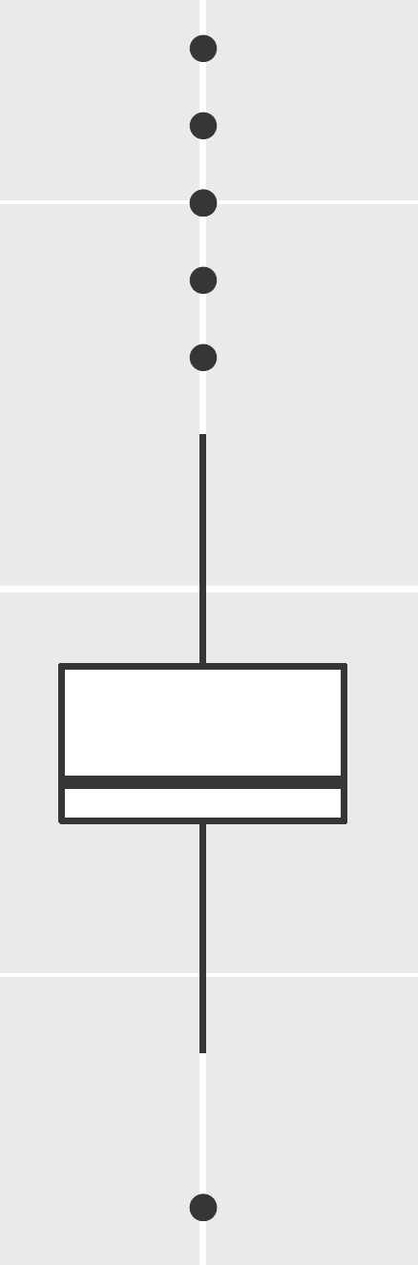
outliers
upper
whisker
75th quantile
median (50th quantile)
25th quantile
bottom
whisker

