Slide 1
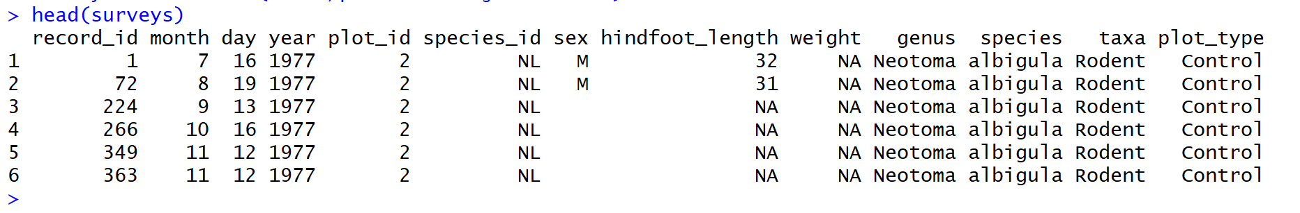
 | record_id | month | day
 | [1,1] | [1,2] | [1,3]
1 | 1 | 7 | 16
 | [2,1] | [2,2] | [2,3]
2 | 72 | 8 | 19
 | [3,1] | [3,2] | [3,3]
3 | 224 | 9 | 13
colnames(surveys)
index [R,C]
rownames(surveys)

