Slide 1

Survival (time-to-event) analysis
Cambridge Centre for Research Informatics Training

Slide 2
Course aims
Recognise when survival analysis should be used, based on dataset/experimental design
Implement survival analysis (including multiple predictor variables & time-varying predictors)
Meaningfully interpret the results
Visualise survival data and survival curves effectively

Slide 3
Session 1
In session 1:
What’s special about survival/time-to-event data?
Survival curves (Kaplan-Meier estimation)
Comparing two curves (log rank test)

Slide 4
Session 2
In session 2:
Continuous predictor variables
Multiple predictor variables (Cox regression)
Evaluating & comparing models

Slide 5
1. Survival (time-to-event) data
Why do we need unique analysis methods?

Slide 6
Survival data
Start
Time
Notes:
Note: time will always be a number >=0, which makes it different to standard continuous variables

Slide 7
“Time to event”
Start
Time
Notes:
The event does not have to be death!
Time until the next bus arrives at different bus stops
Time untio

Slide 8
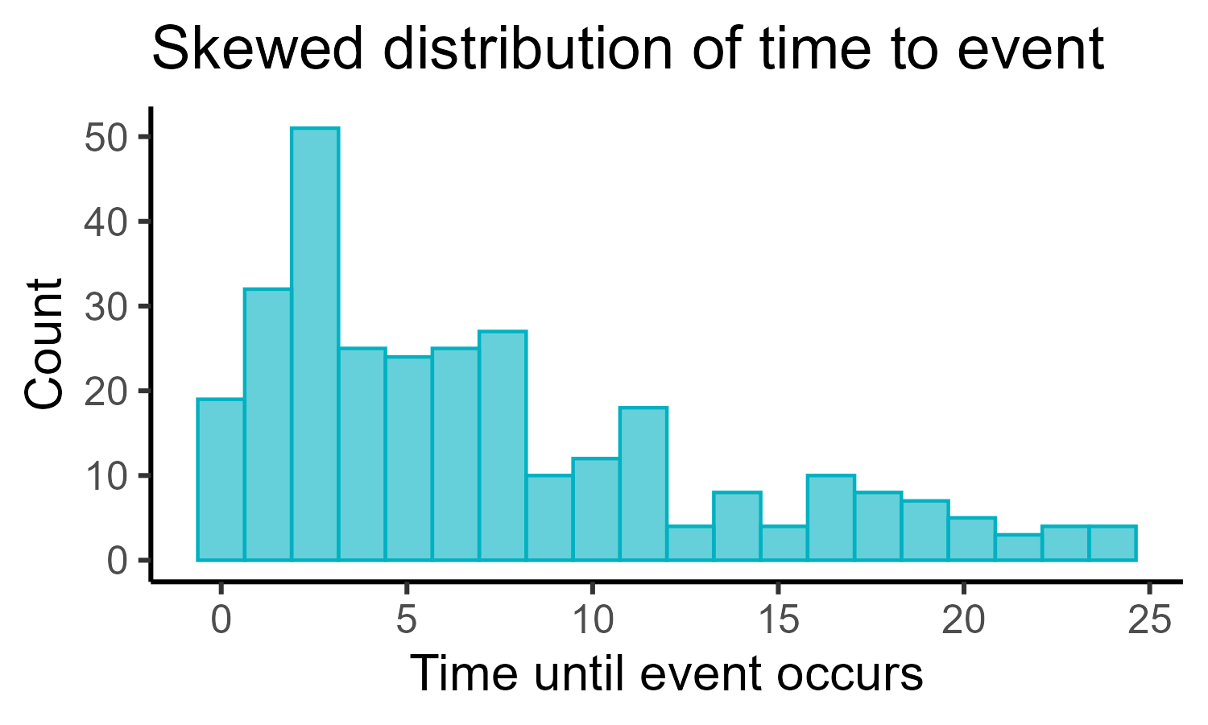
Properties of survival data
Why can’t we use “regular” linear models?
Quirks of survival data:
Often (very) skewed
Values are ≥0
Censoring (missing data)

Slide 9
Censoring
Start of study
End of study
Uncensored
Right-censored
Interval-censored
Notes:
These are the two common issues we need to deal with (and will be the main focus of the course)
Right-censored: either they survived to the end of the study without experiencing the event, or something else happened (e.g., dropping out) that meant we can’t follow them any more and we don’t know if they experienced the event
Short version: right-censored if we were following them during the study, but we don’t know if they ever experienced the event because we stopped following them
Interval censored: super common; when we don’t know the exact instance the event occurred, but we do know it happened after some set time and before some other set time

Slide 10
More censoring (& truncation)
Start of study
End of study
Staggered entry
Left-censored
Left-truncated
Right-truncated
Notes:
These are other things that can occur in survival data, and may or may not need to be accounted for – but won’t be a major focus of this course
Staggered entry: when not everyone enters the study at the same time
Left-censored: when the event of interest occurs before the study started (extremely rare!)
Truncation is deliberate/due to study design:
Left-truncated: when the individual was at risk before the study started, and we don’t know whether they did or didn’t experience the event
Right-truncated: only happens when membership in the study is determined retrospectively; the individual experienced the event after the date of the study that would’ve made them eligible for inclusion

Slide 11
A survival dataset
Participant | Time followed | Event
001 | 4 | 1
002 | 1 | 1
003 | 1 | 0
004 | 6 | 1
005 | 2 | 1
006 | 2 | 1
007 | 6 | 1
008 | 3 | 0
009 | 3 | 1
010 | 5 | 1
.. | .. | ..

Slide 12
A survival dataset
Participant | Time followed | Event
001 | 4 | 1
002 | 1 | 1
003 | 1 | 0
004 | 6 | 1
005 | 2 | 1
006 | 2 | 1
007 | 6 | 1
008 | 3 | 0
009 | 3 | 1
010 | 5 | 1
.. | .. | ..

Slide 13
A survival dataset
Participant | Time followed | Event
001 | 4 | 1
002 | 1 | 1
003 | 1 | 0
004 | 6 | 1
005 | 2 | 1
006 | 2 | 1
007 | 6 | 1
008 | 3 | 0
009 | 3 | 1
010 | 5 | 1
.. | .. | ..

Slide 14
A survival dataset
Participant | Time followed | Event
001 | 4 | 1
002 | 1 | 1
003 | 1 | 0
004 | 6 | 1
005 | 2 | 1
006 | 2 | 1
007 | 6 | 1
008 | 3 | 0
009 | 3 | 1
010 | 5 | 1
.. | .. | ..

Slide 15
A survival dataset
Participant | Time followed | Event
001 | 4 | 1
002 | 1 | 1
003 | 1 | 0
004 | 6 | 1
005 | 2 | 1
006 | 2 | 1
007 | 6 | 1
008 | 3 | 0
009 | 3 | 1
010 | 5 | 1
.. | .. | ..

Slide 16
Example 1
“How long do patients maintain functional kidney grafts following transplant?”
What’s the event?
Examples of censoring?
Notes:
Event: graft/transplant failure
Censoring:
Patient drops out (RC)
Graft never fails by the end of the study (RC)
Death from unrelated causes (competing risk)
Graft fails between clinical visits (IC)
Broad conceptual ideas: structured follow-up + competing risks

Slide 17
Example 2
“How long do tagged migratory birds remain within a defined geographic area after breeding?”
What’s the event?
Examples of censoring?
Notes:
Event: animal leaves area
Censoring:
Animal dies (RC)
Study ends before bird leaves (RC)
Tagging device fails (RC)
Tagging device only reports location once per day/week (IC)
Broad conceptual ideas: loss + intermittent observation

Slide 18
Example 3
“How long do customers stay subscribed before cancelling a streaming service?”
What’s the event?
Examples of censoring?
Notes:
Event: cancellation
Censoring:
Customer never cancels before end of study period (RC)
Customer becomes inactive, e.g., data loss, subscription status unknown (RC)
Cancellation occurs between billing cycles, e.g., monthly (IC)
Broad conceptual ideas: periodic observation

Slide 19
Example 4
“When will a volcano next have a major eruption?”
What’s the event?
Examples of censoring?
Notes:
Event: eruption
Censoring:
No eruption before study ends (RC)
Unknown prior dormancy period (left truncation)
Broad conceptual ideas: historical data + left truncation
To better understand the left truncation issue, imagine:
Volcano erupting sporadically for centuries
Monitoring started in earnest in 2000
The last eruption prior to that monitoring was 1992
Volcano must not have erupted between 1992 and 2000, otherwise we would’ve seen it
We’re biased to only include eruption intervals that extend into the 2000+ dataset
i.e., we can only study volcano waiting times that are still ongoing when we actually start monitoring; we miss any short waiting times/cycles that occurred before we started watching
Leads to an overestimate of average time between eruptions

Slide 20
Summary: Survival data is unique
Time-to-event data is not suitable for linear modelling
It is skewed and always ≥0
It is also regularly censored (missing data)
Right censoring:
An individual may experience the event after study end
The individual experienced a competing event
Interval censoring:
The exact time of the event is unknown (falls in an interval)

Slide 21
2. The survival curve
Using the Kaplan-Meier estimator to deal with censoring

Slide 22
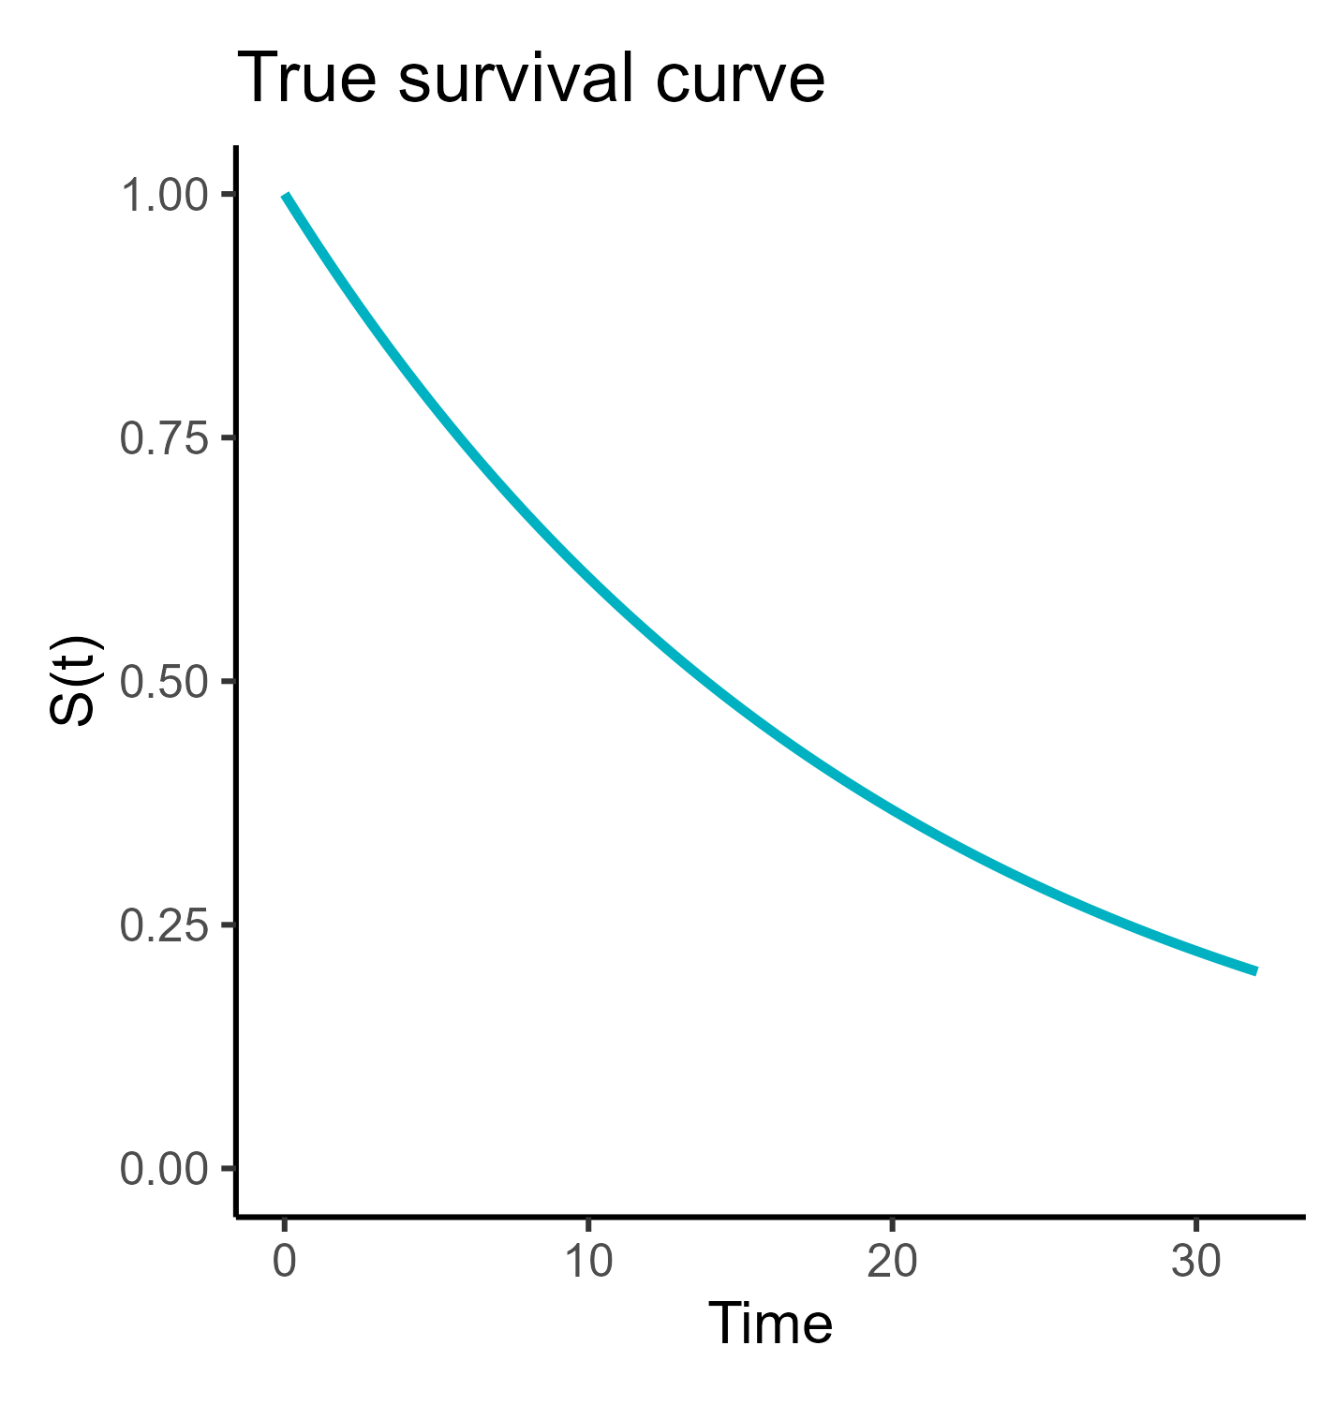
What is a survival curve?
Population survival curve
“Ground truth”
Controls which individuals will experience event (and when)

Slide 23
What is a survival curve?
Population survival curve
“Ground truth”
Controls which individuals will experience event (and when)
We want to know what this curve looks like
But we cannot measure the whole population

Slide 24
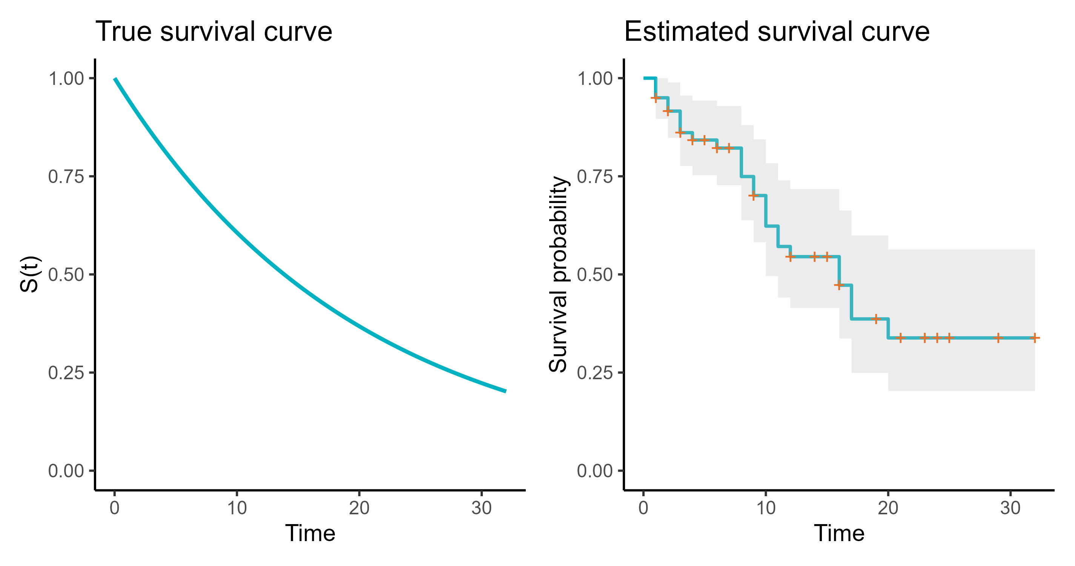
The goal: estimating the survival curve

Slide 25
An example
“How long do dragon eggs take to hatch?”
Event: Egg hatches
Censoring: Egg is unhatched, damaged/removed, etc.

Slide 26
An example
Egg | Time followed | Event
1 | 49 | 0
2 | 12 | 1
3 | 30 | 1
4 | 22 | 0
.. | .. | ..

Slide 27
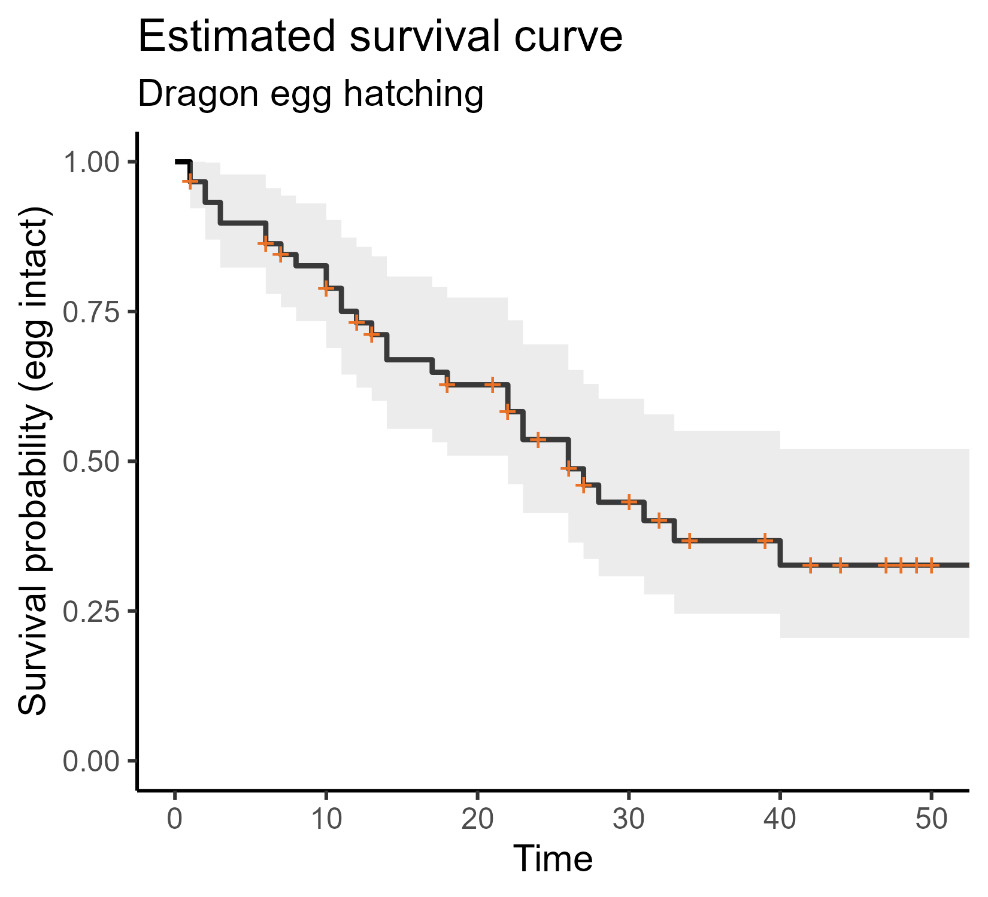
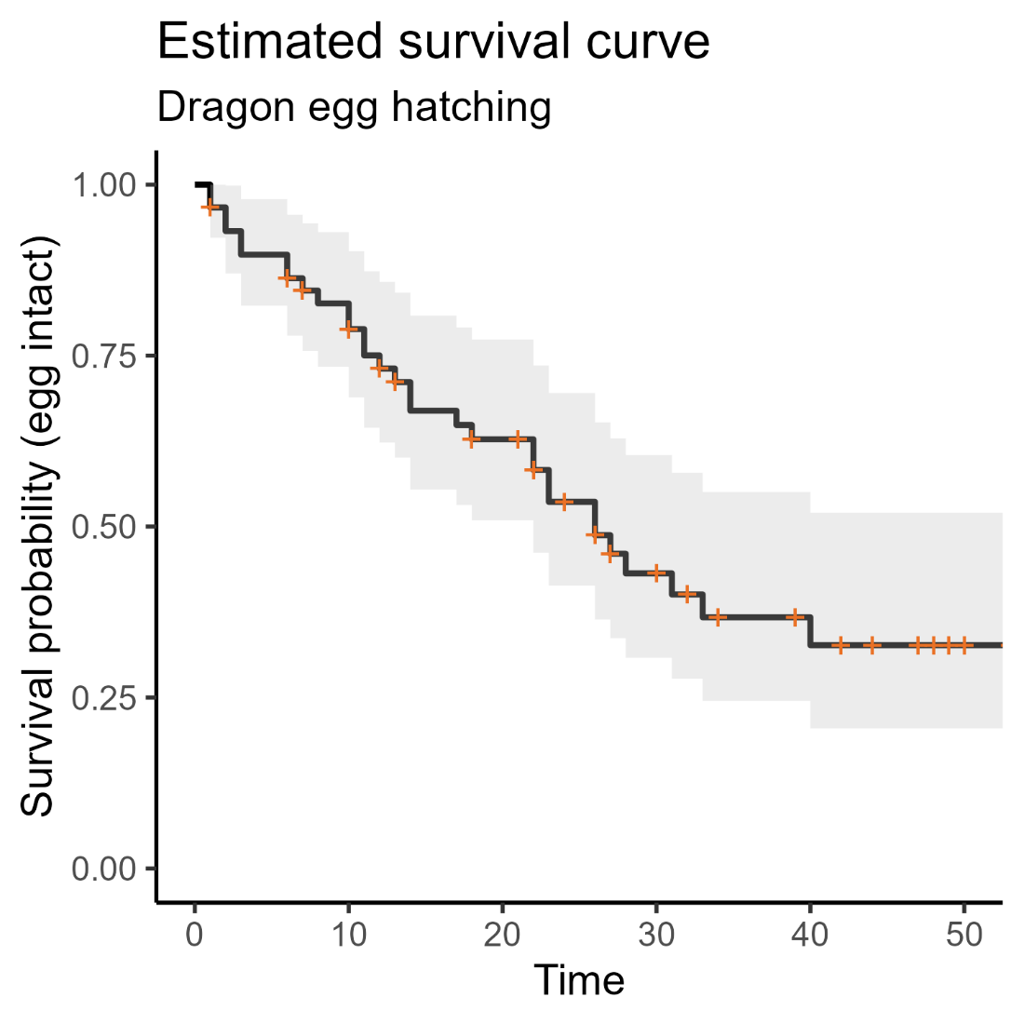
An example

Slide 28
Kaplan-Meier survival curve
Uses:
View the data more intuitively
+ censoring event
Notes:
Follows a classic “step-staircase” shape
The censoring events are noted with the orange + symbols
All the data have been included in a single curve

Slide 29
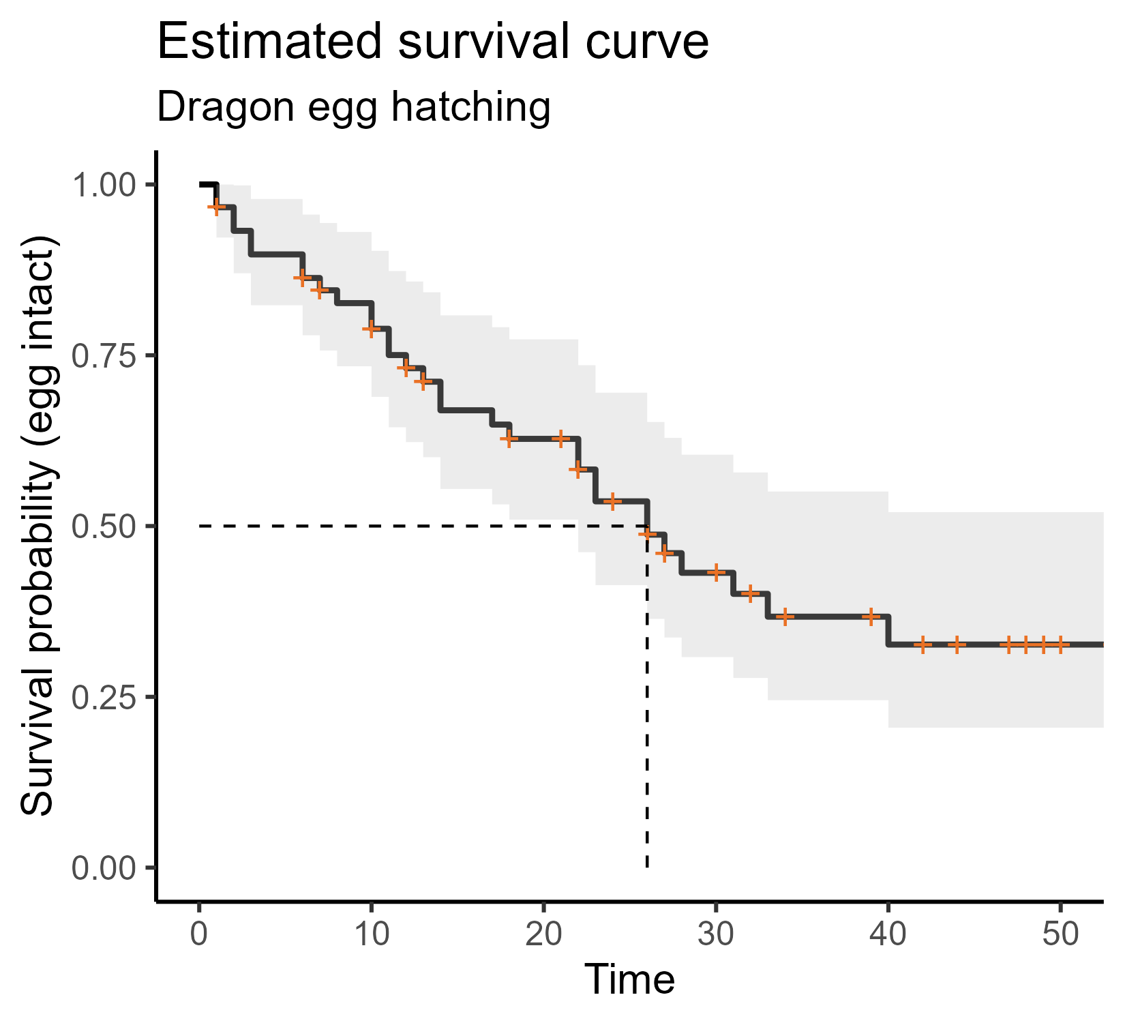
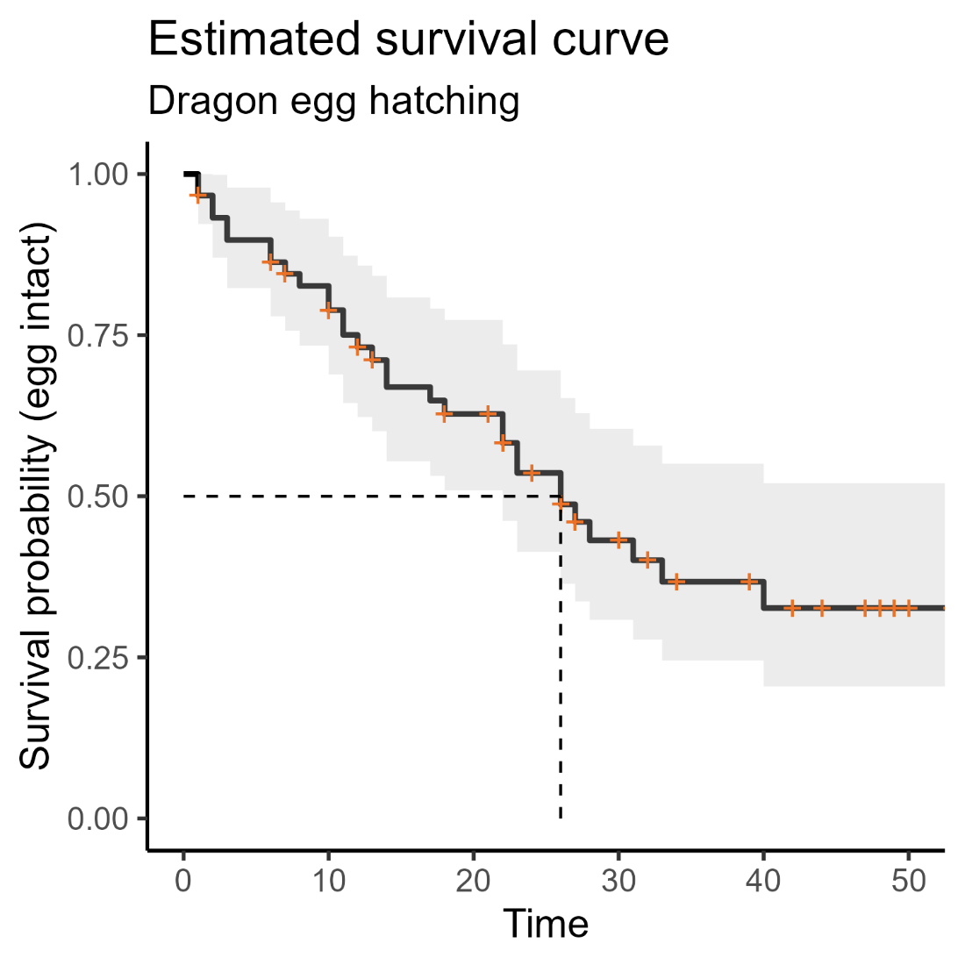
Kaplan-Meier survival curve
Uses:
View the data more intuitively
Estimate key parameters, e.g., median survival time
+ censoring event
Notes:
Follows a classic “step-staircase” shape
The censoring events are noted with the orange + symbols
All the data have been included in a single curve
Median value: time at which you expect 50% of individuals to have experienced the event
(In this case – 26 days)

Slide 30
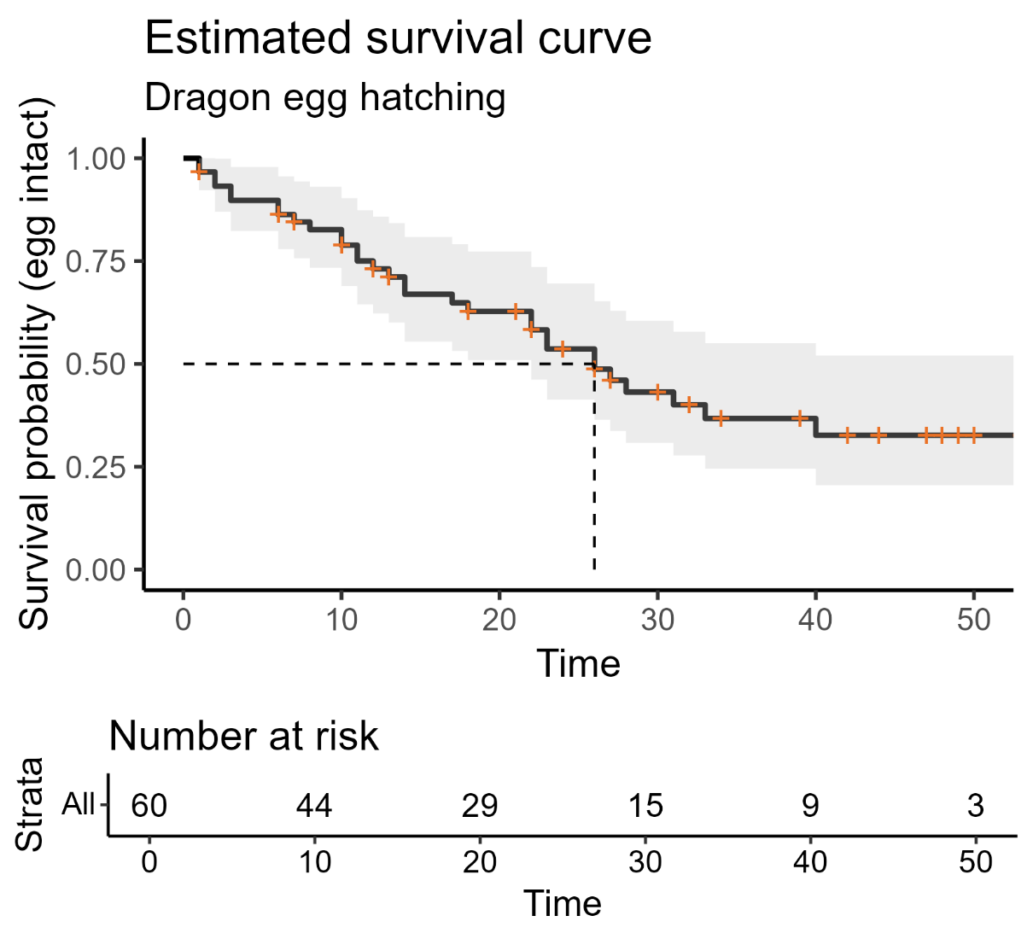
Kaplan-Meier survival curve
Uses:
View the data more intuitively
Estimate key parameters, e.g., median survival time
We can provide other data too
Notes:
The “number at risk” table – shows you, at specific points in the study, how many individuals were still at risk
Meaning = they were still being followed (weren’t censored) and hadn’t yet experienced the event

Slide 31
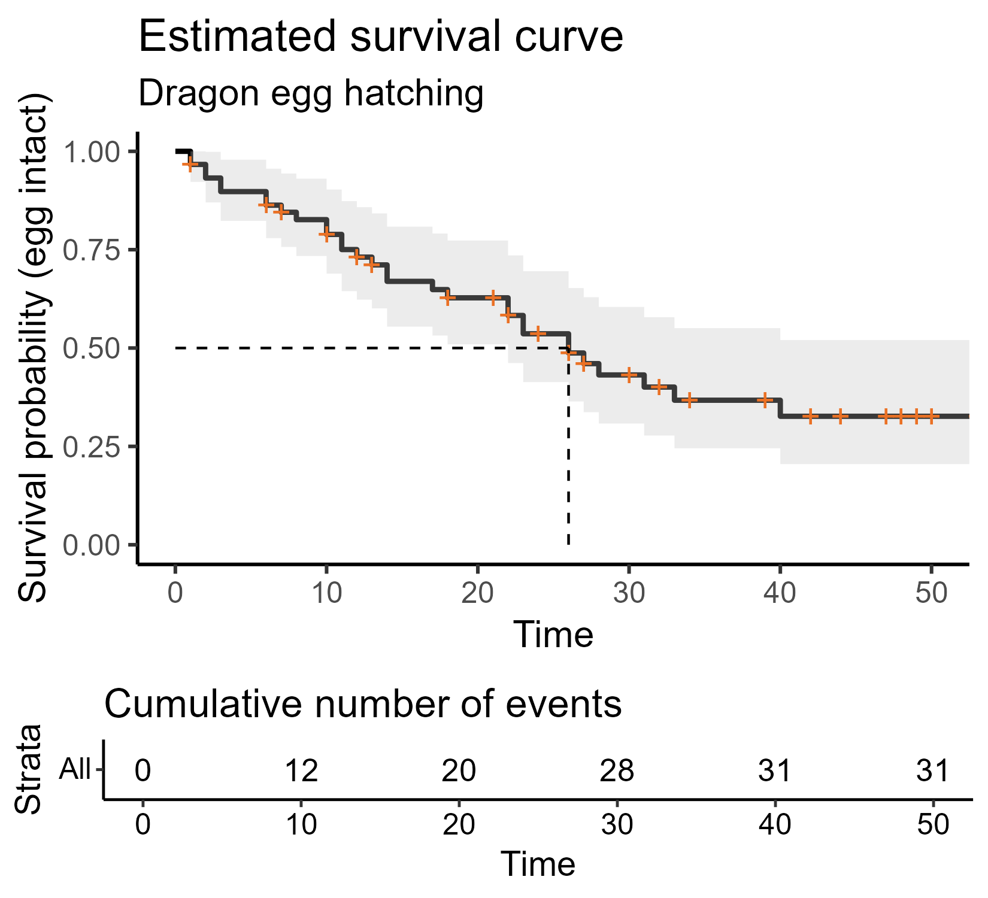
Kaplan-Meier survival curve
Uses:
View the data more intuitively
Estimate key parameters, e.g., median survival time
We can provide other data too
Notes:
Similar information is given in the cumulative events table
This shows how many individuals have experienced the event (doesn’t keep track of dropouts/censored observations, though)

Slide 32
How is the curve constructed?
Constructed using the Kaplan-Meier estimator
Original data survival object
transformed into
Notes:
So when we produce a survival curve, what’s actually being plotted?
You don’t need to do this manually (but it is possible!)

Slide 33
Dragon egg dataset
Egg | Time followed | Event
1 | 49 | 0
2 | 12 | 1
3 | 30 | 1
4 | 22 | 0
.. | .. | ..
Original dataset

Slide 34
Dragon egg dataset
Egg | Time followed | Event
1 | 49 | 0
2 | 12 | 1
3 | 30 | 1
4 | 22 | 0
.. | .. | ..
Original dataset
Survival object
Elapsed time | Number at risk | Number of events | Number of censored | Survival probability
0 | 60 | 0 | 0 | 1
1 | 60 | 2 | 2 | 0.967
2 | 56 | 2 | 0 | 0.932
3 | 54 | 2 | 0 | 0.898
.. | .. | .. | .. | ..
Notes:
We construct (in R/Python) a special “survival object” from the original dataset
Our original dataset has a unique individual (in this case, egg) per row
The new object has a unique time point per row, instead
This is a specialist layout for a dataset that we don’t use in other type of models

Slide 35
Dragon egg dataset
Egg | Time followed | Event
1 | 49 | 0
2 | 12 | 1
3 | 30 | 1
4 | 22 | 0
.. | .. | ..
Original dataset
Survival object
Elapsed time | Number at risk | Number of events | Number of censored | Survival probability
0 | 60 | 0 | 0 | 1
1 | 60 | 2 | 2 | 0.967
2 | 56 | 2 | 0 | 0.932
3 | 54 | 2 | 0 | 0.898
.. | .. | .. | .. | ..
Notes:
The two key columns: elapsed time and survival probability
Accounting for censoring, what’s the survival probability at each new time point?

Slide 36
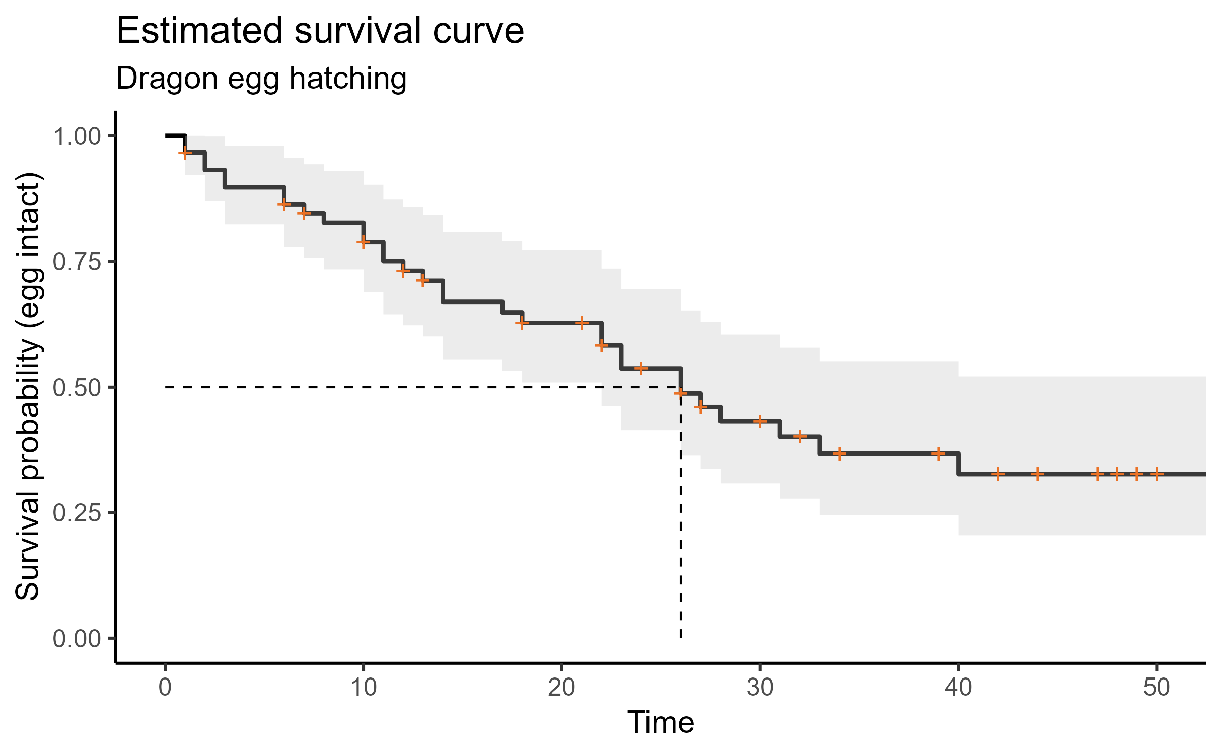
Dragon egg dataset
Notes:
And that’s what we plot when we produce a survival curve!
So: the Kaplan-Meier estimator allows us to convert individual-level data, with censoring
Into probability against time

Slide 37
Summary: Survival curves
In the population, a true survival curve exists
We want to estimate that survival curve using our data
The curve shows time against probability (of not experiencing the event)
We can use the Kaplan-Meier estimator to calculate those probabilities
When presenting survival curves, we can provide additional info via risk and/or cumulative events tables

Slide 38
3. Comparing curves
The log-rank test for a single categorical predictor

Slide 39
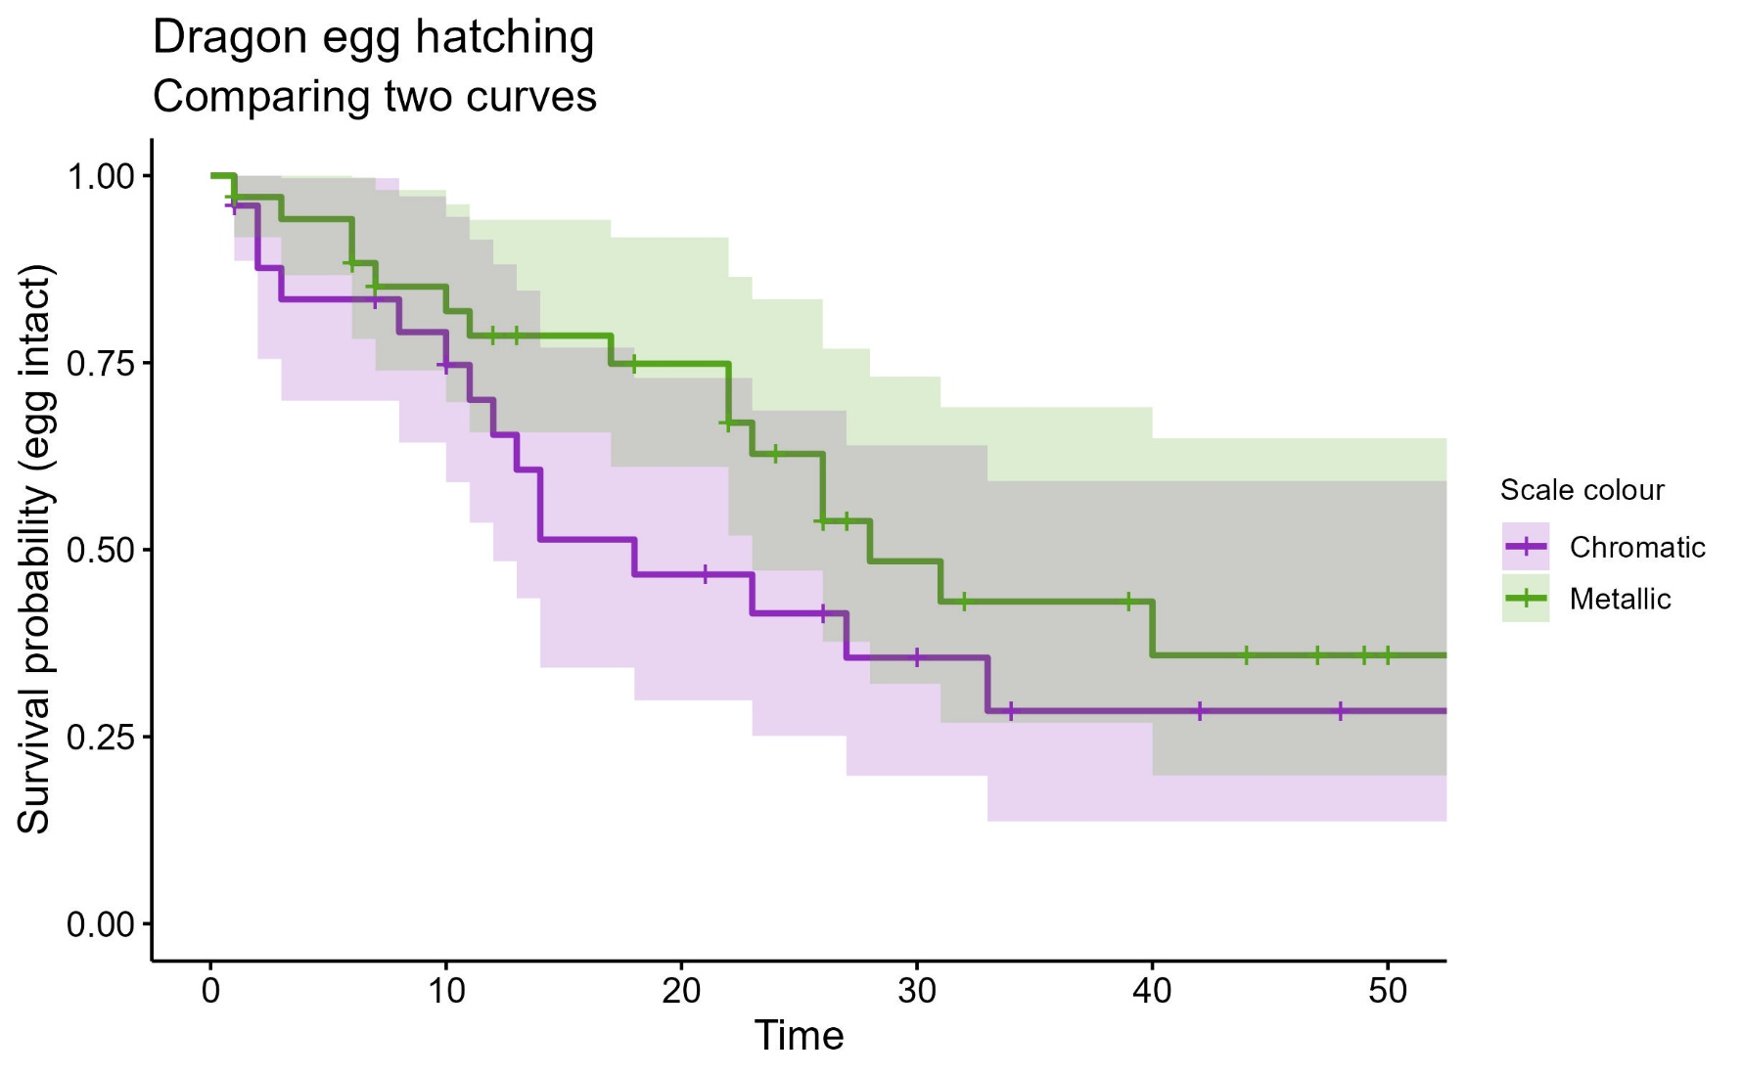
Two dragon populations

Slide 40
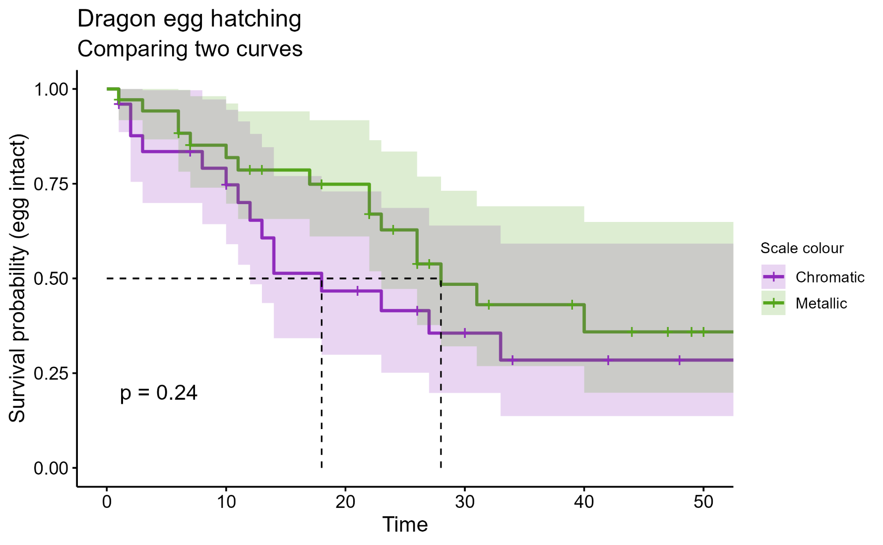
Two dragon populations
Log-rank test:
Used to compare two or more survival curves
Notes:
Used to compare two or more survival curves (single categorical predictor)
Is a null hypothesis significance test
H₀ = groups have identical curves in the population
Produces a p-value
Has assumptions
Can think of it as like a t-test, but for survival data

Slide 41
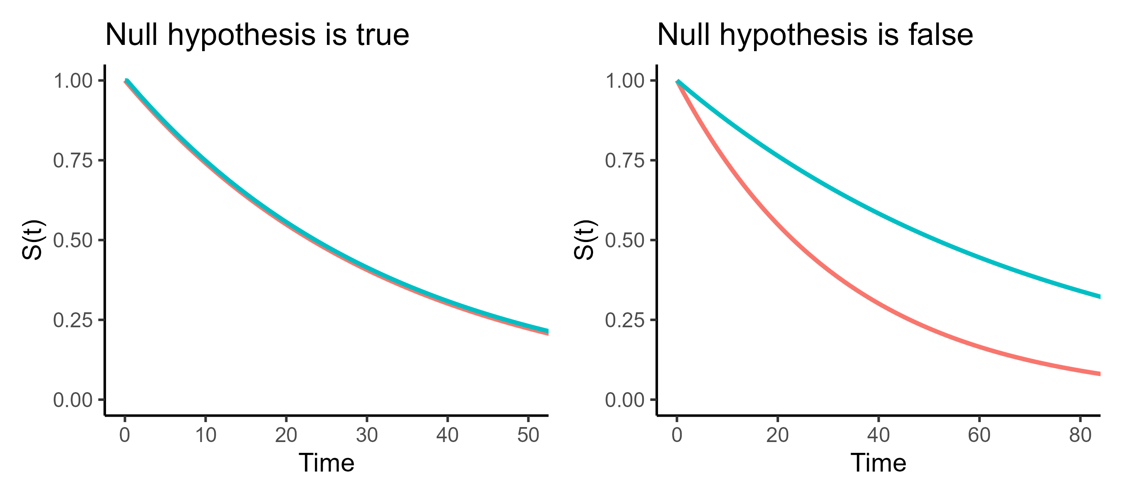
Log-rank test
H₀: groups have an identical survival curve (in the population)
Notes:
Like all significance tests, there must be a null hypothesis
Usually some version of “the world is boring”
Here are two “versions of reality”
(Note: a false null hypothesis could have a steeper curve for blue than red, too; just anything where the curves aren’t the same)

Slide 42
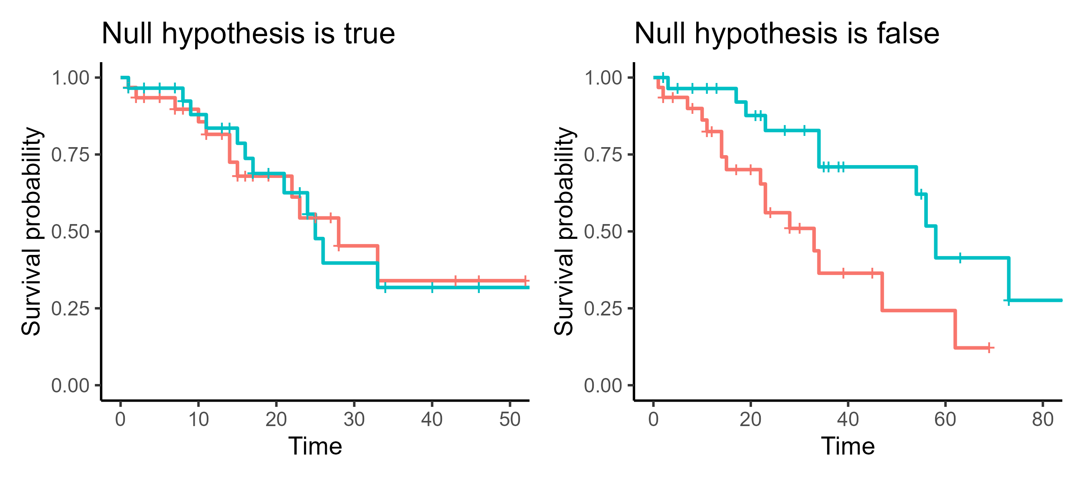
Log-rank test
H₀: groups have an identical survival curve (in the population)
Notes:
Here’s an example of what the datasets might look like, coming from those two different “versions of reality”

Slide 43
Assumptions of log-rank test
Like all significance tests, there are assumptions
Independence
Non-informative censoring
Proportional hazards

Slide 44
Assumptions of log-rank test
Like all significance tests, there are assumptions
Independence
Non-informative censoring
Proportional hazards

Slide 45
Independence
Each “row” of the dataset (each individual) must be equally unrelated to every other row
Start
Notes:
Each row is a single patient
Not related to each other in any way
Not measuring the same patient more than once

Slide 46
Independence
Each “row” of the dataset (each individual) must be equally unrelated to every other row
Start
Notes:
BUT – if patients are grouped within hospitals, e.g., a multi-site clinical study
Now they are related/clustered together
Patients from a single hospital have more similar outcomes, and perhaps more similar probability of experience the event, than they will to patients in other hospitals

Slide 47
Independence
Each “row” of the dataset (each individual) must be equally unrelated to every other row
Start
Notes:
Another example
Event of interest: tooth erupting
Multiple teeth per child
Teeth belonging to the same child are not independent of each other
We know that children tend to go through phases of losing/growing multiple teeth at once

Slide 48
Independence
Each “row” of the dataset (each individual) must be equally unrelated to every other row
Start
Notes:
Another example
Event: graduation/earning a degree
If we track the same individual over multiple degrees (some people are overachievers!) then again, not independent

Slide 49
Independence
Each “row” of the dataset (each individual) must be equally unrelated to every other row
Start
Notes:
If you switched to people’s first degrees, it would fix this problem
Now only one observation per person

Slide 50
Assumptions of log-rank test
Like all significance tests, there are assumptions
Independence
Non-informative censoring
Proportional hazards
Notes:
The first of the two survival-specific assumptions

Slide 51
Non-informative censoring
Censoring is not related to survival/event probability; Probability of being censored is equal for all individuals
Start
Notes:
Event of interest: lightbulb failure
Building maintenance install 500 bulbs in a new building, and a researcher monitors each of them
The informative censoring comes in here:
Regular/routine checks by building maintenance
Bulbs are removed if they look close to failure (flickering, dimming), and are therefore lost to researcher follow-up
So the censoring is directly related to the survival time
The same process that governs the event (failure) occurring, also governs censoring
Why is this a problem?
Your survival analysis will end up overestimating how long bulbs survive
Because all the ones with shorter survival times, get removed/censored before they can contribute

Slide 52
Non-informative censoring
Censoring is not related to survival/event probability; Probability of being censored is equal for all individuals
Start
Notes:
A slightly more complex, but probably for many participants more relevant, example
Imagine:
Event of interest is: getting a transplant kidney
Orange crosses represent censoring – e.g., patient drops out of the study/is lost to follow-up
Sample is made up of individuals with varying degrees of illness, perhaps different stages of kidney disease
Followed from the time they join the waiting list
Here’s the informative censoring:
Patients who become too ill for transplantation are removed from the waiting list, i.e., censored
They are not a random subset of that waiting list, so censoring is not happening at random – it’s happening based on how ill they are
Once removed, their chance of experiencing the event (transplant) is lowered
Meaning the likelihood of getting a kidney, is related to the likelihood of being censored
What would non-informative censoring look like?
Patient moves country
Patient is transferred to another transplant centre that doesn’t share data with the study
Study ends while patient is still on the transplant waiting list
Note: a patient dying is not so much censoring as a “competing event”, but that would also be a potential problem!
In general: it’s very common in medical settings that patients with poorer health are more likely to be lost to follow-up!!

Slide 53
Assumptions of log-rank test
Like all significance tests, there are assumptions
Independence
Non-informative censoring
Proportional hazards

Slide 54
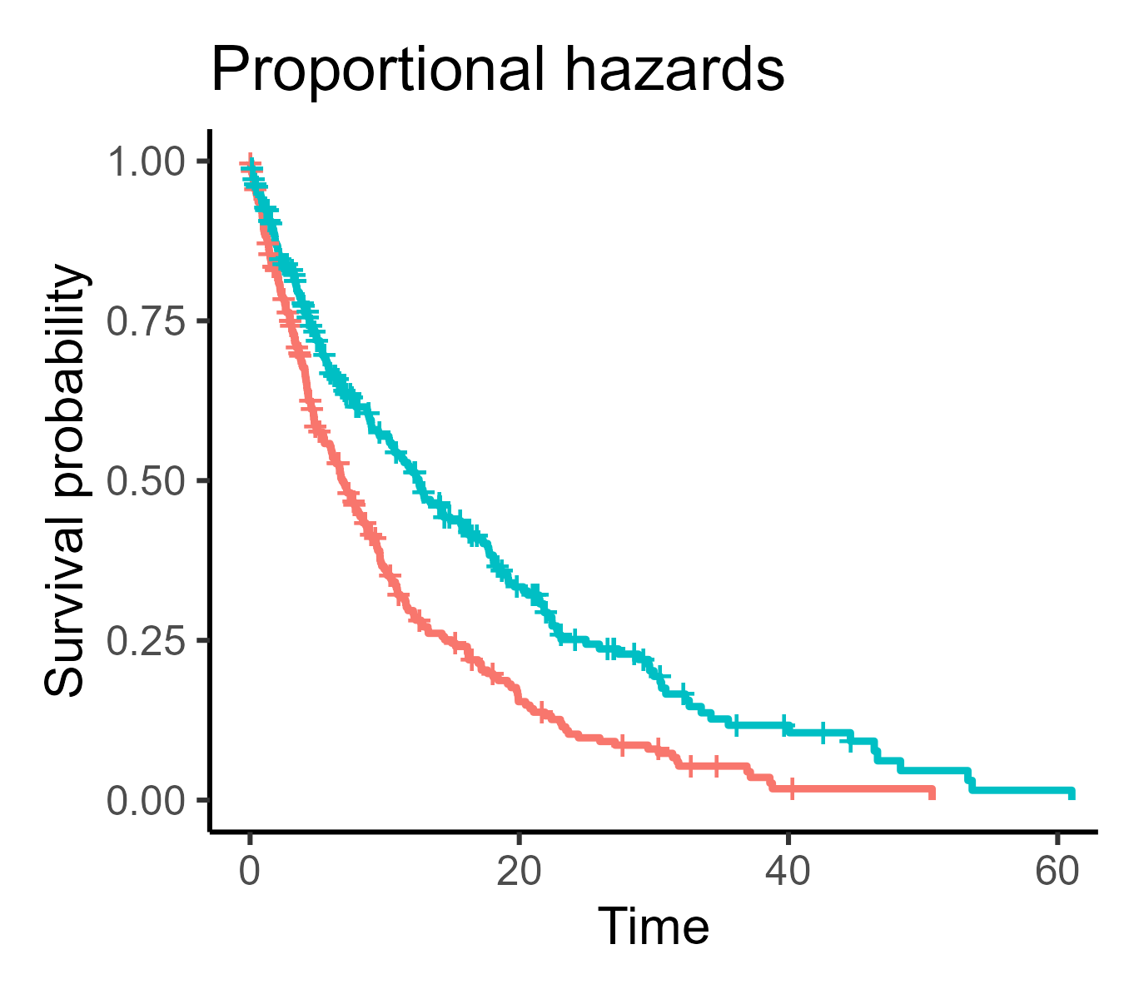
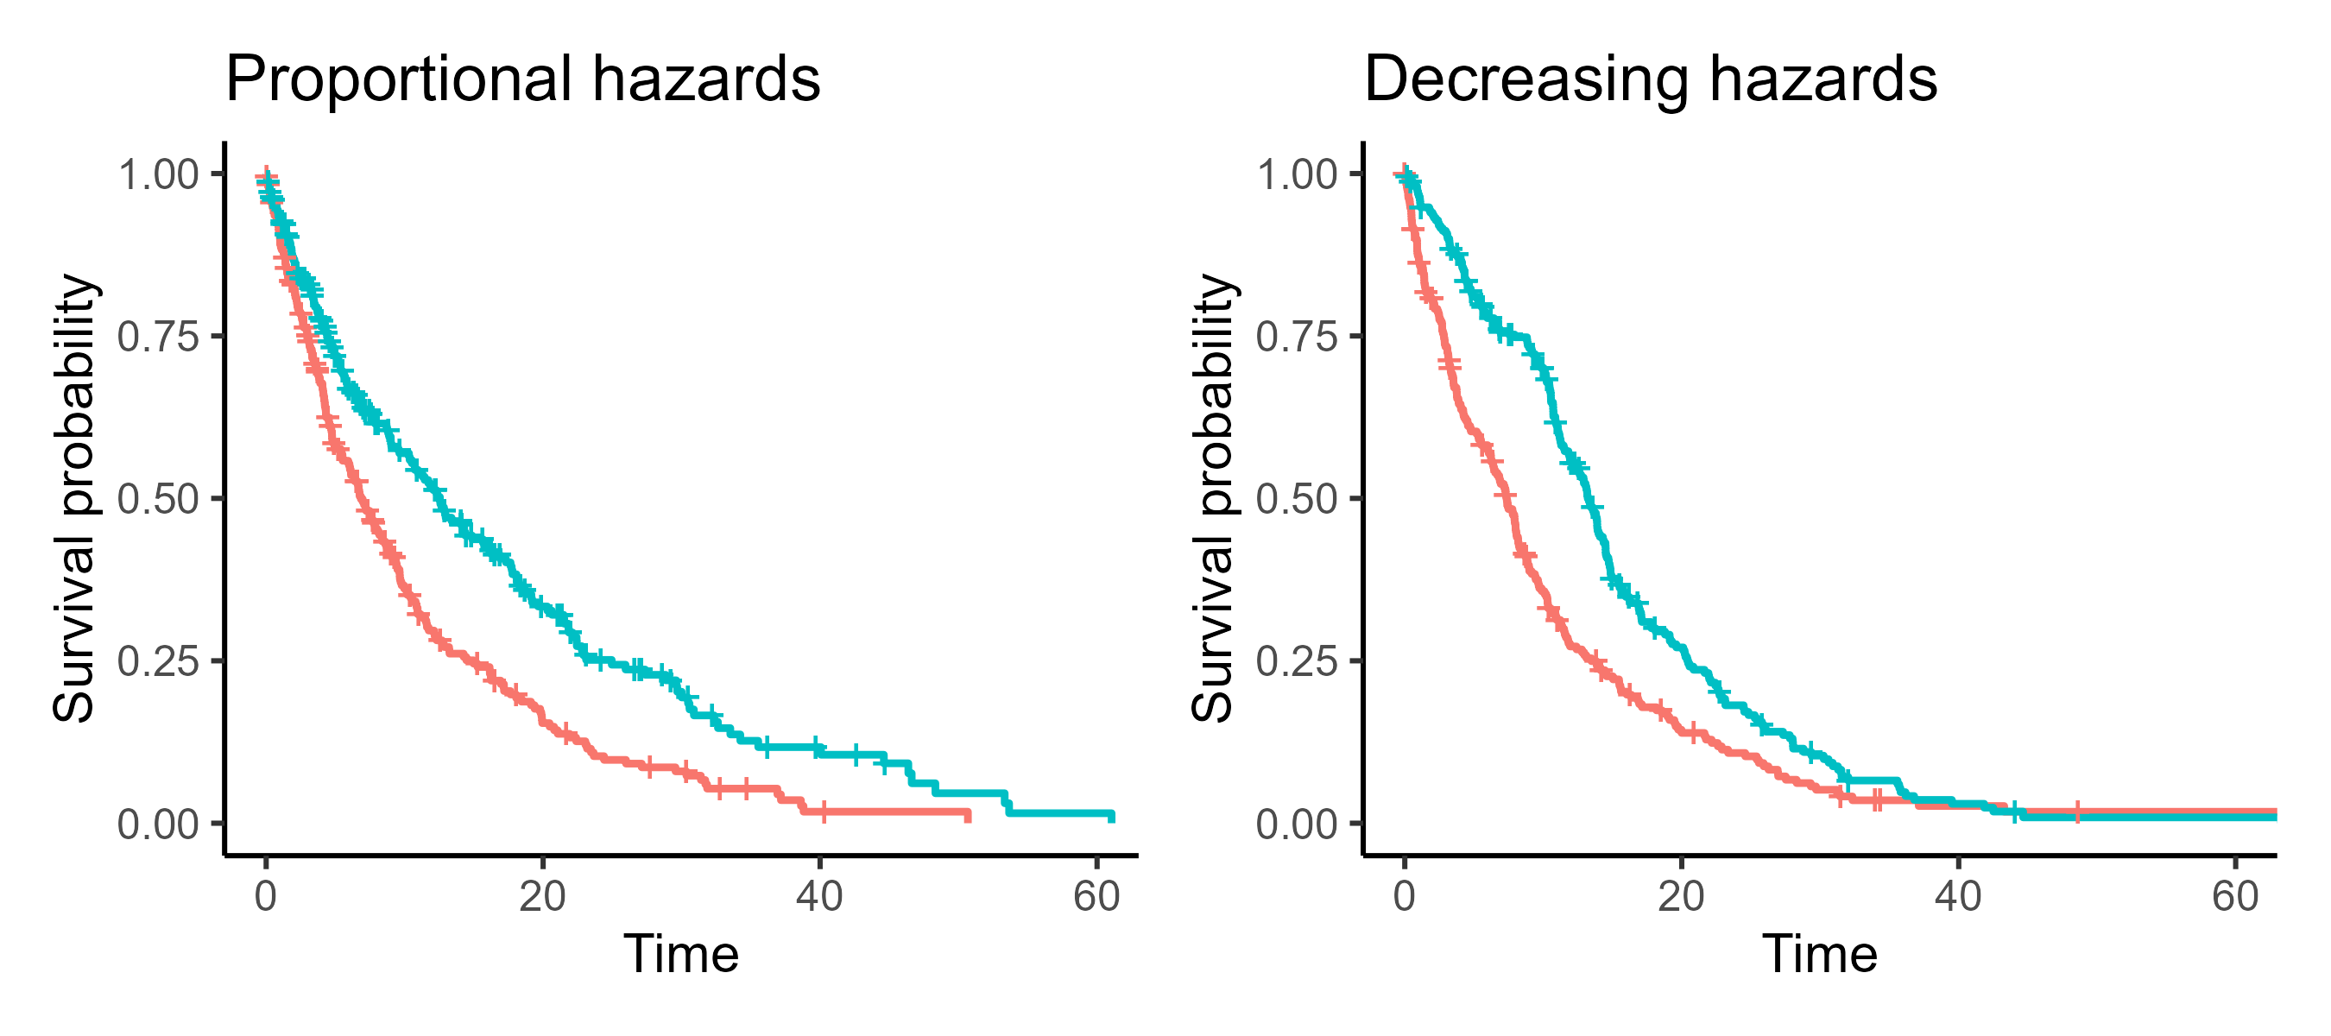
Proportional hazards
The effect of predictor on event occurring is consistent over time
Notes:
So: if chromatic dragon eggs have twice the likelihood of hatching at time 1 compared to metallic dragons, they also have twice the likelihood at time 10

Slide 55
Proportional hazards
The effect of predictor on event occurring is consistent over time
Notes:
So: if chromatic dragon eggs have twice the likelihood of hatching at time 1 compared to metallic dragons, they also have twice the likelihood at time 10

Slide 56
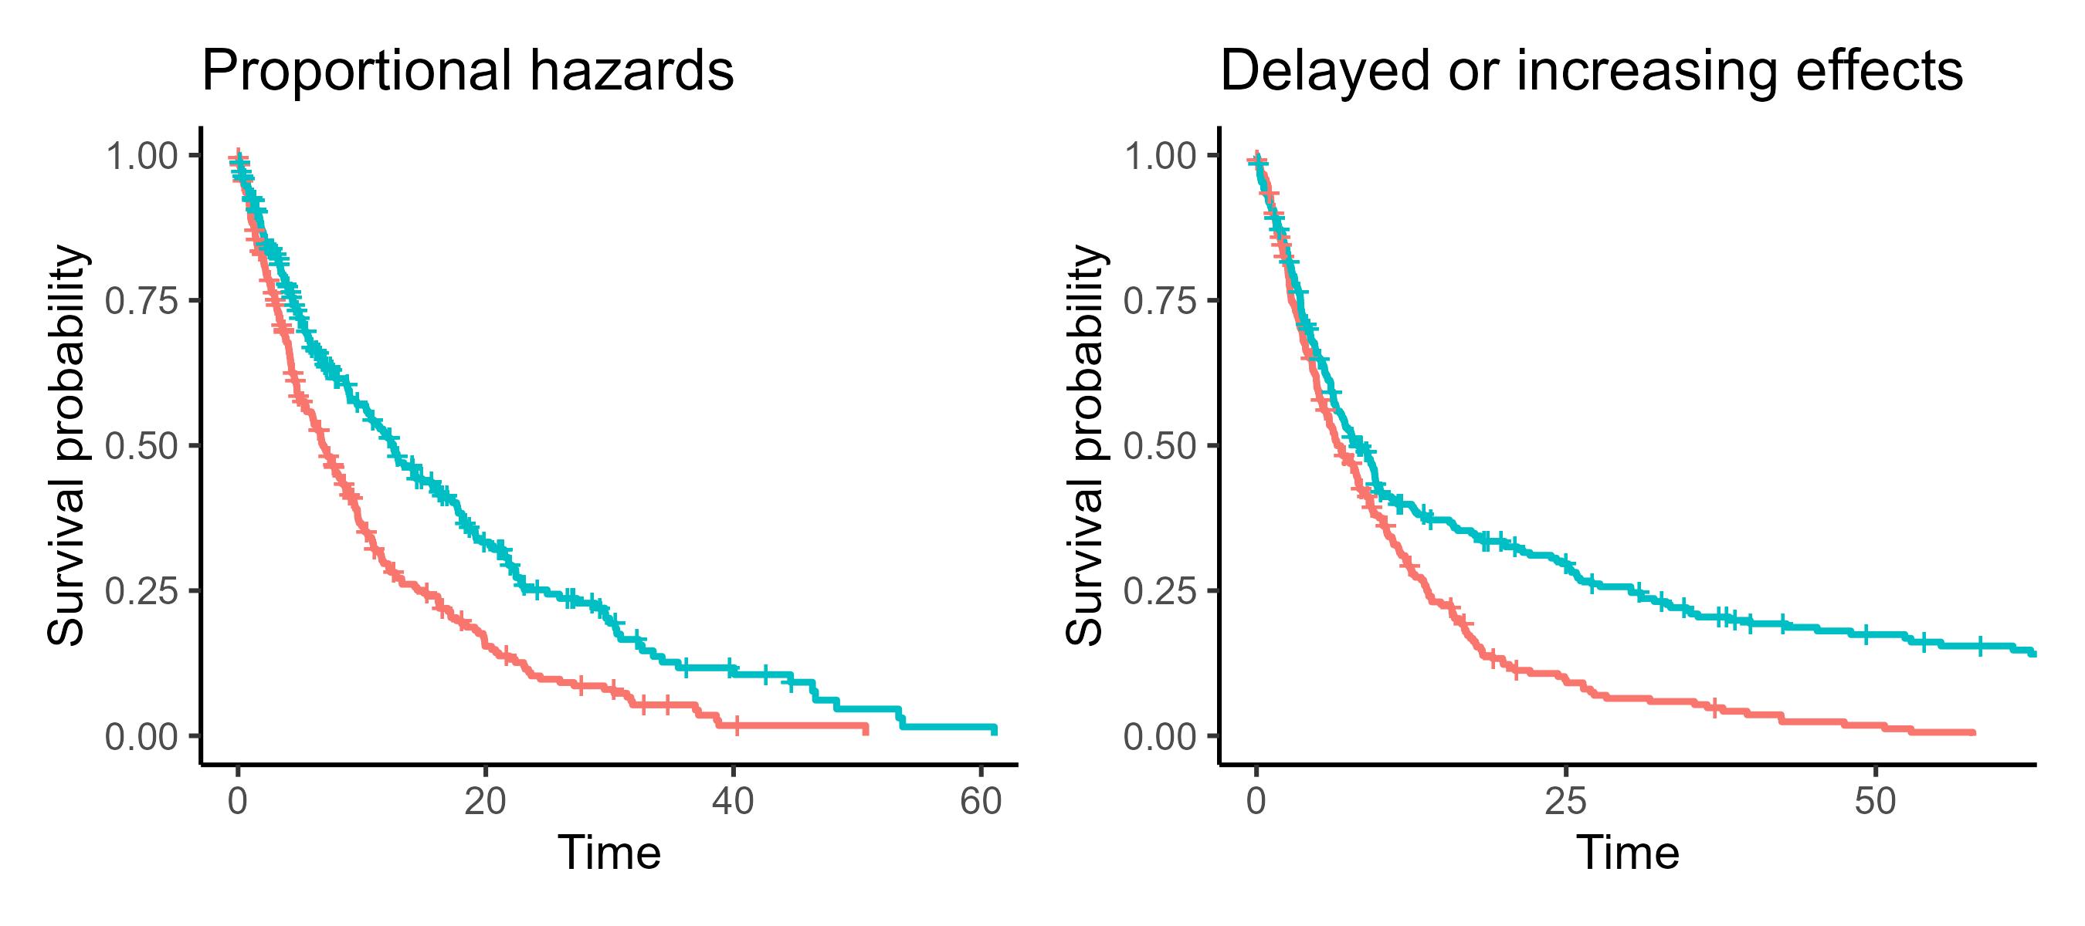
Proportional hazards
The effect of predictor on event occurring is consistent over time
Notes:
So: if chromatic dragon eggs have twice the likelihood of hatching at time 1 compared to metallic dragons, they also have twice the likelihood at time 10

Slide 57
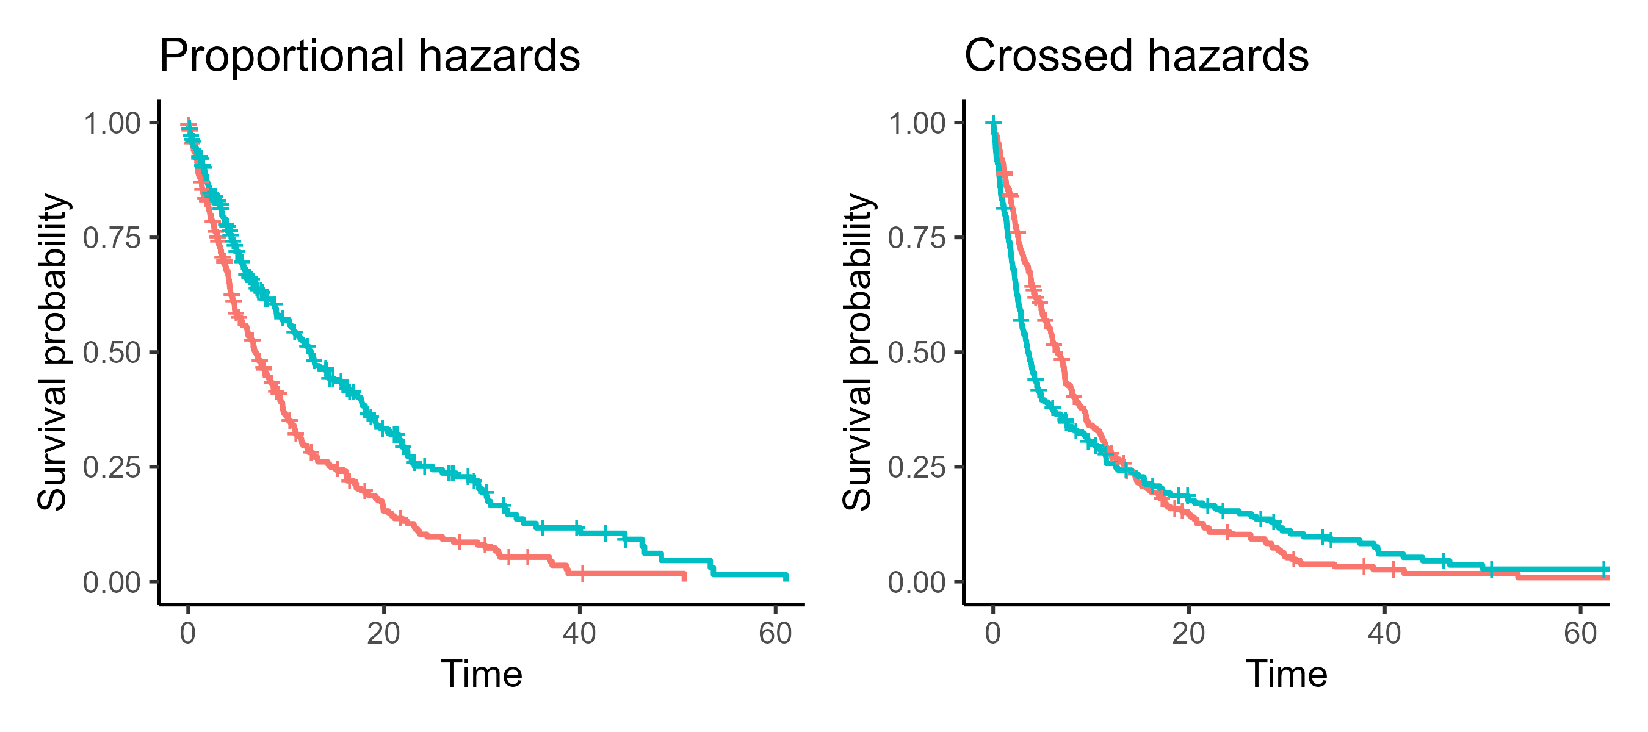
Proportional hazards
The effect of predictor on event occurring is consistent over time
Notes:
Crossed – one group starts with a higher hazard/rate of event, and then at some point it flips

Slide 58
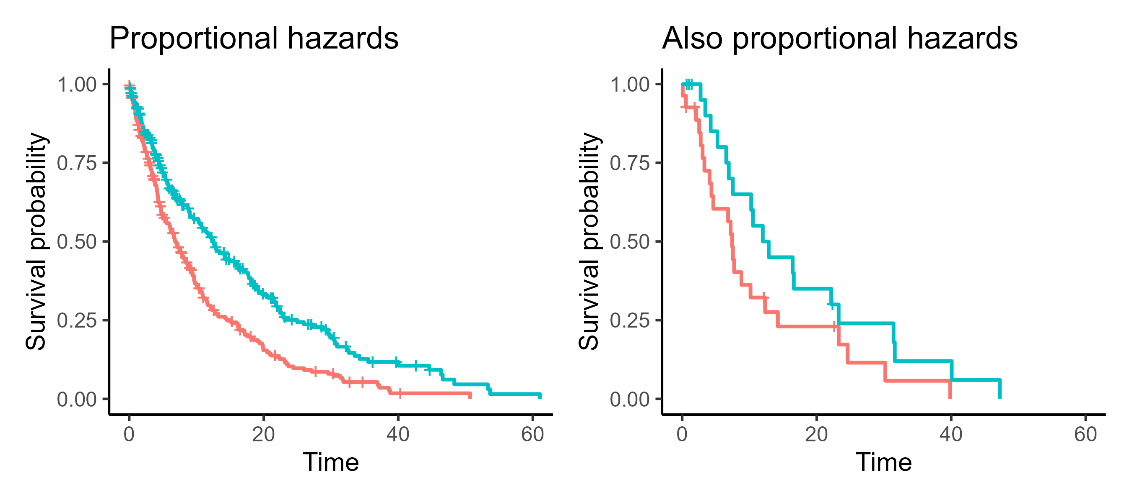
Proportional hazards
Note: it won’t always be foolproof!
Notes:
When the sample size is smaller, the staircase will look much less smooth
So generally we have to be a bit more relaxed in those situations (like with checking diagnostic plots in regular linear models)

Slide 59
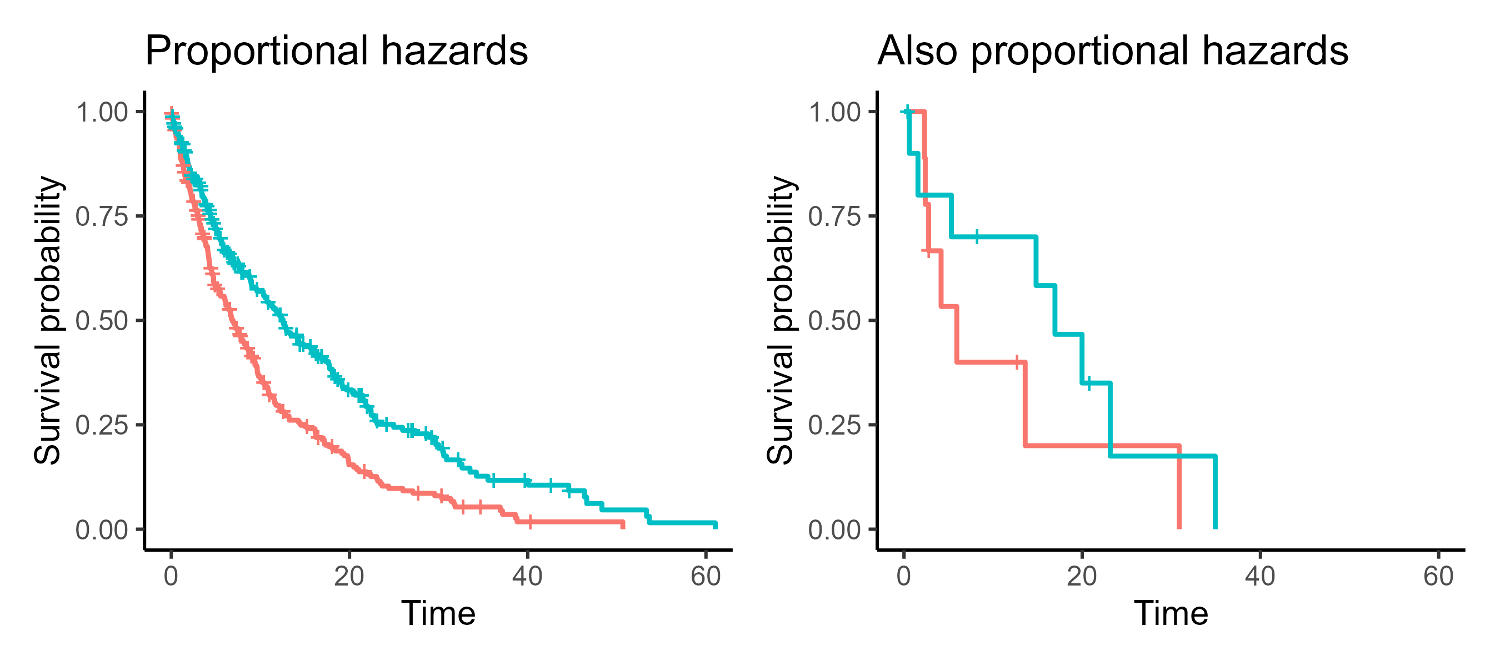
Proportional hazards
Note: it won’t always be foolproof!
Notes:
When the sample size is smaller, the staircase will look much less smooth
So generally we have to be a bit more relaxed in those situations (like with checking diagnostic plots in regular linear models)
Remember: our assumption about proportional hazards is actually about the underlying survival curves in the population that generated the data

Slide 60
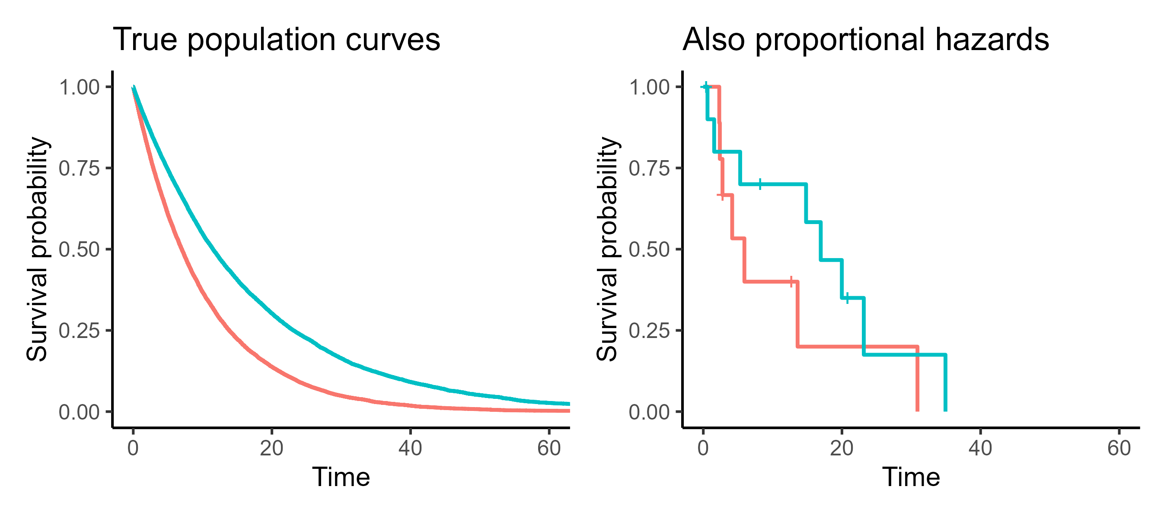
Proportional hazards
Note: we care about the underlying population
Notes:
When the sample size is smaller, the staircase will look much less smooth
So generally we have to be a bit more relaxed in those situations (like with checking diagnostic plots in regular linear models)
Remember: our assumption about proportional hazards is actually about the underlying survival curves in the population that generated the data

Slide 61
Dragon egg example: are assumptions met?
Is time to hatch predicted by dragon scale colour?
Are the assumptions met?
Independence
Non-informative censoring
Proportional hazards
If yes, what could be changed to make them fail?

Slide 62
Dragon egg example: are assumptions met?
Independence:
Can eggs “affect” each other?
Are eggs grouped into nests/clutches?

Slide 63
Dragon egg example: are assumptions met?
Non-informative censoring:
Are eggs are “removed” from the study if they look unhealthy or slow to hatch?
Are there any over-protective dragon parents who hide/move eggs while also incubating better?

Slide 64
Dragon egg example: are assumptions met?
Proportional hazards:
Is the chromatic vs metallic (scale colour) effect consistent at all times?
What if metallic dragon eggs hatch slowly but steadily, while chromatic dragon eggs hatch quickly but with more late-stage complications?
Notes:
Remember, proportional hazards relates to whether the predictor variable(s) have a constant effect on survival
So we need to focus on the scale colour in this instance

Slide 65
Two dragon populations
Notes:
This is the log rank test that we saw earlier
But now we have more a sense of whether it’s appropriate, and how we might want to interpret it

Slide 66
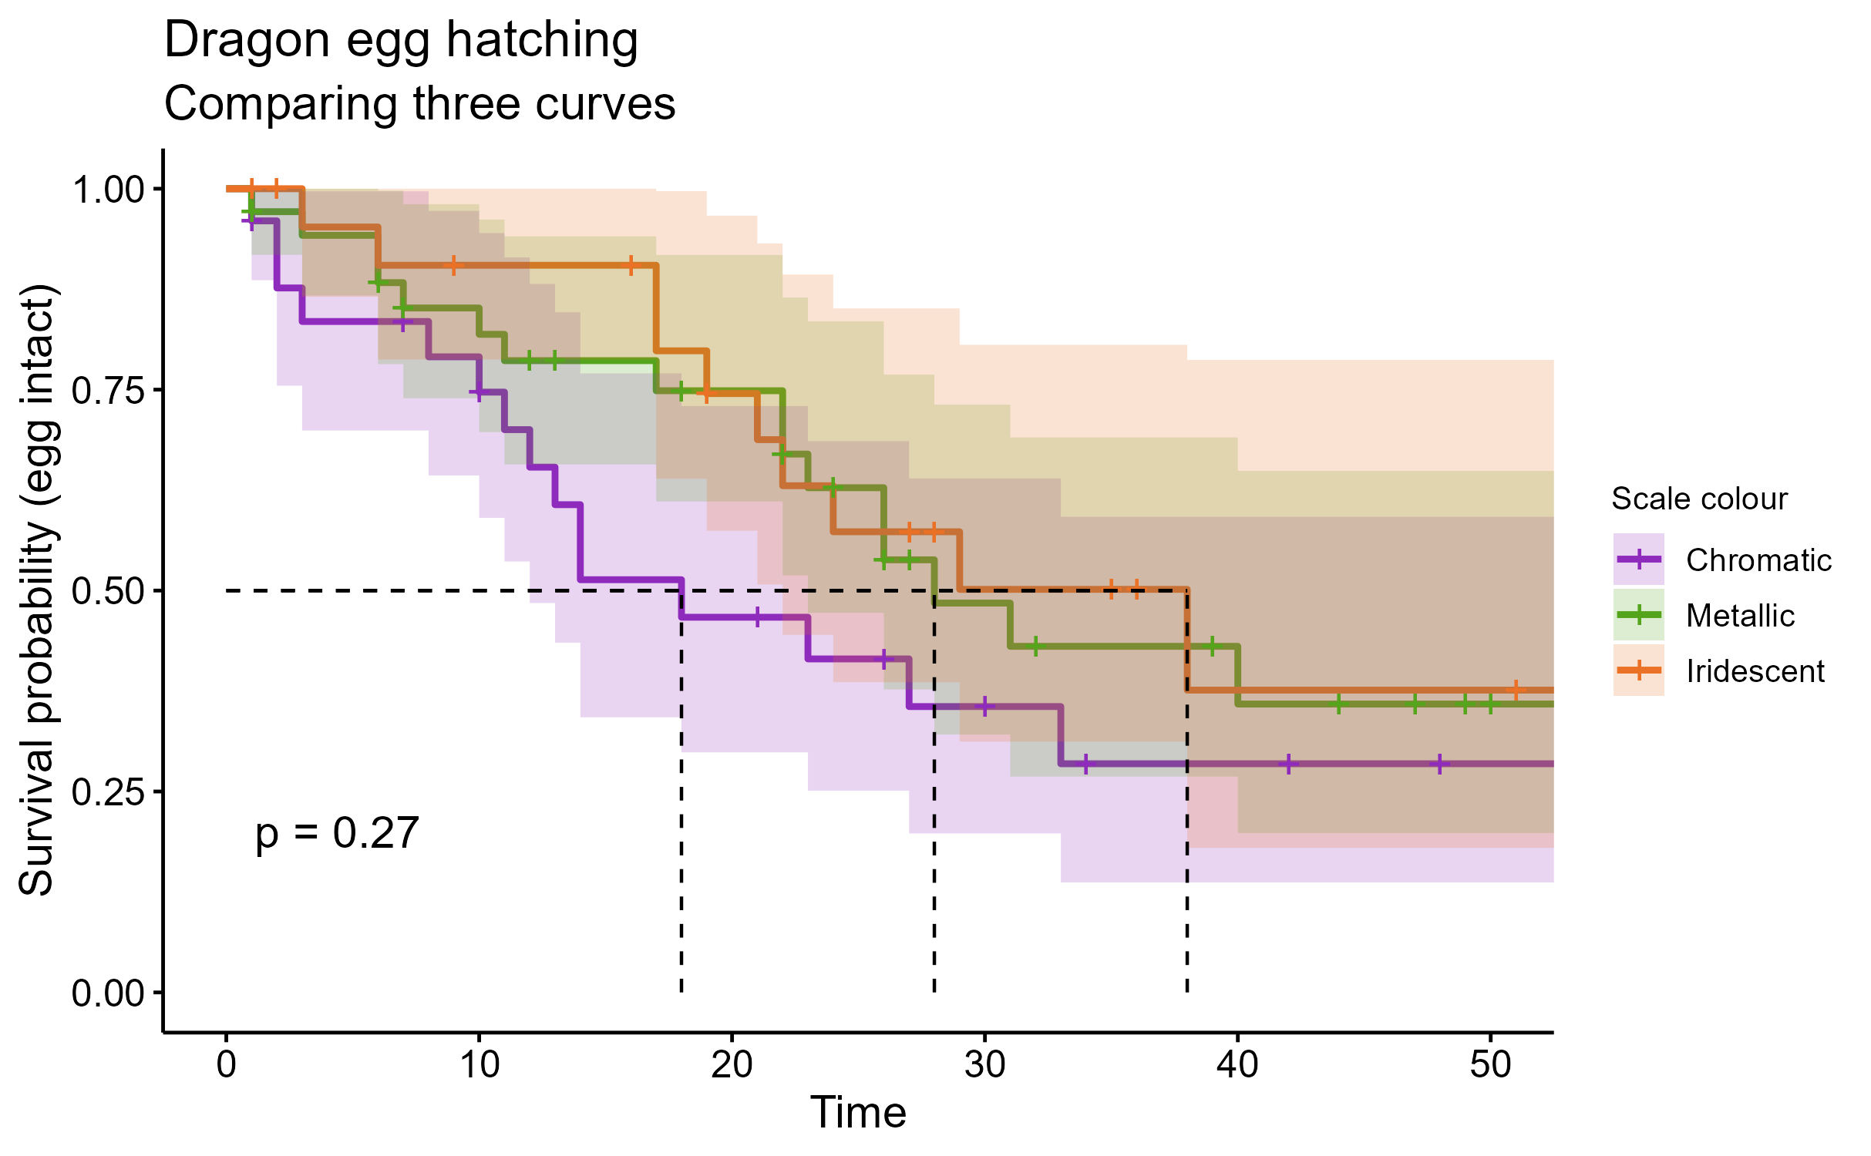
Multiple dragon populations
Notes:
The log-rank test can also be seen as an analogue for a one-way ANOVA
You could have as many different strata/groups as you wanted

Slide 67
Summary: Log-rank test
Allows us to compare groups like a t-test or one-way ANOVA (i.e., single categorical predictor)
The null hypothesis is that all groups share the same underlying survival curve
Makes assumptions about:
Independence
Non-informative censoring
Proportional hazards

Slide 68
Survival (time-to-event) analysis
Cambridge Centre for Research Informatics Training

Slide 69
Session 1
In session 1:
What’s special about survival/time-to-event data?
Survival curves (Kaplan-Meier estimation)
Comparing two curves (log rank test)

Slide 70
Session 2
In session 2:
Continuous predictor variables
Multiple predictor variables (Cox regression)
Evaluating & comparing models

Slide 71
4. Continuous predictors
Introducing Cox proportional hazards regression

Slide 72
How does the predictor “affect” the hazard?
What’s the “risk” of a random lightbulb failing right now?
Start
Notes:
Say we take a person, at random
And we ask: what’s the risk/hazard of them experiencing the event right now, at a given point in time?

Slide 73
How does the predictor “affect” the hazard?
What’s the “risk” of a random customer cancelling right now?
Start
Notes:
Say we take a person, at random
And we ask: what’s the risk/hazard of them experiencing the event right now, at a given point in time?

Slide 74
How does the predictor “affect” the hazard?
What’s the “risk” of a random patient dying right now?
Start
Notes:
Say we take a person, at random
And we ask: what’s the risk/hazard of them experiencing the event right now, at a given point in time?

Slide 75
How does the predictor “affect” the hazard?
What’s the “risk” of a random egg hatching right now?
We know nothing specific about this egg
i.e., no predictors
(yet!)
But we do know something about the general baseline hazard
Start
Notes:
We can figure out the baseline by just looking at all the eggs averaged together

Slide 76
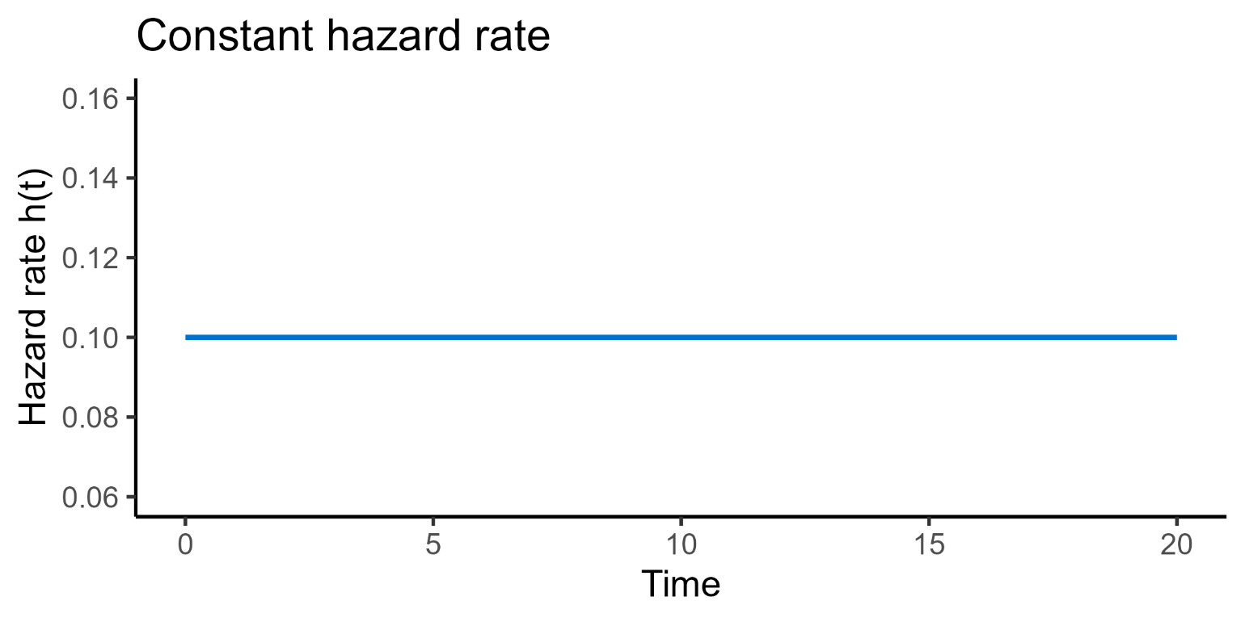
Baseline hazard
Baseline hazard may change over time, even without predictors
Notes:
That baseline hazard is effectively the “mean trend”, or the average trend
It can vary over time in
Constant – things with exponential lifetimes, e.g., a lightbulb that is equally likely to fail at any given time

Slide 77
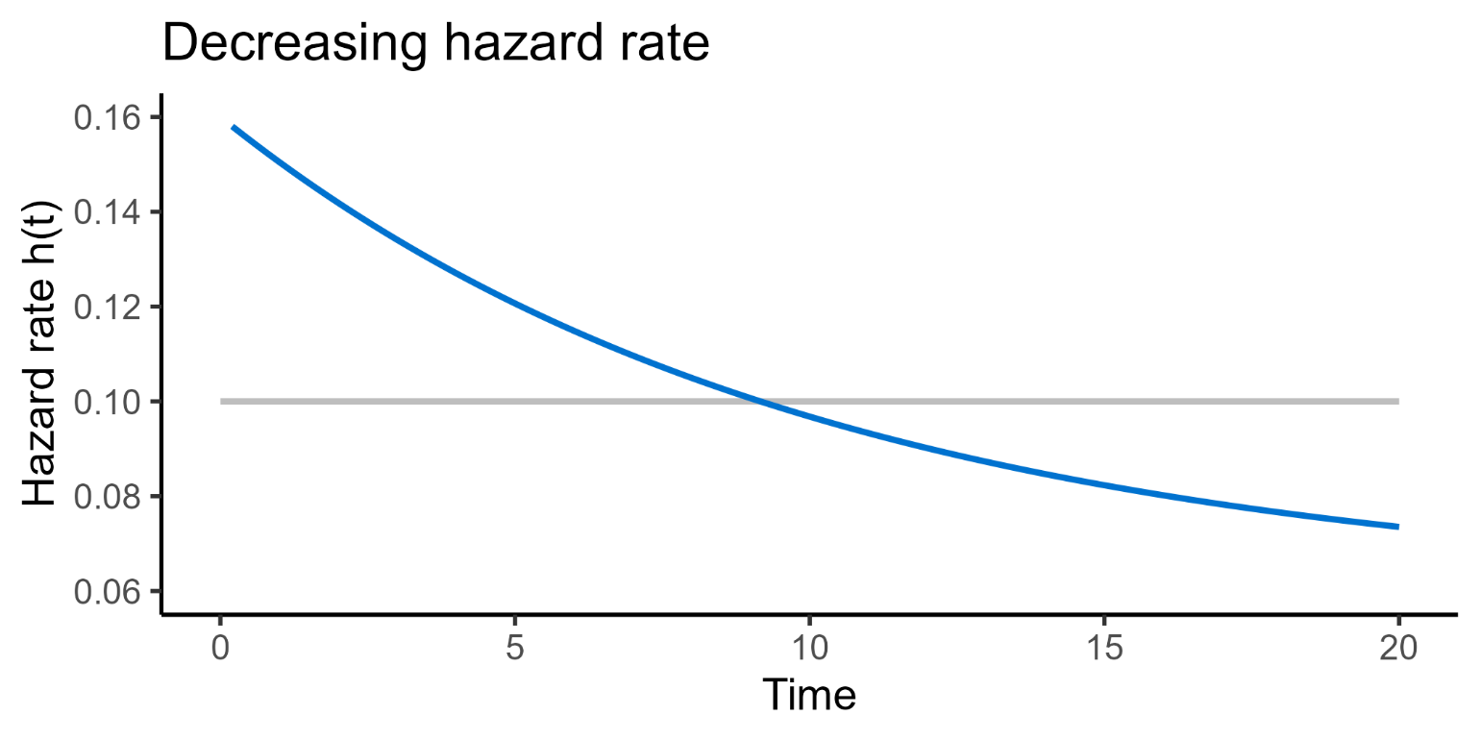
Baseline hazard
Baseline hazard may change over time, even without predictors
Notes:
That baseline hazard is effectively the “mean trend”, or the average trend
It can vary over time in different ways
Decreasing – things less likely to wear with time, e.g., businesses become more stable the longer they are established for

Slide 78
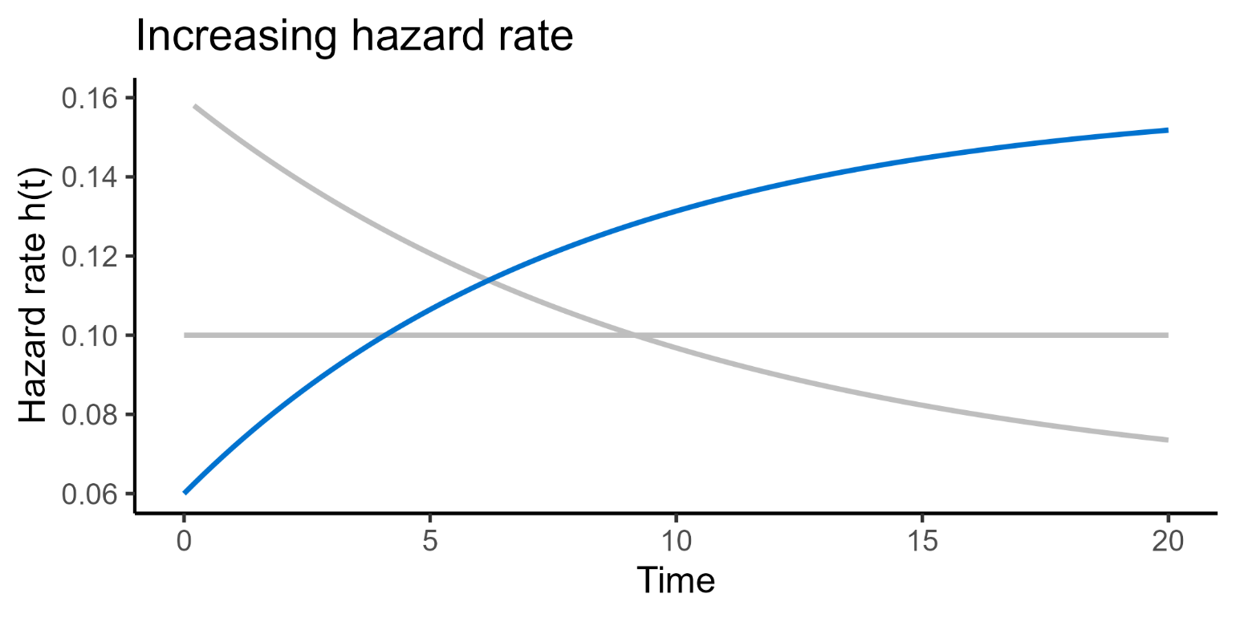
Baseline hazard
Baseline hazard may change over time, even without predictors
Notes:
That baseline hazard is effectively the “mean trend”, or the average trend
It can vary over time in different ways
Increasing – things are more likely to wear with time, e.g., mechanical parts

Slide 79
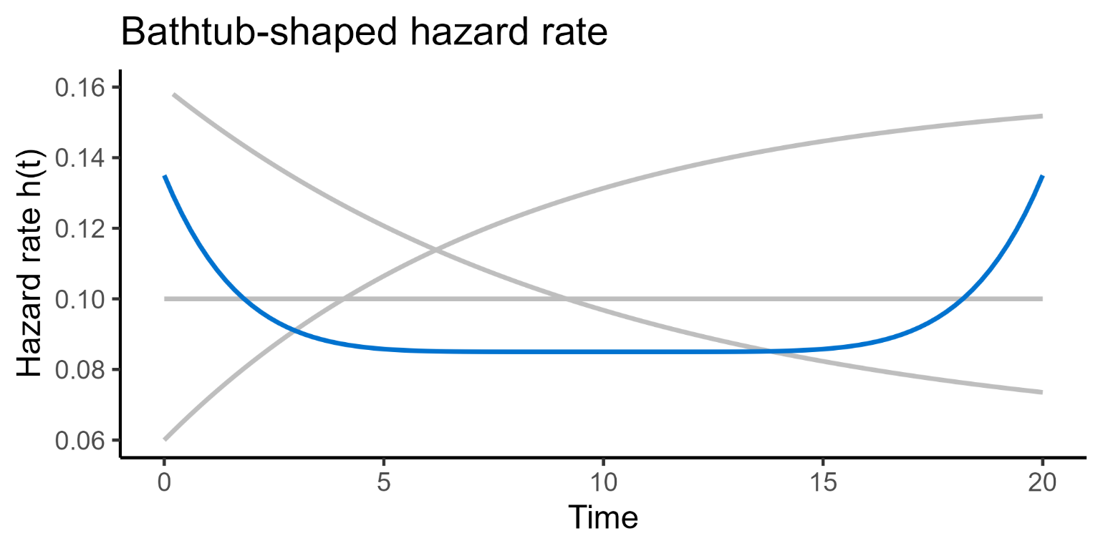
Baseline hazard
Baseline hazard may change over time, even without predictors
Notes:
That baseline hazard is effectively the “mean trend”, or the average trend
It can vary over time in different ways
Bathtub – high failure rates when young and old, e.g., humans

Slide 80
Adding a predictor
Continuous predictor: weight/size of the egg
Start
Notes:
We’re now going to add a continuous predictor: the weight/size
And this allows us to ask questions about the

Slide 81
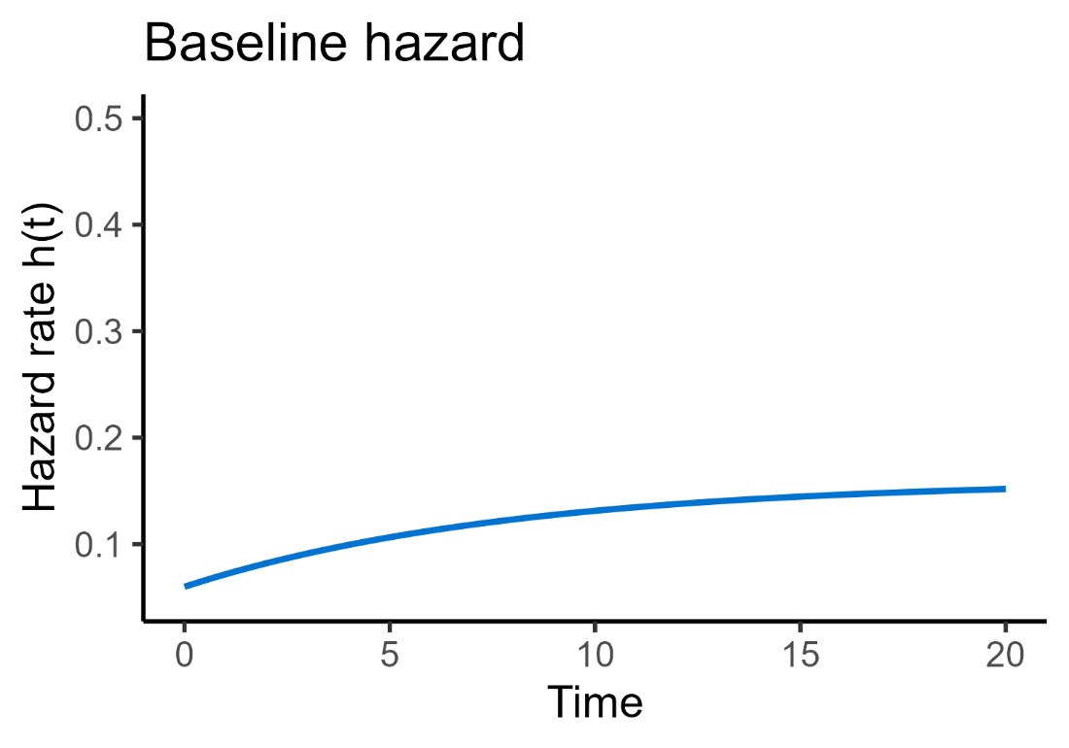
How does the predictor “affect” the hazard?
What’s the “risk” of a random egg hatching right now?
Start
Notes:
Let’s assume that dragon egg hatching has an increasing baseline hazard function

Slide 82
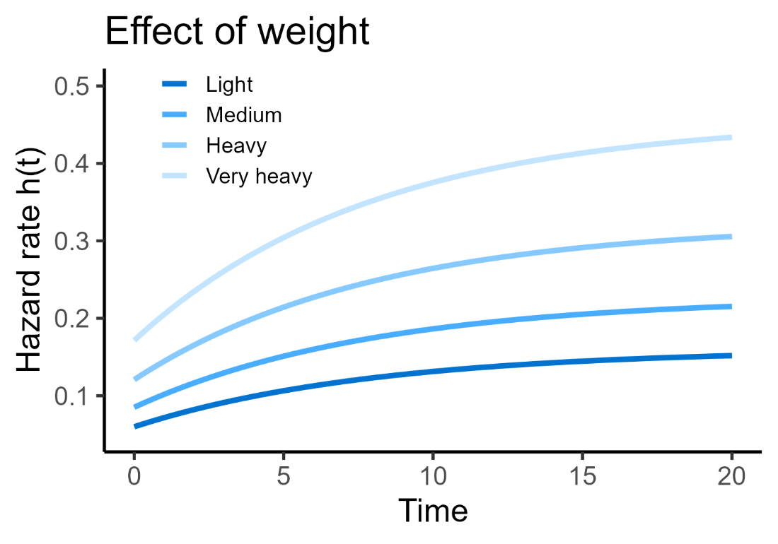
How does the predictor “affect” the hazard?
What’s the “risk” of a random egg hatching right now?
Start
Notes:
Now, we can look at how the weight of the egg affects that baseline

Slide 83
How does the predictor “affect” the hazard?
Predictor “multiplies” the baseline hazard
h(t) = h₀(t) * exp(β₁x₁)
Baseline hazard
Notes:
This is analogous to how, in a simple linear regression, the beta coefficient (gradient) tells us

Slide 84
How does the predictor “affect” the hazard?
Predictor “multiplies” the baseline hazard
h(t) = h₀(t) * exp(β₁x₁)
Baseline hazard
Predictor
Notes:
This is analogous to how, in a simple linear regression, the beta coefficient (gradient) tells us

Slide 85
How does the predictor “affect” the hazard?
Predictor “multiplies” the baseline hazard
h(t) = h₀(t) * exp(β₁x₁)
Baseline hazard
Predictor
Beta coefficient of predictor
Notes:
This is analogous to how, in a simple linear regression, the beta coefficient (gradient) tells us

Slide 86
How does the predictor “affect” the hazard?
Predictor “multiplies” the baseline hazard
h(t) = h₀(t) * exp(β₁x₁)
Baseline hazard
Predictor
Beta coefficient of predictor
“Final” (predicted) hazard
Notes:
This is analogous to how, in a simple linear regression, the beta coefficient (gradient) tells us

Slide 87
5. Multiple predictors
More uses for Cox regression

Slide 88
Cox proportional hazards
h(t) = h₀(t) * exp(β₁x₁ + β₂x₂ … + β_{n}x_{n})

Slide 89
Cox proportional hazards
h(t) = h₀(t) * exp(β₁x₁ + β₂x₂ … + β_{n}x_{n})
Output is the hazard function
= the likelihood of experiencing an event right now (instantaneous likelihood), given survival to time t

Slide 90
Cox proportional hazards
h(t) = h₀(t) * exp(β₁x₁ + β₂x₂ … + β_{n}x_{n})
It’s a combination of the baseline hazard function…
= the likelihood of the event, when all predictors are set to 0
(Acts a bit like a β₀)

Slide 91
Cox proportional hazards
h(t) = h₀(t) * exp(β₁x₁ + β₂x₂ … + β_{n}x_{n})
… multiplied by a linear equation
= set of predictors and their beta coefficients
Notes:
We use the exponential of this linear equation for maths reasons that you do not need to know

Slide 92
Cox proportional hazards
h(t) = h₀(t) * exp(β₁x₁ + β₂x₂ … + β_{n}x_{n})
Allows us to model:
how the baseline hazard function changes
as the value(s) of the predictor(s) change.

Slide 93
Interpretation of a Cox regression model
From a Cox model, we can estimate/calculate:
P-values and confidence intervals
Coefficients for predictors
Survival probability at any specific time
Hazard ratios
For an individual
Or between groups

Slide 94
Assumptions of Cox regression
The assumptions are the same as the long-rank test
Independence
Non-informative censoring
Proportional hazards

Slide 95
Assumptions of Cox regression
The assumptions are the same as the long-rank test*
Independence
Non-informative censoring
Proportional hazards
*Plus, two extra things:
Linearity
Time-independent predictors

Slide 96
Linearity in Cox regression
h(t) = h₀(t) * exp(β₁x₁ + β₂x₂ … + β_{n}x_{n})
Relates to the linear predictor portion
Each unit change for a predictor, must multiply the hazard by a constant amount
Can be checked using Martingale residuals

Slide 97
Time-independent predictors
Values of predictors remain constant
Only need to be measured once at the start of the study
Examples:
Baseline age
Dragon egg weight
Degree subject

Slide 98
Time-independent predictors
If values of predictors vary across the study
Standard Cox regression model cannot be used
Examples:
Disease stage progressing
Subscription cost increasing
Weather/seasonal changes
Notes:
Earlier we had the example of customers cancelling their streaming subscription
And also the example of birds migrating out of the study area

Slide 99
Summary: Cox regression
Allows us to incorporate continuous and multiple predictors
Predict survival probability
Estimate hazard ratios
Test significance/confidence
Shares assumptions with the log-rank test, plus:
Linearity
Time-independent predictors

Slide 100
Survival (time-to-event) analysis
Cambridge Centre for Research Informatics Training

