Slide 1

Survival (time-to-event) analysis
Cambridge Centre for Research Informatics Training

Slide 2
Course aims
Recognise when survival analysis should be used, based on dataset/experimental design
Implement survival analysis (log-rank test and Cox regression)
Interpret the results
Visualise survival data and survival curves effectively

Slide 3
Session 1
In session 1:
What’s special about survival/time-to-event data?
Survival curves (Kaplan-Meier estimation)
Comparing two curves (log rank test)

Slide 4
1. Survival (time-to-event) data
Why do we need unique analysis methods?

Slide 5
Survival data
Start
Time
Notes:
So the usual set-up for a survival analysis, or time-to-event analysis:
Some event of interest
We track individuals for the duration of the study
And record if/when they experience that event

Slide 6
“Time to event”
Start
Time
Notes:
Despite the common name “survival” implying that the event of interest is death
It doesn’t have to be!
Time until the next bus arrives at different bus stops
Time until we catch the next fish
Until mechanical parts fail
Until students graduate

Slide 7
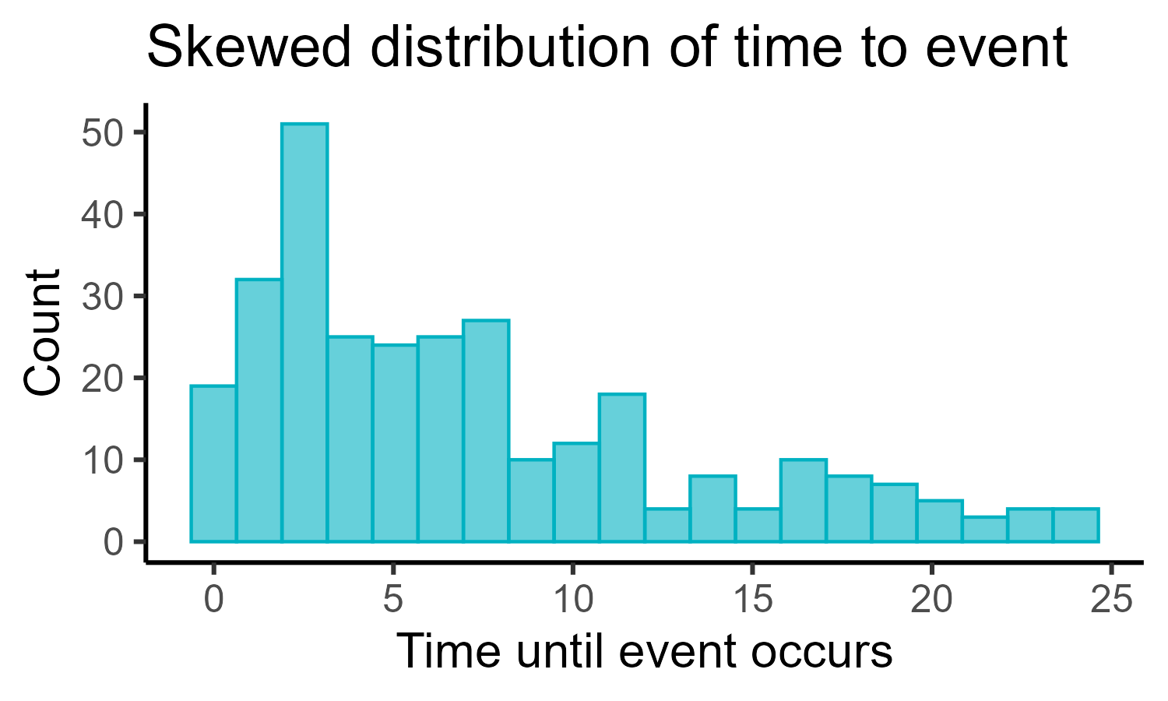
Properties of survival data
Why can’t we use “regular” linear models?
Quirks of survival data:
Often (very) skewed
Values are ≥0
Censoring
(exact time not observed)
Notes:
The thing that is special is what we are predicting, i.e., the outcome
In a regular linear model, we’d predict something that’s continuous (and often normally distributed)
e.g., height, weight
But here we are measuring “time until”
And that has some quirks/features
Also, the design of these experiments means that we often experience something called censoring
Which is when we aren’t able to measure the exact time an event occurred for some individuals

Slide 8
Censoring
Start of study
End of study
Uncensored
Right-censored
Interval-censored
Notes:
These are the two common issues we need to deal with (and will be the main focus of the course)
Uncensored: we know exactly when the event occurred for the individual
Right-censored:
We started following them
But we never found out for sure if they experienced the event
Possibly because they dropped out/couldn’t be followed
Possibly because the study ended beforehand
Interval-censoring:
We don’t know the exact instance the event occurred
But we do know it happened after some set time and before some other set time

Slide 9
More censoring (& truncation)
Start of study
End of study
Staggered entry
Left-censored
Left-truncated
Right-truncated
Notes:
These are other things that can occur in survival data, and may or may not need to be accounted for – but won’t be a major focus of this course
DO NOT WORRY ABOUT UNDERSTANDING ALL OF THESE (right now at least)
They aren’t always going to occur, it will depend a bit on your study design
Staggered entry: when not everyone enters the study at the same time
Left-censored: when the event of interest occurs before the study started (extremely rare!)
Truncation is deliberate/due to study design:
Left-truncated: when the individual was at risk before the study started, and we don’t know whether they did or didn’t experience the event
Right-truncated: only happens when membership in the study is determined retrospectively; the individual experienced the event after the date of the study that would’ve made them eligible for inclusion

Slide 10
A survival dataset
Participant | Time followed | Event
001 | 4 | 1
002 | 1 | 1
003 | 1 | 0
004 | 6 | 1
005 | 2 | 1
006 | 2 | 1
007 | 6 | 1
008 | 3 | 0
009 | 3 | 1
010 | 5 | 1
.. | .. | ..
Notes:
Typical survival dataset will look like this

Slide 11
A survival dataset
Participant | Time followed | Event
001 | 4 | 1
002 | 1 | 1
003 | 1 | 0
004 | 6 | 1
005 | 2 | 1
006 | 2 | 1
007 | 6 | 1
008 | 3 | 0
009 | 3 | 1
010 | 5 | 1
.. | .. | ..
Notes:
In a standard survival analysis, we only measure each individual once
So each row should correspond to a unique individual
(more on that idea later)

Slide 12
A survival dataset
Participant | Time followed | Event
001 | 4 | 1
002 | 1 | 1
003 | 1 | 0
004 | 6 | 1
005 | 2 | 1
006 | 2 | 1
007 | 6 | 1
008 | 3 | 0
009 | 3 | 1
010 | 5 | 1
.. | .. | ..
Notes:
We stop following an individual when they experience the event
Or when the study ends
So this column will have an upper limit of study length, and a lower limit of 0

Slide 13
A survival dataset
Participant | Time followed | Event
001 | 4 | 1
002 | 1 | 1
003 | 1 | 0
004 | 6 | 1
005 | 2 | 1
006 | 2 | 1
007 | 6 | 1
008 | 3 | 0
009 | 3 | 1
010 | 5 | 1
.. | .. | ..
Notes:
We stop following an individual when they experience the event
So if there’s a 1, we know they experienced it at/by that time

Slide 14
A survival dataset
Participant | Time followed | Event
001 | 4 | 1
002 | 1 | 1
003 | 1 | 0
004 | 6 | 1
005 | 2 | 1
006 | 2 | 1
007 | 6 | 1
008 | 3 | 0
009 | 3 | 1
010 | 5 | 1
.. | .. | ..
Notes:
A 0 means censoring
So either by/at that time they had vanished/dropped out
Or we followed them for the full length of the study, and then time = full length

Slide 15
Example 1
“How long do patients maintain functional kidney grafts following transplant?”
What’s the event?
Examples of censoring?
Notes:
Event: graft/transplant failure
Censoring:
Patient drops out (RC)
Graft never fails by the end of the study (RC)
Death from unrelated causes (competing risk)
Graft fails between clinical visits (IC)
Broad conceptual ideas: structured follow-up + competing risks

Slide 16
Example 2
“How long do tagged migratory birds remain within a defined geographic area after breeding?”
What’s the event?
Examples of censoring?
Notes:
Event: animal leaves area
Censoring:
Animal dies (RC)
Study ends before bird leaves (RC)
Tagging device fails (RC)
Tagging device only reports location once per day/week (IC)
Broad conceptual ideas: loss + intermittent observation

Slide 17
Example 3
“How long do customers stay subscribed before cancelling a streaming service?”
What’s the event?
Examples of censoring?
Notes:
Event: cancellation
Censoring:
Customer never cancels before end of study period (RC)
Customer becomes inactive, e.g., data loss, subscription status unknown (RC)
Cancellation occurs between billing cycles, e.g., monthly (IC)
Broad conceptual ideas: periodic observation

Slide 18
Example 4
“When will a volcano next have a major eruption?”
What’s the event?
Examples of censoring?
Notes:
Event: eruption
Censoring:
No eruption before study ends (RC)
Unknown prior dormancy period (left truncation)
Broad conceptual ideas: historical data + left truncation
To better understand the left truncation issue, imagine:
Volcano erupting sporadically for centuries
Monitoring started in earnest in 2000
The last eruption prior to that monitoring was 1992
Volcano must not have erupted between 1992 and 2000, otherwise we would’ve seen it
We’re biased to only include eruption intervals that extend into the 2000+ dataset
i.e., we can only study volcano waiting times that are still ongoing when we actually start monitoring; we miss any short waiting times/cycles that occurred before we started watching
Leads to an overestimate of average time between eruptions

Slide 19
Summary: Survival data is unique
Time-to-event data is not suitable for linear modelling
It is skewed and always ≥0
It is also regularly censored (missing data)
Right censoring:
  An individual may experience the event after study end
  The individual experienced a competing event
Interval censoring:
  The exact time of the event is unknown (falls in an interval)

Slide 20
2. The survival curve
Using the Kaplan-Meier estimator to deal with censoring
Notes:
What do we do with this sort of data, then?

Slide 21
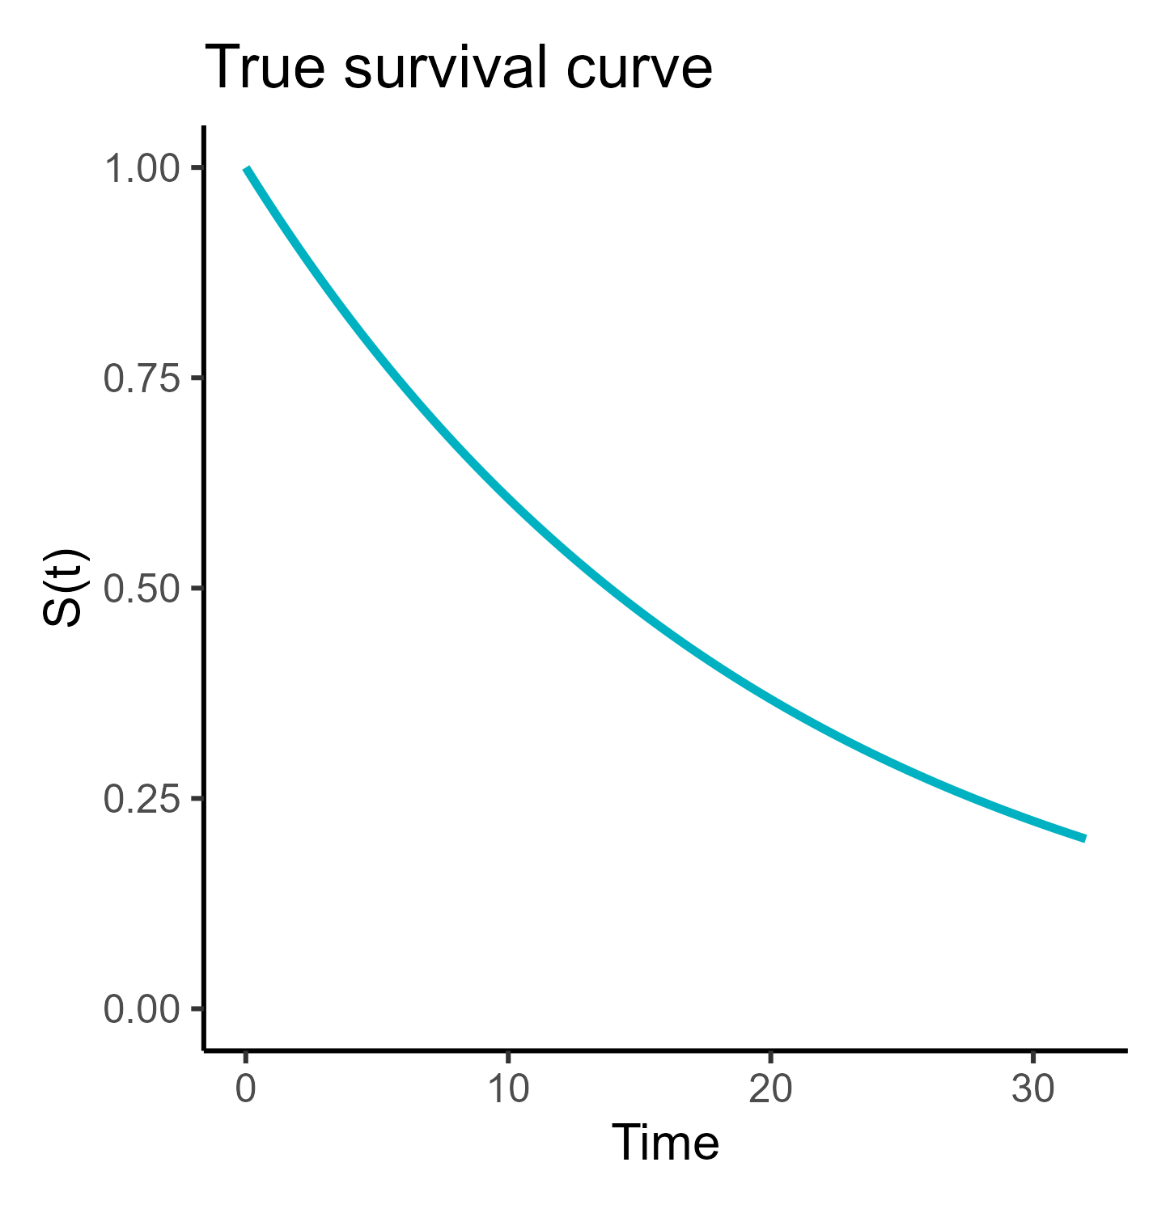
What is a survival curve?
Population survival curve
“Ground truth”
Controls which individuals will experience event (and when)
Notes:
Well, the goal is generally to estimate what’s happening in the real world (population)
In the real world, there is some underlying truth about the rate that individuals experience the event
We can picture that as a curve, tracking:
X-axis = time
Y-axis = probability of survival

Slide 22
What is a survival curve?
Population survival curve
“Ground truth”
Controls which individuals will experience event (and when)
We want to know what this curve looks like
But we cannot measure the whole population
Notes:
But as with all statistical tests, we can’t measure the whole population
The best we can do is estimate it

Slide 23
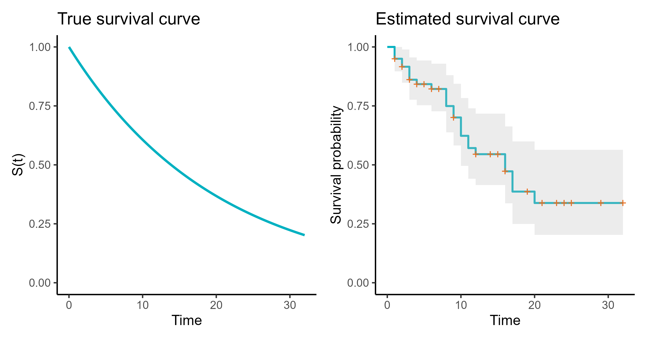
The goal: estimating the survival curve
Notes:
So, what we do is we build an estimate of the survival curve from our data
And hopefully – if our dataset is representative and we haven’t gotten super unlucky – then it will do a reasonably good job of approximating the real population survival curve
(But notice the grey error, jaggedy staircase-shape, and orange censoring events; there is uncertainty and imperfection in a sample!)

Slide 24
An example
“How long do dragon eggs take to hatch?”
Event: Egg hatches
Censoring: Egg is unhatched, damaged/removed, etc.
Notes:
Let’s follow a specific example
If you don’t like the dragons (too whimsical) and want a more biologically grounded example, you can think about this as bird eggs instead

Slide 25
An example
Egg | Time followed | Event
1 | 49 | 0
2 | 12 | 1
3 | 30 | 1
4 | 22 | 0
.. | .. | ..
Notes:
Each row of the dataset is a unique egg
We’ve got the time followed and whether an event occurred

Slide 26
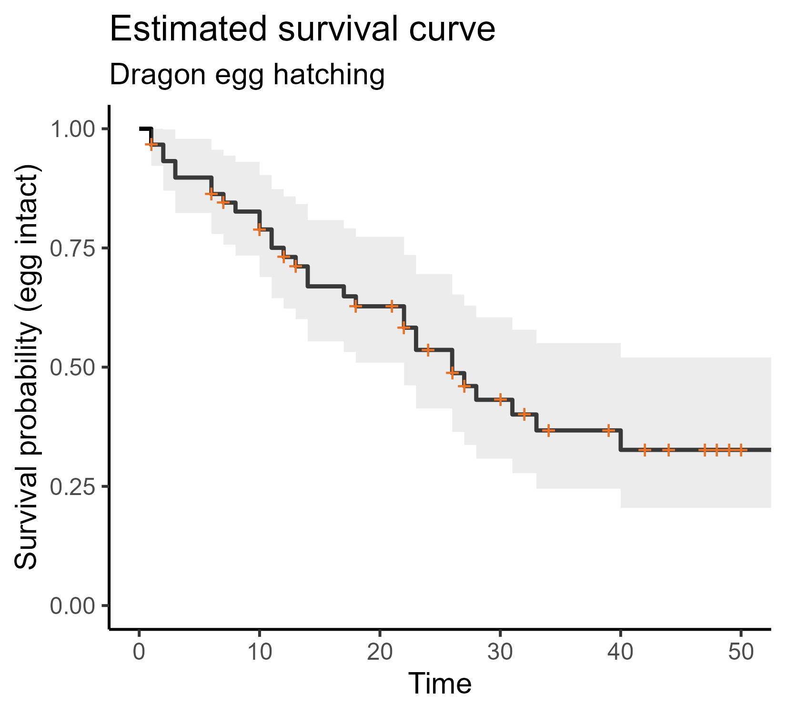
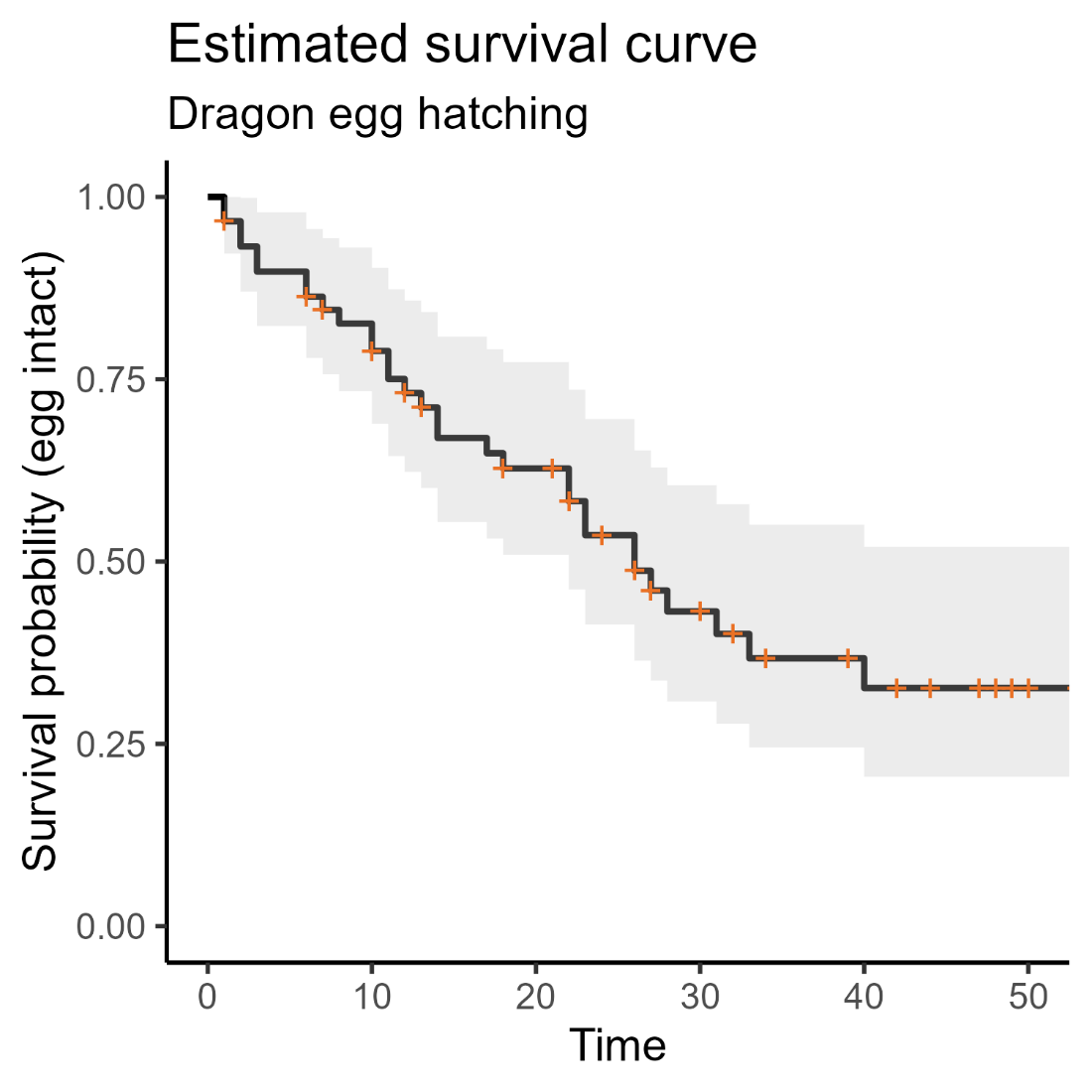
An example
Notes:
And we have estimated a curve from that dataset
Follows a classic “step-staircase” shape
The censoring events are noted with the orange + symbols
All the data have been included in a single curve

Slide 27
Kaplan-Meier survival curve
Uses:
View the data more intuitively
+ censoring event
Notes:
What do we use the curve for?
Well it’s much easier to use than the table we had before

Slide 28
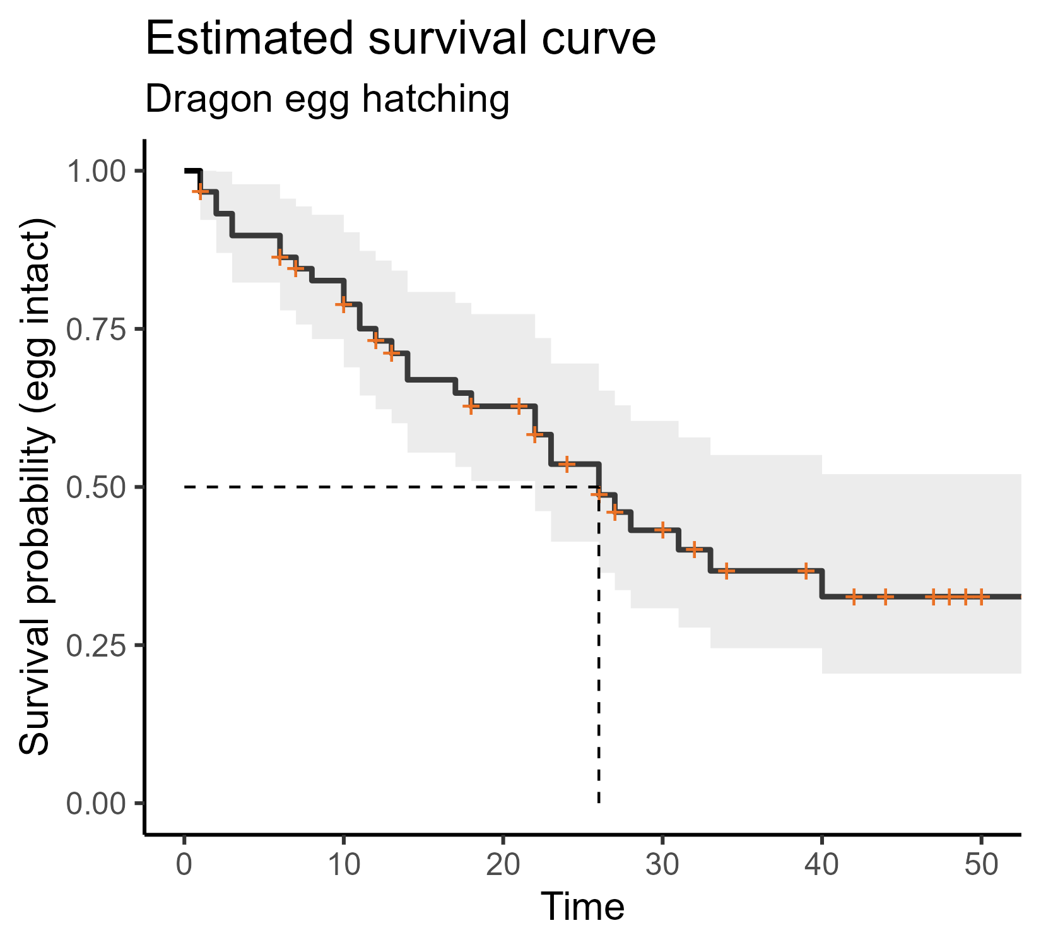
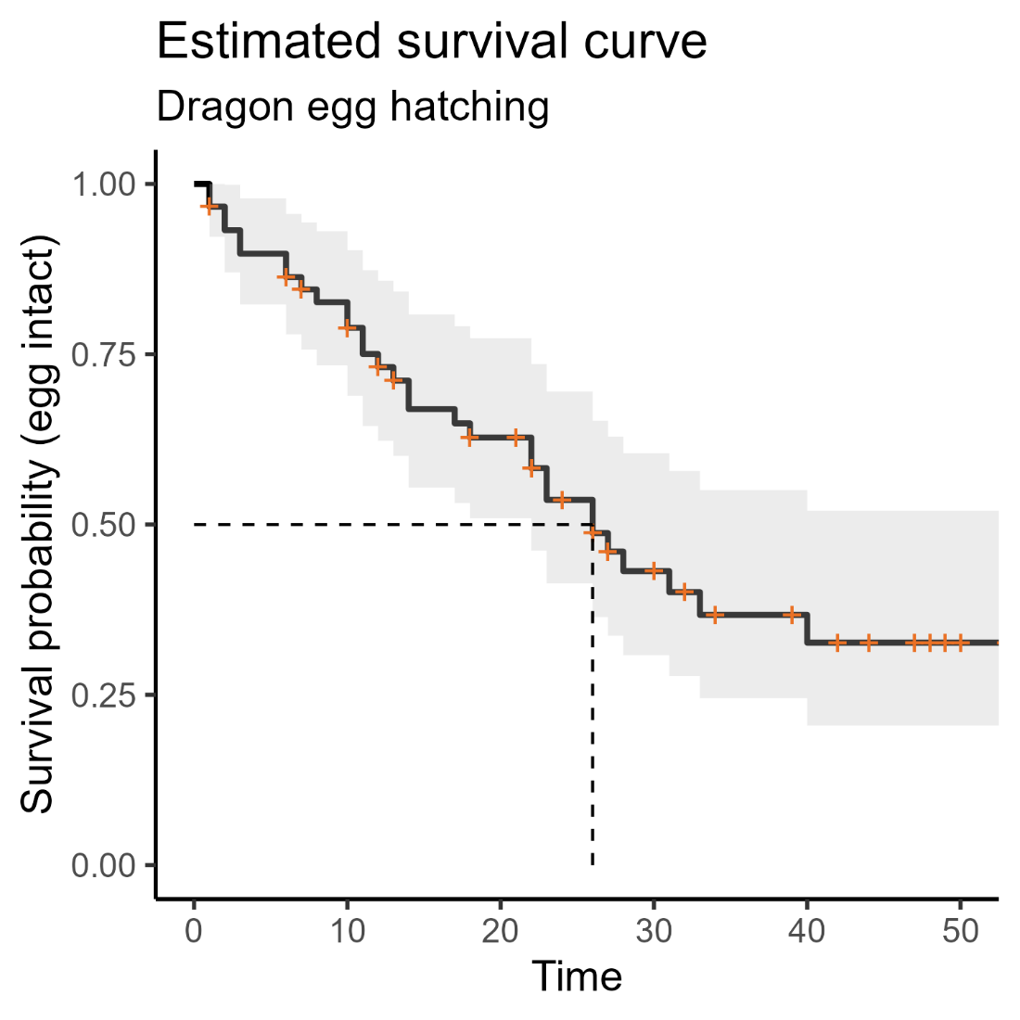
Kaplan-Meier survival curve
Uses:
View the data more intuitively
Estimate key parameters, e.g., median survival time
+ censoring event
Notes:
And from this curve we can extract summary statistics
Most common would be the median value
= time at which you expect 50% of individuals to have experienced the event
(In this case – 26 days)

Slide 29
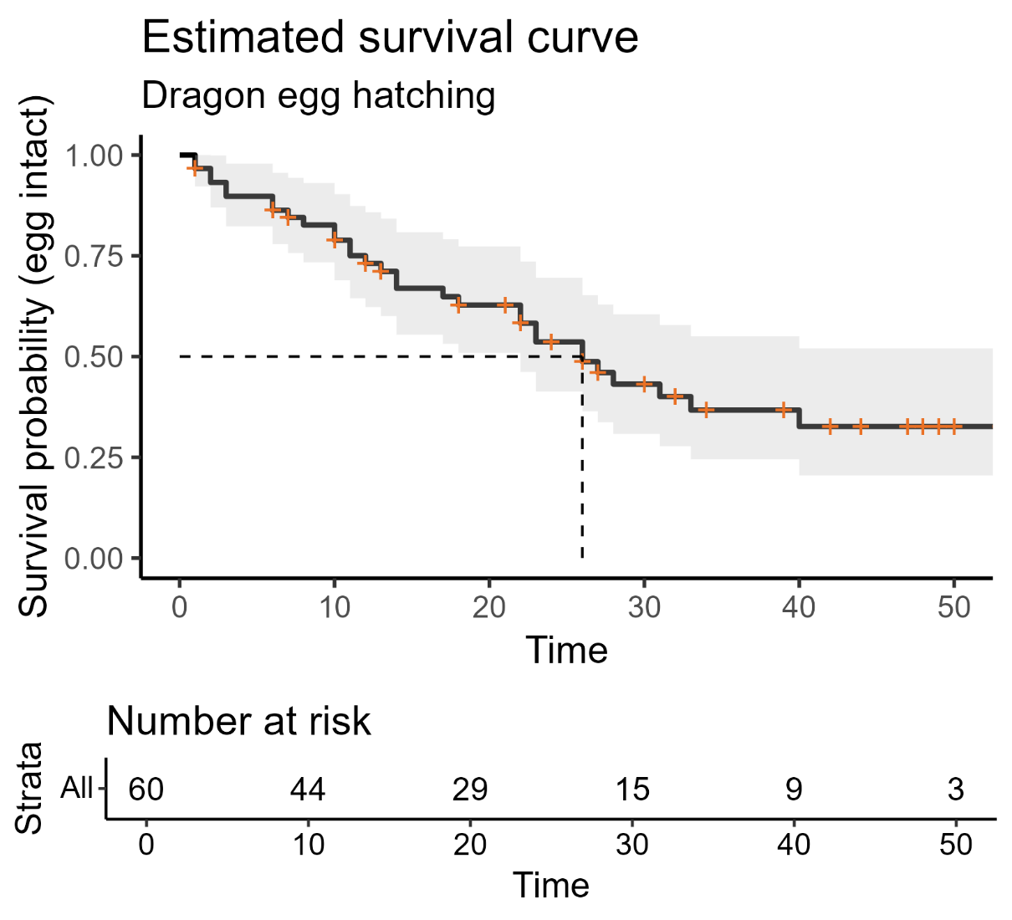
Kaplan-Meier survival curve
Uses:
View the data more intuitively
Estimate key parameters, e.g., median survival time
We can provide other data too
Notes:
If you’re reporting a survival curve (very common in papers)
Then you can also add other information
The “number at risk” table – shows you, at specific points in the study, how many individuals were still at risk
Meaning = they were still being followed (weren’t censored) and hadn’t yet experienced the event

Slide 30
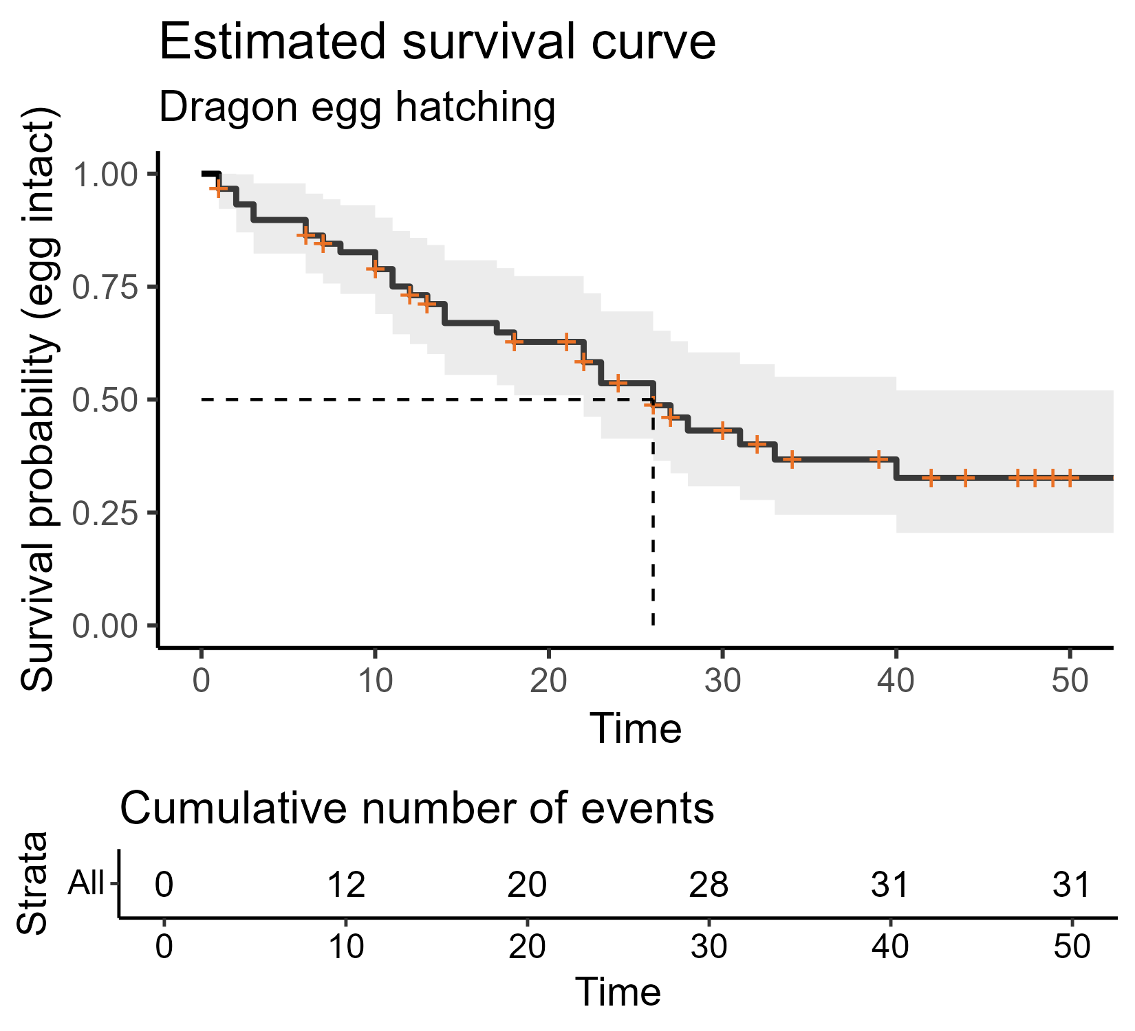
Kaplan-Meier survival curve
Uses:
View the data more intuitively
Estimate key parameters, e.g., median survival time
We can provide other data too
Notes:
Similar information is given in the cumulative events table
This shows how many individuals have experienced the event (doesn’t keep track of dropouts/censored observations, though)

Slide 31
How is the curve constructed?
Constructed using the Kaplan-Meier estimator
Original data survival object
transformed into
Notes:
So when we produce a survival curve, what’s actually being plotted?
Because the data were just a bunch of times and 1s/0s
You don’t need to do this manually (but it is possible!)

Slide 32
Dragon egg dataset
Egg | Time followed | Event
1 | 49 | 0
2 | 12 | 1
3 | 30 | 1
4 | 22 | 0
.. | .. | ..
Original dataset

Slide 33
Dragon egg dataset
Egg | Time followed | Event
1 | 49 | 0
2 | 12 | 1
3 | 30 | 1
4 | 22 | 0
.. | .. | ..
Original dataset
Survival object
Elapsed time | Number at risk | Number of events | Number of censored | Survival probability
0 | 60 | 0 | 0 | 1
1 | 60 | 2 | 2 | 0.967
2 | 56 | 2 | 0 | 0.932
3 | 54 | 2 | 0 | 0.898
.. | .. | .. | .. | ..
Notes:
We construct (in R/Python) a special “survival object” from the original dataset
This is done using something called the Kaplan-Meier estimator – essentially, a formula that lets you convert between the two states
Our original dataset has a unique individual (in this case, egg) per row
The new object has a unique time point per row, instead
This is a specialist layout for a dataset that we don’t use in other type of models

Slide 34
Dragon egg dataset
Egg | Time followed | Event
1 | 49 | 0
2 | 12 | 1
3 | 30 | 1
4 | 22 | 0
.. | .. | ..
Original dataset
Survival object
Elapsed time | Number at risk | Number of events | Number of censored | Survival probability
0 | 60 | 0 | 0 | 1
1 | 60 | 2 | 2 | 0.967
2 | 56 | 2 | 0 | 0.932
3 | 54 | 2 | 0 | 0.898
.. | .. | .. | .. | ..
Notes:
The two key columns: elapsed time and survival probability
Accounting for censoring, what’s the survival probability at each new time point?

Slide 35
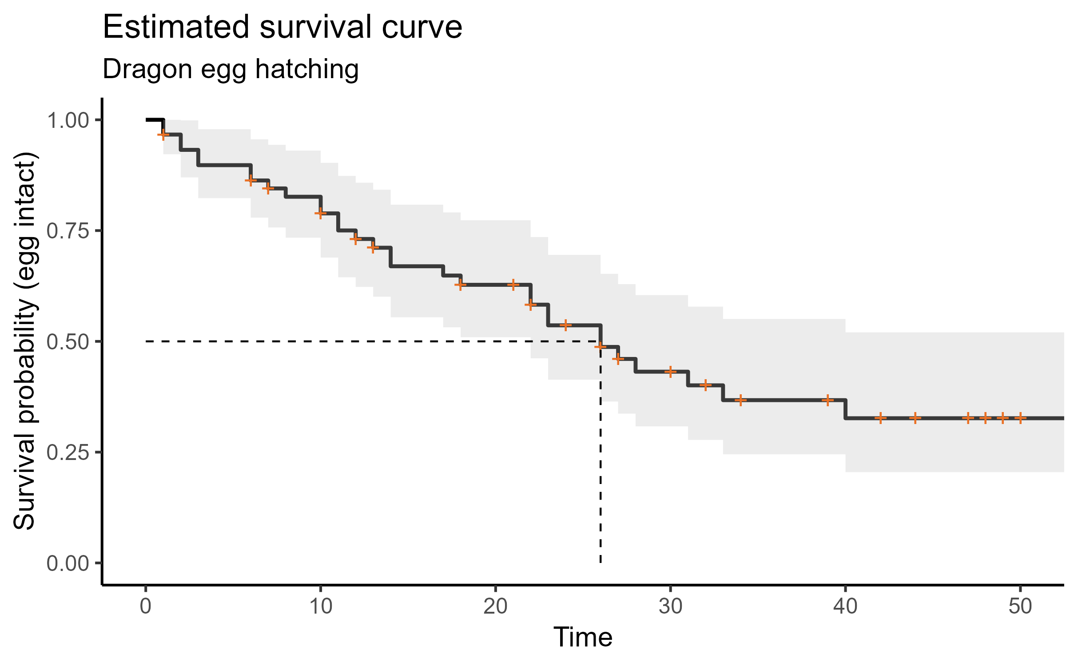
Dragon egg dataset
Notes:
And that’s what we plot when we produce a survival curve!
So: the Kaplan-Meier estimator allows us to convert individual-level data, with censoring
Into probability against time
That’s why you’ll also sometimes hear these called “KM curves”

Slide 36
Summary: Survival curves
In the population, a true survival curve exists
We want to estimate that survival curve using our data
The curve shows time against probability
(of not experiencing the event)
We can use the Kaplan-Meier estimator to calculate those probabilities
When presenting survival curves, we can provide additional info via risk and/or cumulative events tables
Notes:
As always, we are performing a type of inference
We find it helpful to think about the problem in terms of time against probability of survival
And we often find it helpful to present the resulting curves in papers/presentations

Slide 37
3. Comparing curves
The log-rank test for a single categorical predictor
Notes:
So far we’ve only talked about estimation and description
Which is fine – that’s still a very useful thing to do!
But we often like to go further and extract some p-values, test some specific hypotheses

Slide 38
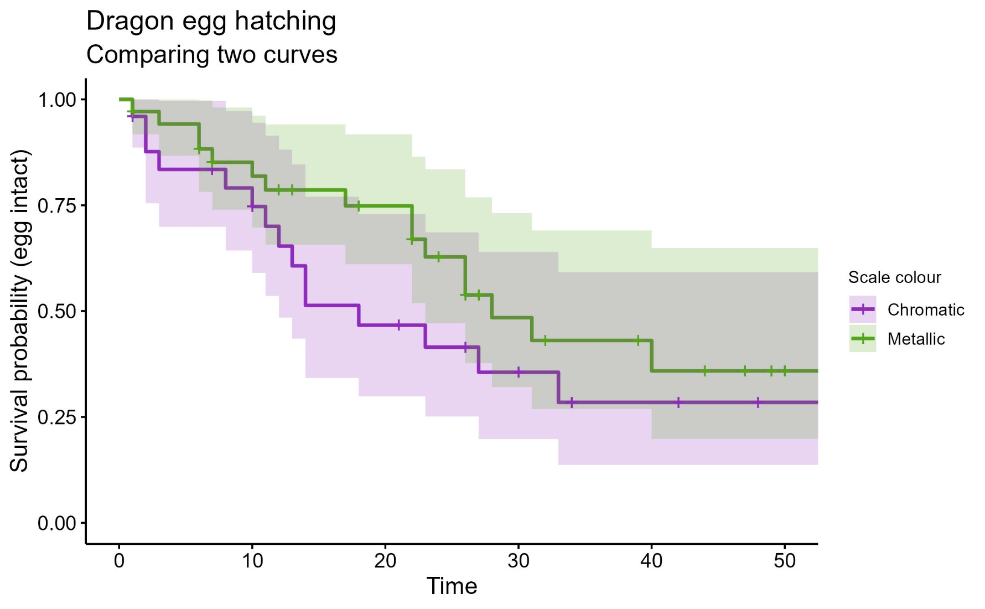
Two dragon populations
Notes:
For example, say I have two groups of dragons (subspecies, scale colour, whatever) to compare to each other

Slide 39
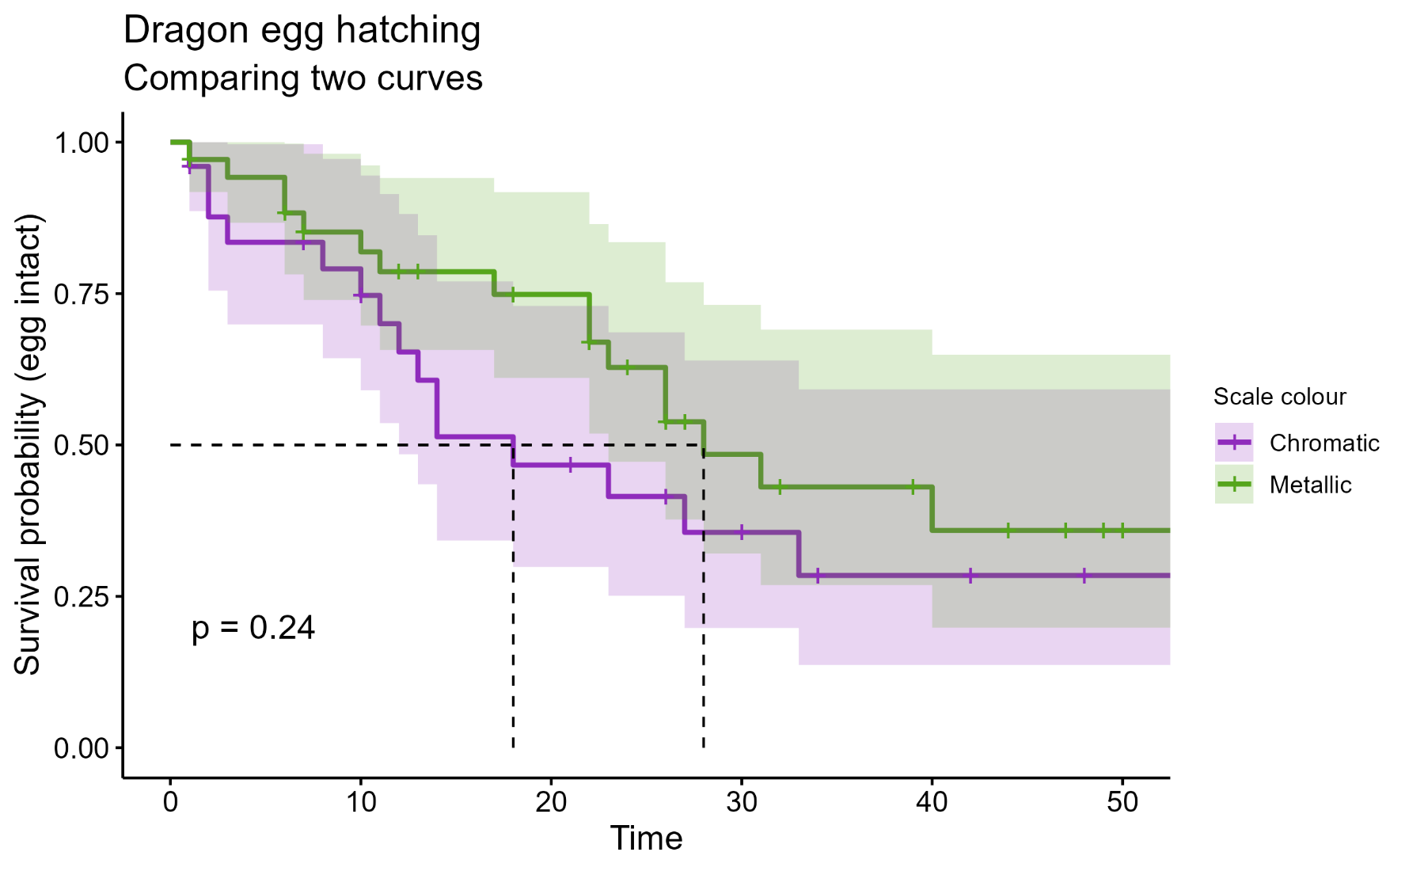
Two dragon populations
Log-rank test:
Used to compare two or more survival curves
Notes:
Log-rank test used to compare two or more survival curves
(single categorical predictor)
Is a null hypothesis significance test
H₀ = groups have identical curves in the population
Produces a p-value
Has assumptions
Can think of it as like a t-test, but for survival data

Slide 40
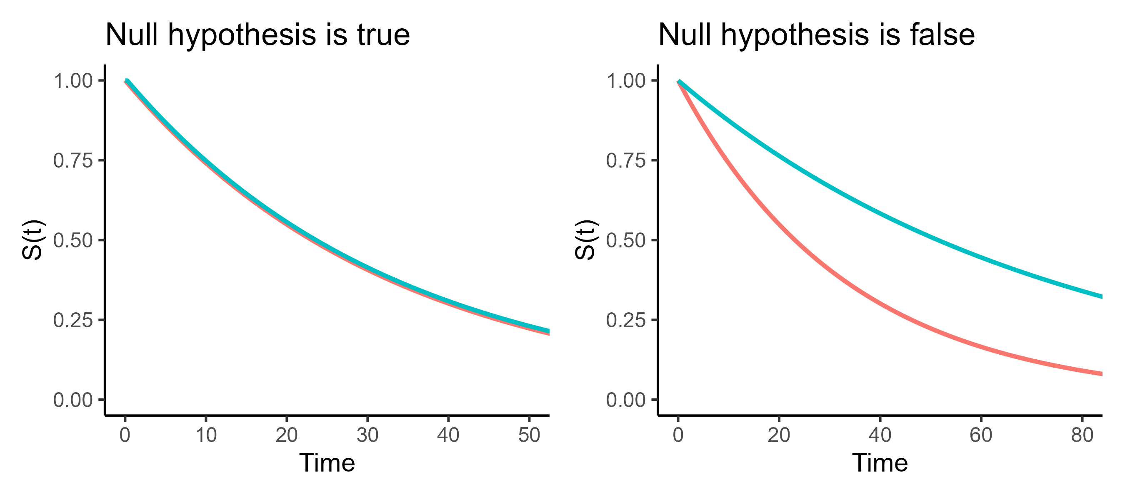
Log-rank test
H₀: groups have an identical survival curve (in the population)
Notes:
Like all significance tests, there must be a null hypothesis
Usually some version of “the world is boring”
And I want to know whether they are better thought of as
One single population with a shared survival curve (i.e., colour makes no difference) – left hand side
Two distinct populations with different survival curves – right hand side
We want to know: which of these is better supported by our data?
(Note: a false null hypothesis could have a steeper curve for blue than red, too; just anything where the curves aren’t the same)

Slide 41
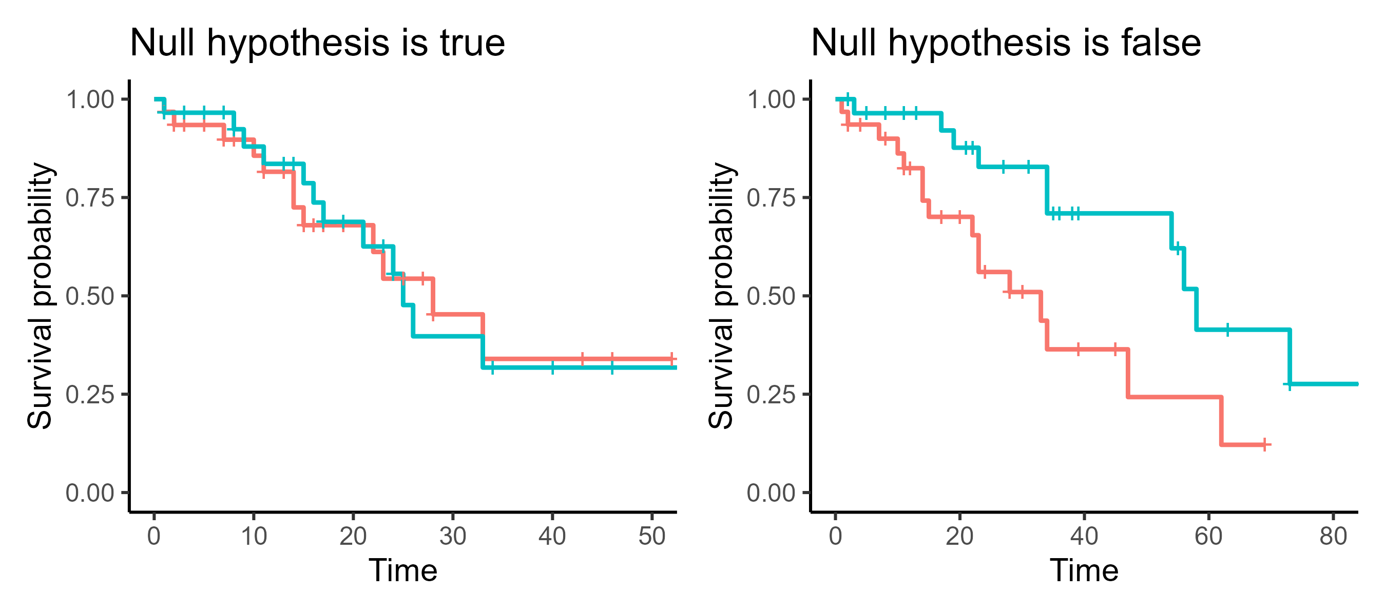
Log-rank test
H₀: groups have an identical survival curve (in the population)
Notes:
Here’s an example of what the actual datasets might look like, coming from those two different “versions of reality”

Slide 42
Assumptions of log-rank test
Like all significance tests, there are assumptions
Independence
Non-informative censoring
Proportional hazards
Notes:
One is a general assumption you’ve probably seen before
The other two are specific to survival data

Slide 43
Assumptions of log-rank test
Like all significance tests, there are assumptions
Independence
Non-informative censoring
Proportional hazards
Notes:
This is an assumption you’ve likely encountered before
Every statistical model makes some assumption about independence

Slide 44
Independence
Each “row” of the dataset (each individual) must be equally unrelated to every other row
Start
Notes:
Each row is a single patient
Not related to each other in any way
Not measuring the same patient more than once

Slide 45
Independence
Each “row” of the dataset (each individual) must be equally unrelated to every other row
Start
Notes:
BUT – if patients are grouped within hospitals, e.g., a multi-site clinical study
That would make them related/clustered together, and not independent
Patients from a single hospital have more similar outcomes, and perhaps more similar probability of experience the event, than they will to patients in other hospitals

Slide 46
Independence
Each “row” of the dataset (each individual) must be equally unrelated to every other row
Start
Notes:
Another example
Event of interest: tooth erupting
Multiple teeth per child
Teeth belonging to the same child are not independent of each other
We know that children tend to go through phases of losing/growing multiple teeth at once

Slide 47
Independence
Each “row” of the dataset (each individual) must be equally unrelated to every other row
Start
Notes:
Another example
Event: graduation/earning a degree
If we track the same individual over multiple degrees (some people are overachievers!) then again, not independent

Slide 48
Independence
Each “row” of the dataset (each individual) must be equally unrelated to every other row
Start
Notes:
If you switched to people’s first degrees, it would fix this problem
Now only one observation per person

Slide 49
Assumptions of log-rank test
Like all significance tests, there are assumptions
Independence
Non-informative censoring
Proportional hazards
Notes:
The first of the two survival-specific assumptions
The short definition:
Censoring & survival are not “linked”
E.g., higher probability of censoring does not mean a higher or lower probability of experiencing the event

Slide 50
Non-informative censoring
Censoring is not related to survival/event probability;
Probability of being censored is equal for all individuals
Start
Notes:
Event of interest: lightbulb failure
Building maintenance install 500 bulbs in a new building, and a researcher monitors each of them
The informative censoring comes in here:
Regular/routine checks by building maintenance
Bulbs are removed if they look close to failure (flickering, dimming), and are therefore lost to researcher follow-up
So the censoring is directly related to the survival time
The same process that governs the event (failure) occurring, also governs censoring
Why is this a problem?
Your survival analysis will end up overestimating how long bulbs survive
Because all the ones with shorter survival times, get removed/censored before they can contribute

Slide 51
Non-informative censoring
Censoring is not related to survival/event probability;
Probability of being censored is equal for all individuals
Start
Notes:
A slightly more complex, but probably for many participants more relevant, example
Imagine:
Event of interest is: getting a transplant kidney
Orange crosses represent censoring – e.g., patient drops out of the study/is lost to follow-up
Sample is made up of individuals with varying degrees of illness, perhaps different stages of kidney disease
Followed from the time they join the waiting list
Here’s the informative censoring:
Patients who become too ill for transplantation are removed from the waiting list, i.e., censored
They are not a random subset of that waiting list, so censoring is not happening at random – it’s happening based on how ill they are
Once removed, their chance of experiencing the event (transplant) is lowered
Meaning the likelihood of getting a kidney, is related to the likelihood of being censored
What would non-informative censoring look like?
Patient moves country
Patient is transferred to another transplant centre that doesn’t share data with the study
Study ends while patient is still on the transplant waiting list
Note: a patient dying is not so much censoring as a “competing event”, but that would also be a potential problem!
In general: it’s very common in medical settings that patients with poorer health are more likely to be lost to follow-up!!

Slide 52
Assumptions of log-rank test
Like all significance tests, there are assumptions
Independence
Non-informative censoring
Proportional hazards

Slide 53
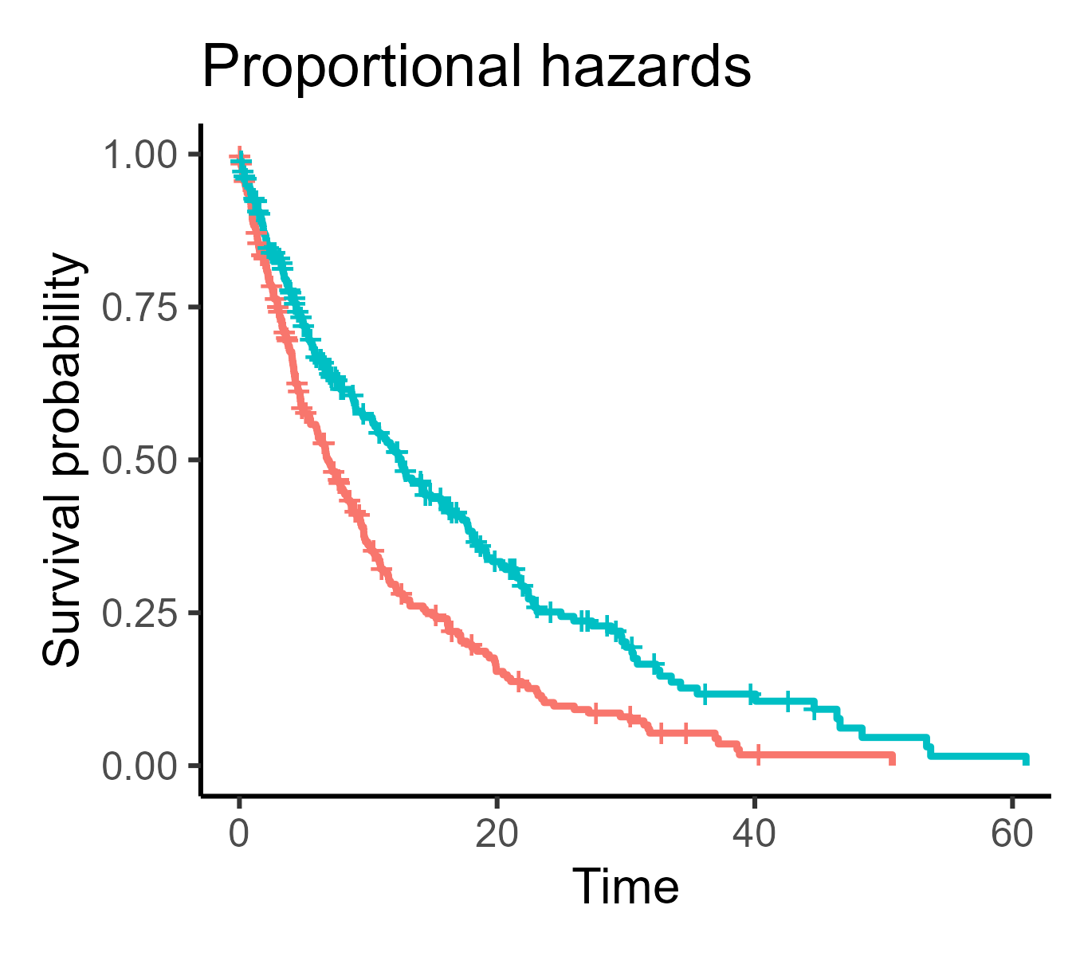
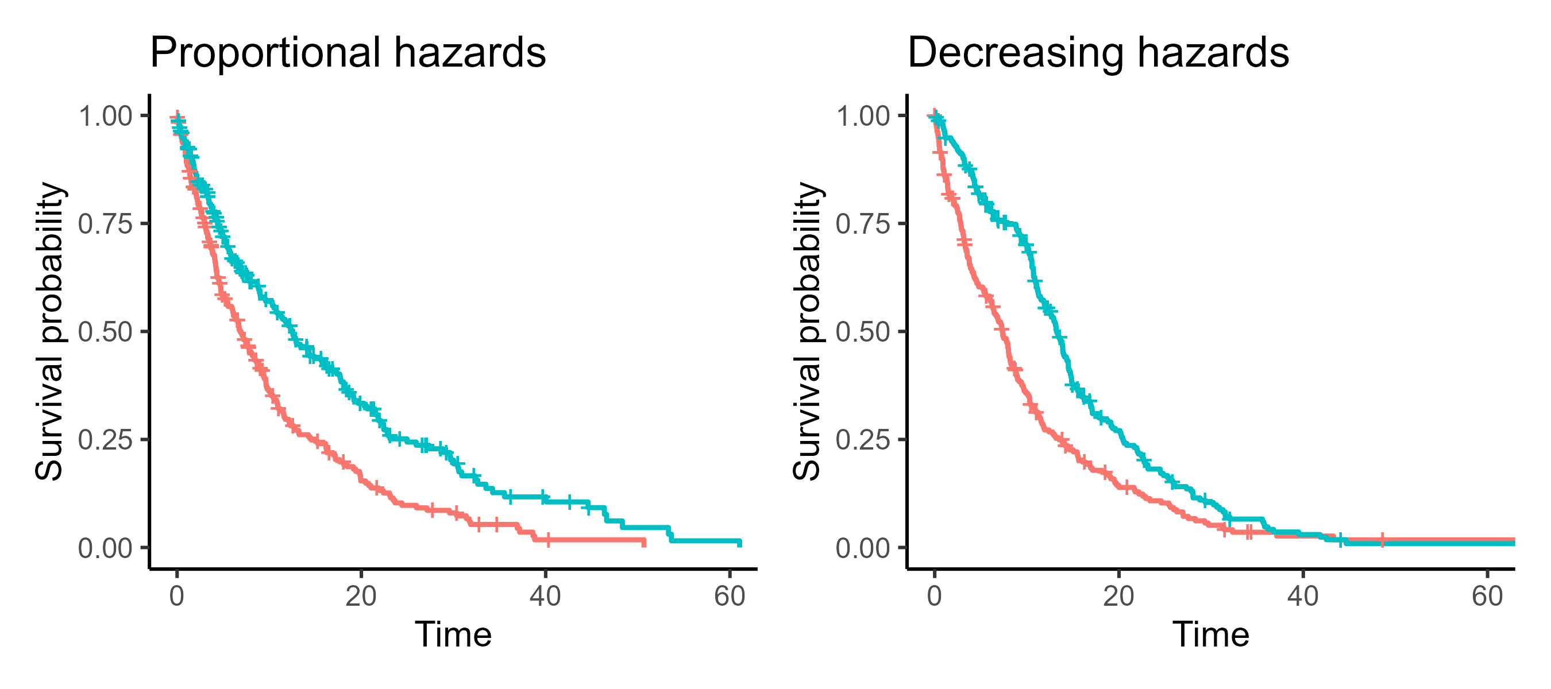
Proportional hazards
The effect of predictor on event occurring is consistent over time
Notes:
Proportional or consistent effects, over time, for the predictor(s)
So: if chromatic dragon eggs have twice the likelihood of hatching at time 1 compared to metallic dragons, they also have twice the likelihood at time 10
Or: if a surgical patient has a third of the chance of being discharged than a non-surgical patient on day 2, they should also have a third of a chance on day 20

Slide 54
Proportional hazards
The effect of predictor on event occurring is consistent over time
Notes:
Hazards can be non-proportional in multiple ways
And one of the easiest ways to check (with a categorical predictor at least) is the survival curves

Slide 55
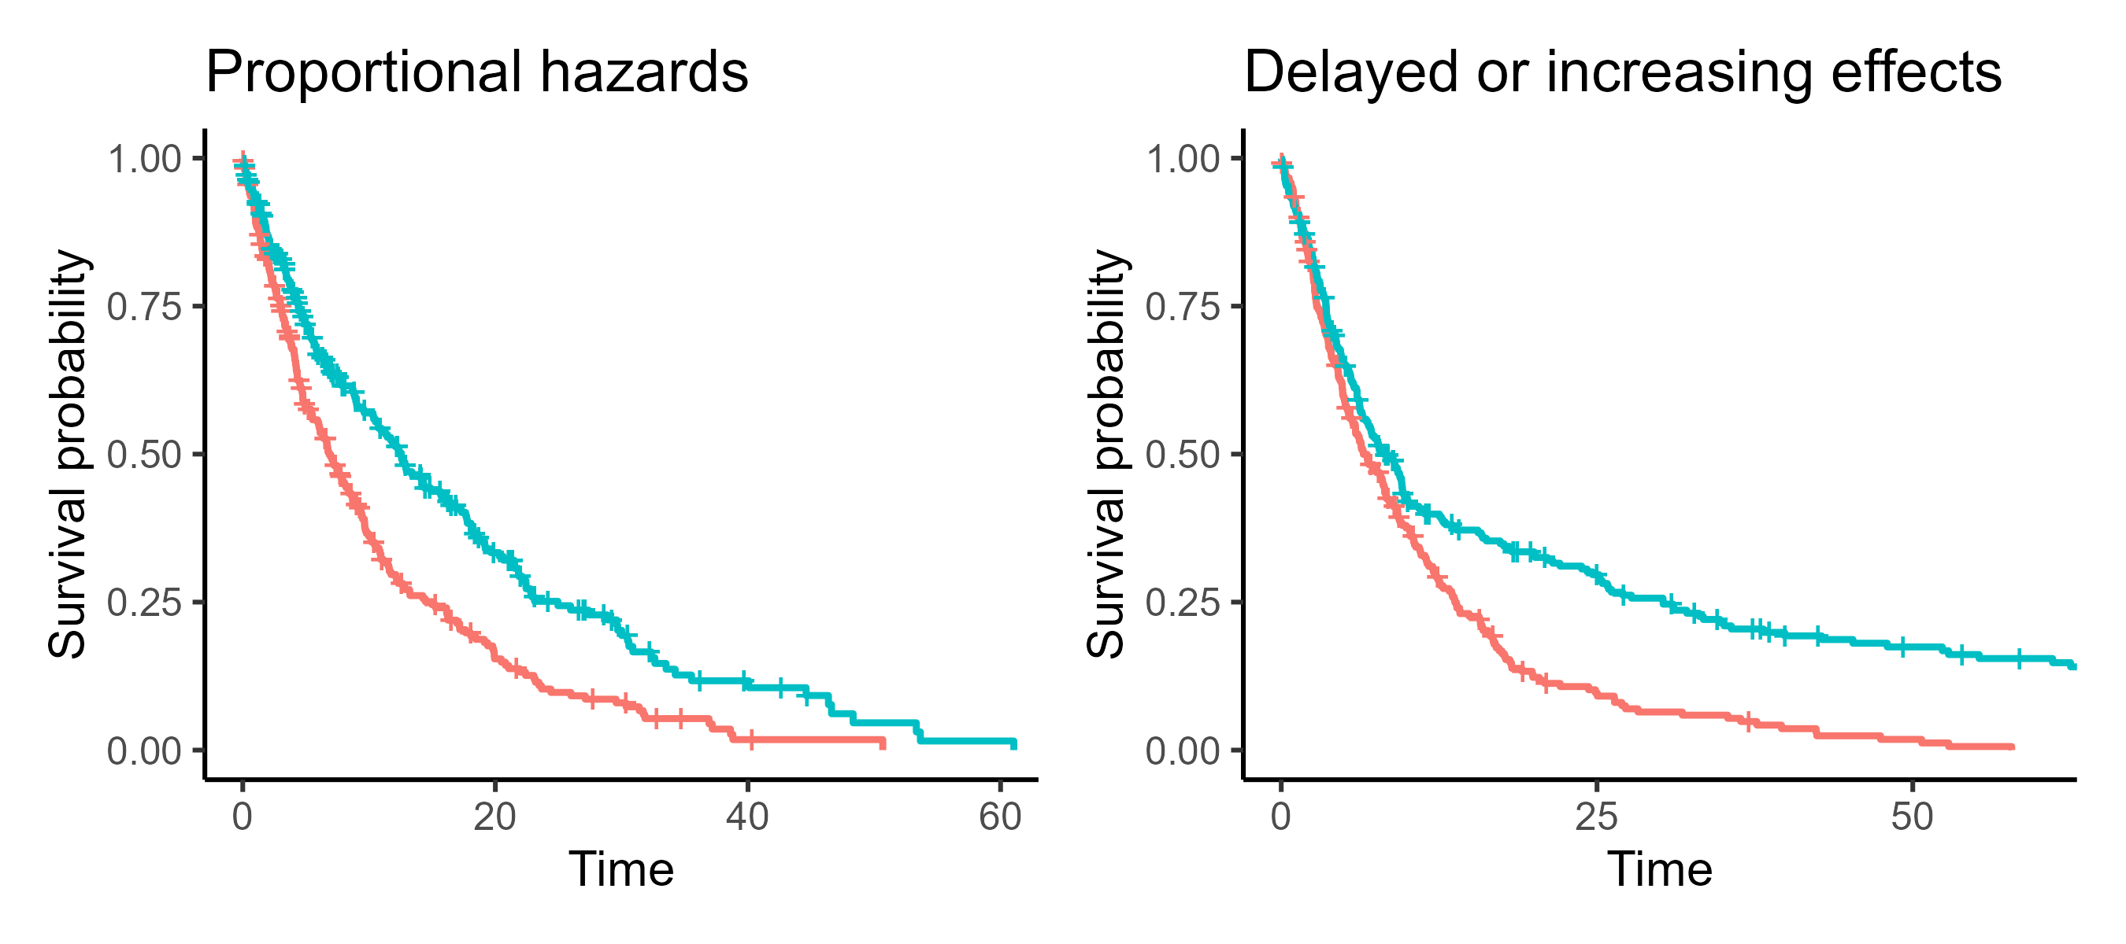
Proportional hazards
The effect of predictor on event occurring is consistent over time
Notes:
Hazards can be non-proportional in multiple ways
And one of the easiest ways to check (with a categorical predictor at least) is the survival curves

Slide 56
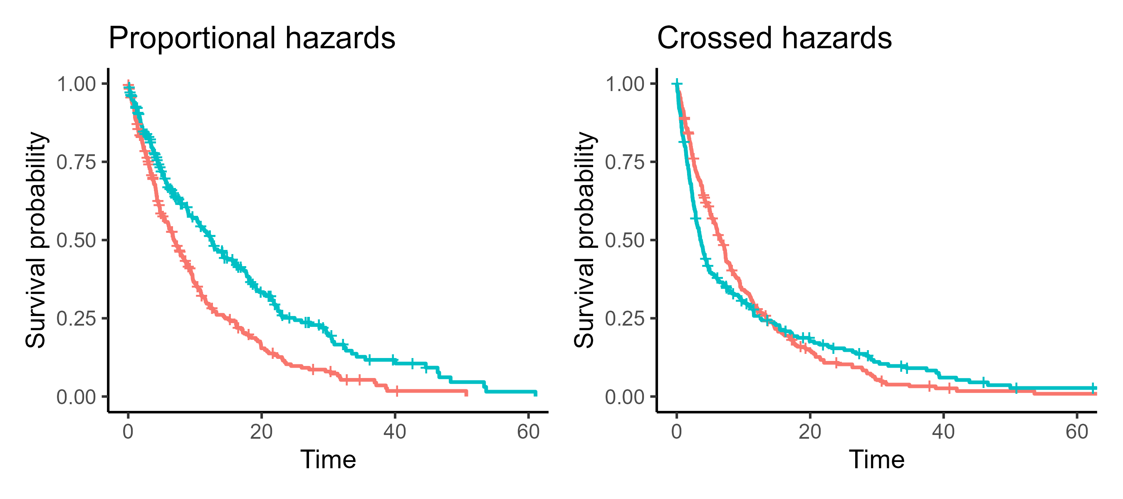
Proportional hazards
The effect of predictor on event occurring is consistent over time
Notes:
Crossed – one group starts with a higher hazard/rate of event, and then at some point it flips

Slide 57
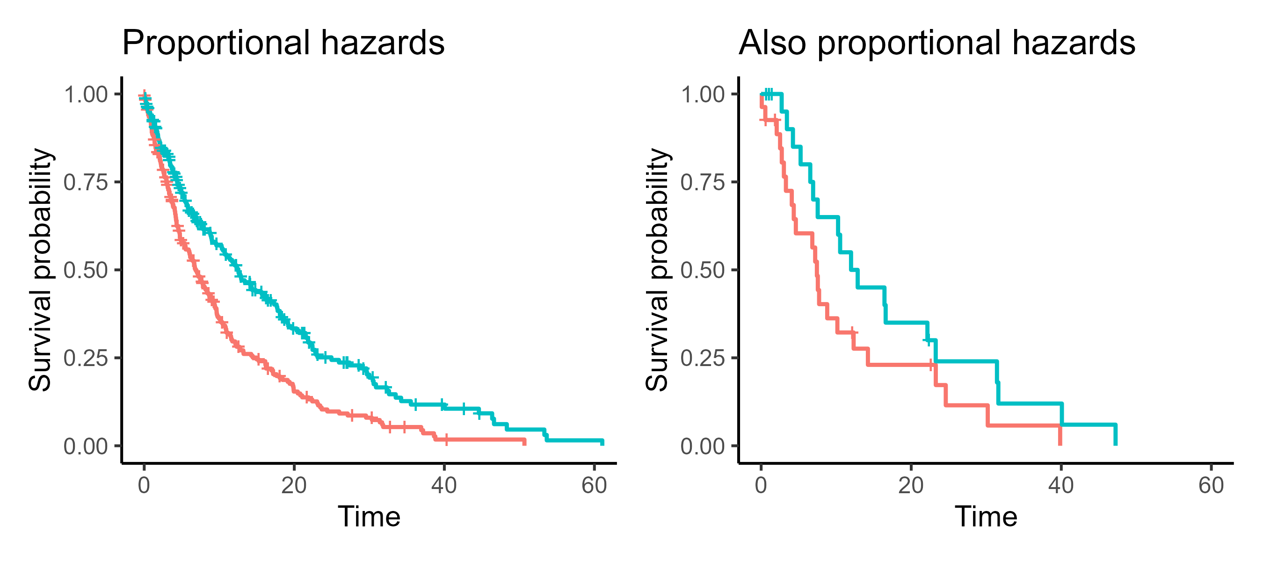
Proportional hazards
Note: it won’t always be foolproof!
Notes:
Important to note: looking at the curves alone isn’t necessarily foolproof
When the sample size is smaller, the staircase will look much less smooth
So generally we have to be a bit more relaxed in those situations (like with checking diagnostic plots in regular linear models)

Slide 58
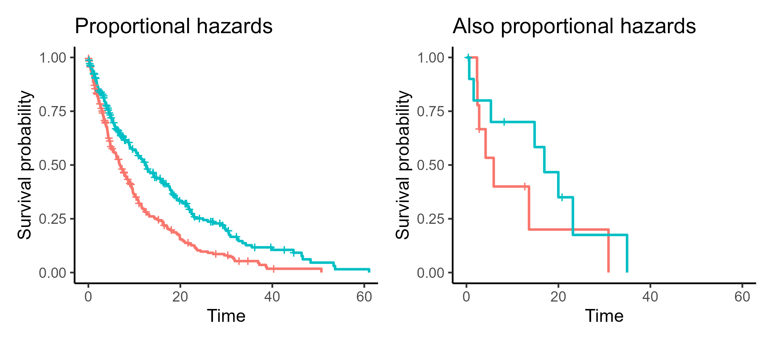
Proportional hazards
Note: it won’t always be foolproof!
Notes:
Important to note: looking at the curves alone isn’t necessarily foolproof
When the sample size is smaller, the staircase will look much less smooth
So generally we have to be a bit more relaxed in those situations (like with checking diagnostic plots in regular linear models)
Remember: our assumption about proportional hazards is actually about the underlying survival curves in the population that generated the data

Slide 59
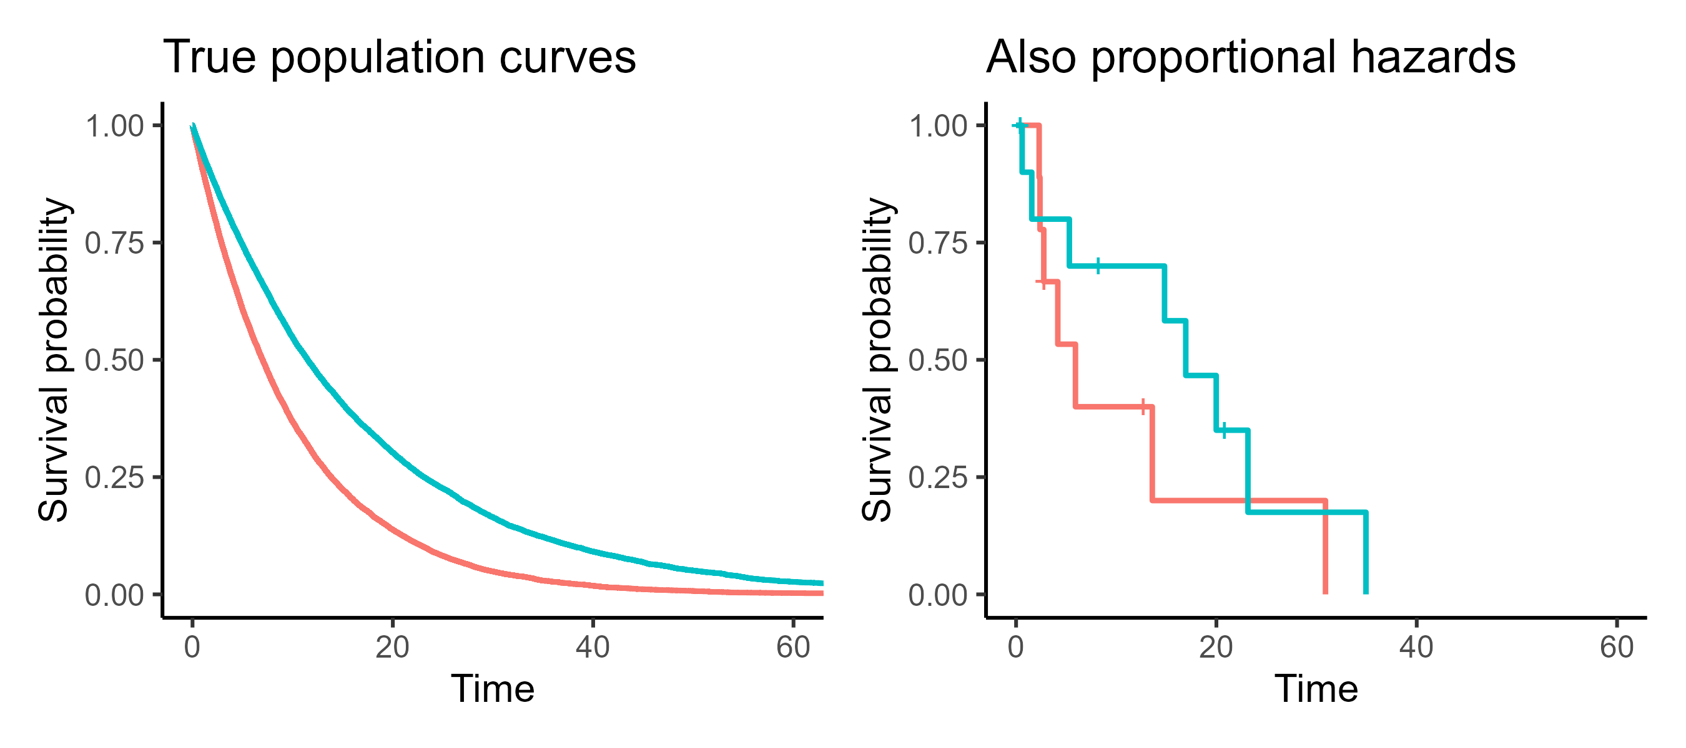
Proportional hazards
Note: we care about the underlying population
Notes:
Important to note: looking at the curves alone isn’t necessarily foolproof
When the sample size is smaller, the staircase will look much less smooth
So generally we have to be a bit more relaxed in those situations (like with checking diagnostic plots in regular linear models)
Remember: our assumption about proportional hazards is actually about the underlying survival curves in the population that generated the data

Slide 60
Dragon egg example: are assumptions met?
Is time to hatch predicted by scale colour?
What could cause the assumption to fail?
Independence
Non-informative censoring
Proportional hazards
Notes:
Okay, so let’s check our ability to think through the assumptions on the example I introduced earlier
Talk with a neighbour
What would have to “go wrong” for each assumption to not be met?
Note: there may be multiple answers for each assumption!

Slide 61
Dragon egg example: are assumptions met?
Independence:
Multiple eggs from same parent(s)
  Genetic similarity
  Shared parental behaviours (e.g., incubation)
  Same clutch: affect each other (e.g., warming up)
Nesting site
Season/year
Notes:
If we have multiple nesting sites, some may be more or less favourable
If we measure over multiple years, we get batch effects

Slide 62
Dragon egg example: are assumptions met?
Non-informative censoring:
Unhealthy/slow-hatching eggs are removed or abandoned
Attentive/protective dragon parents hide eggs
What if chromatic dragon eggs are more likely to be censored than metallic ones?
Notes:
Chromatic eggs being censored (e.g., hidden or damaged) more often is not automatically informative
If chromatic eggs:
Hatch quicker on average
Are also more likely to be abandoned by parents
Then we will see differences between the two groups
But this doesn’t mean that the hatching time and censoring probability are related to each other within the groups
Can be non-informative within each colour group and that’s still fine
In other words: censoring does not need to be independent of predictors, just of the event-causing mechanism/process

Slide 63
Dragon egg example: are assumptions met?
Proportional hazards:
There is no difference up to 30 days, but after that, chromatic eggs hatch faster
Metallic eggs hatch slowly but steadily the whole time, while:
  Chromatic eggs hatch quickly but with late-stage complications
  Or chromatic eggs only start hatching after 30 days have passed
Notes:
Remember, proportional hazards relates to whether the predictor variable(s) have a constant effect on survival
So we need to focus on the scale colour in this instance

Slide 64
Two dragon populations
Notes:
Do you think we can trust this log-rank test, then?
This is the log rank test that we saw earlier
But now we have more a sense of whether it’s appropriate, and how we might want to interpret it

Slide 65
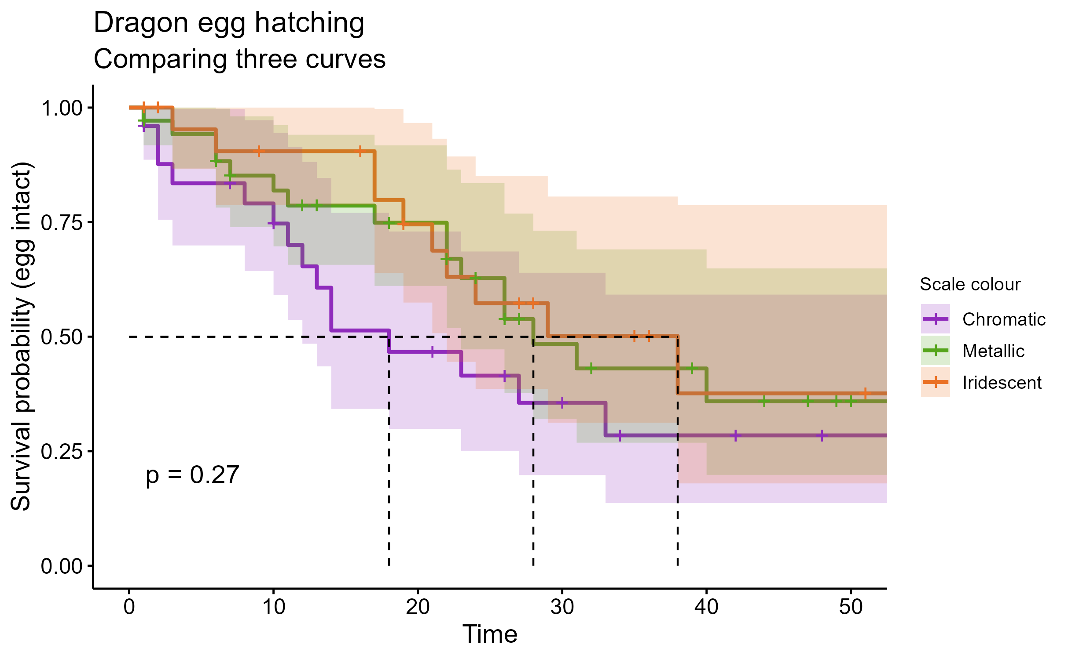
Multiple dragon populations
Notes:
The log-rank test can also be seen as an analogue for a one-way ANOVA
You could have as many different strata/groups as you wanted

Slide 66
Summary: Log-rank test
Allows us to compare groups like a t-test or one-way ANOVA (i.e., single categorical predictor)
The null hypothesis is that all groups share the same underlying survival curve
Makes assumptions about:
  Independence
  Non-informative censoring
  Proportional hazards
Notes:
Probably the simplest/easiest type of analysis to perform on survival data
It only works when we have one categorical predictor (although we can compare as many groups as we like)
Like all statistical tests, it makes assumptions, and you have to check these

Slide 67
Survival (time-to-event) analysis
Cambridge Centre for Research Informatics Training

Slide 68
Session 1
In session 1:
What’s special about survival/time-to-event data?
Survival curves (Kaplan-Meier estimation)
Comparing two curves (log rank test)

Slide 69
Session 2
In session 2:
Continuous predictor variables
(fitting Cox regression models)
Interpreting Cox regression

Slide 70
4. Continuous predictors
Introducing Cox proportional hazards regression
Notes:
In the first session, we looked at:
Describing a dataset overall, a single survival curve (no predictor)
The log-rank test, with a single categorical predictor (multiple groups)
What if we want to know about the impact of a continuous predictor, though?
In that situation, we perform a type of analysis called Cox regression

Slide 71
How does the predictor “affect” the hazard?
What’s the “risk” of a random lightbulb failing right now?
Start
Notes:
Getting your head around how Cox regression works is maybe a bit trickier than a log-rank test
Let’s start by thinking about what the survival/risk looks like without any predictors at all
Say we take an individual at random from the dataset or population
And we ask: what’s the risk/hazard of them experiencing the event right now, at some given point in time?

Slide 72
How does the predictor “affect” the hazard?
What’s the “risk” of a random customer cancelling right now?
Start
Notes:
Let’s start by thinking about what the survival/risk looks like without any predictors at all
Say we take an individual at random from the dataset or population
And we ask: what’s the risk/hazard of them experiencing the event right now, at some given point in time?

Slide 73
How does the predictor “affect” the hazard?
What’s the “risk” of a random patient dying right now?
Start
Notes:
Let’s start by thinking about what the survival/risk looks like without any predictors at all
Say we take an individual at random from the dataset or population
And we ask: what’s the risk/hazard of them experiencing the event right now, at some given point in time?

Slide 74
How does the predictor “affect” the hazard?
What’s the “risk” of a random egg hatching right now?
We know nothing specific about this egg
  i.e., no predictors
  (yet!)
But we do know something about the general baseline hazard
Start
Notes:
(Returning to the egg-hatching example)
If we just think about the entire set of eggs, and ignore any differences between them
We can figure out the baseline “risk” (also known as “hazard”) by just looking at all the eggs averaged together

Slide 75
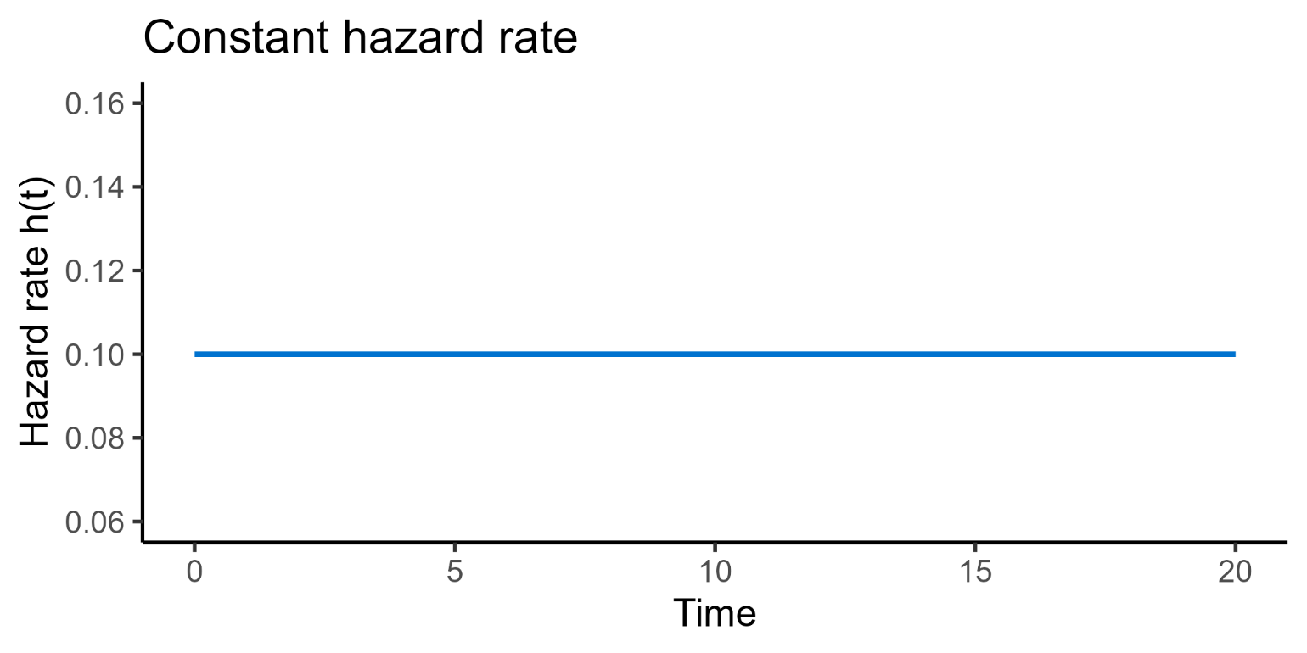
Baseline hazard
Baseline hazard may change over time, even without predictors
Notes:
That baseline hazard can vary over time in different ways
Constant – things with exponential lifetimes, e.g., a lightbulb that is equally likely to fail at any given time

Slide 76
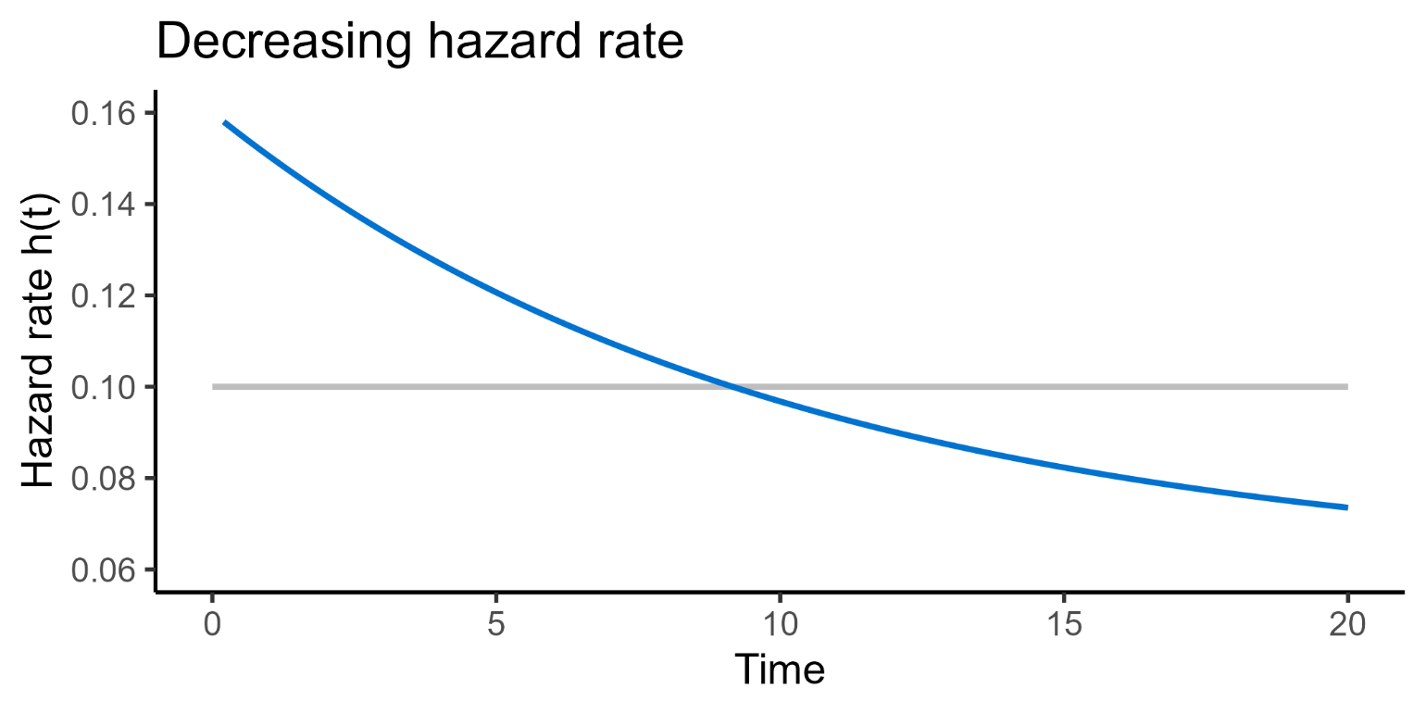
Baseline hazard
Baseline hazard may change over time, even without predictors
Notes:
That baseline hazard can vary over time in different ways
Decreasing – things less likely to wear with time, e.g., businesses become more stable the longer they are established for

Slide 77
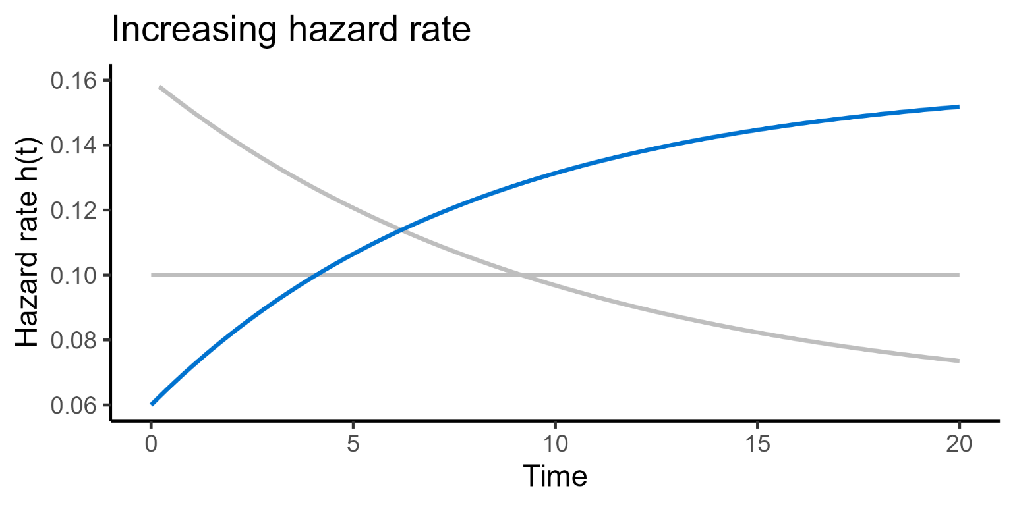
Baseline hazard
Baseline hazard may change over time, even without predictors
Notes:
That baseline hazard can vary over time in different ways
Increasing – things are more likely to wear with time, e.g., mechanical parts

Slide 78
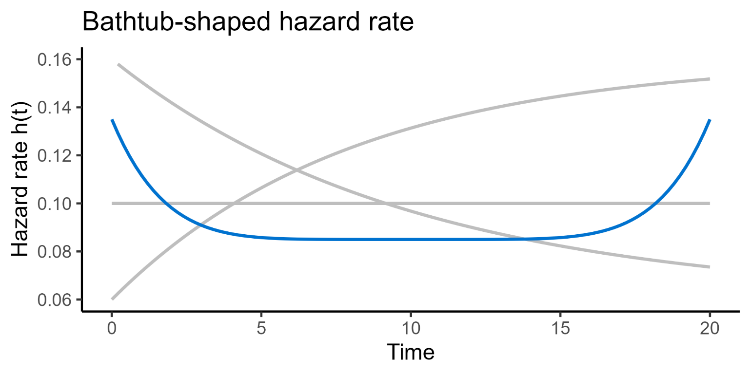
Baseline hazard
Baseline hazard may change over time, even without predictors
Notes:
That baseline hazard can vary over time in different ways
Bathtub – high failure rates when young and old, e.g., humans

Slide 79
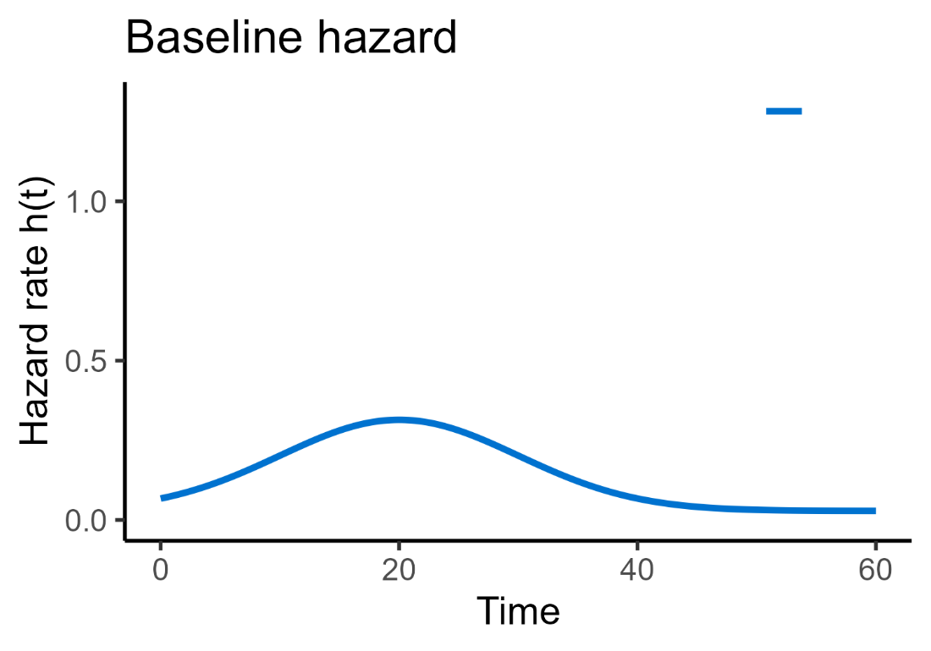
Baseline hazard
What’s the “risk” of a random egg hatching right now?
Start
Notes:
Let’s assume that dragon egg hatching has a baseline hazard function like this
Starts low, peaks around 20 days from the start of the study observation, drops again
Note that it doesn’t really matter – it gets estimated from the dataset, but we’re usually not that bothered about what the shape actually is
And this is a silly example anyway
But essentially it describes, on average, the shape of how the risk/hazard varies over time

Slide 80
Adding a predictor
Continuous predictor: weight/size of the egg
Start
Notes:
We’re now going to add a continuous predictor: the weight/size
And this allows us to ask questions about the impact that this predictor has, on that baseline hazard

Slide 81
How does the predictor “affect” the hazard?
Continuous predictor: weight/size of the egg
Start
Notes:
Let’s assume that dragon egg hatching has an increasing baseline hazard function

Slide 82
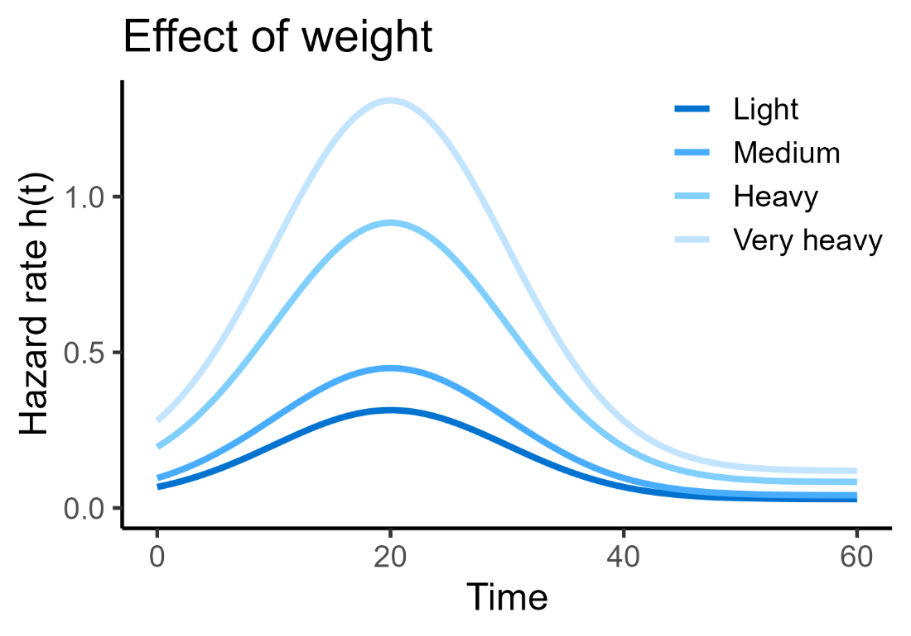
How does the predictor “affect” the hazard?
Different weight can change an egg’s hazard from the baseline
Start
Notes:
Now, we can look at how the weight of the egg affects that baseline
And that’s what we’re really interested in!
(Note; it could also have decreased the hazard, that would still be fine)

Slide 83
How does the predictor “affect” the hazard?
Predictor “multiplies” the baseline hazard
h(t) = h₀(t) * exp(β₁x₁)
Baseline hazard
Notes:
This is analogous to how, in a simple linear regression:
A beta0 gives us some “starting point” or baseline

Slide 84
How does the predictor “affect” the hazard?
Predictor “multiplies” the baseline hazard
h(t) = h₀(t) * exp(β₁x₁)
Baseline hazard
Predictor
Notes:
This is analogous to how, in a simple linear regression:
A beta0 gives us some “starting point” or baseline
We then modify/move from that baseline, based on the values of our predictor variable

Slide 85
How does the predictor “affect” the hazard?
Predictor “multiplies” the baseline hazard
h(t) = h₀(t) * exp(β₁x₁)
Baseline hazard
Predictor
Beta coefficient of predictor
Notes:
This is analogous to how, in a simple linear regression:
A beta0 gives us some “starting point” or baseline
We then modify/move from that baseline, based on the values of our predictor variable
Which are each being multiplied by a beta coefficient of their own

Slide 86
How does the predictor “affect” the hazard?
Predictor “multiplies” the baseline hazard
h(t) = h₀(t) * exp(β₁x₁)
Baseline hazard
Predictor
Beta coefficient of predictor
“Final” (predicted) hazard
Notes:
This is analogous to how, in a simple linear regression:
A beta0 gives us some “starting point” or baseline
We then modify/move from that baseline, based on the values of our predictor variable
Which are each being multiplied by a beta coefficient of their own
To give us some final prediction

Slide 87
Summary: Cox regression
h(t) = h₀(t) * exp(β₁x₁) y = β₀ + β₁x₁
Cox regression is an extension of a linear model
Baseline hazard acts as the “intercept”/β₀
May be modulated/affected by a changing predictor variable
We are trying to predict the “final” hazard, after modulation by a predictor variable
Notes:
So if a log-rank test is an extension/analogue of the t-test/one-way ANOVA
You can think of Cox regression as an extension/analogue of the more general linear model
So far we’ve talked about it like simple linear regression, with one continuous predictor

Slide 88
Summary: Cox regression
h(t) = h₀(t) * exp(β₁x₁+ β₂x₂ + β₃x₁x₂ + … + β_{n}x_{n})
Cox regression is an extension of a linear model
Just like a linear model:
  Any number of predictors
  Categorical, continuous, interactions, transformations etc.
As with any statistical model, there are some assumptions
Notes:
But actually, just like with regular linear models, the number and type of predictors doesn’t matter
And of course: there are assumptions!!

Slide 89
Assumptions of Cox regression
The assumptions are the same as the log-rank test*
Independence
Non-informative censoring
Proportional hazards

Slide 90
Assumptions of Cox regression
The assumptions are the same as the log-rank test*
Independence
Non-informative censoring
Proportional hazards
*Plus, two extra things:
Linearity (continuous predictors)
Time-independent predictors
Notes:
In the online course materials, they will walk you through:
Checking linearity for continuous predictors
How to assess proportional hazards for continuous predictors
But we don’t talk very much about time-independent predictors, so I’ll take a couple of slides to focus on that now

Slide 91
Time-independent predictors
Values of predictors remain constant
Only need to be measured once at the start of the study
Examples:
Baseline age
Dragon egg weight
Degree subject
Notes:
This is more of an experimental design principle

Slide 92
Time-independent predictors
If values of predictors vary across the study
Standard Cox regression model cannot be used
Examples:
Disease stage progressing
Subscription cost increasing
Weather/seasonal changes
Notes:
Standard Cox regression cannot handle time-dependent predictors
You need to use an extension to the model
[Possible bonus chapter in course materials?]
Earlier we had the example of customers cancelling their streaming subscription
And also the example of birds migrating out of the study area

Slide 93
5. Interpreting Cox regression
Understanding hazard ratios

Slide 94
Interpretation of a Cox regression model
From a Cox model, we can estimate/calculate:
P-values and confidence intervals
Coefficients for predictors
Survival probability at any specific time
Hazard ratios
  For an individual
  Or between groups

Slide 95
Hazard ratios
Quantifies how much the change in the predictor variable affects the hazard
Such as:
  Difference in hazard between groups
  Change in hazard per unit change in the predictor
An effect size for Cox regression/survival data
Not the same as odds ratio/risk ratio!
Notes:
Remember hazard = probability of experiencing the event at a given point in time

Slide 96
Hazard ratios for categorical predictors
Notes:
Let’s say we want to know what the hazard ratio is for our scale colour predictor variable

Slide 97
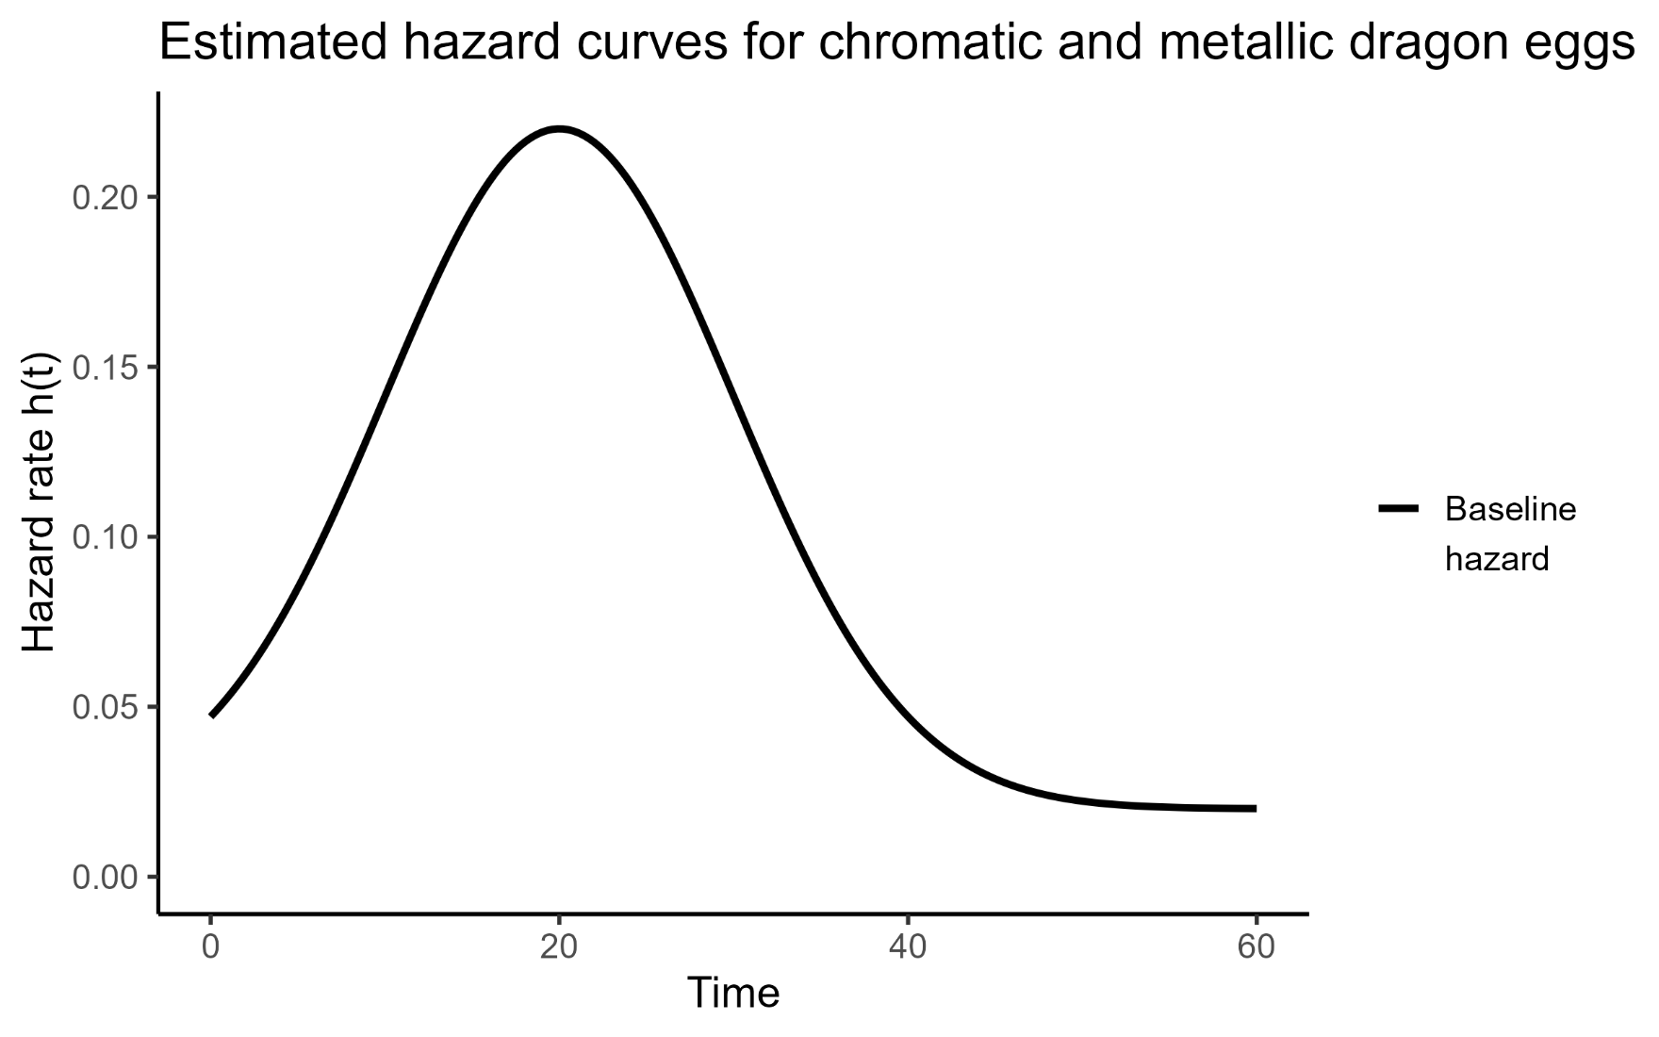
Hazard ratios for categorical predictors
Notes:
The first thing that happens is that baseline hazard gets estimated
This here is a very smoothed/perfect version (the actual estimate would look messier, we’re just visualising/imagining)
So this baseline hazard rises and then falls
Remember the exact shape isn’t all that important

Slide 98
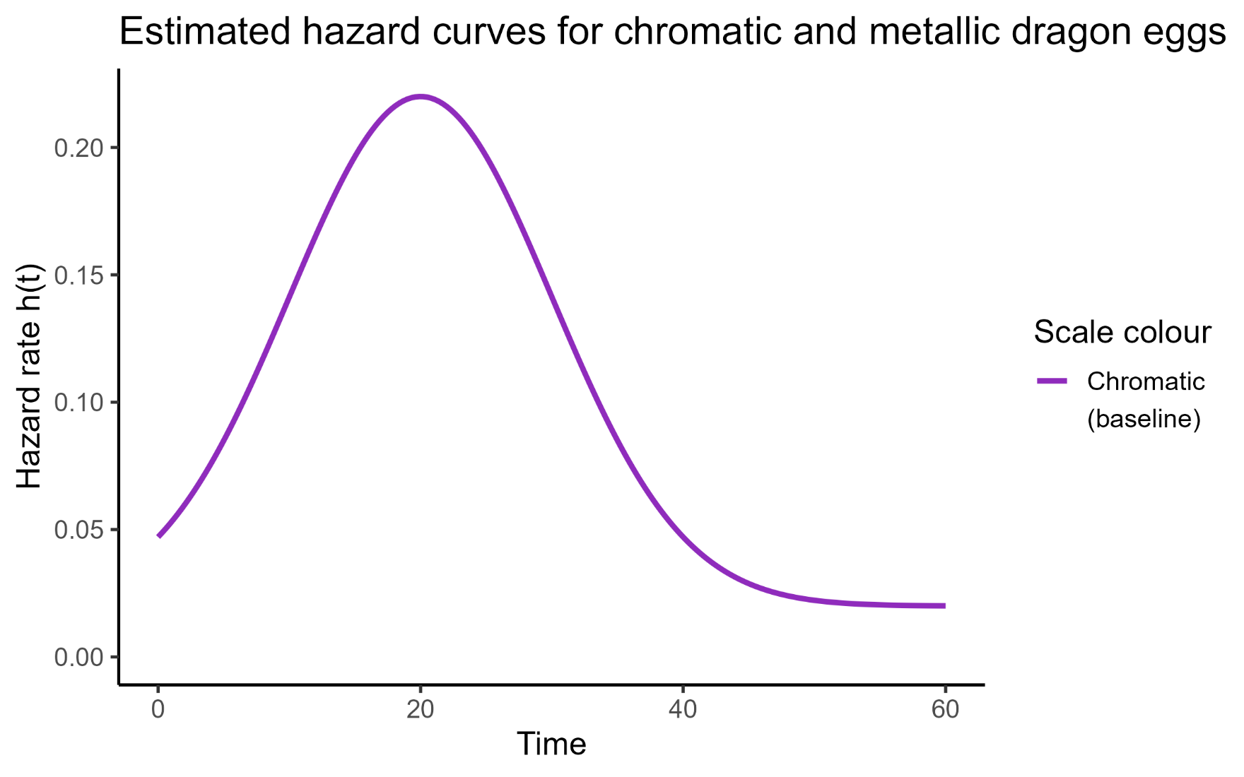
Hazard ratios for categorical predictors
Notes:
The way that it works is that actually, the chromatic group got chosen as our baseline here
So this chromatic hazard curve is also the baseline hazard curve
That’s always how it works with a categorical predictor (like with a one-way ANOVA) – one of the groups gets chosen as the intercept or reference

Slide 99
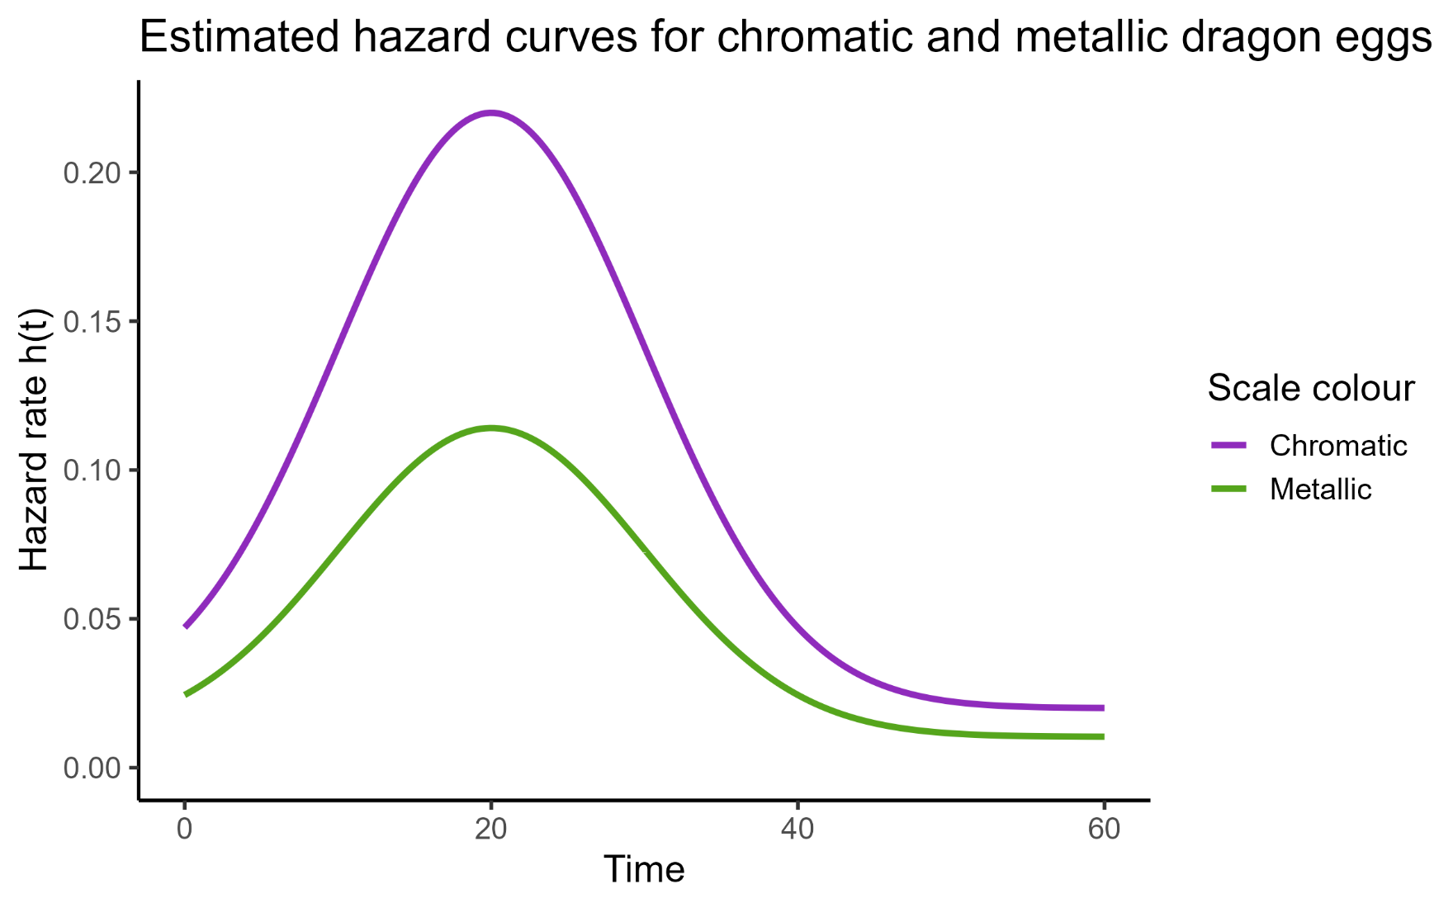
Hazard ratios for categorical predictors
Notes:
And then we can ask – how does changing the value of that predictor
(i.e., moving between the groups)
Affect the hazard?

Slide 100
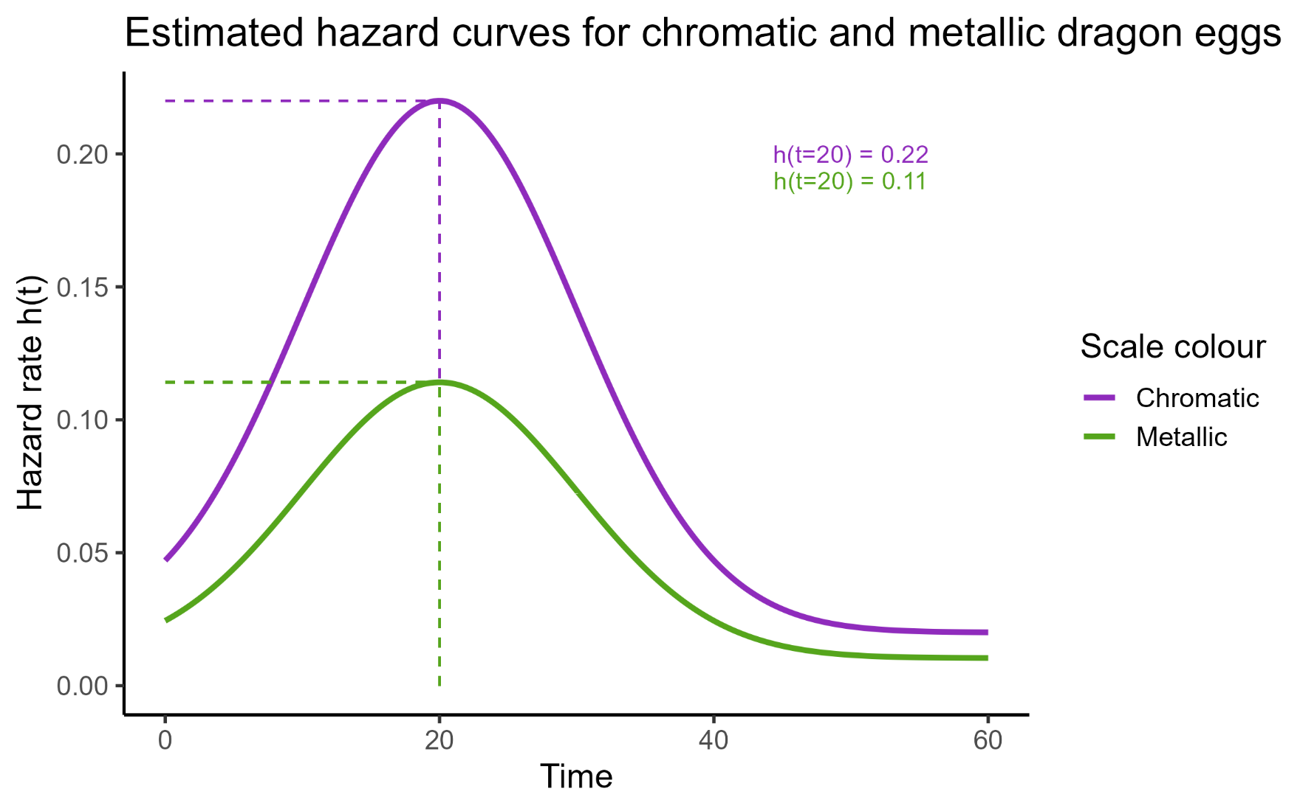
Hazard ratios for categorical predictors
Notes:
Well we can actually measure it
Let’s pick a specific time point, say t=20
The instantaneous hazard (risk of hatching) for the two dragons are shown
And the metallic dragons are at basically exactly 50% of the hazard of the chromatic ones

Slide 101
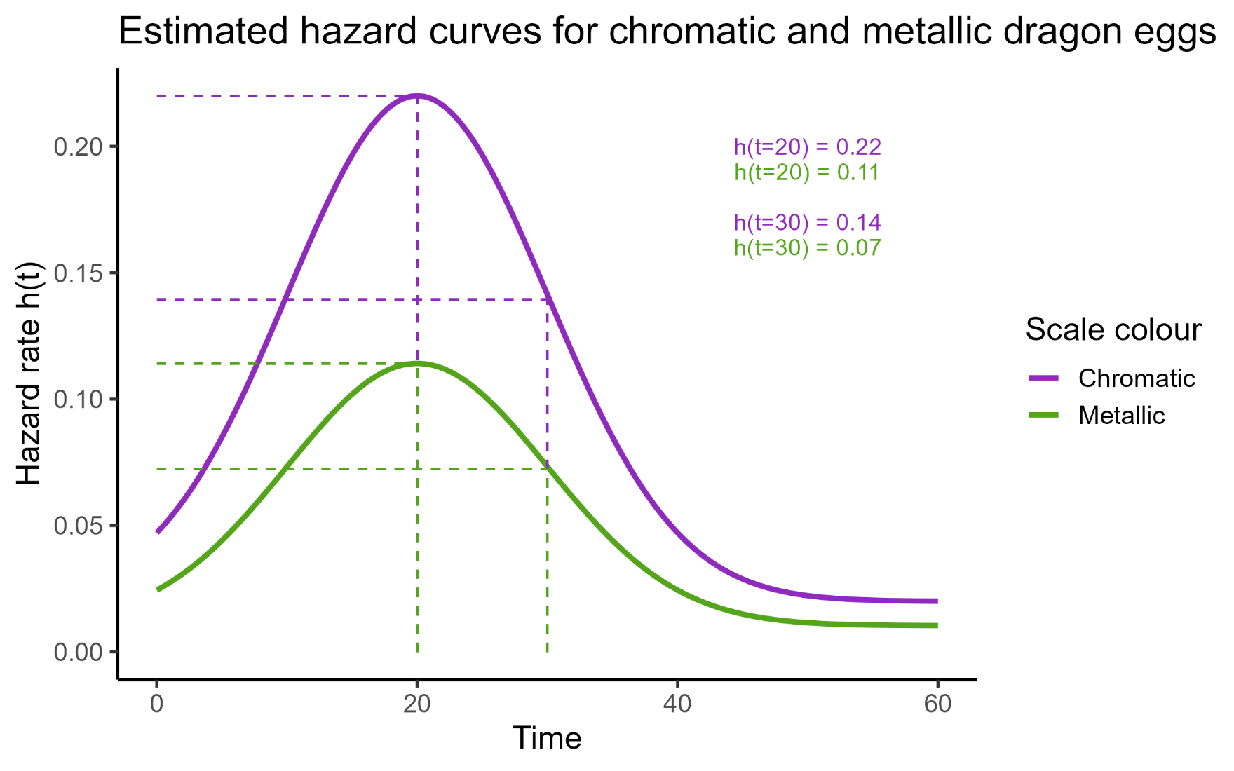
Hazard ratios for categorical predictors
Notes:
If we check a second time point, we see that it still holds true at 50%
Incidentally – this is a perfect visualisation of what we mean by proportional hazards!
The hazard ratio remains constant across all time points

Slide 102
Hazard ratios for categorical predictors
HR ≈ 0.5
Notes:
If we check a second time point, we see that it still holds true at 50%
So the hazard ratio is around 0.5
The hazard when we move from our reference group to our other group, decreases by a half

Slide 103
Hazard ratio
Size of hazard ratio tells you about the strength of the effect
HR > 1 increase hazard
HR = 1 equal hazard
HR < 1 decrease hazard
Note: choice of reference group matters!
Chromatic → metallic 0.5
Metallic → chromatic 2
Notes:
In our dragon example, when we chose chromatic as the reference group, we had an HR of 0.5
But if we’d chosen metallic as the reference group, it would’ve been 2 instead

Slide 104
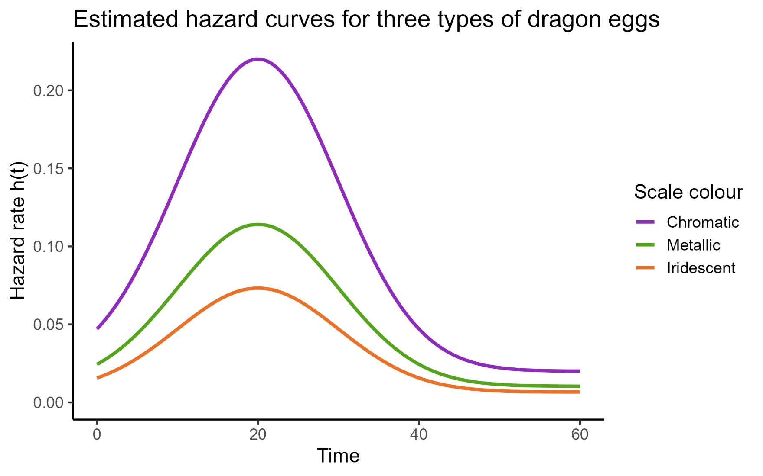
Hazard ratios for categorical predictors
Notes:
If we had a third category, the same principle applies
We ask how it compares against our baseline/reference group

Slide 105
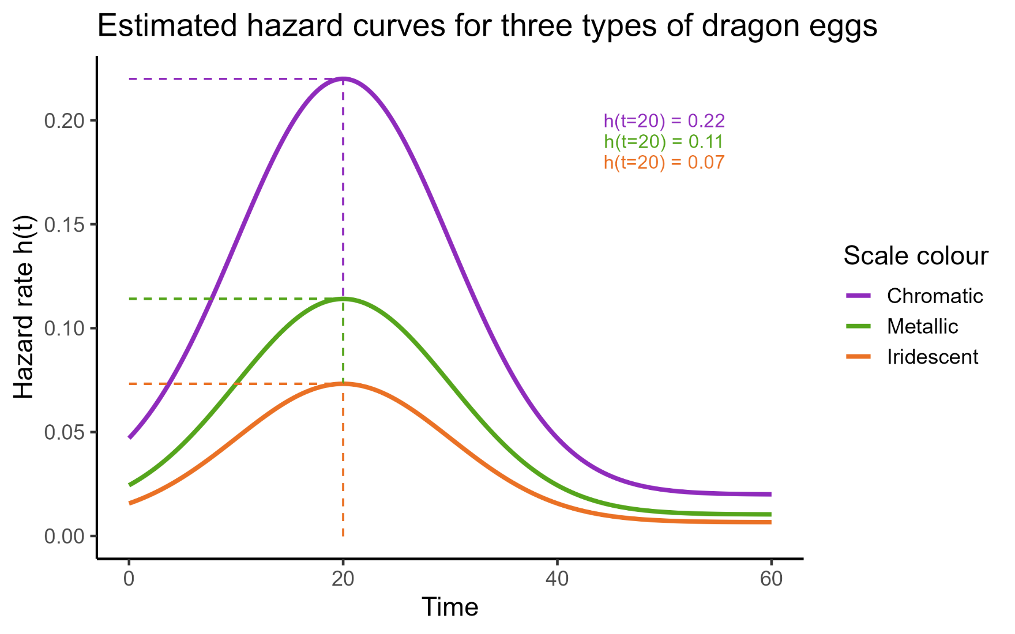
Hazard ratios for categorical predictors
Notes:
In this case, around a third

Slide 106
Hazard ratios for categorical predictors
HR ≈ 0.33

Slide 107
Hazard ratios for continuous predictors
So, what happens when the predictor isn’t categorical?
Start
Notes:
Let’s return to the weight example for a continuous predictor

Slide 108
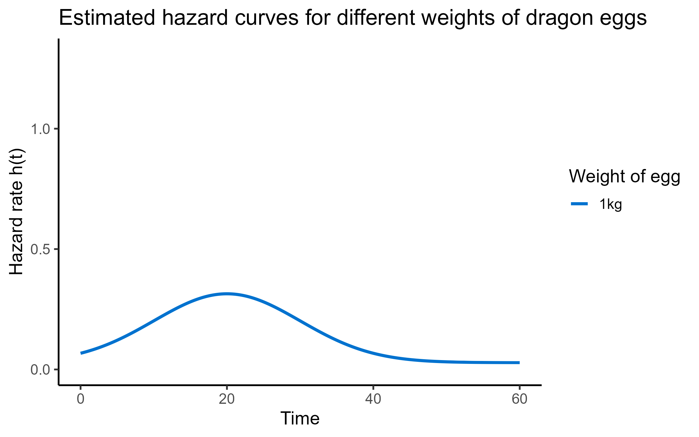
Hazard ratios for continuous predictors
Notes:
We do not need a reference group when the predictor is continuous
(Just like in regular linear modelling)
Instead, a value of 0 gets chosen as the “reference” or baseline
But, since a 0kg egg means nothing to us, let’s start by looking at a 1kg egg instead
(It’s not going to affect our calculation or interpretation!)

Slide 109
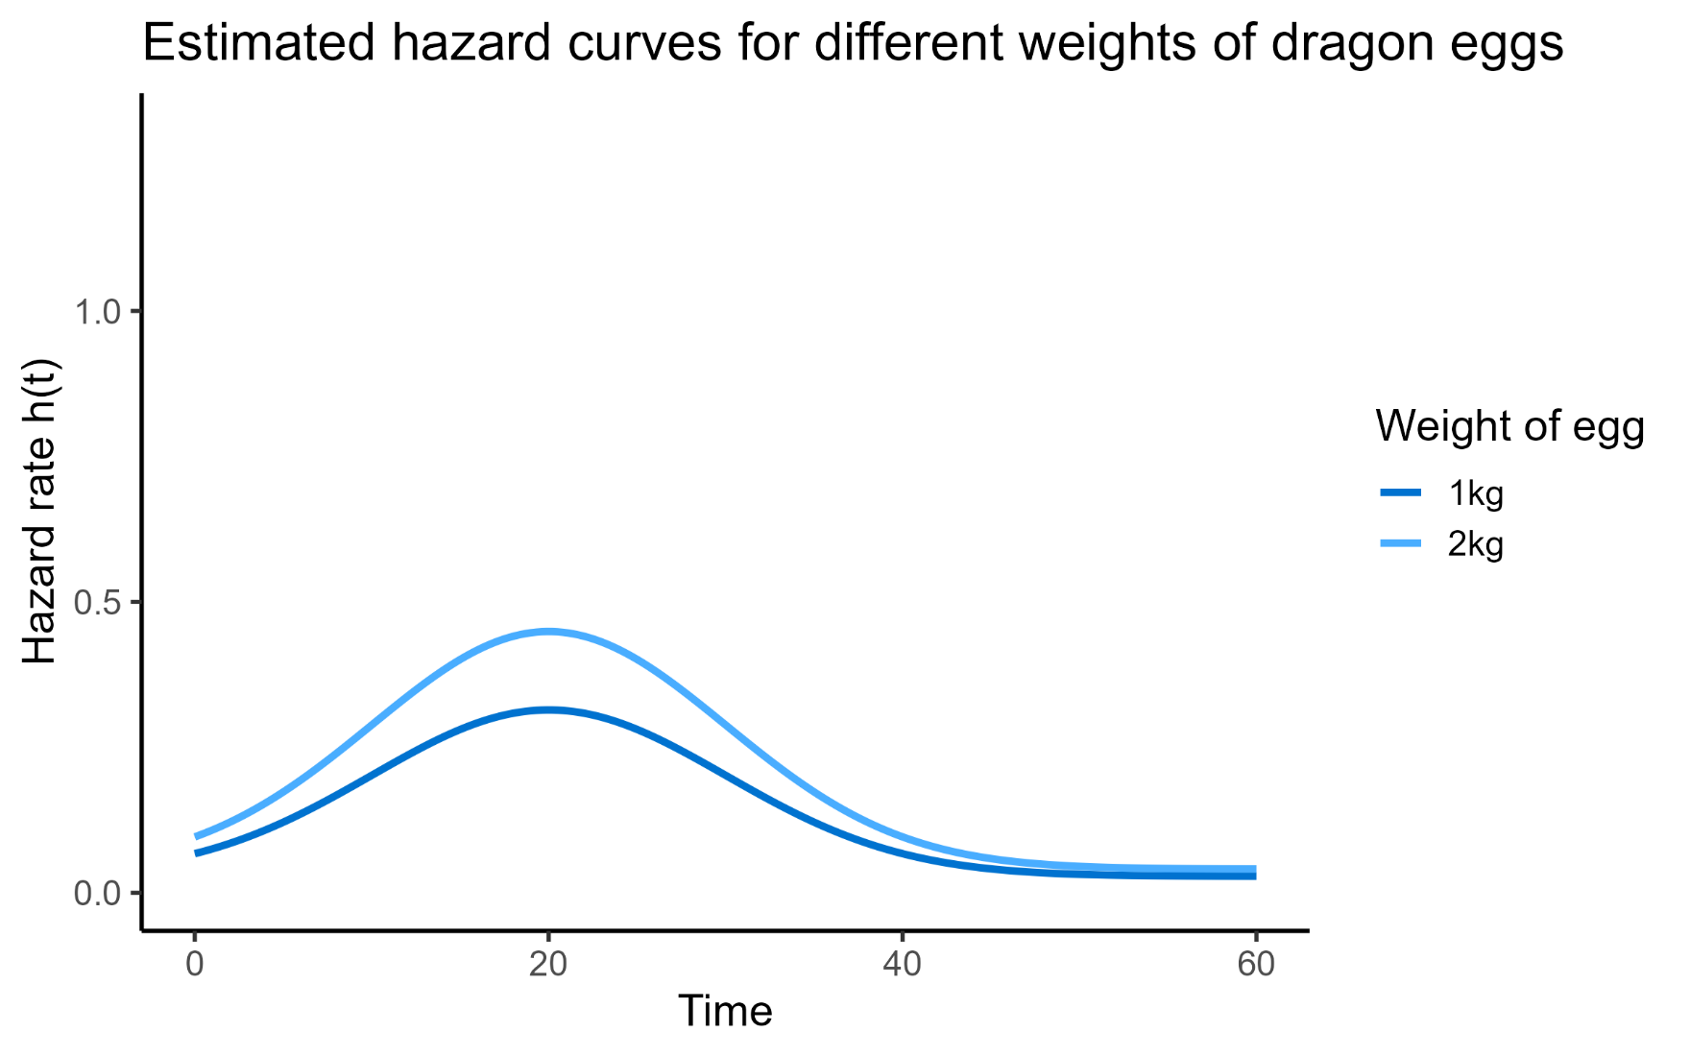
Hazard ratios for continuous predictors
Notes:
What happens when we increase the value of our x-predictor variable by one unit?

Slide 110
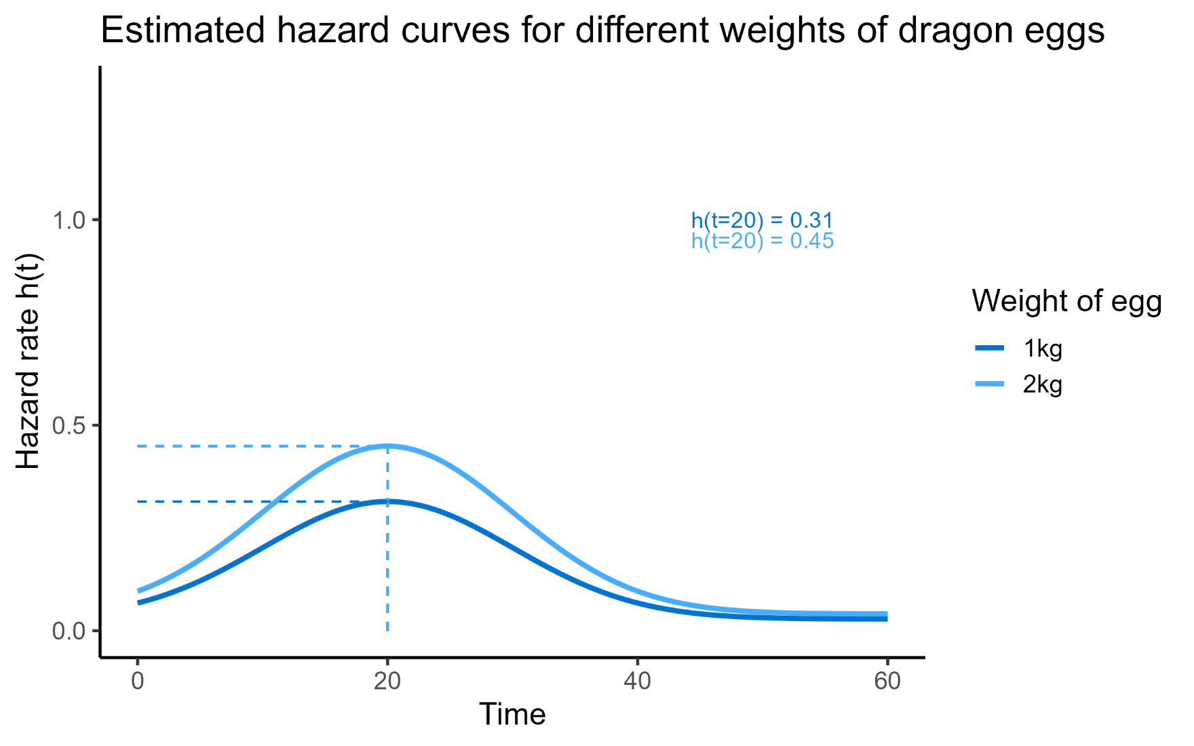
Hazard ratios for continuous predictors
HR ≈ 1.5
Notes:
We see that the hazard changes
And in fact the hazard ratio here is 0.45/0.31 – approximately 1.5
So: as the egg gets heavier, the hazard is increased
(Since our HR > 1)
Note: if we constructed two survival curves, one for 1kg and one for 2kg, what would they look like relative to each other?
→ 2kg would drop away faster

Slide 111
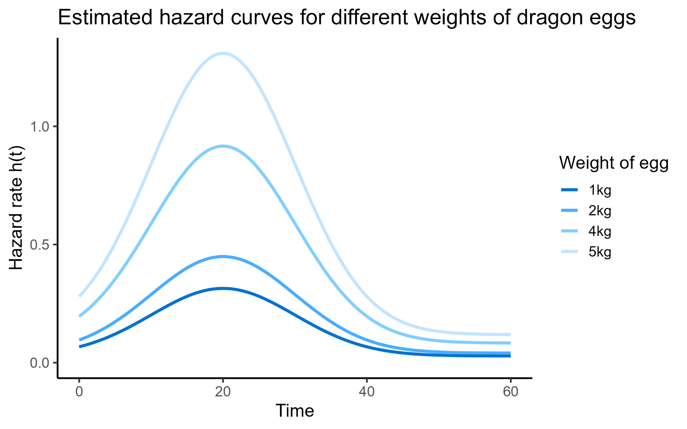
Hazard ratios for continuous predictors
Notes:
But with a continuous predictor, there are an infinite number of values that we could test
What if instead of 1 vs 2, we chose 4 vs 5?

Slide 112
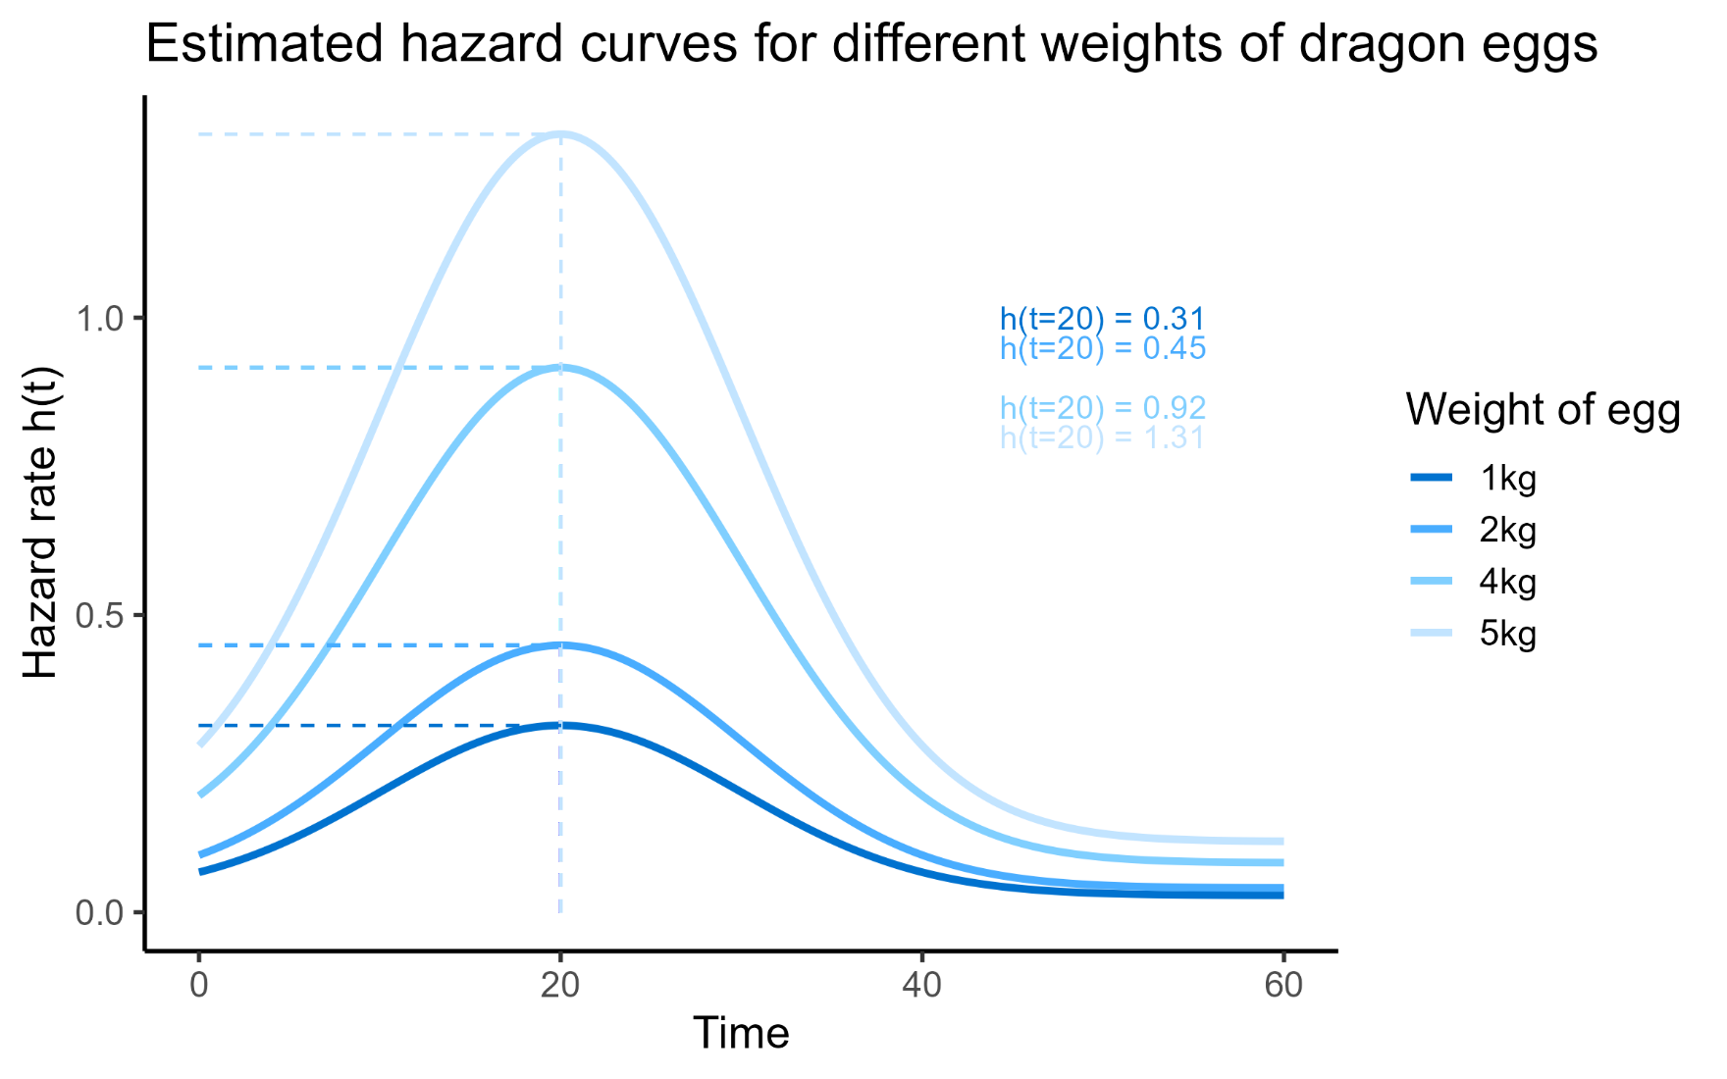
Hazard ratios for continuous predictors
HR ≈ 1.5
Notes:
It doesn’t change the HR
For a continuous predictor, the HR is all about what happens with a single unit change
So 0.45/0.31 = 1.5
And 1.31/0.92 = 1. 5

Slide 113
Summary: Hazard ratios
Can calculate a hazard ratio for each predictor
Size (relative to 1) of hazard ratio tells you about the strength of the effect
For categorical predictors: how much does the hazard change as you move from the reference group to another group?
For continuous predictors: how much does the hazard change for each one-unit increase?

Slide 114
Summary: Cox regression
Allows us to incorporate continuous and multiple predictors
Predict survival probability
Estimate hazard ratios
Test significance/confidence
Shares assumptions with the log-rank test, plus:
  Linearity
  Time-independent predictors

Slide 115
Survival (time-to-event) analysis
Cambridge Centre for Research Informatics Training

