Slide 1


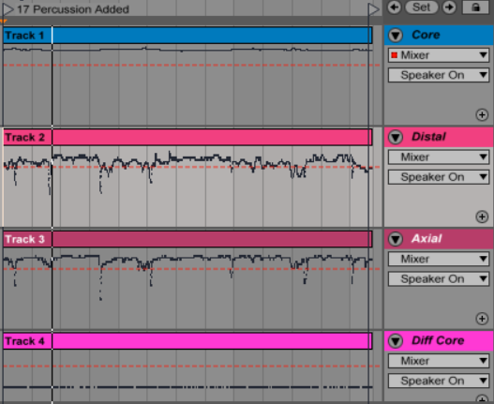
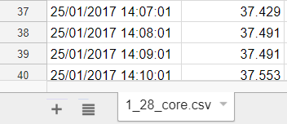
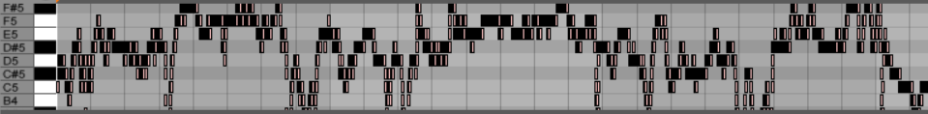
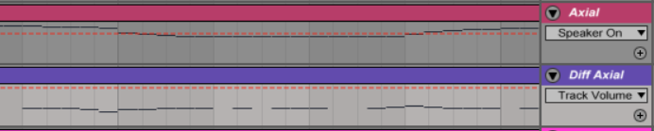
Data Sonification Using Pretty_MIDI and Jupyter Notebook
Camellia Boutros
University of California Santa Cruz, Jack Baskin School of Engineering
ABSTRACT
PROCESS
RESULTS
Conclusions
Data sonification has received some attention in the past, particularly in the 70s as an attempt to create art and more recently as a potential tool in medicine. The most famous of these have used EEG data to create sound, such as Alvin Lucier’s audification projects and recent research undertaken by CCRMA at Stanford; yet there has been little expansion in coordinating multiple datasets, and further attempts to leverage audio to perceive data are few and far between. While exploring these projects, I came to the conclusion that periodic data, such as circadian and ultradian rhythms that occur in human biology, would be extremely suitable to sound mapping. This project embarks on a journey in circadian rhythm sonification by taking various temperature data sets of one subject from a csv file and mapping them to sound in a way that accurately reflects patterns in the data (and between the different sets). The result is one solid step towards a long-ranging goal of coordinating multiple types of circadian and ultradian data to sound in order to reflect a comprehensive overview of the changes within a human body in relation to time. What I have found is that sound is an underutilized but illuminating way to perceive data, one that is potentially more naturally suited to some types of data than the typical visual methods we currently use to representation them.
Building on the history and on the massive availability of technological resources available today, I decided I wanted to begin sonifying specifically human circadian rhythms with the ultimate goal of being able to sonify multiple rhythms from a singular source in a way that is accurate, comprehensible, meaningful in demonstrating the relationships between different rhythms, and easy (even beautiful) to listen to. In other words, I wanted to build a kind of “human symphony” that is informative as well as beautiful. There are many approaches to doing this, as well as many potential pitfalls for inaccuracy.
In the first step, I started out small, choosing three temperature datasets (core, distal, and axial) taken from one subject over a three day period. Originally, I converted the data from a measurement of Celsius to a MIDI note number using the standard frequency-to-MIDI conversion formula (see section on Materials & Methods) and tweaked the values to fit a range where all the data could be perceived, but later would adjust this process so that the piece was not in Equal Temperament tuning, the notes were spread over the same octave ranges, and the math was based on normalized values. There was also the problem that the data came from one person over the course of 72 hours, but the resolution is one sample per minute — much to slow for the ear to pick up any patterns. So I compressed the data by treating each minute like a tenth of a second — the whole piece shrinks from 72 hours to around 4 minutes in length.
After producing a piece that really was the sonified data from three correlated sets, I wanted to go back and really refine what I had; in other words, I wanted to dive deep into the data I already had and retrieve more information from it, as well as make their sonified representations much more accurate and meaningful. It was necessary, for example, to adjust the ranges and pitches so that they more realistically correlated to the data. First, all temperature values across the three datasets had to be normalized using the global minimum and maximum values; then Pretty_MIDI’s pitch bending functionality could be applied to develop control for mapping numbers to note values without “bucketing” them via the standard 12-tone division of the octave, a common (and arbitrary) feature of Western music, as well as a default of MIDI notation. Needing a range large enough for a non-musician to detect subtle shifts in pitch, I chose the octave spread for all three sets to be from the floor frequency A4 (440 Hz) to A6 (1760 Hz), a 4:1 octave ratio. To achieve this mapping from the normalized Celsius value I devised a formula, with the adjustable parameters being Floor Frequency and Octave Ratio (see section on Materials & Methods).
From there I was able take the original frequency-to-MIDI conversion formula and use the remainder of the frequency float value to retrieve an accurate pitch bend value (only whole numbers are used for the MIDI conversion), and set the MIDI note number and pitch bend value to a time value, which was a tenth of a second for one minute of data.
At the end of this step all the data was objectively represented in a non-tuned system, with all the datasets spread across the same ranges.
The next step was to apply different statistical methods and mathematical equations to the data, the most interesting being the first order differential equation. After doing this to the original sets, I now had three completely new arrays to sonify. Finally, I added a percussion track containing event information, signifying when in each individual set we reached the overall maxima and minima data point.
What we now had at the end of this part of the project were the three normalized and pitch bended data sets, their corresponding and almost percussive difference equation sets, and an event-related percussion track that indicated important moments in the original datasets. At this point, the project is in its second phase: still a far from the final destination, but definitely a well-formed structure built on a solid foundation.
As of the current state of the project, all immediate goals have been met. Outputs of the project include*:
Software which takes several related datasets in csv format and accurately outputs a sound recording comprised of the data and statistics performed on it
New datasets obtained from the original three: three corresponding difference equation sets and an event-related percussion track, in addition to the normalized and pitch bended versions of the original sets.
Sound recordings: several versions, all reflecting the same information but with aesthetic parameters experimentally adjusted. Examples of controllable parameters that only affect listening experience (and not the data outputs) include instrumentation/timbre, volume, and range.
* Recordings and code, including the IPython Jupyter Notebok, may be found via the following Google Drive link: https://drive.google.com/drive/folders/0B2wozRID2keMdWxmLTkyUF9ZM0U?usp=sharing
While the project in its current form is now interesting and useful from both a musical standpoint and a scientific one, the next steps are to add more breadth and more depth to it: breadth in terms of new datasets, and depth in terms of deeper, more revealing statistics. These first few steps have constructed and refined the accuracy of the sonifications and made them bearable to listen to; I now want to further improve the piece from an aesthetic standpoint and expand the project to include additional circadian rhythms. Ms. Grant, her peers, and I are continuing this project and working together to optimize it for their research; in this case, that means the best musical outcome as well, as the whole purpose of this experiment is to create music that reveals something important about the numbers that created it. Recently we obtained EEG, EGG, EKG, and activity datasets, and these will soon be integrated into the sonification process with concurrent temperature data. Farther down the road, we would like to attempt mapping this data in real-time, with a human wearing sensors, without having to translate to MIDI first. This step, should it come to fruition, would make the piece truly generative (the composer would really only be adjusting equations and choosing parameters), and could also be a more responsive tool for investigating the human body. Possible uses of technology like this outside of research would be as a medical monitoring tool, either for laymen interested in their own health, or for medical professionals who often find their visual faculties occupied and would benefit from a device that can output data aurally.
OBJECTIVES
-Immediate Objective: Develop a method to sonify multiple human circadian rhythms from a singular source in a way that accurately represents the data and illustrates relationships inherent to it
-Immediate Objective: Render sonifications so that they are beautiful and easy to listen to, in addition to being clear and accurate, promoting listening over long periods of time. This is an important consideration if this technology is to eventually be used as a monitoring tool for medical information.
-Immediate Objective: Discover which analytical methods are worth taking and sonifying to highlight subtle yet significant changes in the data over time.
-Long term Objective: Add complexity in terms of additional datasets and statistical methods, and sophisticate the process so that data is streamed to sound in real-time.
REFERENCES
1. Colin Raffel and Daniel P. W. Ellis. Intuitive Analysis, Creation and Manipulation of MIDI Data with pretty_midi. In Proceedings of the 15th International Conference on Music Information Retrieval Late Breaking and Demo Papers, 2014.
2. Haas, Roland, and Vera Brandes. Music that works Contributions of biology, neurophysiology, psychology, sociology, medicine and musicology. Vienna: Springer Vienna, 2009. Print.
3. "New Device Listens to Brain, May Help Epileptic Patients ..." N.p., n.d. Web. 14 Feb. 2017.
4. Rosenboom, David. Biofeedback and the arts: results of early experiments. Vancouver, B.C: A.R.C. Publications, 1976. Print.
FINDINGS: WHAT DOES IT SOUND LIKE?
Listening to the final recordings, I was for the first time surprised and fascinated by what I heard; the pitch bending is eerie and gives the piece a feeling of life, as opposed to the static and repetitive predecessor in the first cut. The researchers agreed, though they were more impressed by the level of accuracy the sonification had now attained.
Analyzing the data mathematically and sonifying function outputs proved to yield the most interesting sounds. Covariance and correlation confirmed the obvious, which was that the distal and axial sets were positively correlated, and both inversely correlated with the core dataset. What was more interesting was creating new arrays from the existing sets using first-order differential calculus; doing this for all datasets, I now had three completely new arrays to sonify. Leaving out values of zero (indicating no change from one sample to the next), what could be heard was a meaningful accompaniment to the data that could communicate movement of the data. In fact, with the original dataset MIDI turned off, the difference equation MIDI could accurately convey a sense of the data, although now the piece was pointillistic rather than three streams of sound, which proved a more efficient and clear way of perceiving the data. Using the second order derivative, this concept could be taken further to reveal things like local minima and maxima. Adding the global maxima and minima for each individual dataset to a percussion track clearly indicated while listening the points in the recording where we reached a peak or valley in temperature. The recordings were successfully communicating meaningful information about the data, and we were understanding it intuitively. Ultimately, we were experiencing how useful it was to listen to the data in this way.
While I am still experimenting with timbres and octave ranges, I am constantly learning more about the data as it is being revealed to my ears, like unexpectedly frequent events, or the confirmation of periodic “cluster points” between the sets.
MATERIALS & METHODS
Software:
-Python version 2.7, IPython, Pretty_MIDI (IPython Library), Jupyter Notebook, Ableton Live (Digital Audio Workstation)
Hardware:
-Temperature sensor: Currently in development at UC Berkeley with commercial use as the long term goal. Takes measurements in Celsius at a resolution of one measurement per minute.
Data:
-Three temperature datasets (core, distal, and axial) taken from one subject, Azure Grant, a student researching circadian rhythms at UC Berkeley, over a three day period.
Mathematical Methods:
-Standard frequency-to-MIDI conversion formula:
MIDI # = 69 + 12 log2(freq. / 440 Hz)
- A formula I developed to map the normalized Celsius values across any octave range:
Frequency = (Octave Ratio) ^(Normalized Celsius) * Floor Frequency
* Octave Ratio is the ratio of octaves to Floor Frequency
CONTACT
For further information, contact Camellia Boutros at cboutros@ucsc.edu.
ACKNOWLEDGMENTS
I would like to thank Larry Polansky, composer and Professor of Music at UC Santa Cruz, and Charlie McDowell, Professor of Computer Science at UC Santa Cruz. Their support and guidance went well beyond what an undergraduate student would expect from members of faculty, especially when they are so occupied with interesting and exciting projects of their own.
Special thanks is also due to Azure Grant and her lab at UC Berkeley, who graciously and freely let me make use of data they have collected in pursuit of their own research.

