Slide 1
Kinematics II (Week 3)
F=ma Course Series
Cambridge Physics Academy

Slide 2
Warm up
Monkey
The classic monkey problem: An apple hangs from a tree, and a bow and arrow is aimed directly at the apple in the tree. Show that if the apple drops and the bow are fired at the exact same time, the arrow will always hit the apple.
(use an accelerated reference frame!)

Slide 3
In class today
2-D Kinematics
3.1. Projectile motion
3.2. Olympiad kinematics
3.2.1. Constraints and projections
3.2.2. Rotated reference frames
3.2.3. Moving reference frames
3.2.4. Reflections

Slide 4
Idea 3.1:
Projectile motion
Definition: When a projectile moves through multiple dimensions, its motion in those dimensions can be treated independently
y-directional motion often determines how long an object is in the air for
A projectile experiences no gravitational acceleration in the x-direction
Combine information in both dimensions to derive the trajectory of the projectile

Slide 5
Example
3.1. Projectile motion
A ball is thrown from the ground, upward at a speed $v$ and angle $θ$ relative to the horizontal. Find the distance the ball travels before it hits the ground.

Slide 6
Problem
3.1. Projectile motion
A ball is thrown horizontally at speed $v$ off a cliff of height $h$, where the gravitational acceleration is $g$. Find the distance the ball travels before it impacts the ground.

Slide 7
Solution
3.1. Projectile motion
A ball is thrown horizontally at speed $v$ off a cliff of height $h$, where the gravitational acceleration is $g$. Find the distance the ball travels before it impacts the ground.
$$d=v\sqrt{\frac{2d}{g}}$$

Slide 8
Problem
3.1. Projectile motion
A bow and arrow is aimed directly at an apple hanging in a tree at height $h$ above the ground and horizontal distance $D≫h$ from the bow. The instant the apple falls from the tree, the arrow is released. Find the minimal starting speed the arrow needs in order to hit the apple while it is still falling in the air.

Slide 9
Solution
3.1. Projectile motion
A bow and arrow is aimed directly at an apple hanging in a tree at height $h$ above the ground and horizontal distance $D$ from the bow. The instant the apple falls from the tree, the arrow is released. Find the minimal starting speed the arrow needs in order to hit the apple while it is still falling in the air.
$$v=\sqrt{\frac{gD^{2}}{2h}}$$

Slide 10
Idea 3.2:
Olympiad kinematics
Definition: There are some common tricks that show up in olympiad problems
3.2.1: Constraints and projections
3.2.2: Rotated reference frames
3.2.3: Moving reference frames
3.2.4: Reflections

Slide 11
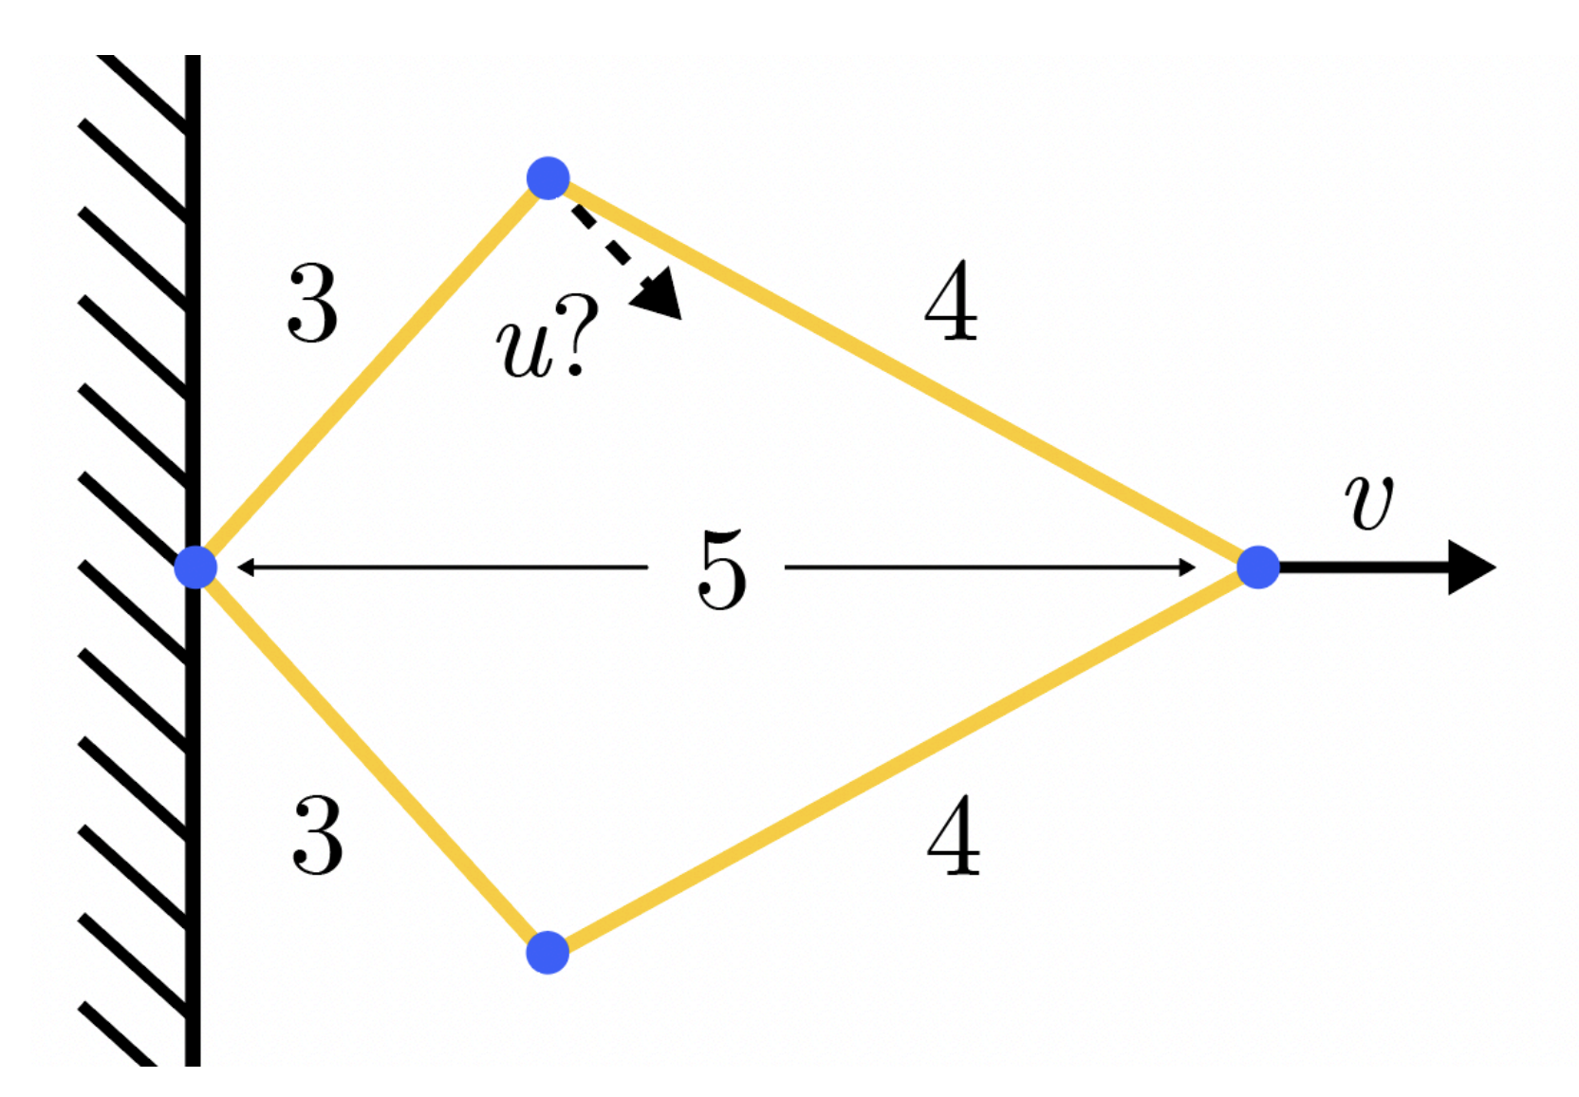
Example
3.2.1. Constraints and projections
A contraption made of four sticks is made with dimensions as shown (in meters). The sticks are connected by joints upon which they can freely rotate. One end of the contraption is attached to the wall and the other is pulled at a speed as shown. What is the speed of the indicated joint at the given moment?

Slide 12
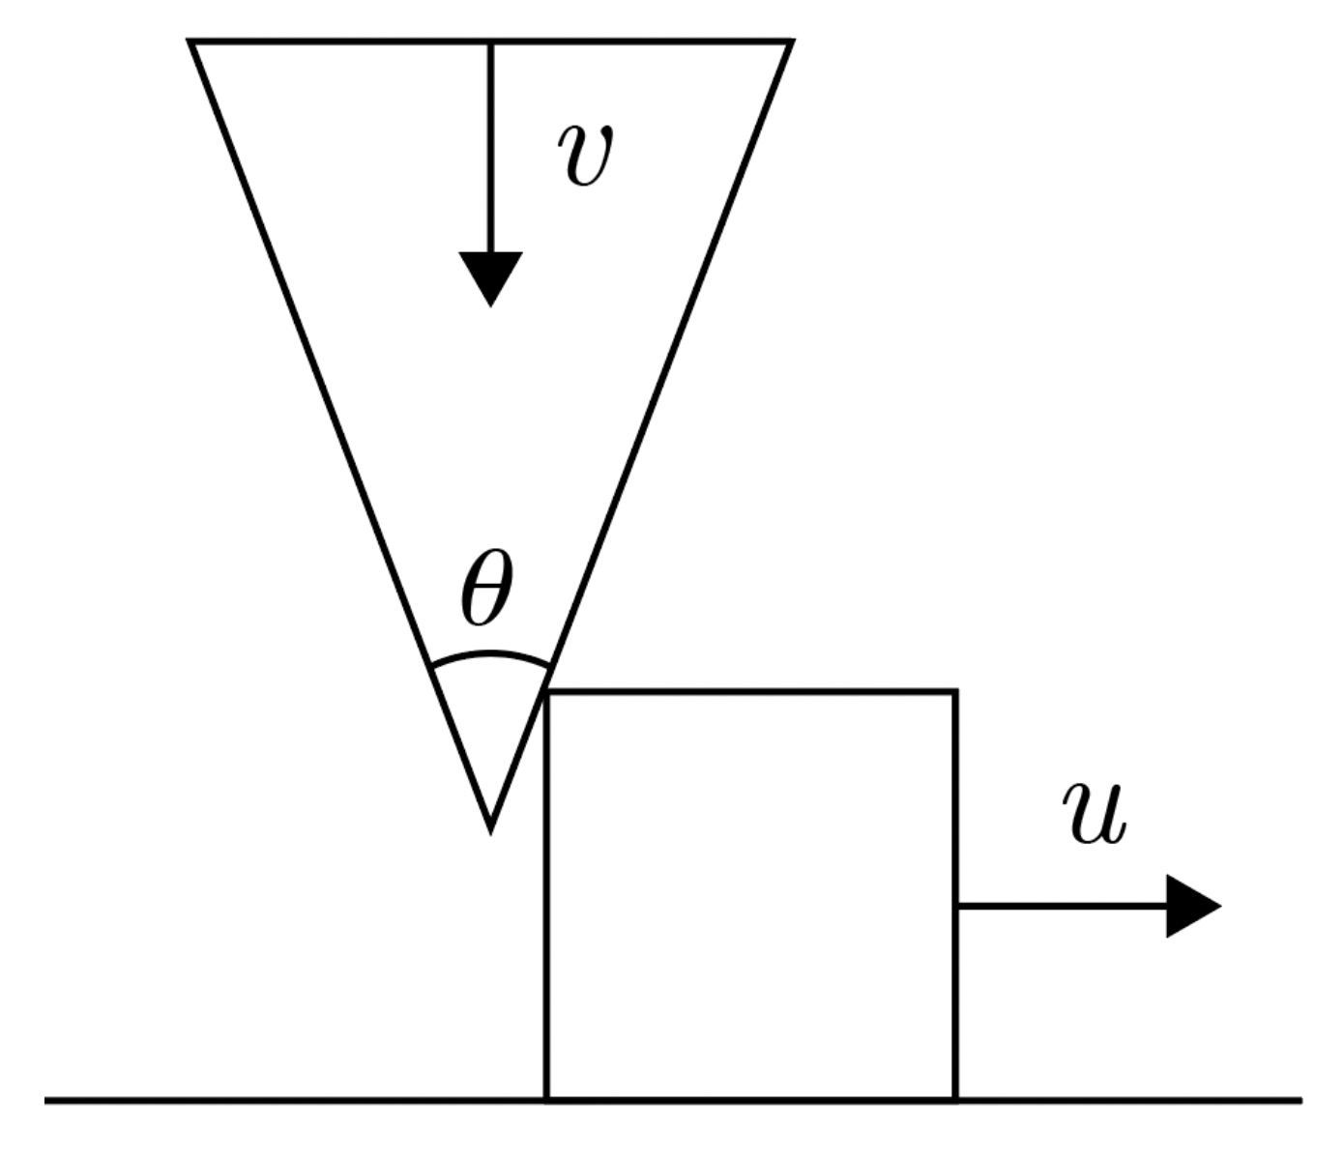
Problem
3.2.1. Constraints and projections
A cannon system is used to shoot a projectile to the right. An infinitely heavy wedge is dropped from a high altitude on a solid block as shown. On impact, the wedge moves at a terminal velocity $v_{0}$. Find the speed $u$ of the block in terms of $v_{0}$ and $θ$.

Slide 13
Solution
3.2.1. Constraints and projections
A cannon system is used to shoot a projectile to the right. An infinitely heavy wedge is dropped from a high altitude on a solid block as shown. On impact, the wedge moves at a terminal velocity $v_{0}$. Find the speed $u$ of the block in terms of $v_{0}$ and $θ$.
$$u=vtan\frac{θ}{2}$$

Slide 14
Example
3.2.2. Rotated reference frames
A ball is dropped a perpendicular distance $d$ above an inclined plane at angle $θ$. Rotate the reference frame to show that the maximal distance the ball can reach from the plane is always $d$.

Slide 15
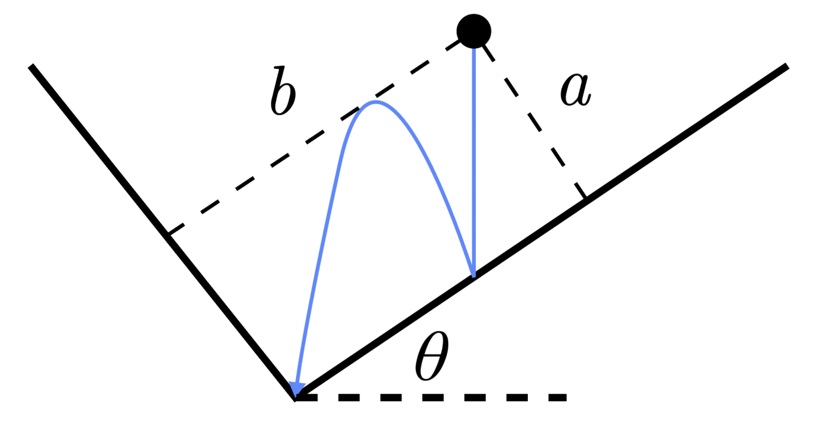
Problem
3.2.2. Rotated reference frames
Two perpendicular planes make a V-shape as shown. One is oriented at an angle $θ$ to the horizontal. A ball is dropped from rest a distance $a$ from the plane on the right. What must the distance $b$ the ball be from the left plane to bounce exactly once as shown before falling into the cusp?

Slide 16
Solution
3.2.2. Rotated reference frames
Two perpendicular planes make a V-shape as shown. One is oriented at an angle $θ$ to the horizontal. A ball is dropped from rest a distance $a$ from the plane on the right. What must the distance $b$ the ball be from the left plane to bounce exactly once as shown before falling into the cusp?
$$b=9atanθ$$

Slide 17
Problem
3.2.3. Moving reference frames
A block is sliding at speed $v$ in the $-y$-direction when it encounters a conveyor belt moving at speed $u$ in the $+x$-direction. The coefficient of friction $μ$ decelerates the block at a rate $a=μg$ while it’s on the conveyor belt. How long does it take for the block to come to rest?
(Hint: shift into the rest frame of the conveyor belt)

Slide 18
Problem
3.2.4. Reflections
A ball is thrown at 10 m/s at a 45 degree angle toward a wall that is 5 m in front of it. The ball bounces off the wall elastically and lands behind its launching point some time later. Find the distance between the landing and launching points.

