Slide 1
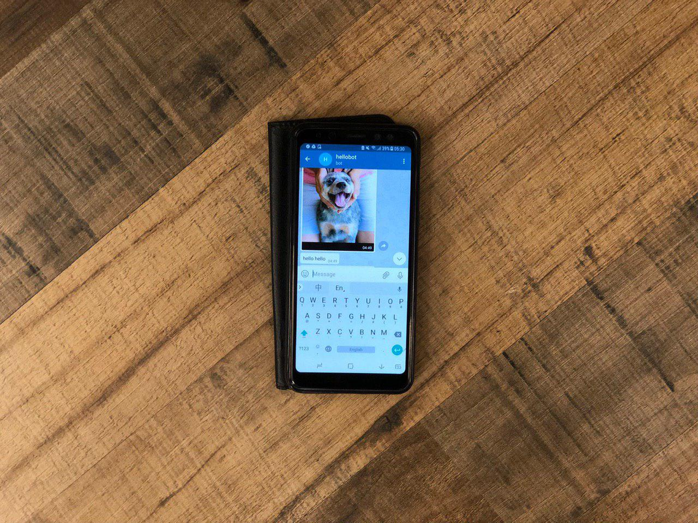
A
I
P
T
N
C
O
D
S
I
KOBE!!

Slide 2


Slide 3
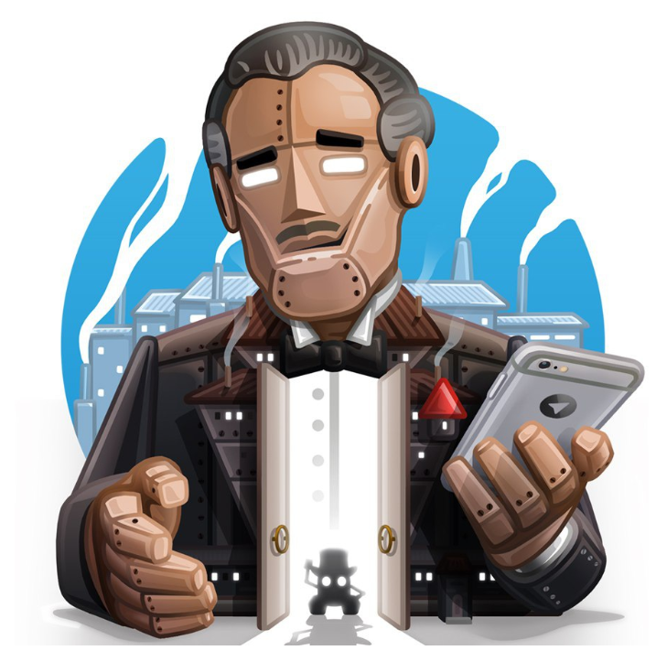
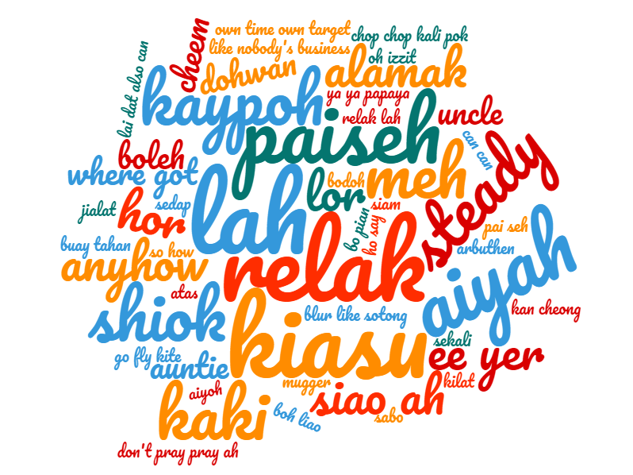

CAPTION DIS
1
User speaks singlish which can be stored as audiofile.
2
Audio file is converted to text and verified with user.
3
Where the converted text is incorrect, the user will help modify. All text are then stored.

Slide 4
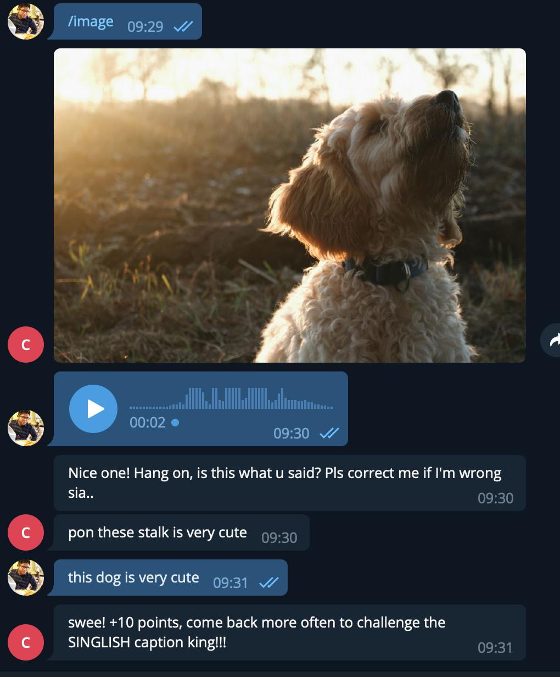
GAMEPLAY
Image is sent for player to input caption for
Player inputs caption through voice message (which is translated into text)
Bot double checks accuracy of speech to text conversion

Slide 5
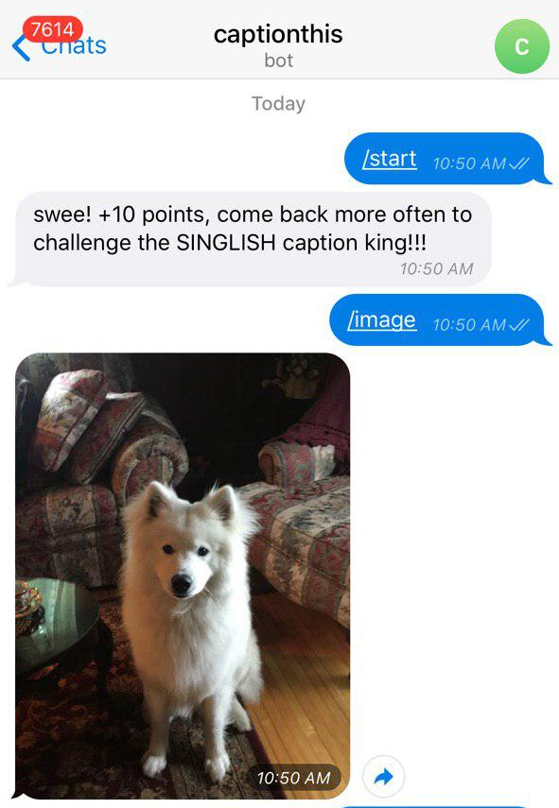
COMMANDS
/start
start the game
/image
get an image

Slide 6
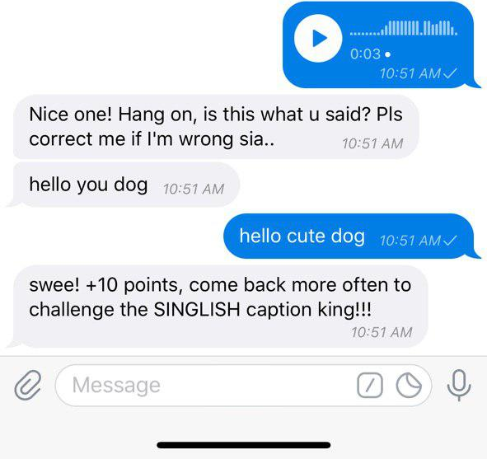
and then...
User replies with voice message
Bot processes speech to text
User verifies speech to text conversion

Slide 7

HOW TO WIN
Players connected to the Bot can vote for the caption they like. Caption with the most votes wins!

Slide 8
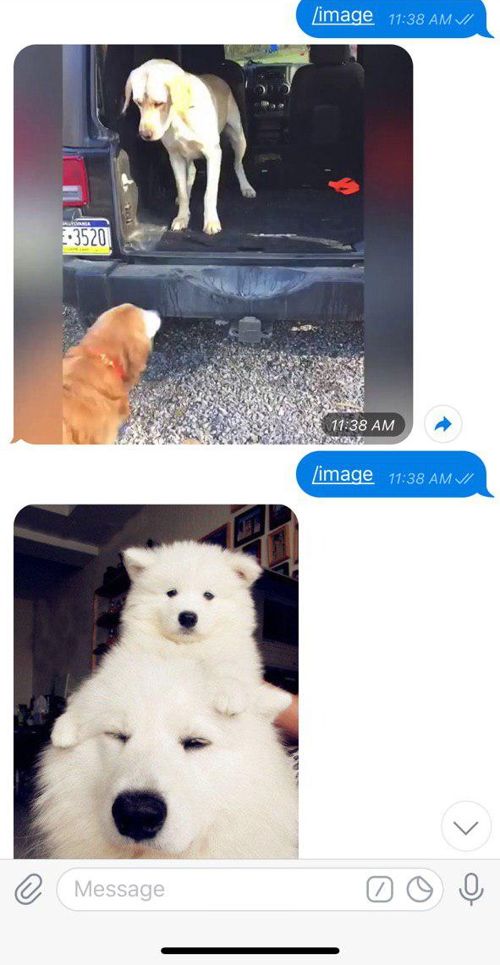
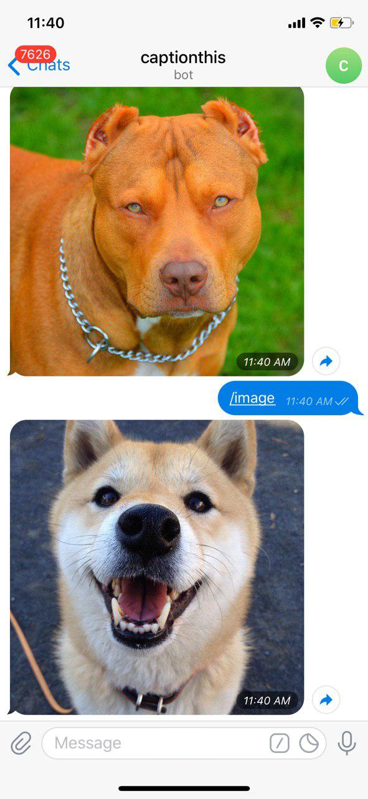
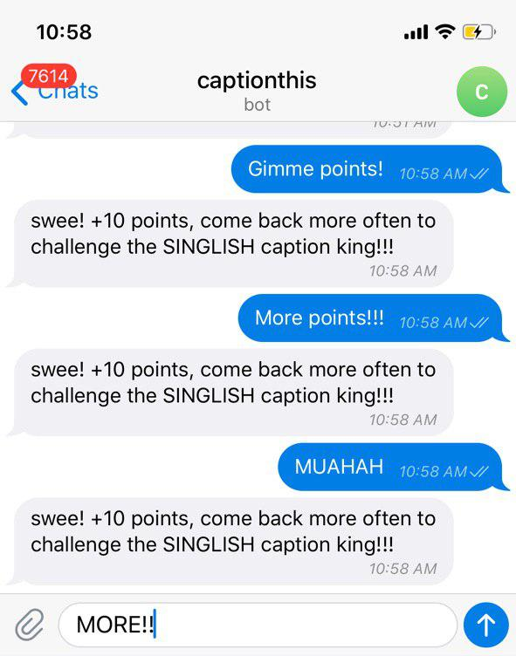
AREAS FOR DEVELOPMENT
1
Allow Bot mod to select media to send out.
2
Implement a voting system.

Slide 9
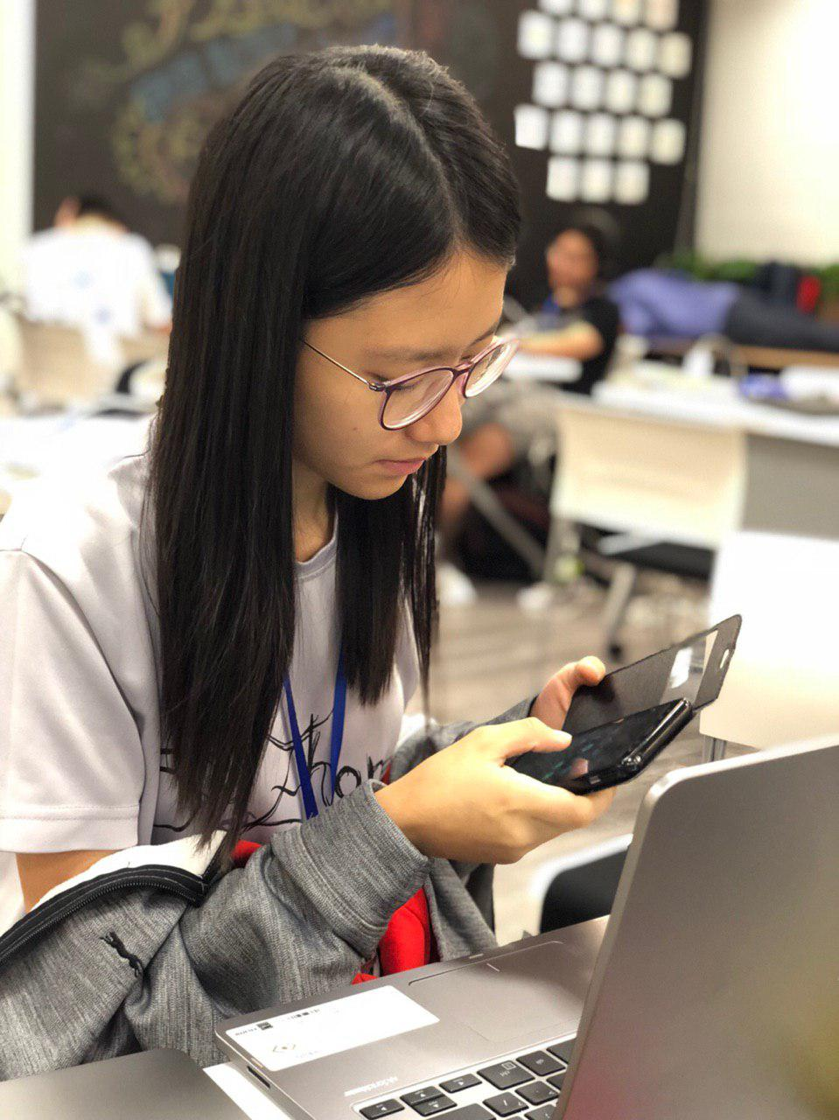
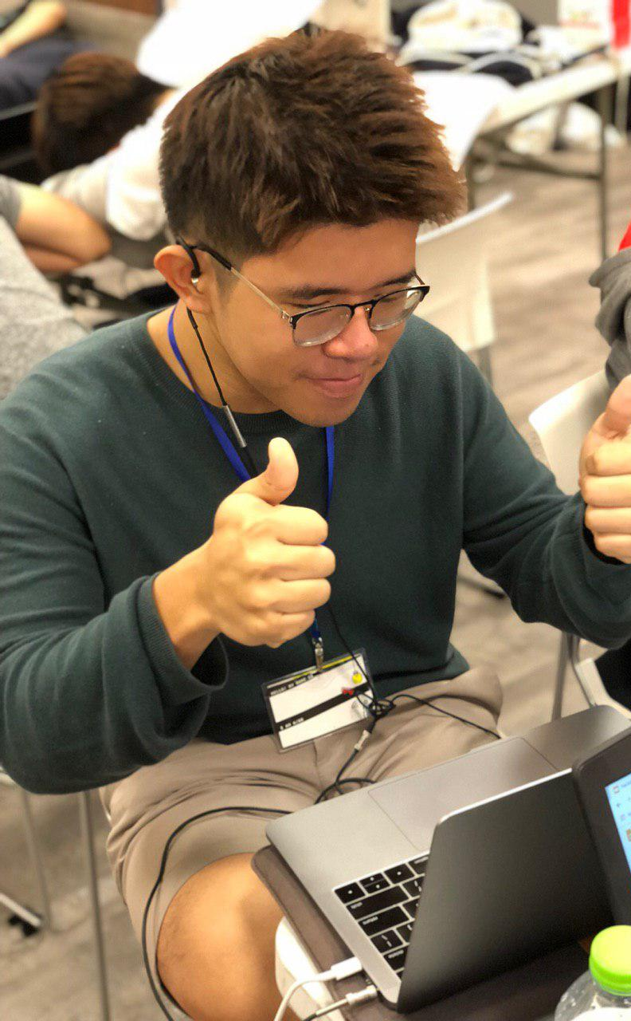
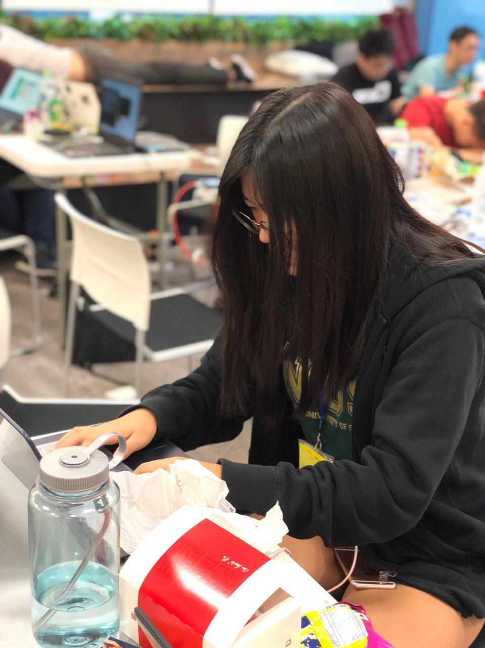
“MARKET TESTING”
“MARKET TESTING”

Slide 10
t
anot??
e
S
a
D
Y
try our bot on telegram @caption_this_bot

