Slide 1
EWAS-fusion

Slide 2
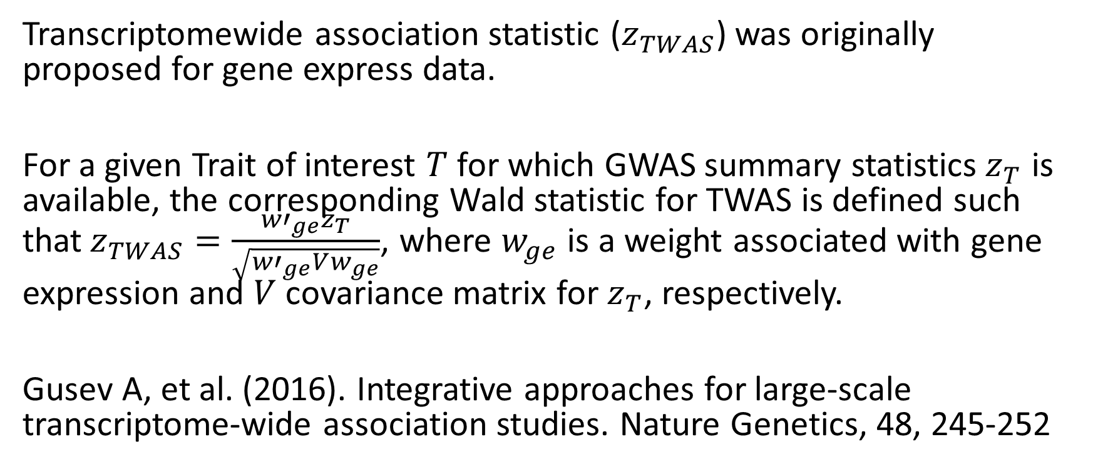
TWAS
Transcriptomewide association statistic ($z_{TWAS}$) was originally proposed for gene express data.
For a given Trait of interest $T$ for which GWAS summary statistics${ z}_{T}$ is available, the corresponding Wald statistic for TWAS is defined such that$z_{TWAS}=\frac{{w′}_{ge}z_{T}}{\sqrt{{w′}_{ge}Vw_{ge}}}$, where $w_{ge}$ is a weight associated with gene expression and $V$ covariance matrix for $z_{T}$, respectively.
Gusev A, et al. (2016). Integrative approaches for large-scale transcriptome-wide association studies. Nature Genetics, 48, 245-252

Slide 3
FUSION I
It stands for Functional Summary-based Imputation (FUSION)
It is a suite of tools for performing a transcriptome-wide (or any other ome-wide) association study by predicting functional/molecular phenotypes into GWAS using only summary statistics. The goal is to identify associations between a GWAS phenotype and a functional phenotype that was only measured in reference data.
This is a closely linked framework to MR, i.e,, for SNP-gene expression-trait association., e.g., Holmes MV, et al. (2017). Mendelian randomization in cardiometabolic disease: challenges in evaluating causality. Nat Rev Cardiol.

Slide 4
FUSION II
The FUSION framework has several advantages: 1. It integrates heritability estimation and covariate adjustment for whole-chromosomes with additional models LASSO, elastic net, BLUP and BSLMM. 2. It offers cross-validation, joint/conditional analyses with the output also informing top hit SNPs and inferred methylation quantitative trait locus (meQTL). 3. he new software uses modified GCTA software (gcta_nr_robust) leading to higher yield of probes with heritabilities reaching statistical significance, GEMMA giving BSLMM estimates and ability to align strands with reference panels. As both the increased number of models and cross-validation led to excessive computing time, we dropped BSLMM models and conducted five cross-validations.
Mancuso N, et al. (2017). Integrating gene expression with summary association statistics to identify susceptibility genes for 30 complex traits. American Journal of Human Genetics, 2017, 100, 473-487.

Slide 5
TWAS-Pipeline
twas.sh, twas-single.sh uses weights in the original paper in three populations, while gtex.* covers those for 53 tissues.
ge-fusion.* sets up TWAS using FUSION models for five expression weights, whereas gtex-fusion.* conducts FUSION analysis for all 43 tissues.

Slide 6
XWAS
Transcriptomewide association studies (TWAS)
Epigenomewide association (EWAS)
Proteomewide … (PWAS)
…

Slide 7
SNP
EWAS Reference panel
Methylation
SNP
(top1, blup, lasso, enet, bslmm)
LD Reference panel
(Bed, bim, fam)
GWAS summary statistics
SNP
Trait
(SNP, A1, A2, Z)

Slide 8
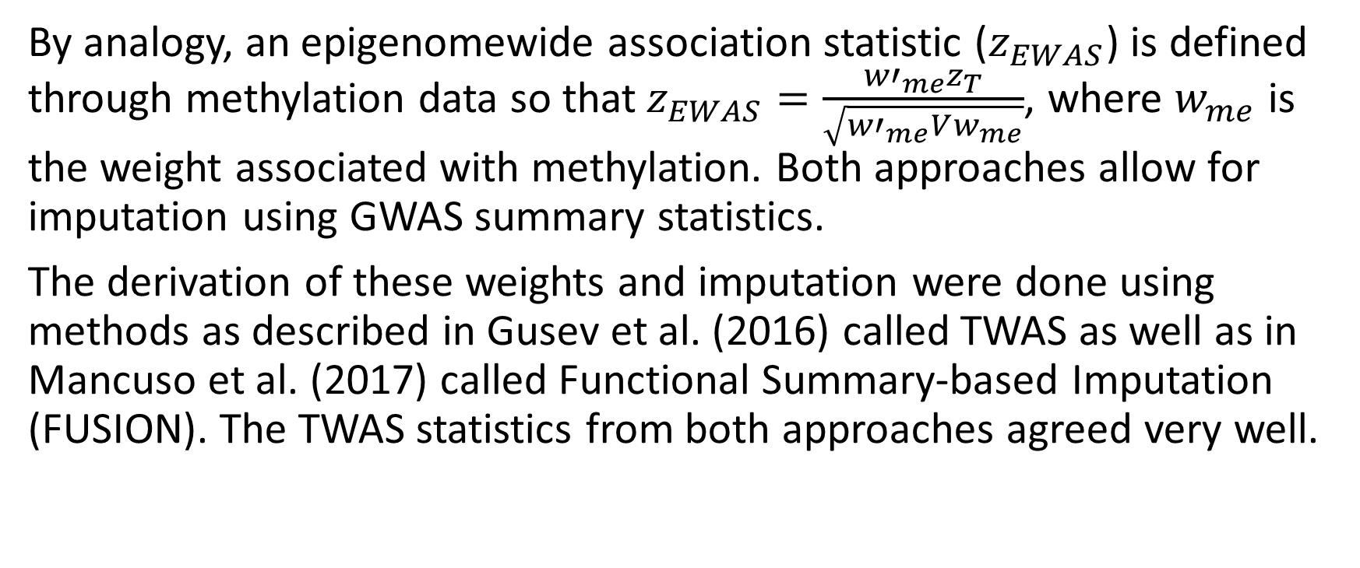
EWAS
By analogy, an epigenomewide association statistic ($z_{EWAS}$) is defined through methylation data so that$z_{EWAS}=\frac{{w′}_{me}z_{T}}{\sqrt{{w′}_{me}Vw_{me}}}$, where $w_{me}$ is the weight associated with methylation. Both approaches allow for imputation using GWAS summary statistics.
The derivation of these weights and imputation were done using methods as described in Gusev et al. (2016) called TWAS as well as in Mancuso et al. (2017) called Functional Summary-based Imputation (FUSION). The TWAS statistics from both approaches agreed very well.

Slide 9
EWAS-fusion I
EWAS-fusion is a sge/parallel implementation using weights generated from Illumina infinium humanmethylation450 beadchip analogous to TWAS.
get_weight.qsub is a revised script to generate probe-specific weights and ewas-fusion.sh is the script for association analysis both via sge.
Our reference panel for EWAS imputation contains 79,569 probes reaching the heritability p value threshold of 0.01. The association as well as joint/conditional analysis using our weights and LD panel is implemented in software called EWAS-fusion. Like the original TWAS, our implementation will enable a range of GWAS summary statistics to be used coupled with downstream analysis.

Slide 10
EWAS-fusion II
A total of 442,920 CpG sites based on Illumina humanmethylation450 chips on 1,146 individuals in EPIC-Norfolk study were available. Among these, 1,117 individuals also had genotype data from Affymetrix BioBank Axiom chips.
HapMap2 SNPs from genetic data of these individuals were extracted via PLINK2 according to cis-positions of each probe and subsequently used to build weight analogous to gene expression data as implemented in computer software TWAS.
We filtered probes according to their heritabilities estimated from software GCTA at significant level of 0.01. We then performed EWAS for given GWAS summary statistics. The weight generation and methylation imputation was implemented in software called TWAS-pipeline, which allows for whole epigenome computation.

