Slide 1
Business Dashboard – Café Shop

Slide 2
Content
Introduction
Why ?
How ?
Overview
Main card
Some basic chart
Business Performance
Summary card for each Store
Scoring
Planning
Forecasting
Inventory Turnover ratio

Slide 3
Introduction
WHY ?
This dashboard is built based on business data of the coffee shop chain in the first 6 months of 2023.
The dashboard will help me get an overview of the store's business activities over time, best-selling products, busy times of the day,...
HOW ?
This dashboard is built based on business data of the coffee shop chain in the first 6 months of 2023
Besides transaction data, I use some additional data about product types and product groups for analysis
Based on the content in the dashboard, I can come up with the next plan for my store. This will be discussed in the final section

Slide 4
Overview
The metrics I will use in the Overview dashboard
Group Metric | Metric | Define
GMV | GMV (Revenue) | Total GMV from 1/2023 to 6/2023, Can be divided by month or by store
 | Avg GMV per day | Average revenue from each/all store per day
 | %Target H1/2023 | = GMV / TargetGMV (Target GMV is a randomize number chosen by me)
Transaction | Number of Transactions | Number of Transactions by Time, Day or Month
And some analytical dimensions such as
By Store Location
Top & Bottom 5 product by Revenue/Transaction
By Time, Day or Month
...

Slide 5
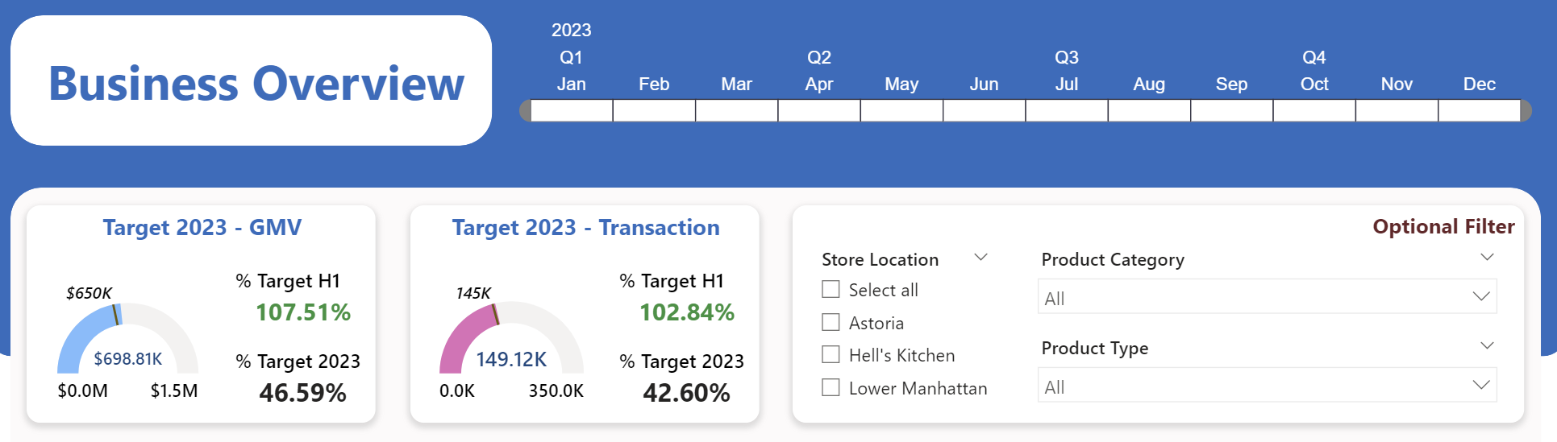
Overview
The time filter supports the time options on the report
Gause card, it displays your goals, % goals. Here I choose the goal of revenue and number of transactions
Filter your Location, Product Category & Product Type here. Your selection will be affected to dashboard

Slide 6
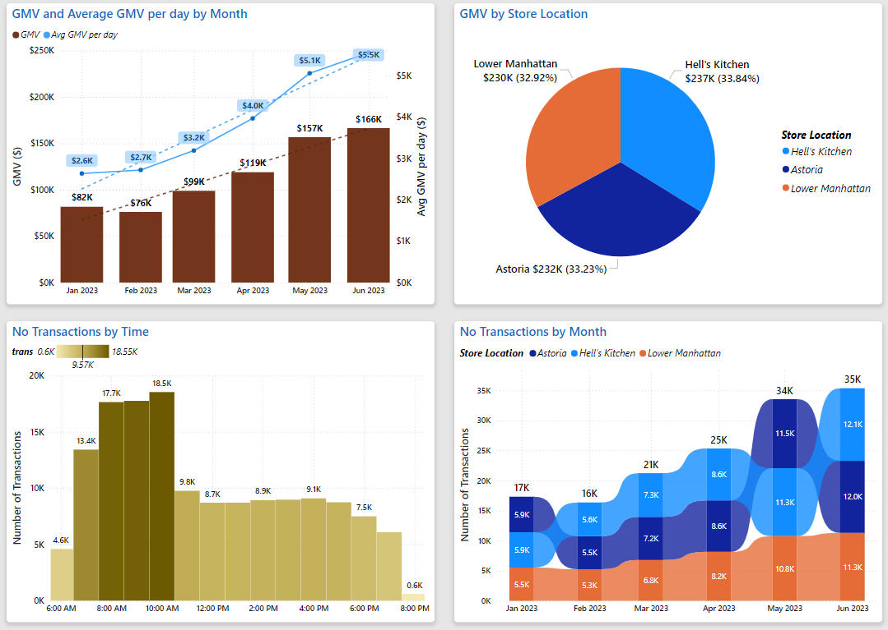
Monthly revenue, average daily revenue, revenue trend is shown through this chart
Pie chart supports the viewpoint of sales from the store, the proportion of each store on the total revenue
You can know the crowded time of the stores through the statistical chart of the number of hourly transactions during the day
Ribbon chart supports the viewpoint of transactions from the store, the total number of transactions over time

Slide 7
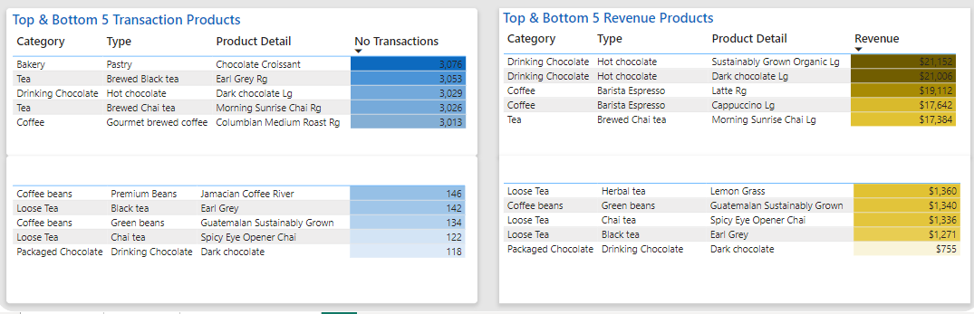
You can find the 5 best -selling and least selling products here based on its number of transactions
Ranking data can be changed by the filter at the top right of the Dashboard
You can find the 5 best -selling and least sell products here based on that product revenue
Ranking data can be changed by the filter at the top right of the Dashboard

Slide 8
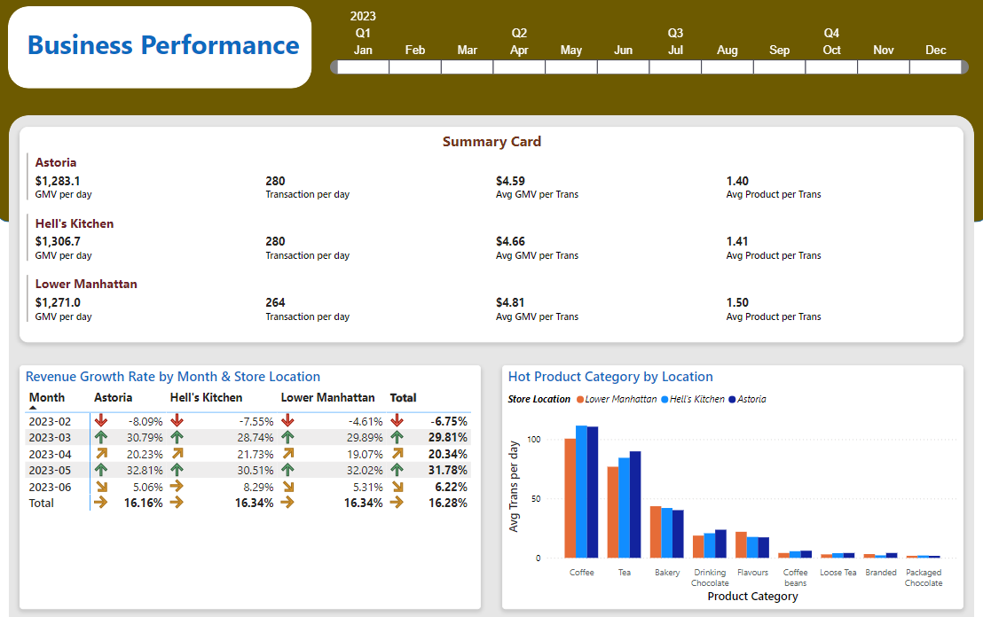
Business Performance
Metric in this Page:
Summary Card by each Store:
GMV per day (average)
Number of transactions per day (average)
Average GMV per transaction
Average Product per transaction
Growth rate by Month & Store Location
The most popular product at each store (based on Average Transaction per day)
The table shows the growth rate of each store per month
What category of product is most popular at each branch/store?

Slide 9
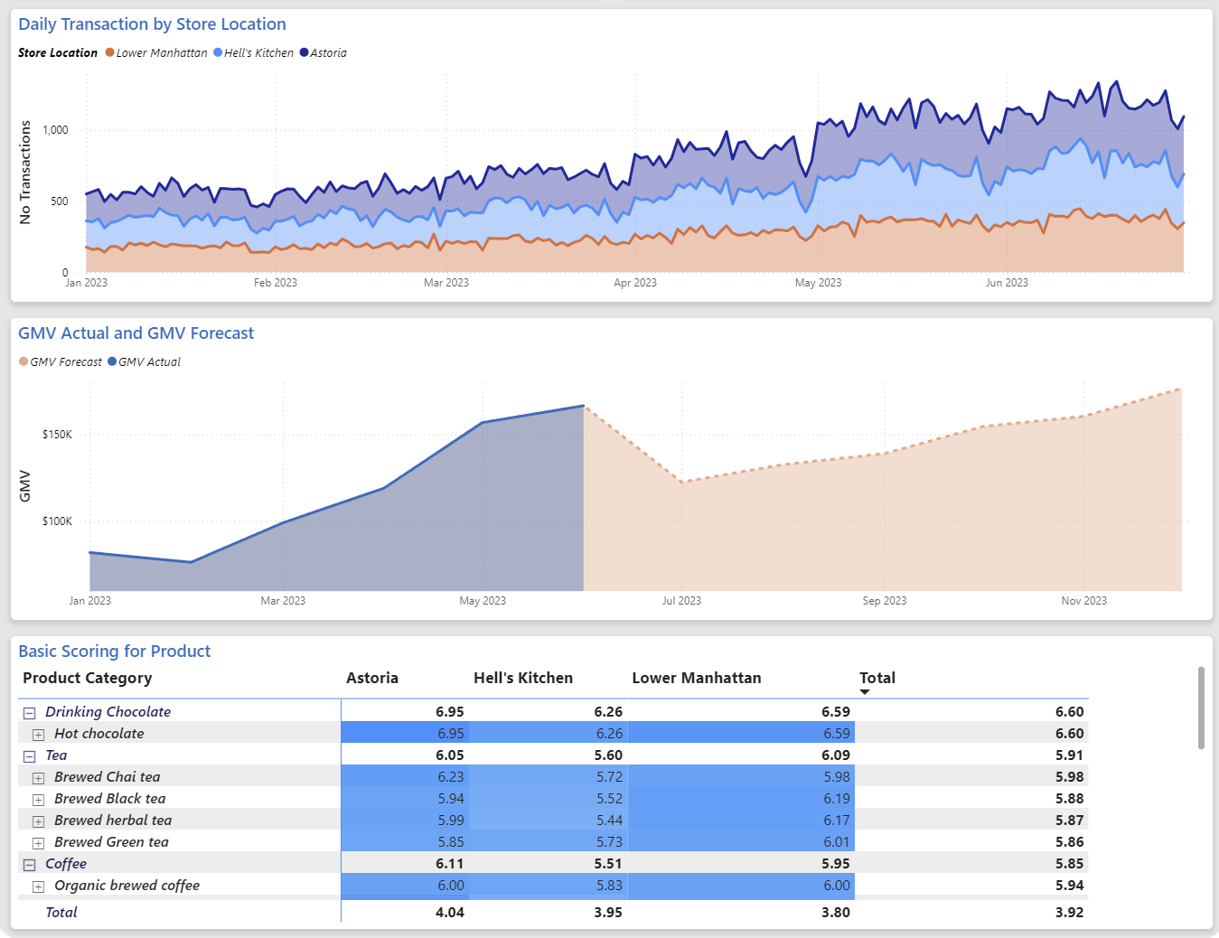
Business Performance
Metric in this Page:
Daily Transaction by Store Location
GMV Actual and GMV Forecast
Based on GMV data from 1/2023 to 6/2023, I applied to ARIMA model to forecast GMV in the future
3. Basic Scoring for Product
- Based on 4 characteristics: unit price, number of transactions, total amount (revenue) and average number of products on invoice
=> I scaled and scored for each product with score range from 0 to 10 point.
I can know which products are selling well, bringing a lot of business value to me, and which products need to be improved or sold in combos.

Slide 10
Planning
Data Aggregation
Transaction data
Cashflow data ?
Purchase Order data ?
Inventory Tracking data ?
Inventory Analysis
Inventory Turnover Ratio
Early Inventory Warning
Prediction of Revenue
More transaction data helps generalize seasonality, trends, and events
Have an exact revenue target
Suggestions for selling combos help push poorly selling products

