Slide 1
Battle of Neighborhoods
The United Kingdom – Choosing a proper Town to relocate based on House Price, IMD rank and neighborhood clustering

Slide 2
Data: https://www.ons.gov.uk - 2015
- Median House Price: the midway point of all the houses/units sold at price over a set period ( yearly)
-The Index of Multiple Deprivation (IMD rank): the official measure of relative deprivation for small areas in England ( usually from Income, Employment, Education, Health, Crime, Housing barrier and Living environment) . If a small area's rank is closer to 1 than that of another area, it is more deprived.

Slide 3
Problem:
A family would like to move to the UK and buy a property, their budget is around 150.000 – 200.000 GBP
The Town should have a great locality and in commercial area so that they will have chances to get new jobs there.
The Town should have a good IMD rank, above 80.

Slide 4
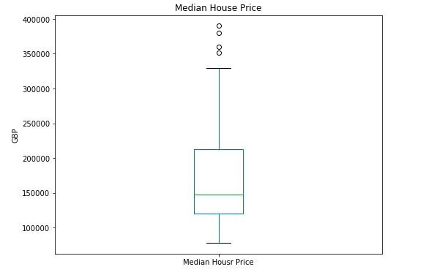
Exploring Median House Price

Slide 5
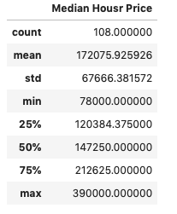
The lowest median house price is around 78000GBP and the highest is 390000GBP. Average house price falls around 172075GBP. Therefore, the given budget is reasonable that is also the price most people pay for house in England.

Slide 6
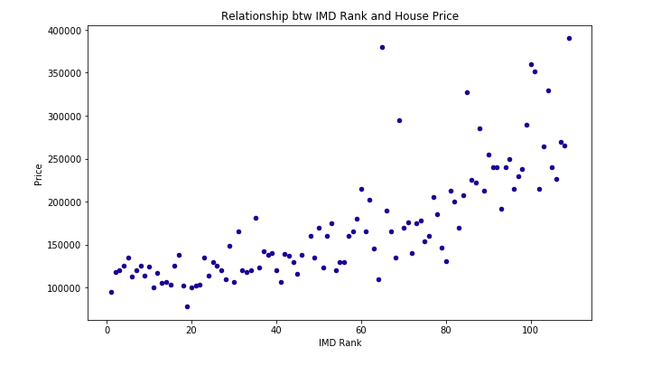
Relationship between Median House Price and IMD rank: negative correlation

Slide 7
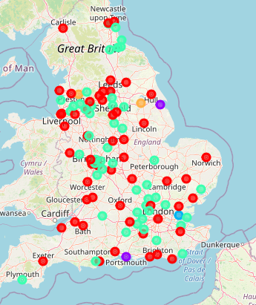
Clustering neighborhoods

Slide 8
Clustering neighborhoods
There are five clusters with 2 main clusters: commercial area and local area.
- Commercial area includes big city such as London, Leeds, Manchester, York..
Local area includes smaller town like Oxford, Hull, Carlise, Brington…

Slide 9
Recommendation
According to given problem, there are two Town meet the requirement: median house price is no more than 200.000GBP with a great IMD rank ( >80) and locate in commercial area: York and Shrewsbury.

