Slide 1

3d Photo Mobile
CSC 525 Computer Graphics
Term Project
OpenGL in C++
By
Zach Hudson
and
Chase Coates

Slide 2

Implimentation Details
Tree data structure
Arrays
Objects

Slide 3

Organization
Most in proj.cpp
Camera object
Picture object
TreeNode struct

Slide 4
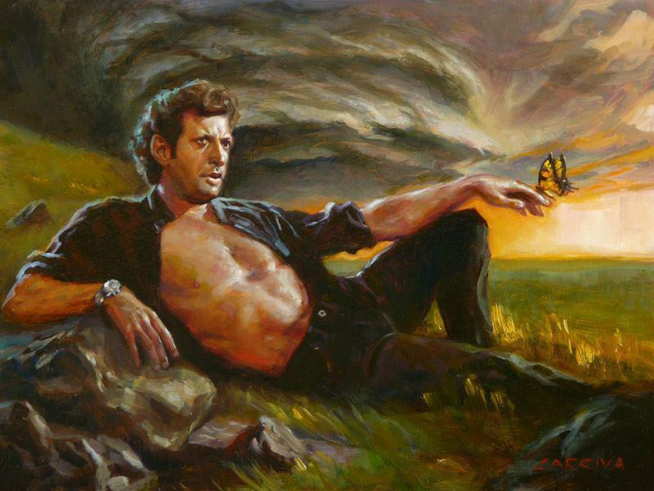
3rd Party Libraries
SOIL
  Simple OpenGL Image Library
  Loading of image files into textures
tiny_dir
  Directory traversal

Slide 5
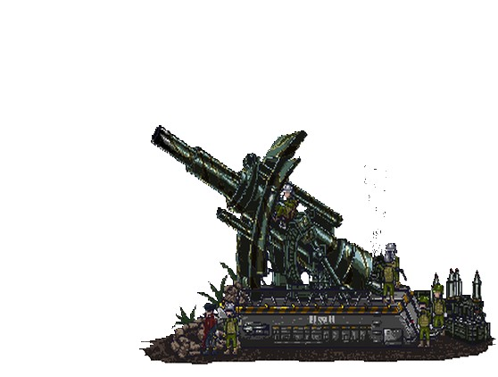
Challenges
Alpha Blending
Determining which picture is clicked
  Z Buffer
Creating the tree

Slide 6
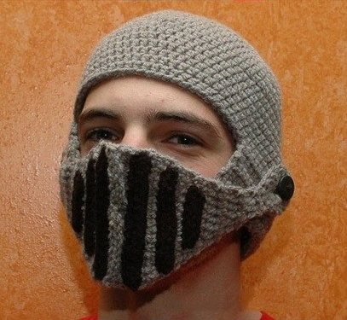
Features
Loading
  Text file
  Scanning a directory
  Using directory structure
Flying in and out
Presentation mode

Slide 7
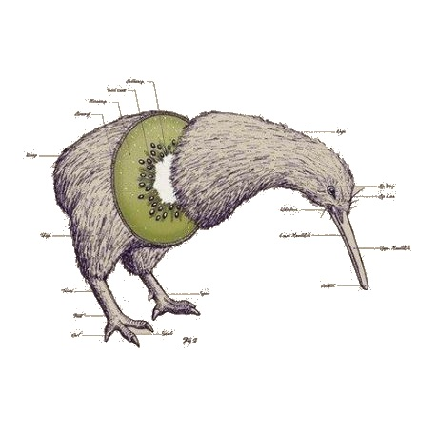
Features
Stop the animation
Turn off Z buffer depth checking
Turn off frame clearing

Slide 8
Questions?
?

