Slide 1

3d Photo Mobile
CSC 525 Computer Graphics
Term Project
OpenGL in C++
By
Zach Hudson
and
Chase Coates

Slide 2
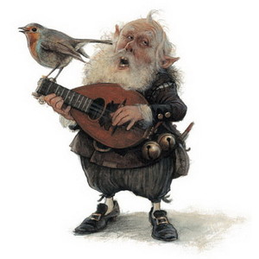
Implementation Details
Tree data structure
Arrays
Objects

Slide 3

Organization
Most in proj.cpp
Camera object
Picture object
TreeNode struct

Slide 4
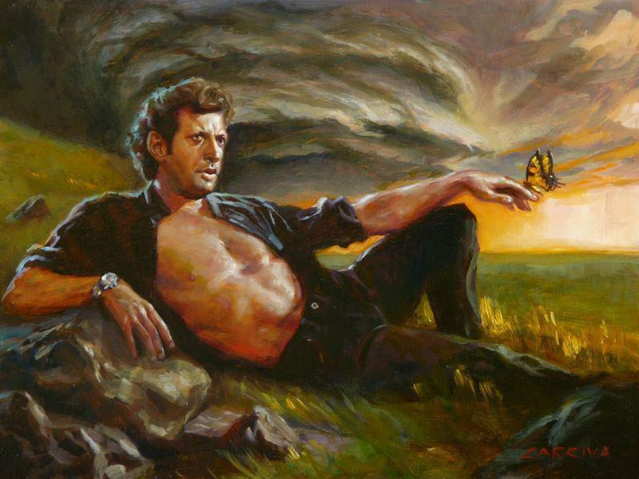
3rd Party Libraries
SOIL
  Simple OpenGL Image Library
  Loading of image files into textures
tiny_dir
  Directory traversal

Slide 5
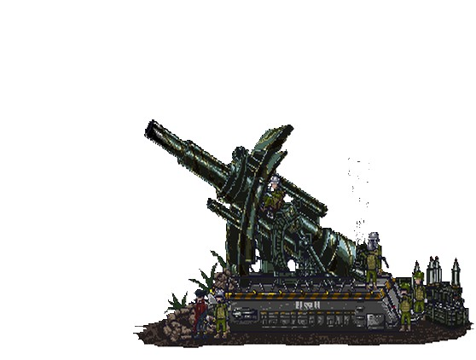
Challenges
Alpha Blending
Determining which picture is clicked
Creating the tree

Slide 6

Features
Loading
  Text file
  Scanning a directory
  Using directory structure
  Command Line Arguments
Flying in and out
Dynamic Sizing
Presentation mode

Slide 7
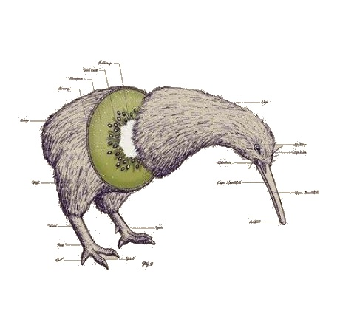
Features
Stop the animation
Turn off Z buffer depth checking
Turn off frame clearing
Framerate
Stoping Animation
Rebuilding the Tree
Camera Controls
Coords

Slide 8
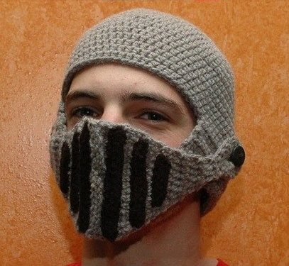
User Friendly
Can take command line arguments
  Manifest file
  Directory Tree
  Directory Search
Defaults

Slide 9

Wish we...
Dynamic text size and position
Prevent pictures from passing in front
Music

Slide 10
Questions?
?

