Slide 1


Overview of Bitcoin, Blockchain,
and Cryptofinancial Technology
Ryan X. Charles
Blockchain University
Tokyo, Dec. 17, 2015
Ryan X. Charles
Founder of Datt (datt.co)
twitter.com/ryanxcharles
github.com/ryanxcharles
Code Samples and Slides at:
github.com/ryanxcharles/blockchain-university
Datt

Slide 2
Outline
Who am I?
Bitcoin History & Technology
Altcoins & Other Blockchains
Non-Blockchains
Bitcoin Economy
Bitcoin Implementations
Ryan X. Charles
Founder of Datt (datt.co)
twitter.com/ryanxcharles
github.com/ryanxcharles
Code Samples and Slides at:
github.com/ryanxcharles/blockchain-university
Datt

Slide 3

Who is Ryan X. Charles?
Programming since age 10
Web designer/developer, 1999 – 2005
Physicist, 2005 – 2013
Angry at govt/banks, 2008
Discovered bitcoin, 2011
Full-time bitcoin, 2013
BitPay -> reddit -> BitGo -> Datt
bitcore, Copay, fullnode, Datt
Ryan X. Charles
Founder of Datt (datt.co)
twitter.com/ryanxcharles
github.com/ryanxcharles
Code Samples and Slides at:
github.com/ryanxcharles/blockchain-university
Datt

Slide 4
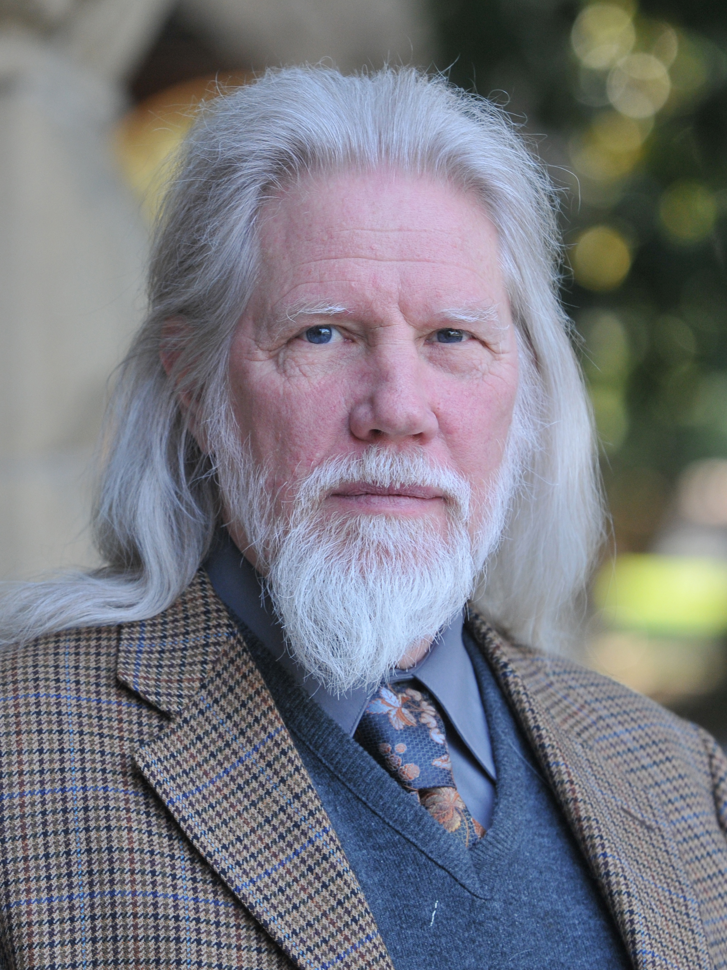
Crypto History of Bitcoin
Public Key Cryptography, 1976 (Diffie-Hellman)
DigiCash, 1990 – 1998
Hashcash, Adam Back, 1997
b-money, Wei Dai 1998
Bit Gold, Nick Szabo, 2005? 2008?
Bitcoin Whitepaper, 2008
Bitcoin Genesis Block, 2009
Witfield Diffie
Ryan X. Charles
Founder of Datt (datt.co)
twitter.com/ryanxcharles
github.com/ryanxcharles
Code Samples and Slides at:
github.com/ryanxcharles/blockchain-university
Datt

Slide 5
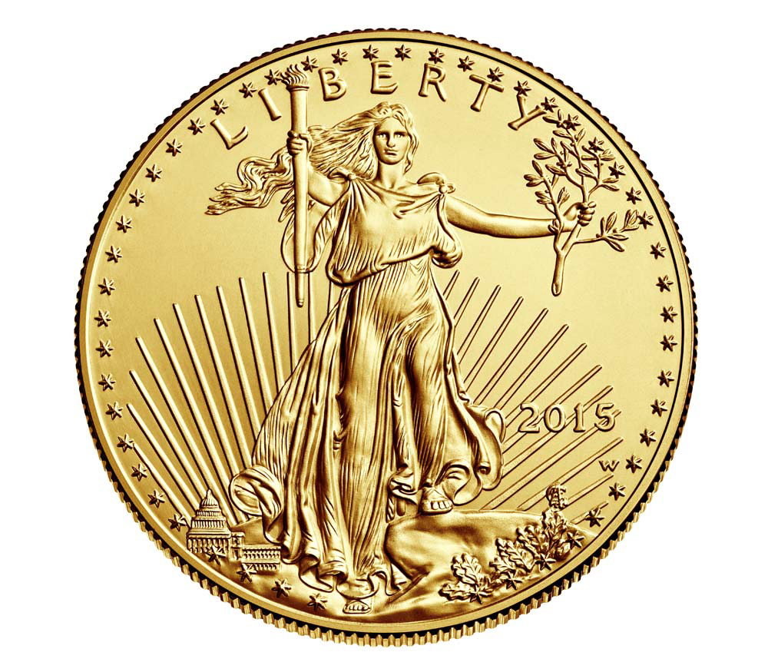
Money History of Bitcoin
Pre-gold*, ~100,000 BC – Today
Gold*, ~5000 BC
Fractional Reserve Banking*, ~1000 AD
Classical Gold Standard, 1870 – ~1915
Bretton Woods, 1944 – 1971
Bitcoin, 2009
* Caveat: Rough estimate
Ryan X. Charles
Founder of Datt (datt.co)
twitter.com/ryanxcharles
github.com/ryanxcharles
Code Samples and Slides at:
github.com/ryanxcharles/blockchain-university
Datt

Slide 6
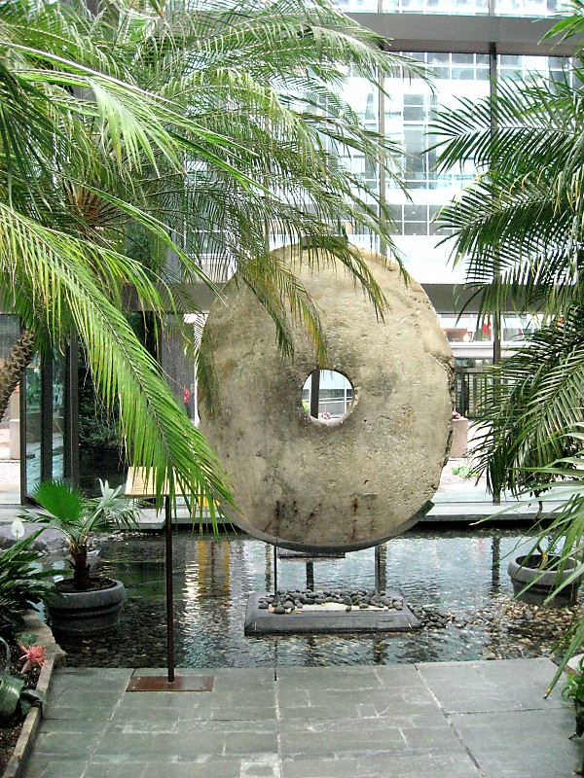
Rai Stones: Physical Bitcoin
Quarried in Micronesia & Guam
Used as money on Yap
Stones do not move – rely on oral history to track ownership
Really difficult to make new ones – can't just print them (without modern tech)
Just like bitcoin: value comes from proof-of-work, history of ownership is shared information
Ryan X. Charles
Founder of Datt (datt.co)
twitter.com/ryanxcharles
github.com/ryanxcharles
Code Samples and Slides at:
github.com/ryanxcharles/blockchain-university
Datt

Slide 7
Bitcoin Blockchain Overview
Blocks contain transactions and a proof-of-work hash
Each block links to previous block
Each transaction links to outputs of earlier transactions
Ryan X. Charles
Founder of Datt (datt.co)
twitter.com/ryanxcharles
github.com/ryanxcharles
Code Samples and Slides at:
github.com/ryanxcharles/blockchain-university
Datt

Slide 8
Bitcoin Blockchain Overview
Genesis Block:
  The First Block
Coinbase Transaction:
  First transaction in a block
  Mining reward
  Has “null” inputs
Ryan X. Charles
Founder of Datt (datt.co)
twitter.com/ryanxcharles
github.com/ryanxcharles
Code Samples and Slides at:
github.com/ryanxcharles/blockchain-university
Datt

Slide 9
Bitcoin Blockchain Overview
Each block has:
  Proof-of-Work Hash (PoW)
  Nonce
  Meta data and transactions
Example PoW with data “test data”
  Nonce: 0, Hash: df59bb7272f144dc7d3620e6f9e14234
  Nonce: 1, Hash: 460142d2a0349c13a48b422261d708eb
  Nonce: 2, Hash: 71be158053f58c9e1f094fb3f7da282e
  …
  Nonce: 146, Hash: 00f82186722b46b2adb57f321793e44f
Ryan X. Charles
Founder of Datt (datt.co)
twitter.com/ryanxcharles
github.com/ryanxcharles
Code Samples and Slides at:
github.com/ryanxcharles/blockchain-university
Datt

Slide 10
Bitcoin Blockchain Summary
Transactions are digitally signed (public key cryptography).
  Cannot fake a transaction – must have private key to produce valid signature
Hash functions used for proof-of-work on each block.
“Encryption” has nothing to do with it – just digital signatures and hash functions.
Transactions grouped in blocks, one big chain back to the genesis block.
Each transaction links to earlier transaction(s) back to Coinbase transaction(s).
Ryan X. Charles
Founder of Datt (datt.co)
twitter.com/ryanxcharles
github.com/ryanxcharles
Code Samples and Slides at:
github.com/ryanxcharles/blockchain-university
Datt

Slide 11
Important Concepts
Bitcoins are mined. 50 new bitcoins per block for first four years, 25 per block for next four years, etc. Total of 21 million.
Miners perform proof-of-work hashing. CPUs → Graphics cards → FPGAs → ASICs.
“full node” - a fully-validating node. “light node”, or “SPV” - only validates block headers.
Bitcoin has no central authority. The only way to change the rules is to change the software the miners, full nodes, and wallets run. Democratic by CPU power and economic power.
Do you control your private keys?
Ryan X. Charles
Founder of Datt (datt.co)
twitter.com/ryanxcharles
github.com/ryanxcharles
Code Samples and Slides at:
github.com/ryanxcharles/blockchain-university
Datt

Slide 12
The Creator: Satoshi Nakamoto
Active on cryptography mailing list 2008
Active on bitcoin forum 2009 – 2010
Last known message late 2010
Writings recorded at: http://nakamotoinstitute.org/
Highly recommended to read his writings!
Ryan X. Charles
Founder of Datt (datt.co)
twitter.com/ryanxcharles
github.com/ryanxcharles
Code Samples and Slides at:
github.com/ryanxcharles/blockchain-university
Datt

Slide 13
Byzantine Consensus
Byzantine Generals Problem – a well-known computer science problem.
If generals want to attack a city, when no one is in charge, how do they arrive at consensus about what particular time to attack?
Bitcoin is a solution to this problem (use proof-of-work on times – most proof-of-work wins) https://bitcointalk.org/oldSiteFiles/byzantine.html
Ryan X. Charles
Founder of Datt (datt.co)
twitter.com/ryanxcharles
github.com/ryanxcharles
Code Samples and Slides at:
github.com/ryanxcharles/blockchain-university
Datt

Slide 14
“The Blockchain”
“Bitcoin: A Peer-to-Peer Electronic Cash System” https://bitcoin.org/bitcoin.pdf
The word “blockchain” does not appear in whitepaper or original source code. (“block chain”, two separate words, does appear in original source code, but not whitepaper)
“Blockchains,” distributed consensus of transactions grouped into blocks, have become popular for reasons other than money, particularly other financial services & identity.
Bitcoin was invented for one purpose: decentralized electronic cash. Other uses of blockchain are nice bonus.
Ryan X. Charles
Founder of Datt (datt.co)
twitter.com/ryanxcharles
github.com/ryanxcharles
Code Samples and Slides at:
github.com/ryanxcharles/blockchain-university
Datt

Slide 15


Altcoins
(The First Non-Bitcoin Blockchains)
First appeared ~2012.
Litecoin first popular altcoin.
Dogecoin second popular altcoin.
Almost all are forks of bitcoin, or a fork of a fork. Some, like NXT, are complete rewrites.
Most do not have novel features. Some do.
Bitcoin market cap: ~$6.5 billion
All alts put together: < $1 billion
Ryan X. Charles
Founder of Datt (datt.co)
twitter.com/ryanxcharles
github.com/ryanxcharles
Code Samples and Slides at:
github.com/ryanxcharles/blockchain-university
Datt

Slide 16
Alternative Uses of Blockchain
(besides money)
Stocks, bonds, fiat currencies, commodities – decentralized ownership, but centralized backing
Identity, names, rotating keys, revoking keys
Smart contracts (money or other assets change hands according to complex conditions executed automatically)
Smart property & Internet of Things (property perform actions, can be owned by cryptographically)
Proof-of-existence, patents, trademarks, copyright
DACs and DAOs (distributed autonomous corporations & organizations)
If it involves distributed consensus, consider blockchain
Ryan X. Charles
Founder of Datt (datt.co)
twitter.com/ryanxcharles
github.com/ryanxcharles
Code Samples and Slides at:
github.com/ryanxcharles/blockchain-university
Datt

Slide 17
Permissioned Blockchains
Bitcoin is permissionless. Anyone can use it. Anyone can mine it. No one owns it. (Although some actors have more power than others – more bitcoin, more hash power, commit access, etc.)
Banks are creating permissioned blockchains. Based on the same principles, but not open to the public. They are owned by the banks.
Exploring monetary and non-monetary uses of blockchain technology.
R3: http://www.coindesk.com/bitcoin-headlines-r3-blockchain-dream-team/
Ryan X. Charles
Founder of Datt (datt.co)
twitter.com/ryanxcharles
github.com/ryanxcharles
Code Samples and Slides at:
github.com/ryanxcharles/blockchain-university
Datt

Slide 18
Blockchains in a Box
OpenChain – easily produce a blockchain that is optionally attached to bitcoin https://www.openchain.org/
MultiChain – easily produce a blockchain with custom features as a fork of Bitcoin Core http://www.multichain.com/
Can be permissionless (open, anyone can use) or permissioned (closed, only used by select parties)
Ryan X. Charles
Founder of Datt (datt.co)
twitter.com/ryanxcharles
github.com/ryanxcharles
Code Samples and Slides at:
github.com/ryanxcharles/blockchain-university
Datt

Slide 19
Blockchains in a Box
OpenChain – easily produce a blockchain that is optionally attached to bitcoin https://www.openchain.org/
MultiChain – easily produce a blockchain with custom features as a fork of Bitcoin Core http://www.multichain.com/
Can be permissionless (open, anyone can use) or permissioned (closed, only used by select parties)
Ryan X. Charles
Founder of Datt (datt.co)
twitter.com/ryanxcharles
github.com/ryanxcharles
Code Samples and Slides at:
github.com/ryanxcharles/blockchain-university
Datt

Slide 20
Ethereum
Bitcoin script is not Turing complete (there are some programs that cannot be written with it)
Ethereum script is Turing complete – can program any conceivable contract
Bitcoin is designed to solve the problem of digital cash. Ethereum is designed to solve everything else.
Bitcoin infrastructure better developed (companies, software, capital), but Ethereum potentially more useful
See Gav Wood's recent article, “So Ethereum is released.” https://medium.com/@gavofyork/so-ethereum-is-released-4291da46b770
Ryan X. Charles
Founder of Datt (datt.co)
twitter.com/ryanxcharles
github.com/ryanxcharles
Code Samples and Slides at:
github.com/ryanxcharles/blockchain-university
Datt

Slide 21
Non-Blockchains
Ripple – a distributed ledger, based on similar cryptography to bitcoin, but NOT proof-of-work or proof-of-stake
Stellar – a fork of Ripple
Both of them can track arbitrary assets and rely on third parties to exchange for “real” assets, e.g. withdrawing dollars or bitcoin
Fall under “cryptofinance” category, but they DO NOT have blockchains!
Ryan X. Charles
Founder of Datt (datt.co)
twitter.com/ryanxcharles
github.com/ryanxcharles
Code Samples and Slides at:
github.com/ryanxcharles/blockchain-university
Datt

Slide 22
A Note on Security
Bitcoin miners are the world's most powerful supercomputer. (5 billion teraflops vs. 54 thousand teraflops*)
Reversing bitcoin transactions requires having an enormous amount of computing power, only achievable by a State actor.
Reversing a small, private blockchain requires far less computing power and is achievable by small actors. Beware.
* Conversion info: https://www.quora.com/How-to-convert-mflop-s-to-mhash-s … I calculated assuming 700 million Ghash/s current hash rate, and 700 Mhash/s to 5340 Gflop/s
Current top super computers: http://www.top500.org/lists/2015/06/
Ryan X. Charles
Founder of Datt (datt.co)
twitter.com/ryanxcharles
github.com/ryanxcharles
Code Samples and Slides at:
github.com/ryanxcharles/blockchain-university
Datt

Slide 23
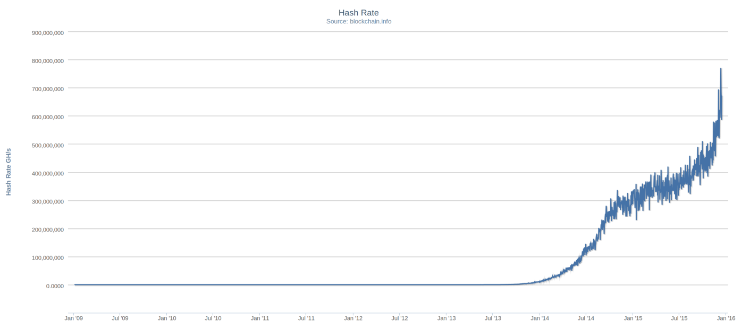
Bitcoin's All-Time Hash Rate
Ryan X. Charles
Founder of Datt (datt.co)
twitter.com/ryanxcharles
github.com/ryanxcharles
Code Samples and Slides at:
github.com/ryanxcharles/blockchain-university
Datt

Slide 24
Colored Coins
Put meta data on bitcoin transactions to track assets (stock, bonds, whatever) on the bitcoin blockchain.
Protocols: Open Assets, CoinSpark, Chromaway, Colu, others.
Upside: Security of bitcoin.
Downside: Limited block size and thus transaction count. Rules are not enforced by miners.
Ryan X. Charles
Founder of Datt (datt.co)
twitter.com/ryanxcharles
github.com/ryanxcharles
Code Samples and Slides at:
github.com/ryanxcharles/blockchain-university
Datt

Slide 25
Two-Way Pegged Sidechains
Invented by Blockstream, theoretically allows transfer of bitcoin to other blockchains by “pegging” - proof-of-peg lets you spend bitcoin on the sidechain, proof-of-unpeg lets you retrieve bitcoin back on normal chain
Upside: Security of bitcoin, network effect of bitcoin, unlimited advanced uses of blockchain.
Downside: Not yet implemented.
Ryan X. Charles
Founder of Datt (datt.co)
twitter.com/ryanxcharles
github.com/ryanxcharles
Code Samples and Slides at:
github.com/ryanxcharles/blockchain-university
Datt

Slide 26
Technology Summary
Bitcoin
Altcoins
Ethereum
Non-Blockchain (Ripple, Stellar)
Permissioned Blockchains (banks)
Bitcoin-dependent: Colored Coins; Sidechains
...hard to beat bitcoin's security and network effect
Ryan X. Charles
Founder of Datt (datt.co)
twitter.com/ryanxcharles
github.com/ryanxcharles
Code Samples and Slides at:
github.com/ryanxcharles/blockchain-university
Datt

Slide 27
Bitcoin Economy
Wallets
Exchanges
APIs and Developer Tools
Payment Gateways
Miners
Storage
Merchants
Investment
Non-Monetary Advanced Uses
Financial Services
Ryan X. Charles
Founder of Datt (datt.co)
twitter.com/ryanxcharles
github.com/ryanxcharles
Code Samples and Slides at:
github.com/ryanxcharles/blockchain-university
Datt

Slide 28
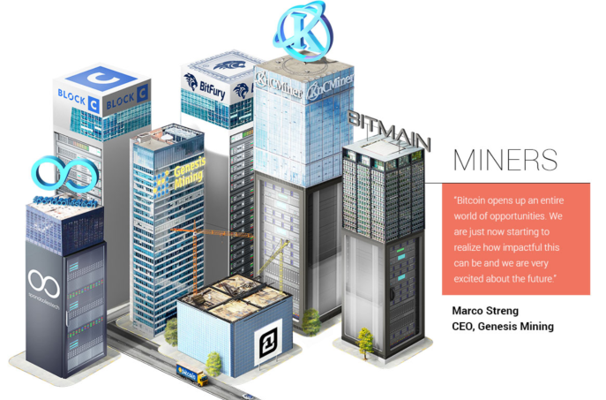
Miners
Graphics by BitPay, Bitcoin Magazine & Josh Dykgraaf
Ryan X. Charles
Founder of Datt (datt.co)
twitter.com/ryanxcharles
github.com/ryanxcharles
Code Samples and Slides at:
github.com/ryanxcharles/blockchain-university
Datt

Slide 29
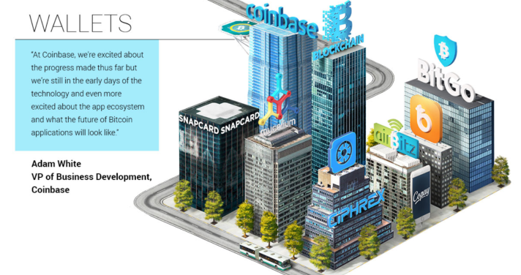
Wallets
Graphics by BitPay, Bitcoin Magazine & Josh Dykgraaf
Ryan X. Charles
Founder of Datt (datt.co)
twitter.com/ryanxcharles
github.com/ryanxcharles
Code Samples and Slides at:
github.com/ryanxcharles/blockchain-university
Datt

Slide 30
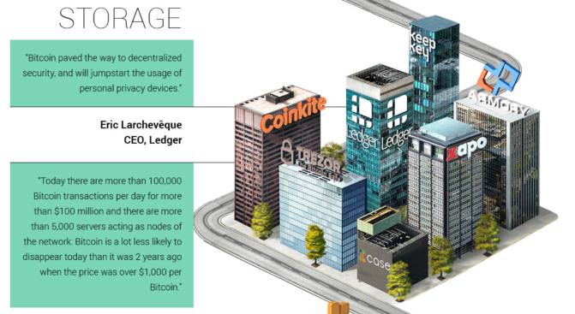
Storage
Graphics by BitPay, Bitcoin Magazine & Josh Dykgraaf
Ryan X. Charles
Founder of Datt (datt.co)
twitter.com/ryanxcharles
github.com/ryanxcharles
Code Samples and Slides at:
github.com/ryanxcharles/blockchain-university
Datt

Slide 31
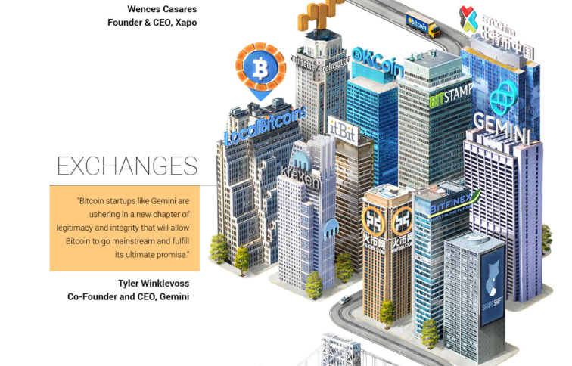
Exchanges
Graphics by BitPay, Bitcoin Magazine & Josh Dykgraaf
Ryan X. Charles
Founder of Datt (datt.co)
twitter.com/ryanxcharles
github.com/ryanxcharles
Code Samples and Slides at:
github.com/ryanxcharles/blockchain-university
Datt

Slide 32
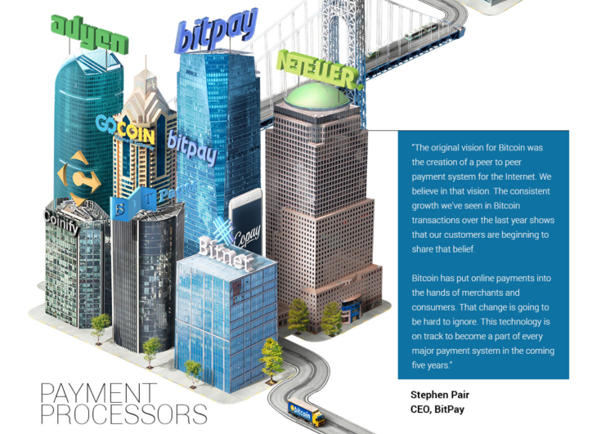
Payment Processors
Graphics by BitPay, Bitcoin Magazine & Josh Dykgraaf
Ryan X. Charles
Founder of Datt (datt.co)
twitter.com/ryanxcharles
github.com/ryanxcharles
Code Samples and Slides at:
github.com/ryanxcharles/blockchain-university
Datt

Slide 33
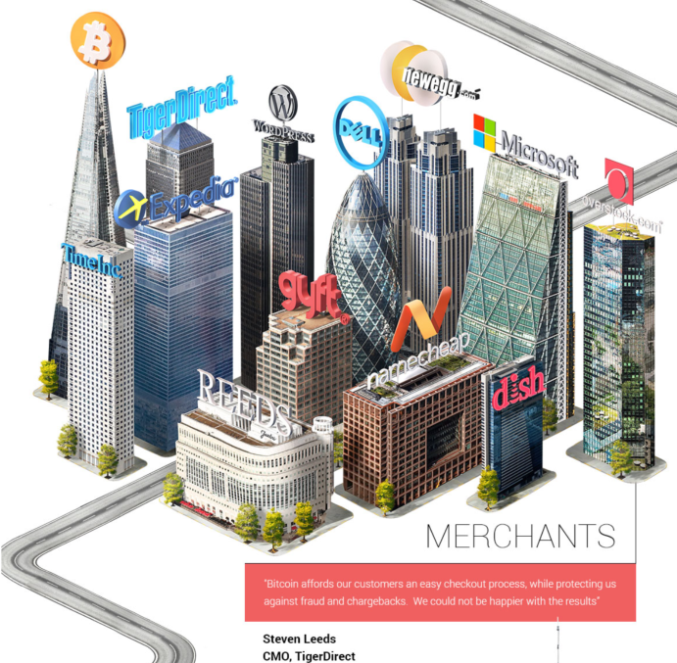
Merchants
Graphics by BitPay, Bitcoin Magazine & Josh Dykgraaf
Ryan X. Charles
Founder of Datt (datt.co)
twitter.com/ryanxcharles
github.com/ryanxcharles
Code Samples and Slides at:
github.com/ryanxcharles/blockchain-university
Datt

Slide 34
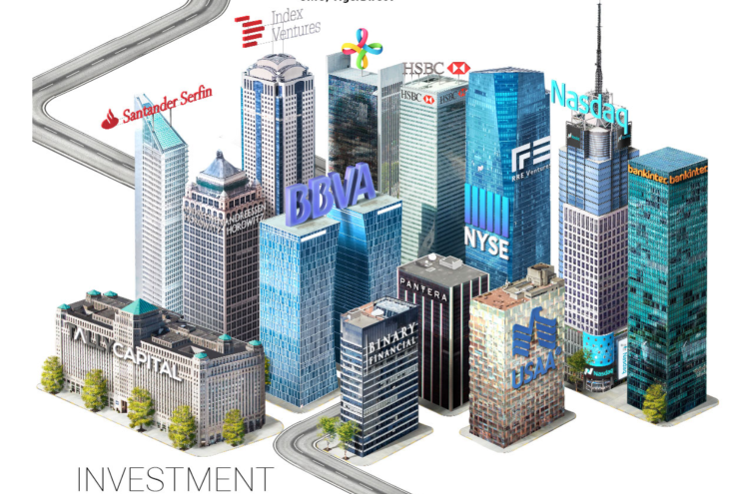
Investment
Graphics by BitPay, Bitcoin Magazine & Josh Dykgraaf
Ryan X. Charles
Founder of Datt (datt.co)
twitter.com/ryanxcharles
github.com/ryanxcharles
Code Samples and Slides at:
github.com/ryanxcharles/blockchain-university
Datt

Slide 35
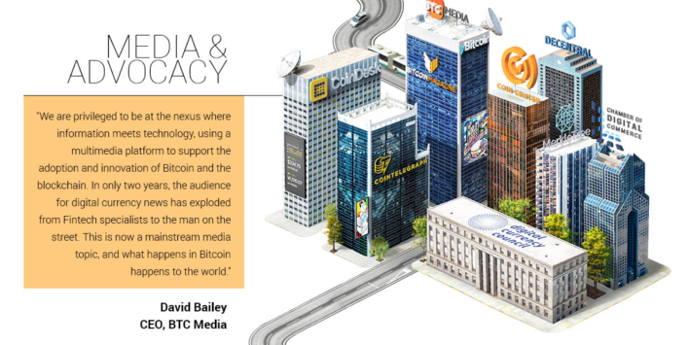
Media & Advocacy
Graphics by BitPay, Bitcoin Magazine & Josh Dykgraaf
Ryan X. Charles
Founder of Datt (datt.co)
twitter.com/ryanxcharles
github.com/ryanxcharles
Code Samples and Slides at:
github.com/ryanxcharles/blockchain-university
Datt

Slide 36
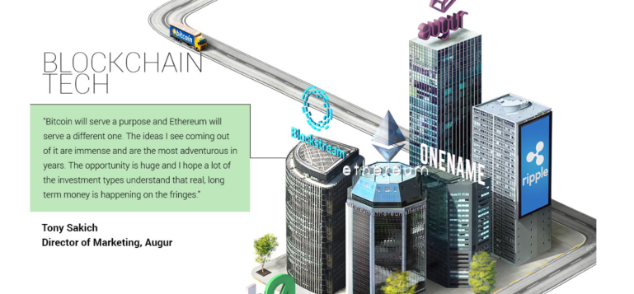
Advanced Uses of Blockchain
Graphics by BitPay, Bitcoin Magazine & Josh Dykgraaf
Ryan X. Charles
Founder of Datt (datt.co)
twitter.com/ryanxcharles
github.com/ryanxcharles
Code Samples and Slides at:
github.com/ryanxcharles/blockchain-university
Datt

Slide 37
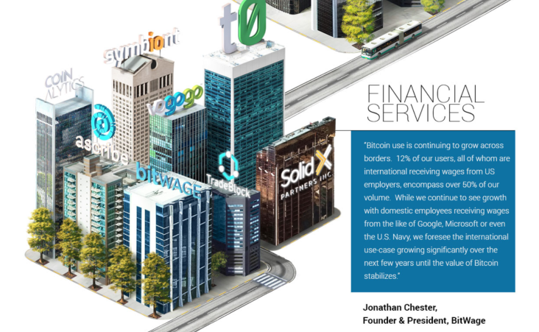
Financial Services
Graphics by BitPay, Bitcoin Magazine & Josh Dykgraaf
Ryan X. Charles
Founder of Datt (datt.co)
twitter.com/ryanxcharles
github.com/ryanxcharles
Code Samples and Slides at:
github.com/ryanxcharles/blockchain-university
Datt

Slide 38
Implementations of Bitcoin
Bitcoin Core – Original C++ implementation, maintained by “Core” developers
BitcoinJ – The first re-implementation
Btcd – A full implementation in Go
bitcore, bitcoinjs, fullnode – Javascript & Node.js
rust-bitcoin – Rust
python-bitcoinlib, caesure – Python
Ryan X. Charles
Founder of Datt (datt.co)
twitter.com/ryanxcharles
github.com/ryanxcharles
Code Samples and Slides at:
github.com/ryanxcharles/blockchain-university
Datt

