Slide 1


Transactions and Blocks
in Bitwise Detail
Ryan X. Charles
Blockchain University
San Francisco, Oct. 26 – Oct. 30, 2015
Ryan X. Charles
Founder of Datt (datt.co)
twitter.com/ryanxcharles
github.com/ryanxcharles
Code Samples and Slides at:
github.com/ryanxcharles/blockchain-university
Datt

Slide 2
Outline
Blockchain Overview
Number Formats
Public Keys, Signatures, & Addresses
Inputs & Outputs
Transactions
Blocks
Ryan X. Charles
Founder of Datt (datt.co)
twitter.com/ryanxcharles
github.com/ryanxcharles
Code Samples and Slides at:
github.com/ryanxcharles/blockchain-university
Datt

Slide 3
Blockchain Overview
Blocks contain transactions and a proof-of-work hash
Each block links to previous block
Each transaction links to outputs of earlier transactions
Ryan X. Charles
Founder of Datt (datt.co)
twitter.com/ryanxcharles
github.com/ryanxcharles
Code Samples and Slides at:
github.com/ryanxcharles/blockchain-university
Datt

Slide 4
Blockchain Overview
Genesis Block:
  The First Block
Coinbase Transaction:
  First transaction in a block
  Mining reward
  Has “null” inputs
Ryan X. Charles
Founder of Datt (datt.co)
twitter.com/ryanxcharles
github.com/ryanxcharles
Code Samples and Slides at:
github.com/ryanxcharles/blockchain-university
Datt

Slide 5
Blockchain Overview
Each block has:
  Proof-of-Work Hash (PoW)
  Nonce
  Meta data and transactions
Example PoW with data “test data”
  Nonce: 0, Hash: df59bb7272f144dc7d3620e6f9e14234
  Nonce: 1, Hash: 460142d2a0349c13a48b422261d708eb
  Nonce: 2, Hash: 71be158053f58c9e1f094fb3f7da282e
  …
  Nonce: 146, Hash: 00f82186722b46b2adb57f321793e44f
Ryan X. Charles
Founder of Datt (datt.co)
twitter.com/ryanxcharles
github.com/ryanxcharles
Code Samples and Slides at:
github.com/ryanxcharles/blockchain-university
Datt

Slide 6
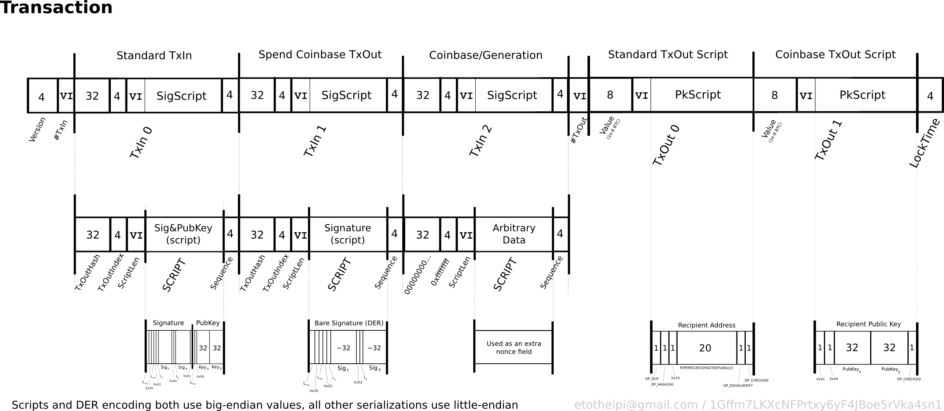
Transaction Detail Overview
Summary: Transactions have inputs and outputs. Plot by Alan Rainer.
Ryan X. Charles
Founder of Datt (datt.co)
twitter.com/ryanxcharles
github.com/ryanxcharles
Code Samples and Slides at:
github.com/ryanxcharles/blockchain-university
Datt

Slide 7
Number Formats
Which number format does bitcoin use?
Big endian
Little endian
Sign+magnitude
Two's complement
Fixed point
Floating point
String
8 bit
16 bit
32 bit
64 bit
256 bit
Custom variable size
Another variable size
Ryan X. Charles
Founder of Datt (datt.co)
twitter.com/ryanxcharles
github.com/ryanxcharles
Code Samples and Slides at:
github.com/ryanxcharles/blockchain-university
Datt

Slide 8
Number Formats
Which number format does bitcoin use?
All of them.
“I wanted to see how many number formats I could use in a single protocol, so I invented bitcoin.”
- Satoshi Nakamoto (apocryphal)
Ryan X. Charles
Founder of Datt (datt.co)
twitter.com/ryanxcharles
github.com/ryanxcharles
Code Samples and Slides at:
github.com/ryanxcharles/blockchain-university
Datt

Slide 9
Endianness
Big endian
One thousand
1000 (decimal)
3e8 (hex)
3 232 (decimal bytes)
03 e8 (hex bytes)
00000011 11101000 (bin bytes)
Little endian
One thousand
0001 (decimal)
8e3 (hex)
232 3 (decimal bytes)
e8 03 (hex bytes)
11101000 00000011 (bin bytes)
Ryan X. Charles
Founder of Datt (datt.co)
twitter.com/ryanxcharles
github.com/ryanxcharles
Code Samples and Slides at:
github.com/ryanxcharles/blockchain-university
Datt

Slide 10
Sign (+/-)
Sign magnitude
Most significant bit: 0 pos., 1 neg.
(4 bytes, big endian)
-1 (decimal)
-1 (hex)
128 0 0 1 (decimal bytes)
80 00 00 01 (hex bytes)
10000000 00000000 00000000 00000001 (bin bytes)
Two's complement
X → 2^{N} – X, where N is bits
-1: 1 → 2³² – 1 = 4294967295
(4 bytes, big endian)
-1 (decimal)
-1 (hex)
255 255 255 255 (decimal bytes)
ff ff ff ff (hex bytes)
11111111 11111111 11111111 11111111 (bin bytes)
Ryan X. Charles
Founder of Datt (datt.co)
twitter.com/ryanxcharles
github.com/ryanxcharles
Code Samples and Slides at:
github.com/ryanxcharles/blockchain-university
Datt

Slide 11
Sign (+/-)
Sign magnitude
Most significant bit: 0 pos., 1 neg.
(4 bytes, little endian)
-1 (decimal)
-1 (hex)
1 0 0 128 (decimal bytes)
01 00 00 80 (hex bytes)
00000001 00000000 00000000 10000000 (bin bytes)
Two's complement
X → 2^{N} – X, where N is bits
-1: 1 → 2³² – 1 = 4294967295
(4 bytes, little endian)
-1 (decimal)
-1 (hex)
255 255 255 255 (decimal bytes)
ff ff ff ff (hex bytes)
11111111 11111111 11111111 11111111 (bin bytes)
Ryan X. Charles
Founder of Datt (datt.co)
twitter.com/ryanxcharles
github.com/ryanxcharles
Code Samples and Slides at:
github.com/ryanxcharles/blockchain-university
Datt

Slide 12
Decimal to Hex Examples
Decimal
5
5
5
-5
-5
-6
-6
4 hex bytes, little endian
05 00 00 00 (unsigned)
05 00 00 00 (sign+magnitude)
05 00 00 00 (two's complement)
05 00 00 10 (sign+magnitude)
fb ff ff ff (two's complement)
06 00 00 10 (sign+magnitude)
fa ff ff ff (two's complement)
Ryan X. Charles
Founder of Datt (datt.co)
twitter.com/ryanxcharles
github.com/ryanxcharles
Code Samples and Slides at:
github.com/ryanxcharles/blockchain-university
Datt

Slide 13
Varint (Compact Size)
How to transmit the size of data?
  Could always use 4 bytes
    e.g., “600 bytes to follow” stored as 32 bit uint
    Data size limited to max 4 byte int (4294967295 bytes)
...but everyone stores the blockchain.
    00 00 00 01 is 3 bytes of wasted space
    Should use minimal # of byte
Bitcoin's “Compact Size”
  Varies in size from 1 byte for small nums, 9 bytes for big
Ryan X. Charles
Founder of Datt (datt.co)
twitter.com/ryanxcharles
github.com/ryanxcharles
Code Samples and Slides at:
github.com/ryanxcharles/blockchain-university
Datt

