Slide 1
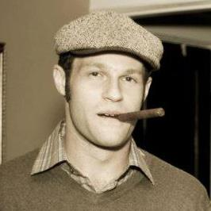

Technical Instructions
Ryan X. Charles
Blockchain University
Tokyo, Dec. 19, 2015
Ryan X. Charles
Founder of Datt (datt.co)
twitter.com/ryanxcharles
github.com/ryanxcharles
Code Samples and Slides at:
github.com/ryanxcharles/blockchain-university
Datt

Slide 2
Software for Demos
Use either Linux or OSX. If using Windows, create an account on terminal.com and create a Linux VM
Install git
Install node.js 4.2.x
Clone my blockchain-university repo (github.com/ryanxcharles/blockchain-university)
Type “npm install” inside that directory
You can now run the samples in bin/*
Ryan X. Charles
Founder of Datt (datt.co)
twitter.com/ryanxcharles
github.com/ryanxcharles
Code Samples and Slides at:
github.com/ryanxcharles/blockchain-university
Datt

