Slide 1
Assignment 3 presentation
Cloud-based
multitasking parallel computing

Slide 2
Problem defination
A Software-as-a-Service Platform :This platform will accept users’ requests to do matrix operations. Matrices are given in the two files. Matrix is assumed to be square i.e. NxN.
Features:
Matrix Calculator Service (Addition, Subtraction, and Multiplication )
Load balancing
Fault tolerance
Cloud Elasticity
Interaction with End user

Slide 3
Client side
Master side
Worker side
Update Result
Requests
Table
Tasks queue
Tasks queue
Read matrix from txt files
PUT
PUT
GET
Get
Task
thread
Loop
Read operator
ServeOneClient
thread
YES
ServeOneworker
thread
GET
STOP
End
thread
PUT
Operator
Socket 1234
GET
Send
Result
thread
Calculate
thread
Case”+,-,*”
Packaged
data
(sendwork)
PUT
YES
GET
ScanHeart thread
Processing request table
Socket 1235
Worker
die
Notify ServeOneworker
DEL
Case”S”
(stop)
Packaged
data
(sendwork)
Worker status
GET
PUT
Monitor Server thread
Result queue
Scan
Worker
status
Table
PUT
Case”CS”
(check status)
Packaged
data
(sendwork)
Per sec
Socket 1236
Monitor
States
thread

Slide 4
Feature of the system
Ability to serve multiple users
Applied Multi-threaded programming mode
Applied socket to communicate among client, master and worker
Fault tolerance is achieved through task backup and monitoring of worker status.
Load balancing is achieved by monitoring the status of the worker
Allow users to stop program running at any time
Could return result and the bill to client.

Slide 5
Challenges
Version control.
Insufficient programming ability.
Architecture, push or pull?
Load balancing
Fault Tolerance

Slide 6
Solutions
Version control.
Github
Insufficient programming ability.
team programming
Architecture, push or pull?
Parallel application of two methods
Load balancing
Get the status of each worker by listening to the heartbeat of each worker
Fault Tolerance
Back up tasks in the “Processing Task Table" while sending the task.

Slide 7
What we learn
Team work
Version control is very important
How to developing an entire Cloud middleware system
How to design and implement a working cloud application
Mastered the ability to program with multithreading and network communication
How to design and implement a Software-as-a-Service Platform

Slide 8
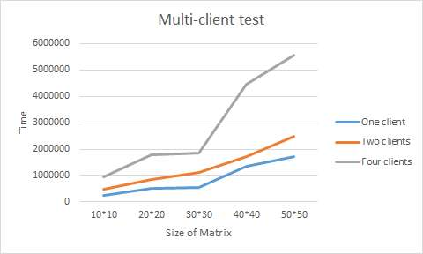

Evaluation results

Slide 9
Conclusion
Parallel computing can greatly improve the speed of computing
SaaS provides a complete software solution that you purchase on a pay-as-you-go.
Cloud architecture can support SaaS very well。
Service upgrades and updates only need to be done on the server side, and users no longer need to update by themselves.
Customers no longer need specific devices to access specific services

Slide 10
Questions?

