Slide 1
DATABASE CASE STUDY
Food Redistribution
Management Database
Database design and testing in a 12-week team project
camelliapramanik.github.io
Camellia Pramanick
01
Notes:
Food Redistribution Database Design Project.pdf, University of Detroit Mercy, December 4, 2024. User confirmed contributions in both database design and testing on October 15, 2026.

Slide 2
PROBLEM AND CONTRIBUTION
A database for coordinating surplus food
The problem
My contribution
Restaurants, pantries and nonprofits needed a shared record of available food, destinations and donation status.
Contributed to relational database design and testing, with attention to data integrity and dependable information retrieval.
The team solution
Why it mattered
Linked users, restaurants, food items, pantries, NGOs and donations in a MySQL database.
Made the flow of a donation traceable within the prototype, supporting inventory and donation reporting.
Camellia Pramanick
02
Notes:
Food Redistribution Database Design Project.pdf, University of Detroit Mercy, December 4, 2024. User confirmed contributions in both database design and testing on October 15, 2026.
Report pp. 5, 11–16. Team project scope, not a measured community deployment.

Slide 3
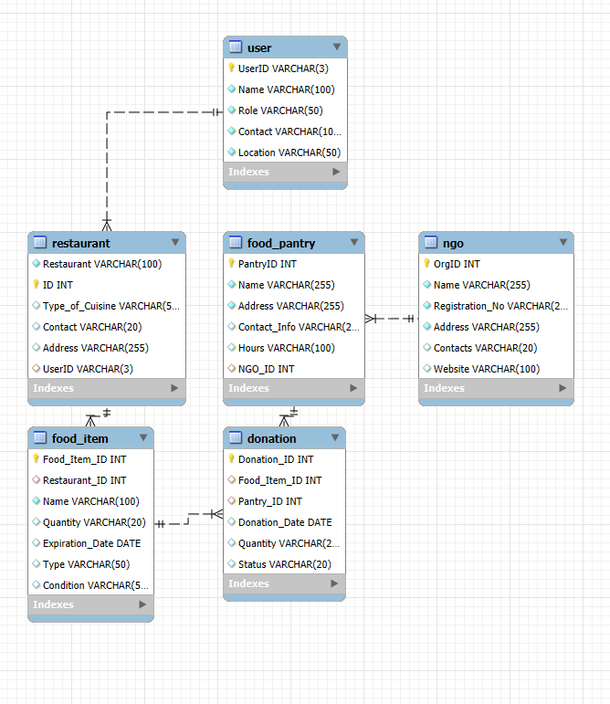
DATA MODEL
Six related entities connected the workflow
Restaurant to food item
Food item to donation
Donation to food pantry
Food pantry to NGO
Primary and foreign keys connected records across the model. Normalization reduced repeated information.
Camellia Pramanick
03
Notes:
Food Redistribution Database Design Project.pdf, University of Detroit Mercy, December 4, 2024. User confirmed contributions in both database design and testing on October 15, 2026.
Original EER diagram from report p. 32. Image preserved from supplied PDF.

Slide 4
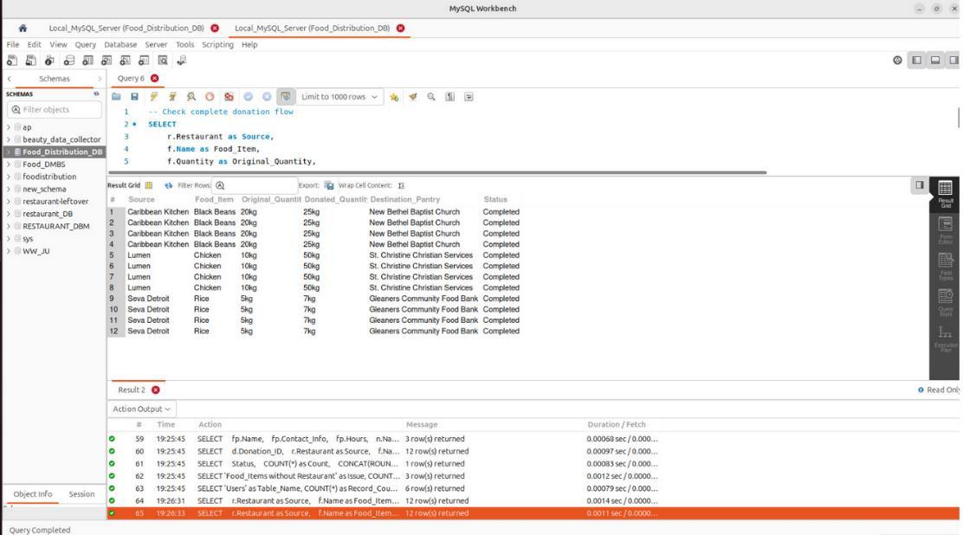
IMPLEMENTATION EVIDENCE
SQL made donation records traceable
A connected view
The query connected the source restaurant, food item, donated quantity, destination and status.
Analyst relevance
Joins and clear entity relationships turned separate tables into information users could review.
Camellia Pramanick
04
Notes:
Food Redistribution Database Design Project.pdf, University of Detroit Mercy, December 4, 2024. User confirmed contributions in both database design and testing on October 15, 2026.
Original project screenshot, report p. 50. Academic sample records. No operational impact is inferred from the displayed rows.

Slide 5
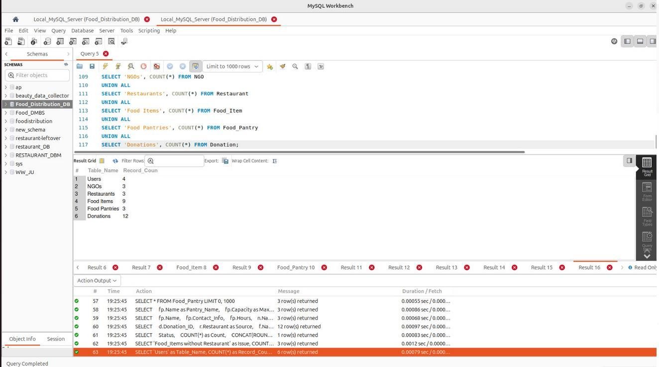
QUALITY ASSURANCE
Testing checked the data behind the workflow
Database checks
Reviewed table contents, keys and relationships to identify inconsistent or invalid records.
Functional checks
Tested search filters, permissions and tracking behavior, and supported defect resolution.
Camellia Pramanick
05
Notes:
Food Redistribution Database Design Project.pdf, University of Detroit Mercy, December 4, 2024. User confirmed contributions in both database design and testing on October 15, 2026.
Original table-count evidence from report p. 51. Testing contribution confirmed by user and LinkedIn project description. Counts are prototype sample records.

Slide 6
REPORTING APPLICATIONS
The model supported operational reporting
Inventory availability
Donation tracking
Identify food by type, quantity and expiration date to support allocation and timely distribution.
Connect food sources and destinations to review donation status and follow up on pending items.
Donor and pantry activity
Data quality follow-up
Summarize contributions and pantry activity for coordination and project reporting.
Use exceptions and relationship checks to flag incomplete records before reporting.
Camellia Pramanick
06
Notes:
Food Redistribution Database Design Project.pdf, University of Detroit Mercy, December 4, 2024. User confirmed contributions in both database design and testing on October 15, 2026.
Report pp. 37–39 describes reporting requirements. These are supported reporting use cases, not evidence of deployed operational dashboards.

Slide 7
CONTRIBUTION AND NEXT STEPS
What the project demonstrated
My contribution
Skills demonstrated
Combined database design with validation and functional testing as part of a four-person academic team.
Relational modeling, MySQL, MySQL Workbench, Lucidchart, data validation and collaborative problem solving.
Next improvement
Scope
Store quantities as numeric values with explicit units, and enforce available-stock and expiration rules.
The deliverable was an academic prototype. Community impact and production performance were not measured.
Camellia Pramanick
07
Notes:
Food Redistribution Database Design Project.pdf, University of Detroit Mercy, December 4, 2024. User confirmed contributions in both database design and testing on October 15, 2026.
Future improvements are recommendations, not claims of completed implementation. Report schema uses VARCHAR quantities. No food-waste reduction or production performance metric was supplied.

