Slide 1
BUSINESS INTELLIGENCE
Sales & Customer
Intelligence
SQL Server and Power BI portfolio case study
camelliapramanik.github.io
Camellia Pramanick
01
Notes:
https://github.com/camelliapramanik/sales-customer-intelligence
Source: README, docs/metadata/snapshot.json and docs/VALIDATION.md. Microsoft AdventureWorks sample data, not an employer engagement.

Slide 2
THE WORK
A sales model built for business questions
Business questions
My contribution
Where did revenue come from? Which customers remained active? How did product and channel margins compare?
Built the SQL analytics layer, transformed data in Power Query, and developed a Power BI model and DAX measures.
1 fact table
5 dimensions
55 measures
Sales order detail grain
Date, customer, product,
territory and salesperson
Reusable KPI definitions
Camellia Pramanick
02
Notes:
https://github.com/camelliapramanik/sales-customer-intelligence/blob/main/docs/DATA_MODEL.md
55 measures and 4 visible analytical pages verified in repository metadata.

Slide 3
SAMPLE DATA
The analytical scope
121,317
31,465
sales-detail rows
distinct orders
19,119
109.85M
purchasing customers
net sales in source monetary units
Reporting period: May 30, 2022 to June 29, 2025
Camellia Pramanick
03
Notes:
https://github.com/camelliapramanik/sales-customer-intelligence/blob/main/docs/metadata/snapshot.json
All values unfiltered, independently aggregated from embedded PBIX data. Source monetary units, no currency conversion. Profit is a standard-cost estimate.

Slide 4
FINDING 01
Channel revenue and margin diverged
Share of net sales
Estimated standard-cost margin
Decision supported: review product mix, discounts and cost assumptions before changing channel strategy.
Camellia Pramanick
04
Notes:
https://github.com/camelliapramanik/sales-customer-intelligence/blob/main/docs/metadata/snapshot.json
Online sales 29,358,677.89 and profit 12,080,819.83. Reseller sales 80,487,703.01 and profit 476,904.22. Percentages computed from these sums. Investigate mix, discounts and historical cost assumptions before acting.

Slide 5
FINDING 02
Bikes accounted for 86.17% of sales
Revenue concentration
The category mix made dependence on bikes visible and gave users a starting point for product analysis.
A follow-up question
Accessories had a 49.87% estimated margin. Would a targeted cross-sell test be worthwhile?
Camellia Pramanick
05
Notes:
https://github.com/camelliapramanik/sales-customer-intelligence/blob/main/docs/metadata/snapshot.json
Sales by category in source monetary units. Accessories had 1.16% of sales and 49.87% estimated standard-cost margin. This suggests a question to investigate, not demonstrated cross-sell uplift.

Slide 6
CUSTOMER ANALYTICS
Purchasing activity needed a clear definition
5,111
14,008
active within 90 days
inactive for more than 90 days
What the report enabled
Interpretation
Compared purchase recency with historical customer value to prioritize accounts for further investigation.
Measured activity as of June 29, 2025. The 90-day rule described recency, not a validated churn prediction.
Camellia Pramanick
06
Notes:
https://github.com/camelliapramanik/sales-customer-intelligence/blob/main/docs/METRICS.md
Source snapshot as of June 29, 2025. Active means last purchase at most 90 days before analysis date. Inactive is not confirmed churn.

Slide 7
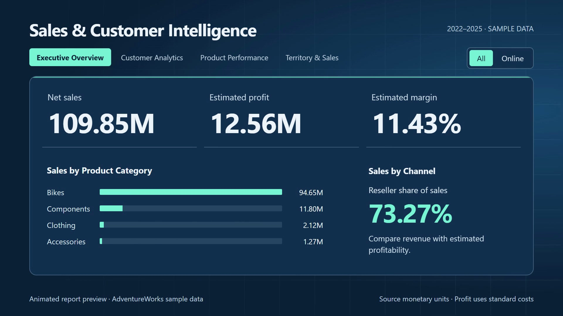
REPORT EXPERIENCE
Four report pages supported exploration
Executive Overview
Customer Analytics
Product Performance
Territory & Sales Performance
Shared filters, page navigation and metric definitions supported consistent exploration.
Watch the report walkthrough
Camellia Pramanick
07
Notes:
https://github.com/camelliapramanik/sales-customer-intelligence/blob/main/docs/REPORT_GUIDE.md
Image is the repository launch-video preview, an animated reconstruction from imported sample data, not a Power BI Desktop screenshot.

Slide 8
QUALITY AND BUSINESS USE
Reliable reporting required validation
Data checks
Important limits
Validated fact grain, dimension keys and relationship coverage. The embedded data had no duplicate detail IDs or unmatched dimension keys.
Profit used standard costs. Partial years required comparable periods. Customer names were not unique account identifiers.
Skills demonstrated
Business value
T-SQL, dimensional modeling, Power Query, DAX filter context, KPI definitions and business interpretation.
Provided a consistent way to investigate sales concentration, customer activity and estimated profitability in sample data.
Camellia Pramanick
08
Notes:
https://github.com/camelliapramanik/sales-customer-intelligence/blob/main/docs/VALIDATION.md
Zero duplicate fact IDs, zero duplicate dimension keys and zero unmatched fact keys found in embedded-data validation. These are repository checks, not a new SQL Server or DAX execution.

