Slide 1
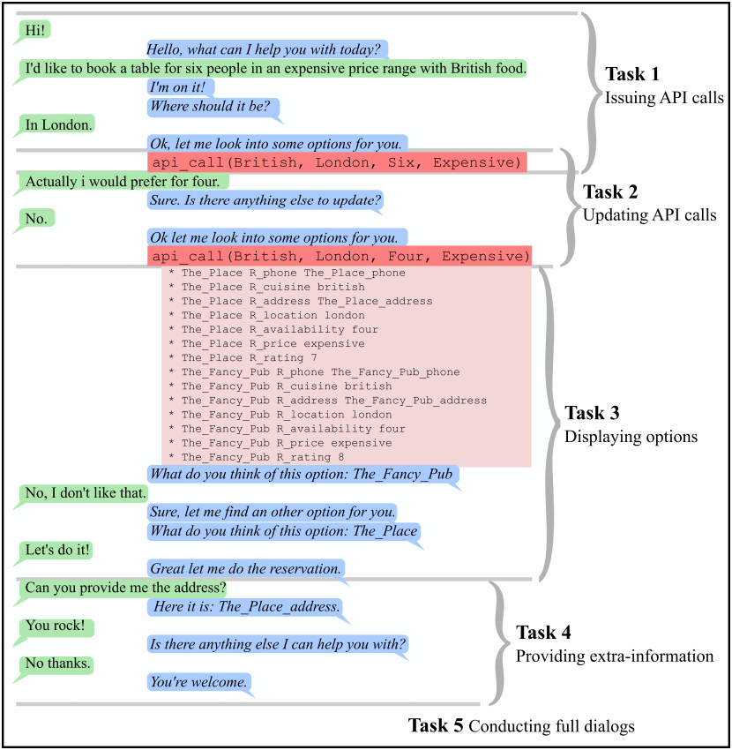
Knowledge Base - Sample
Dialogue
cuisine | location | price range | rating | party size | address | phone number
French | London | cheap | 1 | 4 | … | …
British | Tokyo | moderate | 2 | 6 | … | …
… | … | expensive | … | … | … | …
Natural Language Pattern - Generate
Hello, what can I help you with today?
I’d like to book a table for <@party_size> people in an <@price_range> price range with <cuisine> food.
API call – Query knowledge base
Picture on the right from https://arxiv.org/pdf/1605.07683.pdf

