Slide 1

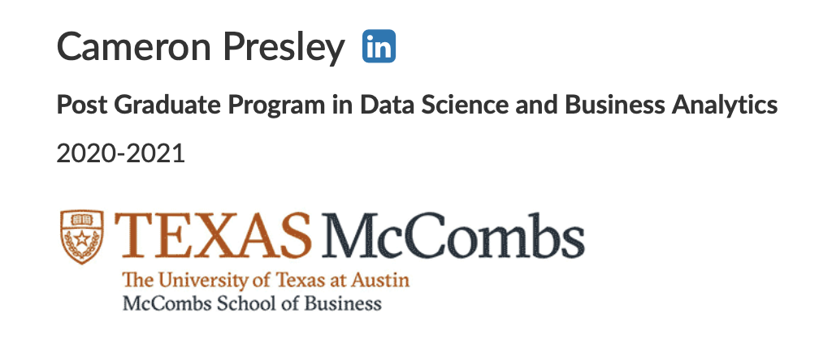
Visit with Us
Travel Package Predictions submitted: 2021-05-06

Slide 2
Objective
Analyze the customers' data and information to provide recommendations to the Policy Maker and Marketing Team to improve the yield from the next marketing campaign while improving the costs.
Build a model to predict the potential customer who is going to purchase the newly introduced travel package for Wellness Tourism.

Slide 3

Background
The Policy Maker of "Visit with Us" tourism company wants to enable and establish a viable business model to expand the customer base.
Currently, there are 5 types of packages the company is offering - Basic, Standard, Deluxe, Super Deluxe, King. Looking at the data of the last year, we observed that 18% of the customers purchased the packages.
However, the marketing cost was quite high because customers were contacted at random without looking at the available information.
The company is now planning to launch a new product i.e. Wellness Tourism Package. Wellness Tourism is defined as Travel that allows the traveler to maintain, enhance or kick-start a healthy lifestyle, and support or increase one's sense of well-being.
However, this time company wants to harness the available data of existing and potential customers to make the marketing expenditure more efficient.

Slide 4
Features: Customer Details
CustomerID: Unique customer ID
ProdTaken: Product taken flag (predictor)
Age: Age of customer
TypeofContact: How customer was contacted (Company Invited or Self Inquiry)
CityTier: City tier
Occupation: Occupation of customer
Gender: Gender of customer
NumberOfPersonVisited: Total number of person came with customer
PreferredPropertyStar: Preferred hotel property rating by customer
MaritalStatus: Marital status of customer
NumberOfTrips: Average number of the trip in a year by customer
Passport: The customer has passport or not
OwnCar: Customers owns a car flag
NumberOfChildrenVisited: Total number of children visit with customer
Designation: Designation of the customer in the current organization
MonthlyIncome: Gross monthly income of the customer

Slide 5
Features:
Customer Interaction Data
PitchSatisfactionScore: Sales pitch satisfactory score
ProductPitched: Product pitched by a salesperson
NumberOfFollowups: Total number of follow up has been done by sales after the initial sales pitch
DurationOfPitch: Duration of the pitch by a salesman to customer

Slide 6
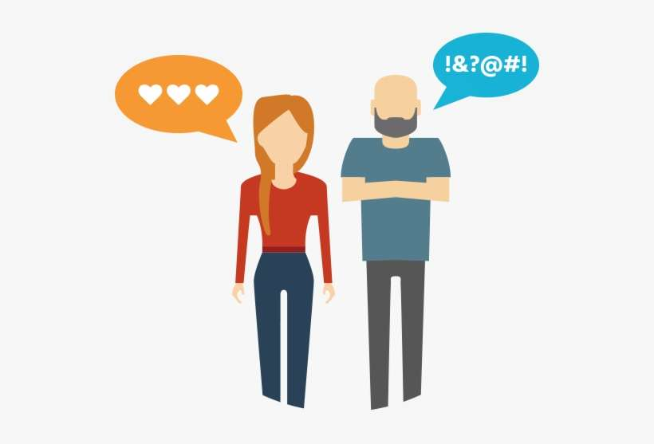
Customer Profile

Slide 7
Demographics
Age: 38 yrs (avg)
Gender: Male (60%)
Marital Status:
38% Single / Divorced
14% Unmarried
Location:
65% - Tier 1 Cities
31% - Tier 3 Cities
Occupation:
49% salaried
42.6% SBO
8.8% LBO
Positions Held:
50% Execs, no ICs
Income:
$283K per annum
Car Ownership:
62% own
Passport Holders:
29%
Preferences
Property Type:
3-5 stars
62% - 3 stars
Travel Party Size:
1-5 people
3 people (50%)
Traveling with Kids:
50% travel with a single child under 5 yrs old
Trips per Year: 3.23
Other Factors
First Contact:
Self Inquiry
Travel Party Size:
1-5 people
3 people (50%)
Traveling with Kids:
50% travel with a single child under 5 yrs old
Trips per Year: 3.23
Buying Behavior
No influence to attach rate for Travel Packages:
First Contact
Gender
Car Ownership
Number of Children < 5yrs Traveling
Factors with influence:
35 % of Single (incl. Unmarried) buy
35% with Passports buy (2x more than non-holders)
Higher end Properties have higher attach rates
Executives buy more
Large business owners buy the most (25%)
30% pitched the Basic/Standard buy
Sales Motion
Sales Pitch:
15.5 minutes – avg.
Sales Touch:
3.7 times – avg.
Sales Ptich Satisfaction:
3 out of 5
Products Pitched:
53% - standard /basic
35% - deluxe
12% - king/super deluxe

Slide 8
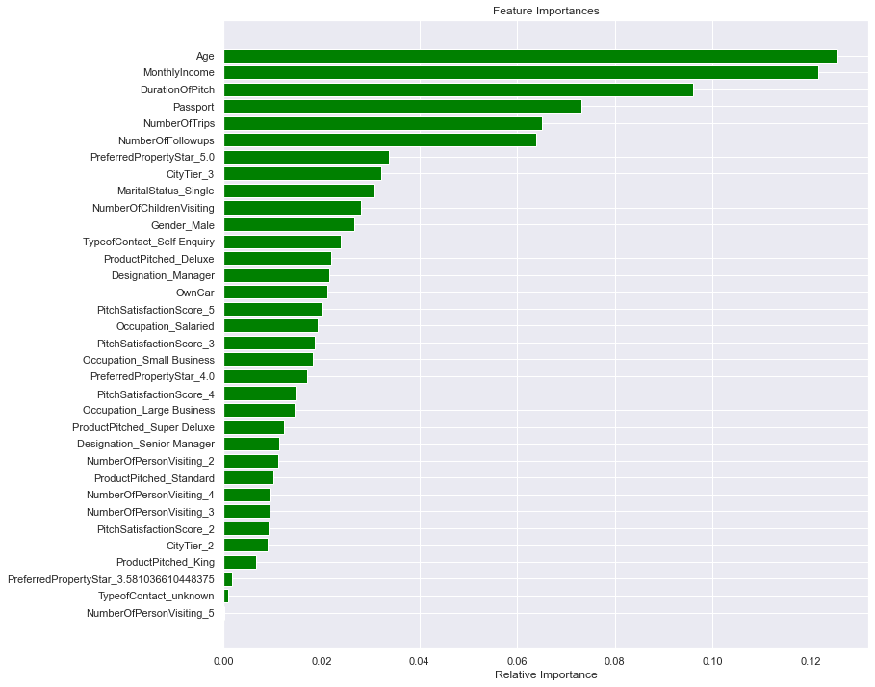
Prediction Model

Slide 9
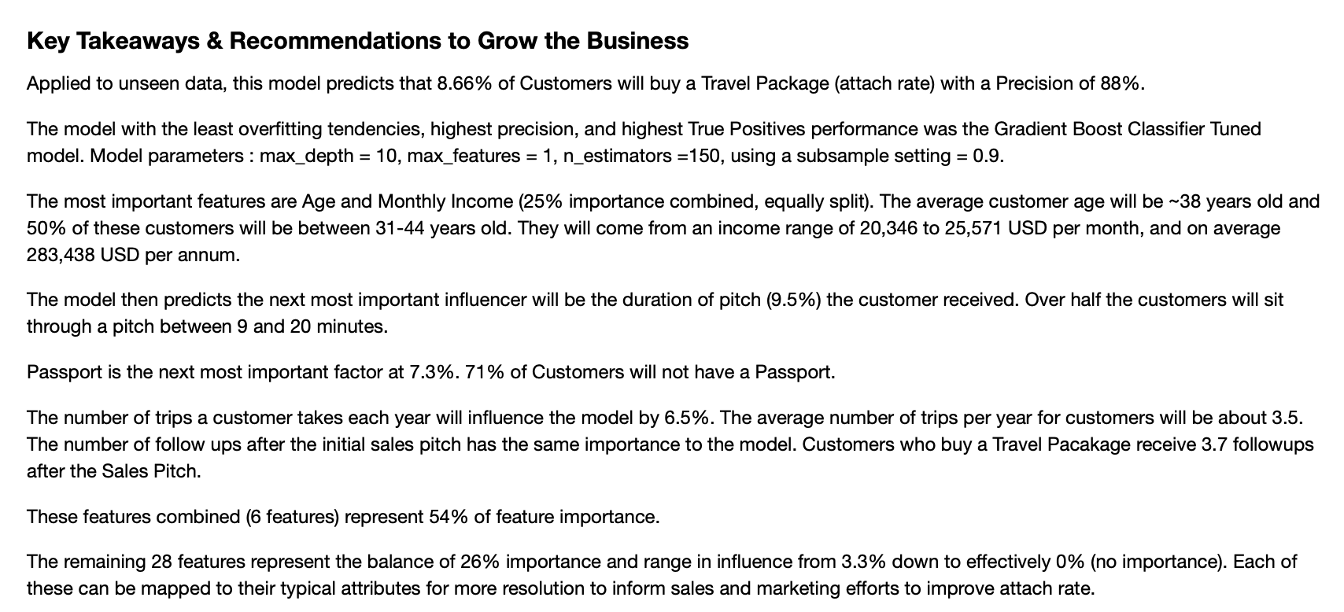

Slide 10
Visit with Us
Travel Package Predictions submitted: 2021-05-06

