Slide 1
PSSNs

Slide 2
Norse

Slide 3
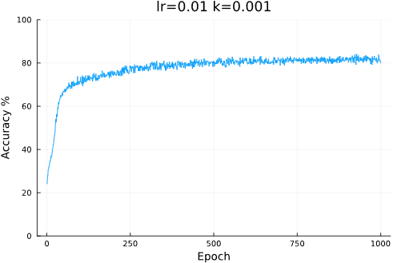
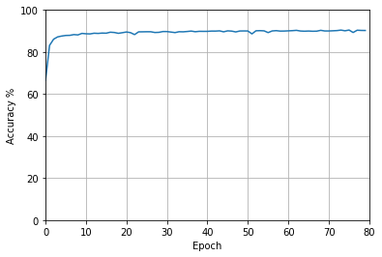
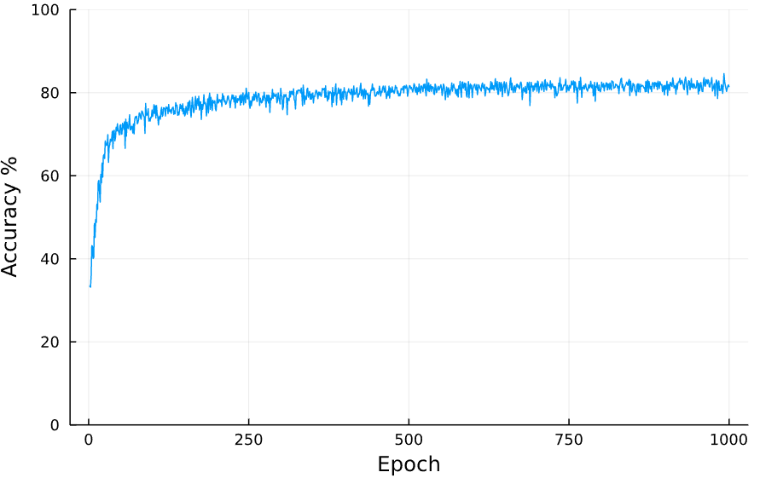
Iris Dataset
PSSN
Norse
82% - 2m – [4,3] layer size – CPU
90% – 5m – [4,50,3] layer size – CPU
82% - 23m – [4,50,3] layer size – CPU

Slide 4
Iris Method Comparison

