Slide 1


Customer Insights Report prepared for: Axis Insurance product line: Health Insurance date: Feb. 24, 2021
Notes:
ID=d924773e-9a16-4d6d-9803-8cb819e99682 Recipe=text_billboard Type=TextOnly Variant=0 FamilyID=AccentBoxWalbaum_Zero

Slide 2
Overview
Scope and Deliverables
Data Overview
EDA
Answers to Key Questions
Insights and Conclusions

Slide 3
Scope and Deliverables
This report is prepared for Axis Insurance.
Deliverables include:
EDA with key insights on the Customer dataset.
Explore medical claims for Smokers as compared to Non-Smokers. Do Smokers have higher medical claims?
Explore BMI differences between Males and Females, are they different.
Explore if Smokers are affected by their residence (”Region”), namely are they different across different Regions.
Explore the BMI for women with no children, one child, or two children and if they are the same?

Slide 4
Data Overview
Data Cleanse | Variable Count | Total Observations
No Missing Data Change Object Types to Category | 7 total 4 numerical 3 categorical | 1,338
Variable Name | Description
Age | Age of primary beneficiary, excludes customers > 64 yrs old
Sex | Policy holder’s gender (Male or Female)
BMI | Body Mass Index (BMI), measure of weight (kg) to height (m), with ideal between 18.5 to 24.9.
Children | Number of children covered by the insurance plan.
Smoker | Yes or No based on whether the insured regularly smokes tobacco.
Region | Beneficiaries' residence in the US divided into 4 regions – northeast, southeast, southwest, northwest
Charges | Individual medical costs billed to health insurance
Notes:
Data Dictionary –
Age - This is an integer indicating the age of the primary beneficiary (excluding those above 64 years, since they are generally covered by the government).
Sex - This is the policy holder's gender, either male or female.
BMI - This is the body mass index (BMI), which provides a sense of how over or under-weight a person is relative to their height. BMI is equal to weight (in kilograms) divided by height (in meters) squared. An ideal BMI is within the range of 18.5 to 24.9.
Children - This is an integer indicating the number of children / dependents covered by the insurance plan.
Smoker - This is yes or no depending on whether the insured regularly smokes tobacco.
Region - This is the beneficiary's place of residence in the U.S., divided into four geographic regions - northeast, southeast, southwest, or northwest.
Charges​ - Individual medical costs billed to health insurance

Slide 5
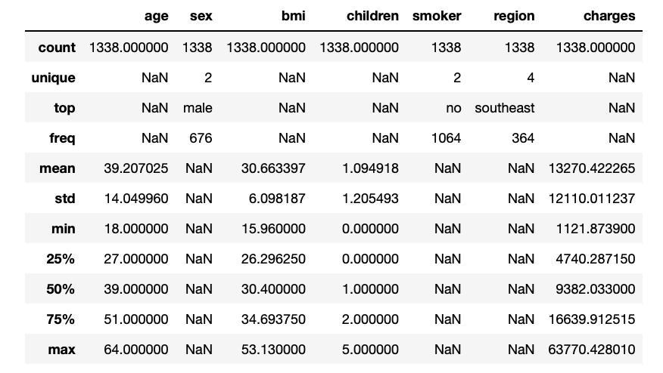
Overview of Variables: Count, Mean, Std Dev, and 5 Number Summary

Slide 6
1. EDA
Exploratory Data Analysis: Univariate, Bi-Variate, and Multi-Variate

Slide 7
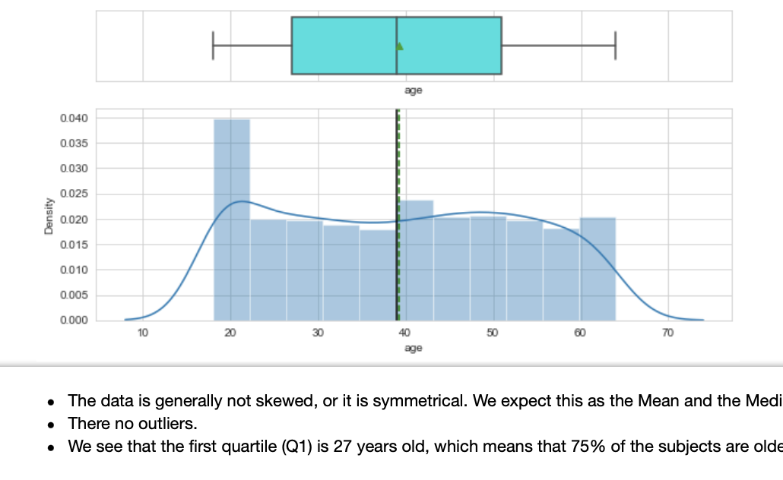
Age

Slide 8
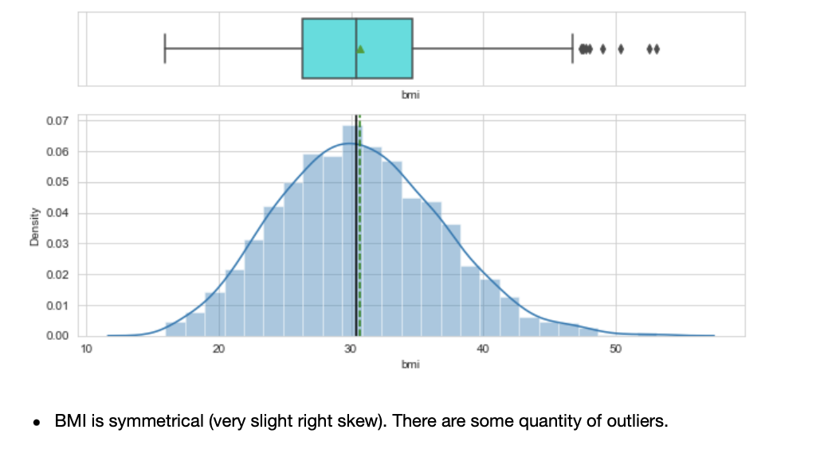
BMI

Slide 9
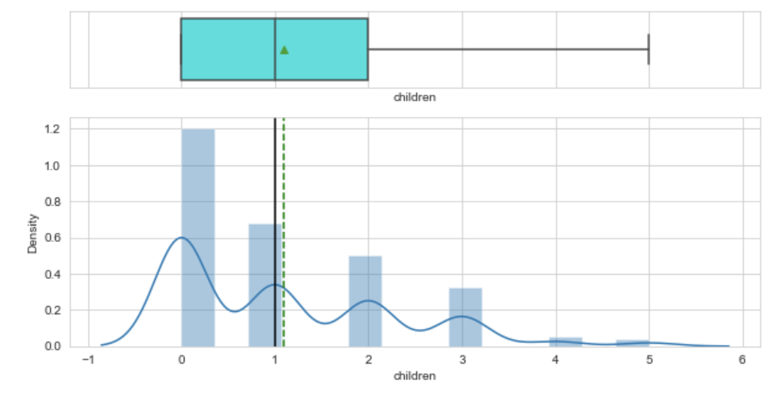
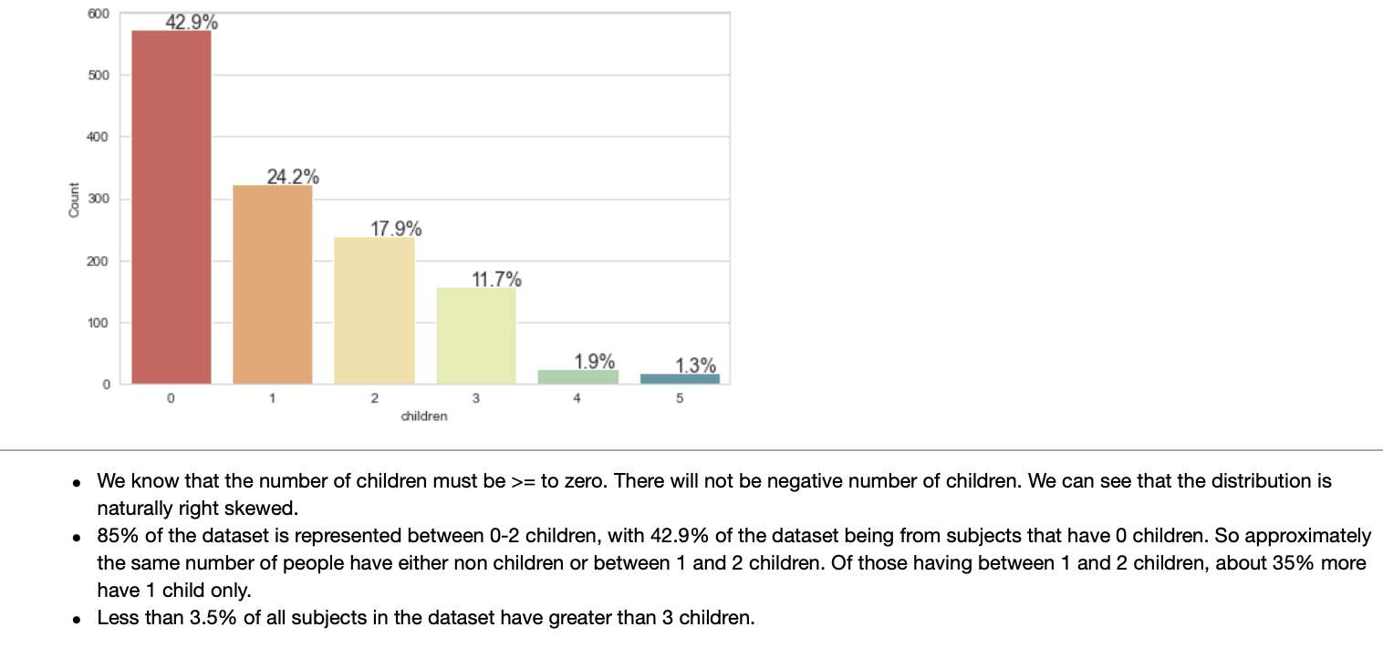
Children

Slide 10
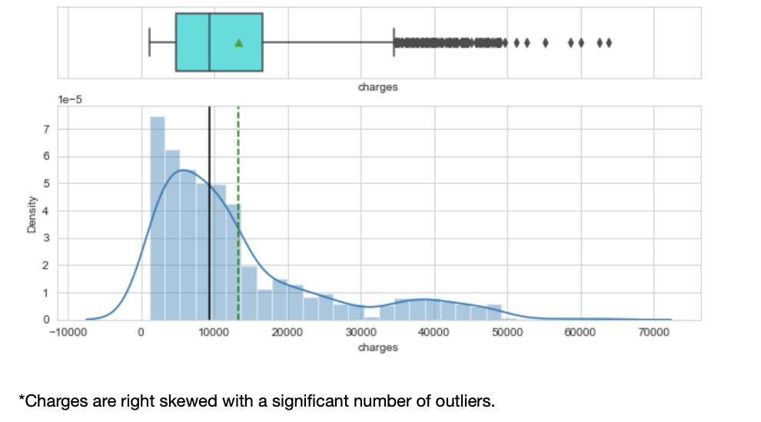
Charges

Slide 11
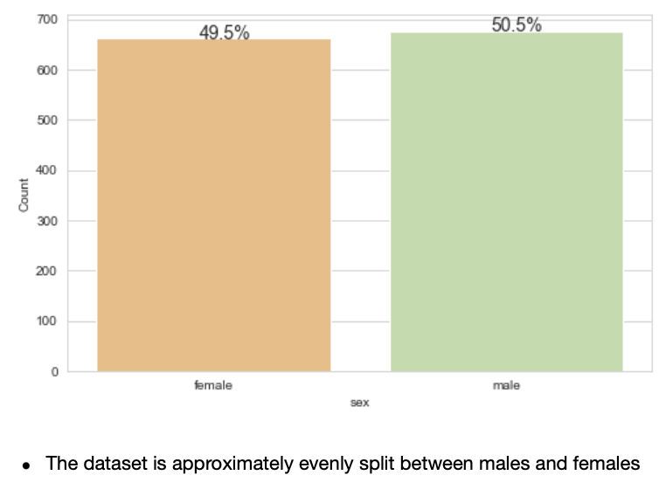
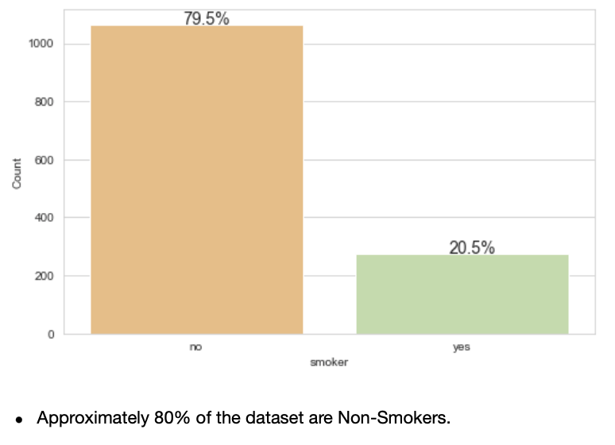
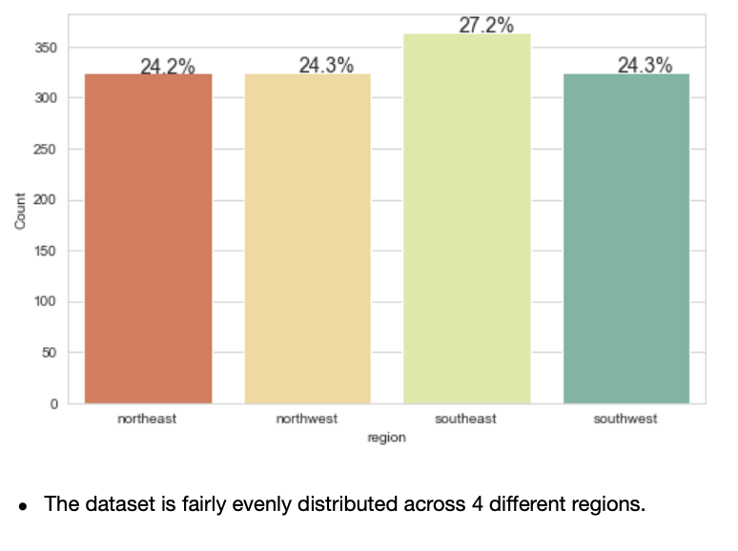
Sex, Smokers, and Region
Male v. Female
Smoker vs. Non-Smoker
Regional Comparison

Slide 12
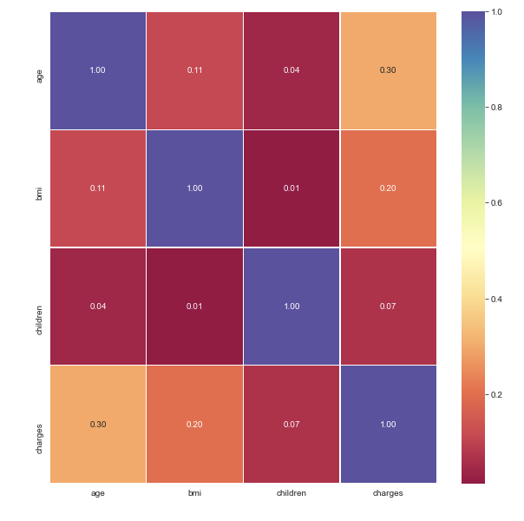
Correlation Matrix
None of the variables are highly correlated.
This informs our other analysis that we cannot necessarily expect a strong influence from bivariate relationships. We will need to incorporate a multi-variate view to explore deeper relationships between variables.

Slide 13
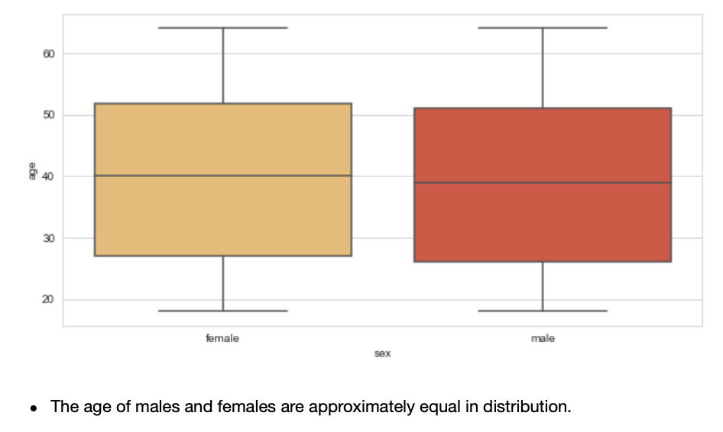
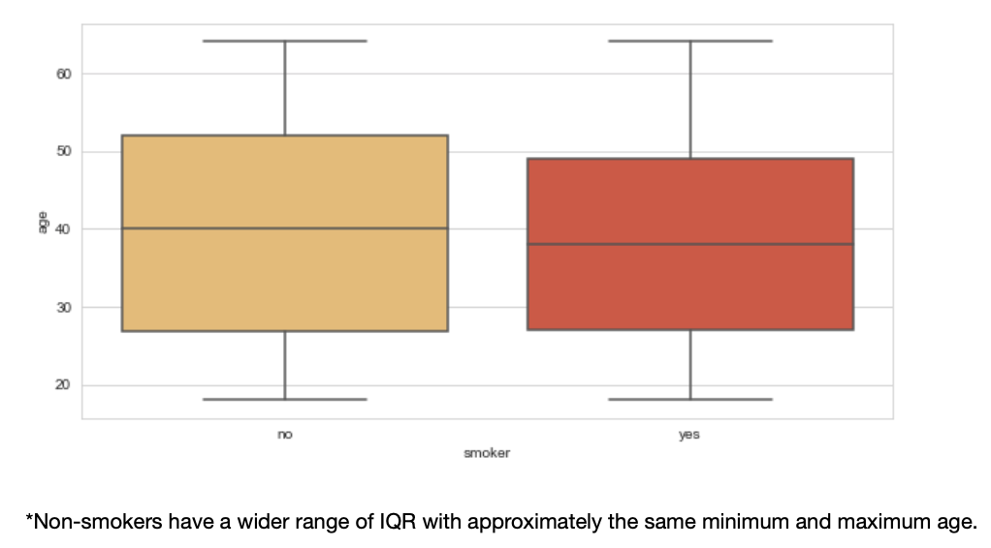
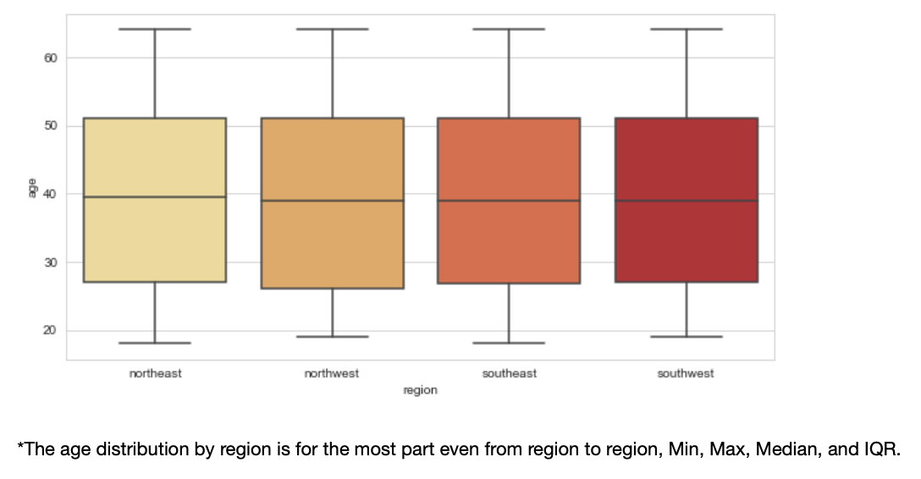
Age vs. Sex, Smoker, and Region
Age v. Sex
Age vs. Smoker
Age vs. Region

Slide 14
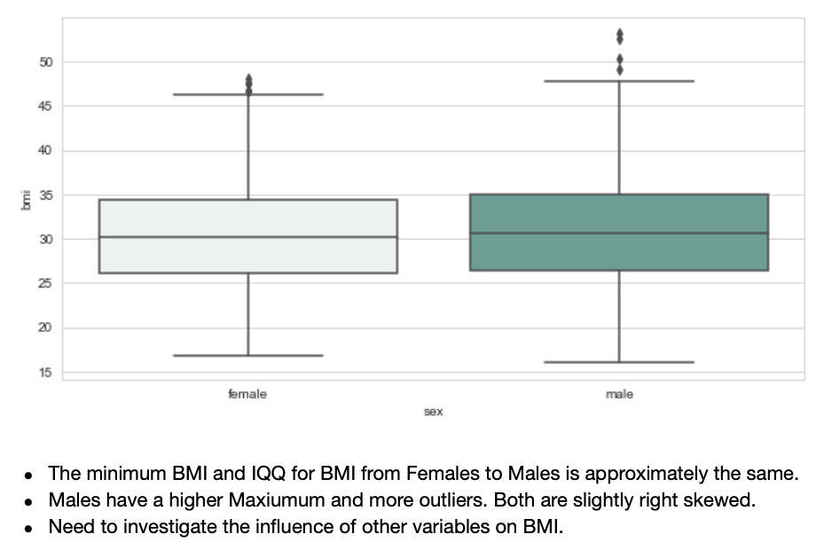
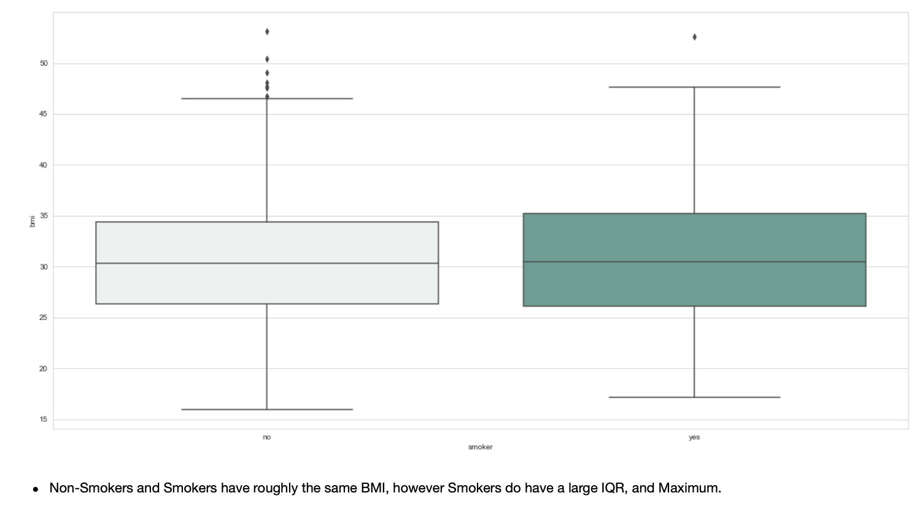
BMI vs. Sex & Smoker
BMI v. Sex
BMI vs. Smoker

Slide 15
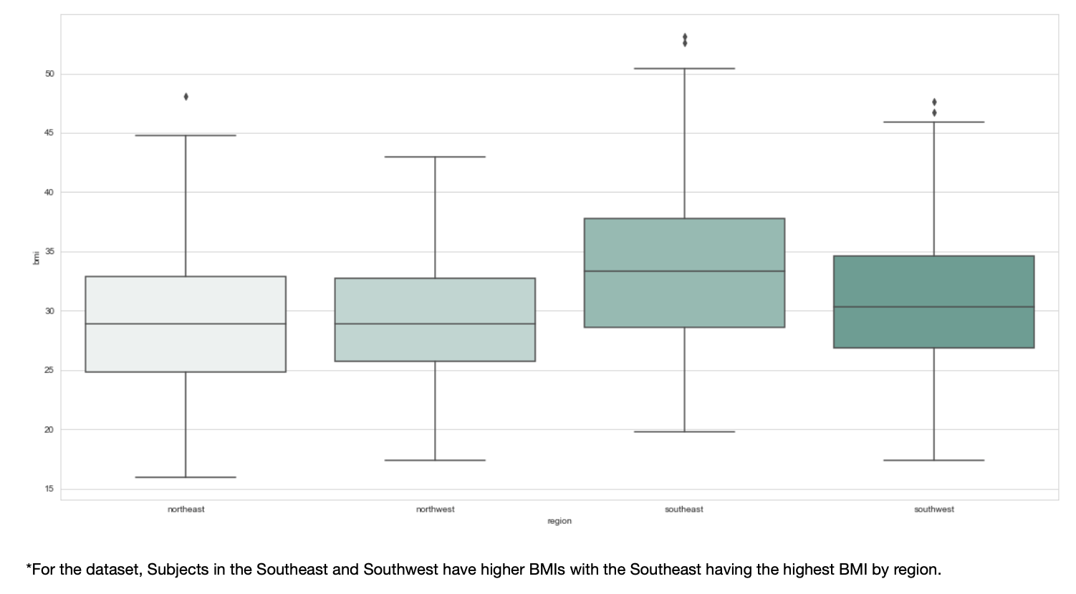
BMI vs. Region

Slide 16
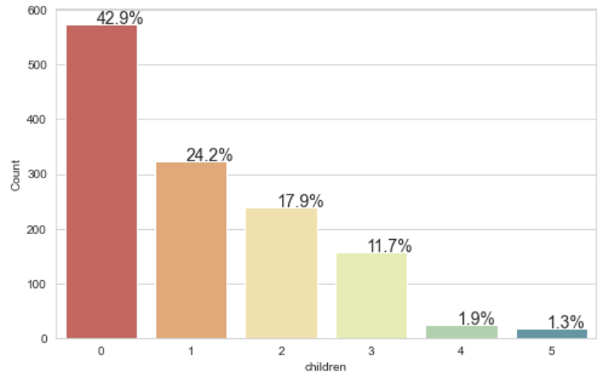
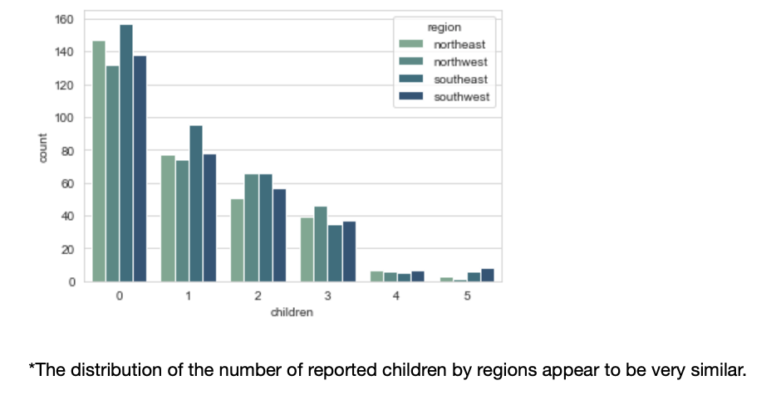
Children vs. Region

Slide 17
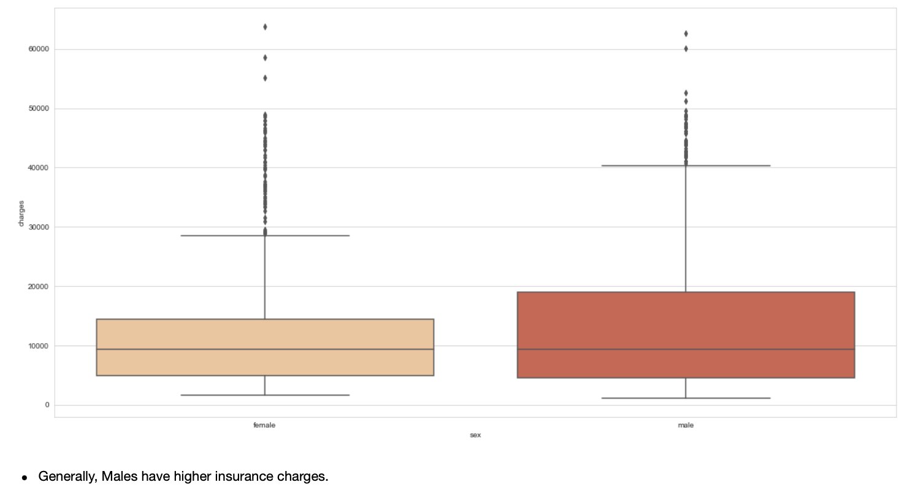
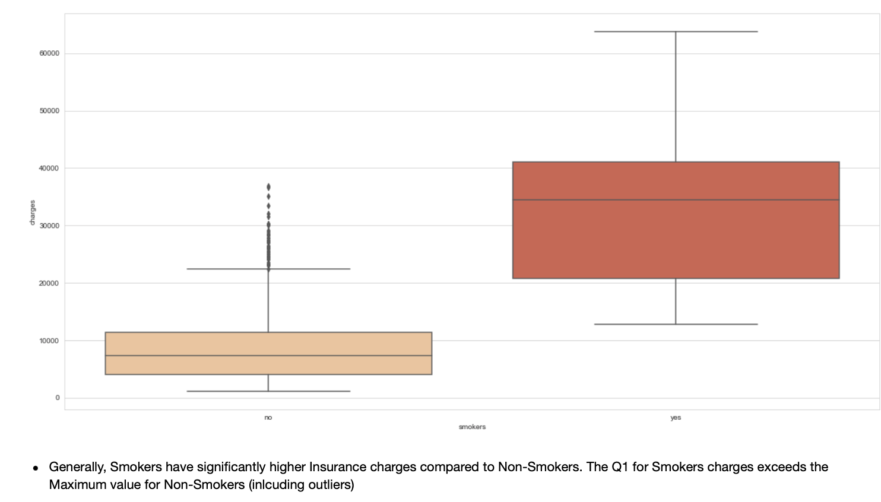
Charges vs. Sex & Smoker
Charges v. Sex
Charges vs. Smoker

Slide 18
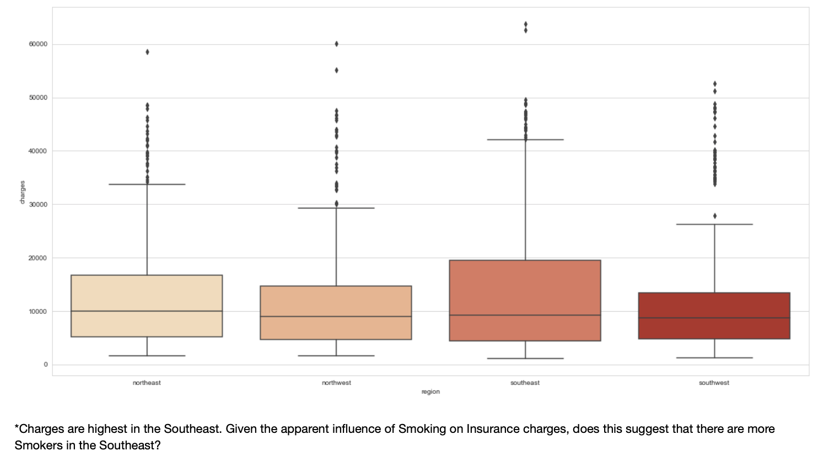
Charges vs. Region

Slide 19
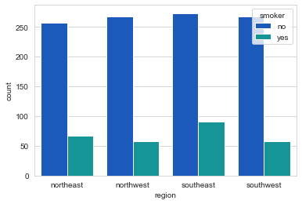
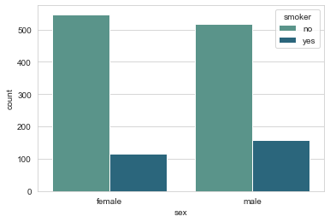
Smoker vs. Sex & Region
There are indeed more Smokers in the Southeast, followed by the Northeast, Northwest-Southwest (~ the same), respectively.
The split between Smokers and Non-Smokers by Sex is similar, but there are more Smokers who are Male than Female.

Slide 20
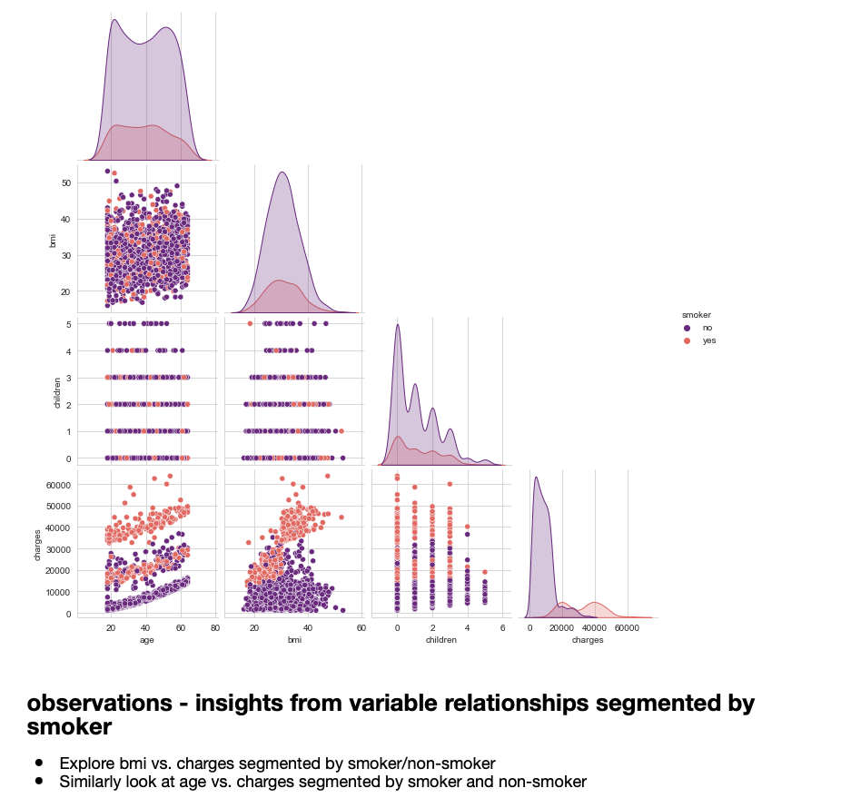
Smokers
Looking back at the Correlation Matrix we know there is a low correlation between pairs of numerical variables, however, by looking at the same pairings segmented by Smokers and Non-Smokers, patterns begin to emerge that we can explore more deeply. Specifically, charges for smokers by age and BMI.

Slide 21
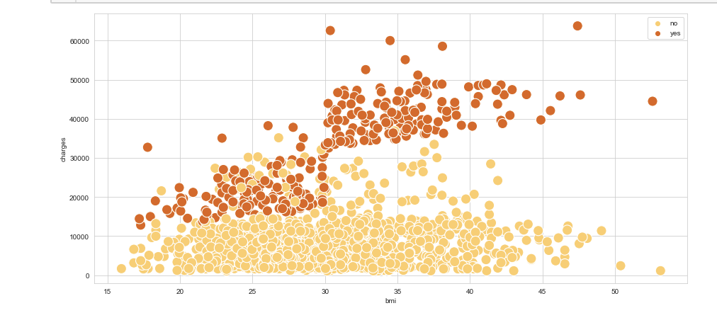
Charges vs. BMI vs. Smokers
We can see that the Non-Smokers have lower charges overall than Smokers.
The rate of change for Non-Smokers charges is relatively flat (i.e., slope ~= to 0) with increasing BMI as compared to Smokers who have linearly increasing charges with increasing BMI.

Slide 22
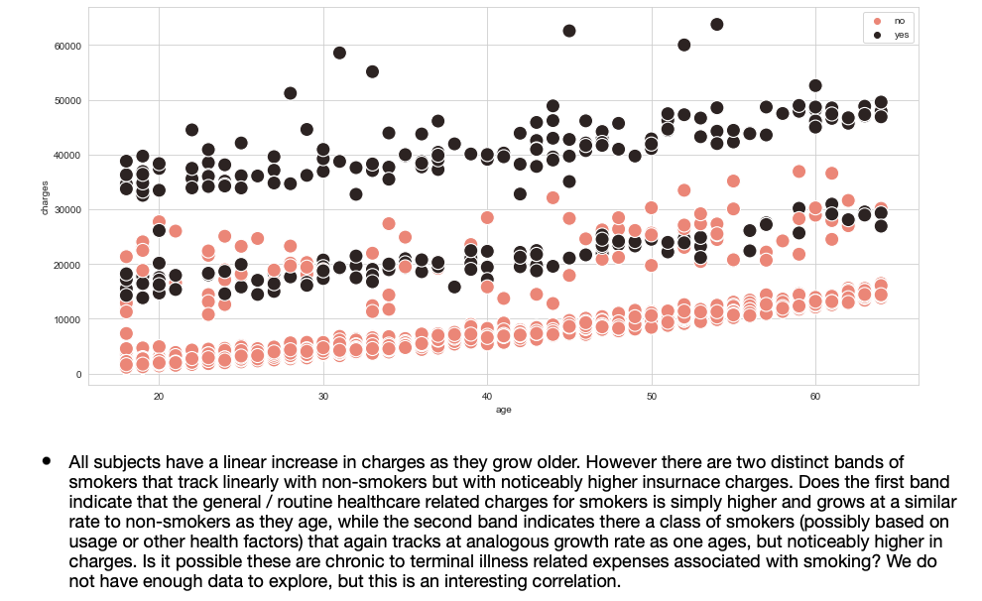
Charges vs. Age vs. Smokers

Slide 23
2. Medical Claims Made By Smokers
Prove (or disprove) that the medical claims made by people who smoke is greater than those who don’t smoke.

Slide 24
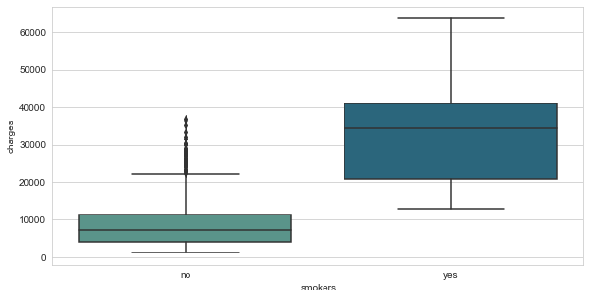
Observations : Smokers vs. Charges
We see that there is a significant difference in the charges between those who Smoke and those who do not Smoke (i.e., non-Smokers).
The Non-Smokers have many outliers with respect to charges, however, the Grand Max for Non-Smokers barely reaches Q3 of the Smokers IQR for the sample in question.
There are no outliers for Smoker related Charges and the charges are right skewed.
The two variables are Mutually Exclusive. In short, one cannot be a Smoker and be a Non-Smoker at the same time.

Slide 25
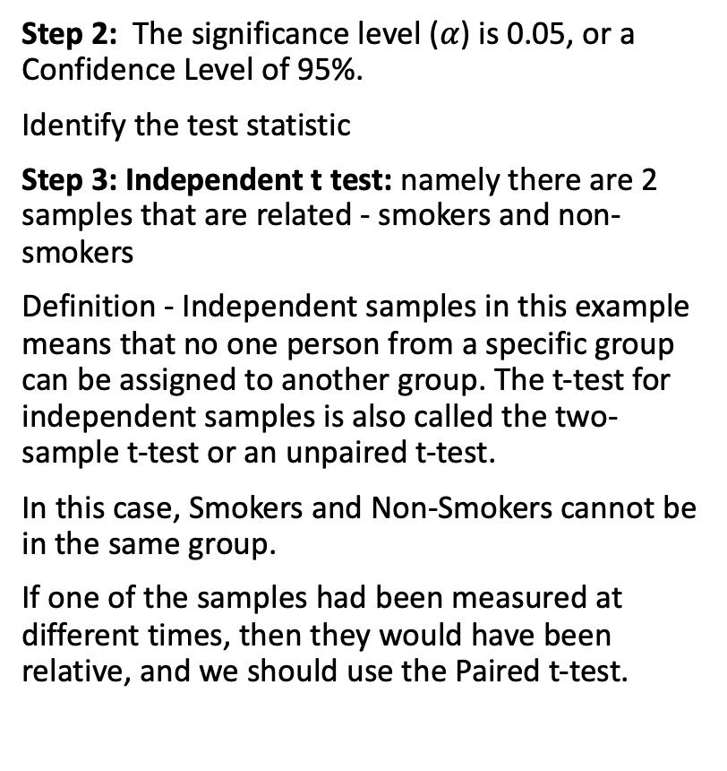
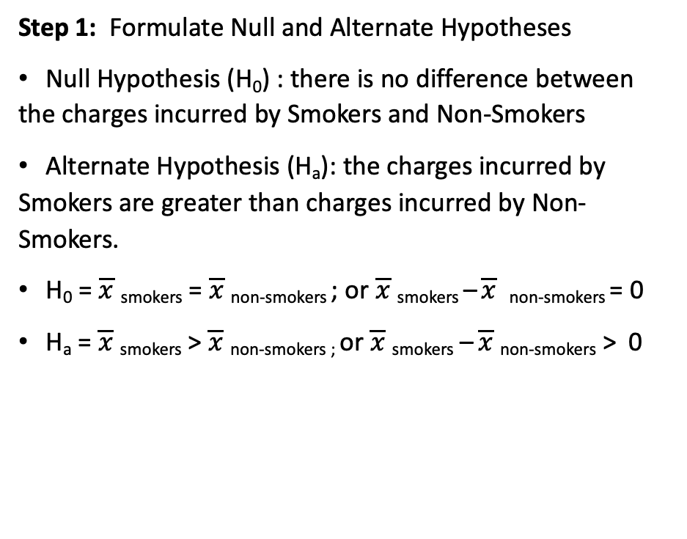
Answer
Step 2: The significance level ($α$) is 0.05, or a Confidence Level of 95%.
Identify the test statistic
Step 3: Independent t test: namely there are 2 samples that are related - smokers and non-smokers
Definition - Independent samples in this example means that no one person from a specific group can be assigned to another group. The t-test for independent samples is also called the two-sample t-test or an unpaired t-test.
In this case, Smokers and Non-Smokers cannot be in the same group.
If one of the samples had been measured at different times, then they would have been relative, and we should use the Paired t-test.
Step 1: Formulate Null and Alternate Hypotheses
Null Hypothesis (H₀) : there is no difference between the charges incurred by Smokers and Non-Smokers
Alternate Hypothesis (H_{a}): the charges incurred by Smokers are greater than charges incurred by Non-Smokers.
H₀ = $\overline{x}$ _{smokers} = $\overline{x}$ _{non-smokers} ; or $\overline{x}$ _{smokers} – $\overline{x}$ _{non-smokers} = 0
H_{a} = $\overline{x}$ _{smokers} > $\overline{x}$ _{non-smokers ;} or $\overline{x}$ _{smokers} – $\overline{x}$ _{non-smokers} > 0

Slide 26

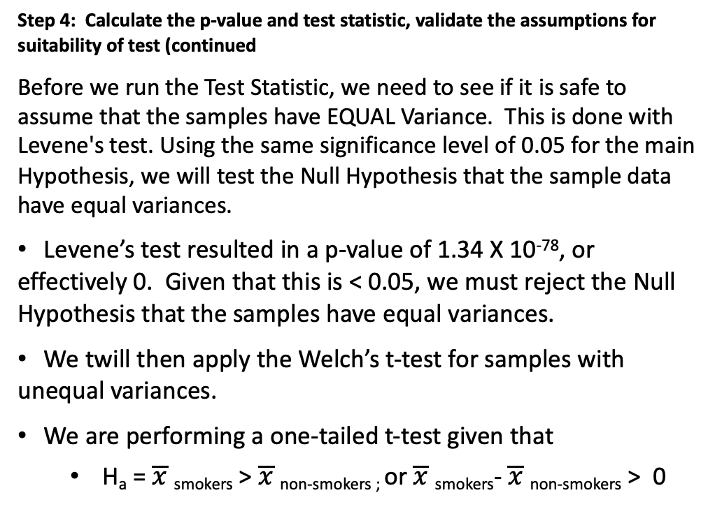
Answer
RESULTS and Conclusions:
The one-tailed p-value is effectively 0, or less than our significance level of 0.05. Therefore, we REJECT the Null Hypothesis and the Alternate Hypothesis stands.
We cannot say that there is ”No Difference” in the Charges between Smokers and Non-Smokers.
We can say that at a 95% Confidence Level that the charges associated with Smokers are greater than the charges associated with Non-Smokers.
Step 4: Calculate the p-value and test statistic, validate the assumptions for suitability of test (continued
Before we run the Test Statistic, we need to see if it is safe to assume that the samples have EQUAL Variance. This is done with Levene's test. Using the same significance level of 0.05 for the main Hypothesis, we will test the Null Hypothesis that the sample data have equal variances.
Levene’s test resulted in a p-value of 1.34 X 10⁻⁷⁸, or effectively 0. Given that this is < 0.05, we must reject the Null Hypothesis that the samples have equal variances.
We twill then apply the Welch’s t-test for samples with unequal variances.
We are performing a one-tailed t-test given that
H_{a} = $\overline{x}$ _{smokers} > $\overline{x}$ _{non-smokers ;} or $\overline{x}$ _{smokers}- $\overline{x}$ _{non-smokers} > 0

Slide 27
3. BMI & Sex (Gender)
Prove (or disprove) with statistical evidence that the BMI for Females is different than that of Males.

Slide 28
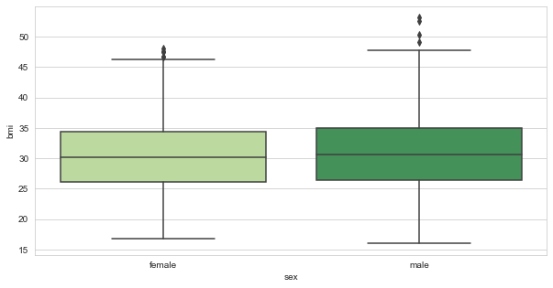
Observations – BMI vs. Sex
BMI by Gender (sex) is essentially equivalent
They have essentially the same Median, the same IQR.
Males have more outliers than Females.
There is a slight right skewness but generally, evenly distributed.
These two variables are mutually exclusive, namely if you are a Male, you are not a Female.

Slide 29
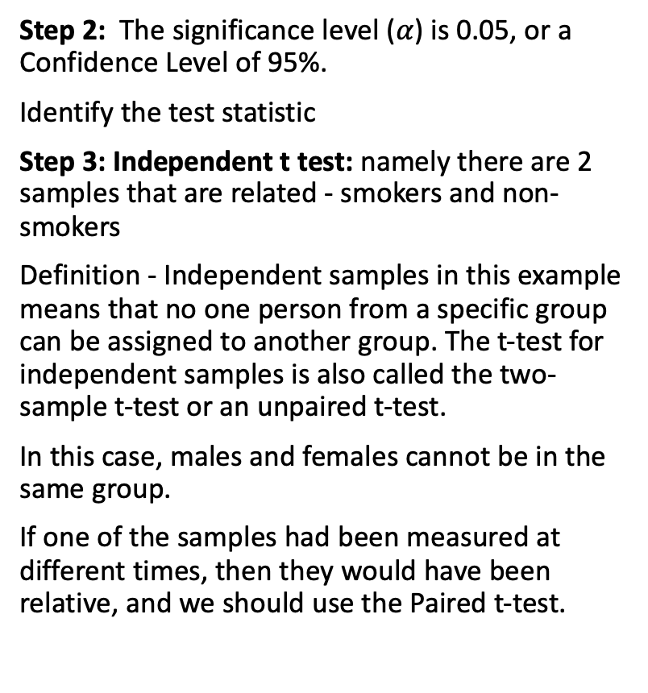
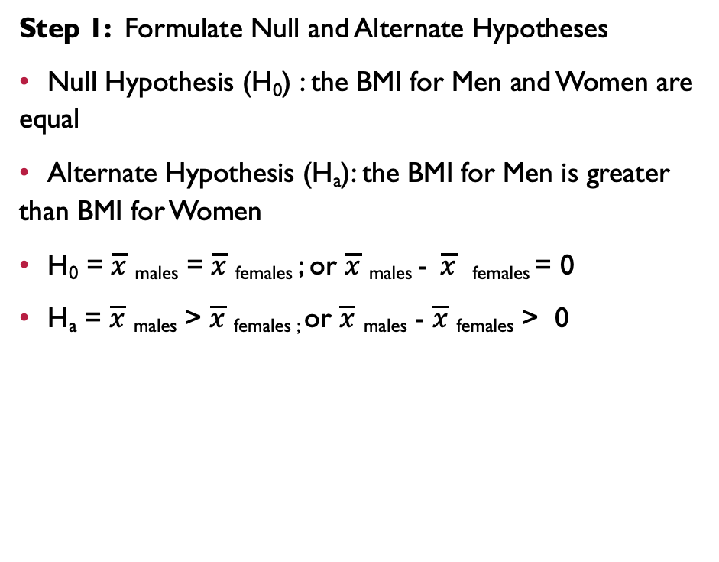
Answer
Step 2: The significance level ($α$) is 0.05, or a Confidence Level of 95%.
Identify the test statistic
Step 3: Independent t test: namely there are 2 samples that are related - smokers and non-smokers
Definition - Independent samples in this example means that no one person from a specific group can be assigned to another group. The t-test for independent samples is also called the two-sample t-test or an unpaired t-test.
In this case, males and females cannot be in the same group.
If one of the samples had been measured at different times, then they would have been relative, and we should use the Paired t-test.
Step 1: Formulate Null and Alternate Hypotheses
Null Hypothesis (H₀) : the BMI for Men and Women are equal
Alternate Hypothesis (H_{a}): the BMI for Men is greater than BMI for Women
H₀ = $\overline{x}$ _{males} = $\overline{x}$ _{females} ; or $\overline{x}$ _{males} - $\overline{x}$ _{females} = 0
H_{a} = $\overline{x}$ _{males} > $\overline{x}$ _{females ;} or $\overline{x}$ _{males} - $\overline{x}$ _{females} > 0

Slide 30
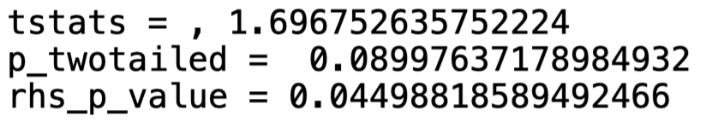
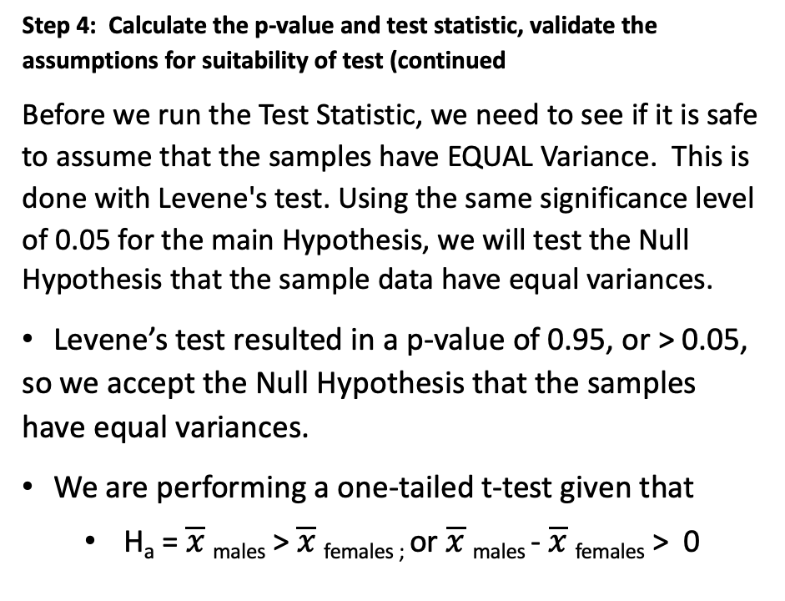
Answer
RESULTS and Conclusions:
The one-tailed p-value is effectively 0.044, or less than our significance level of 0.05. Therefore, we REJECT the Null Hypothesis.
We cannot say that there is ”No Difference” in BMI between Males and Females.
We can say that at a 95% Confidence Level that the BMI for Males is greater than the BMI for Females.
Step 4: Calculate the p-value and test statistic, validate the assumptions for suitability of test (continued
Before we run the Test Statistic, we need to see if it is safe to assume that the samples have EQUAL Variance. This is done with Levene's test. Using the same significance level of 0.05 for the main Hypothesis, we will test the Null Hypothesis that the sample data have equal variances.
Levene’s test resulted in a p-value of 0.95, or > 0.05, so we accept the Null Hypothesis that the samples have equal variances.
We are performing a one-tailed t-test given that
H_{a} = $\overline{x}$ _{males} > $\overline{x}$ _{females ;} or $\overline{x}$ _{males} - $\overline{x}$ _{females} > 0

Slide 31
4. Smokers vs. Region
Is the proportion of smokers significantly different across regions (different regions)?

Slide 32
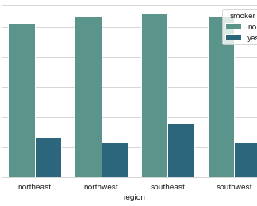
Observations – Smokers vs. Region
The magnitude of Non-Smokers across regions is approximately equal from region to region.
Proportionally, there are more Smokers in the Southeast, followed by the Northeast. They are then followed by Northwest, and Southwest, which are equal. But are these differences statistically significant?

Slide 33
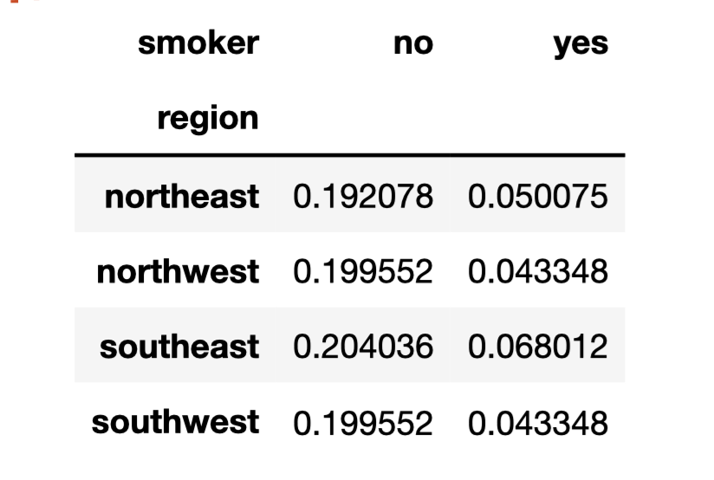
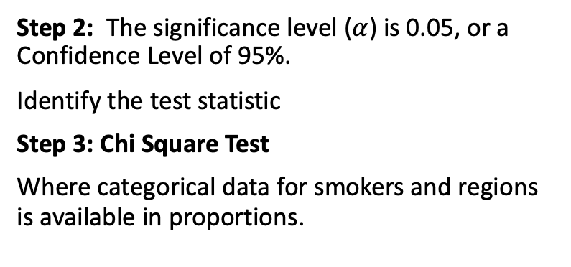
Answer
Step 2: The significance level ($α$) is 0.05, or a Confidence Level of 95%.
Identify the test statistic
Step 3: Chi Square Test
Where categorical data for smokers and regions is available in proportions.
Step 1: Formulate Null and Alternate Hypotheses
Null Hypothesis (H₀) : the proportion of smokers is equal across all regions.
Alternate Hypothesis (H_{a}): the proportion of smokers is not equal across regions.
CONTINGENCY TABLE - PROPORTIONS

Slide 34
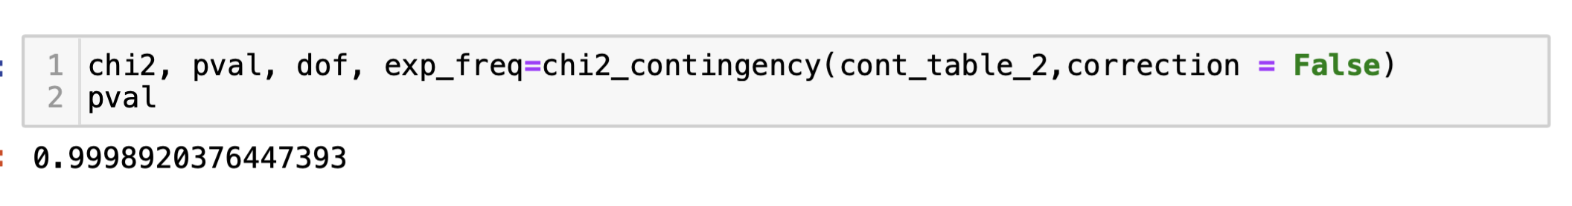
Answer
Step 4: Calculate the p-value and test statistic, validate the assumptions for suitability of test
RESULTS and Conclusions:
Using the Contingency Table built from proportion of smokers by region, the p-value is 0.99, which is > 0.05 therefore, we FAIL TO REJECT the Null Hypothesis that proportion of smokers is effectively the same across different regions.

Slide 35
5. BMI for Women vs. Number of Children
Is the Mean BMI for women with no children, or one child, and two children the same?

Slide 36
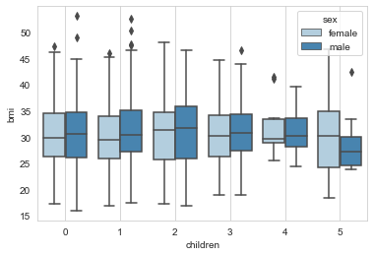
Observations – BMI vs. Children VS. Sex
It is not clear from the visualization of Children vs. BMI segmented by Sex that there is noticeable difference in BMI for females as the number of children increase.

Slide 37
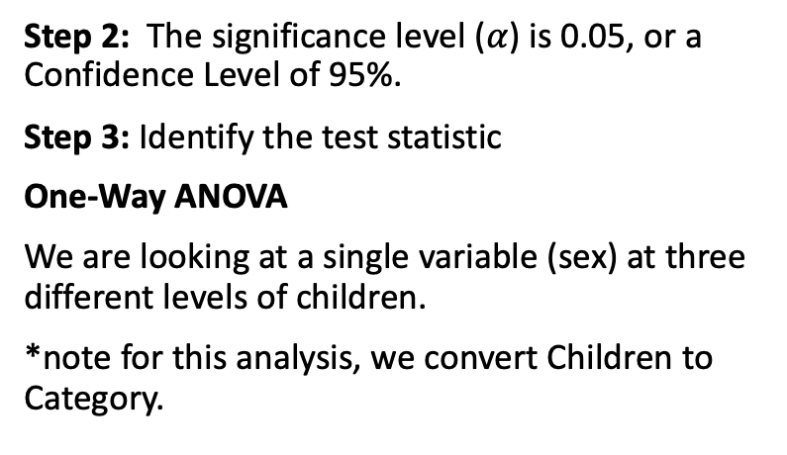
Answer
Step 2: The significance level ($α$) is 0.05, or a Confidence Level of 95%.
Step 3: Identify the test statistic
One-Way ANOVA
We are looking at a single variable (sex) at three different levels of children.
*note for this analysis, we convert Children to Category.
Step 1: Formulate Null and Alternate Hypotheses
Null Hypothesis (H₀) : the means of BMI for females with no children, one child, and two children are equal.
Alternate Hypothesis (H_{a}): the means of BMI for females with no children, one child, and two children are unequal.

Slide 38
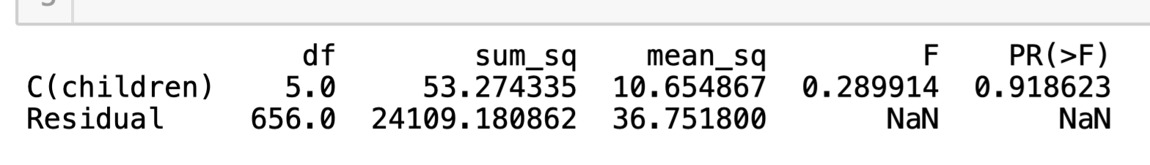
Answer
Step 4: Calculate the p-value and test statistic, validate the assumptions for suitability of test
RESULTS and Conclusions:
We see that the p-value is 0.91 >> 0.05, therefore we FAIL to REJECT the Null Hypothesis, or there is no difference in BMI between women who have a 0, 1, or 2 children.

Slide 39
Insights and Conclusions
Customers range from 18-64 years old (49.5% females, 50.5% males) with 75% of the customers older than 27 years old.
They come from 4 different regions in the US, with 27% from the Southeast and the balance evenly split across the other three regions – Southwest, Northwest, and Northeast.
79.5% of the customers do not smoke tobacco regularly and are considered Non-Smokers, with more Males smoking more than females, and more smokers being from the Southeast. We however did not prove statistically that there is a difference in the proportion of smokers by region.
On average, customer have 1 child insured on their policy. 42.9% of customers have no children, and 85% of call customers have 0 to 2 children on their policy. The maximum number of children per customer insured is 5 (1.3%).
Customers in this sample had a BMI ranging from 15.96 to 53.13, with 50% of the customers being between 26.29 and 34.69. The average BMI is 30.66. Greater than 75% of the customers we above the maximum of the ideal range for BMI. We proved statistically that the BMI for Males and Females are equal. This group of customers are considered medically to be obese. The BMI for the dataset is highest in the Southeast. We also proved statistically there this no difference in BMI for women who have 0,1, and 2 children which eliminates childbearing as a material contributor to BMI in females.
The medical claims (“charges”) were proven with a 95% confidence level to be higher for Smokers than Non-Smokers.
In summary, we know that there is strong influence from smoking on elevated medical claims. We know that generally those who smoke tend to have increasing charges as they grow older, occurring in two distinct bands of elevated charges, possibly linked to other health factors. Conversely, for Non-Smokers, we can see that range of medical claims remain relatively flat throughout one’s life.

Slide 40
Customer Insights Report prepared for: Axis Insurance product line: Health Insurance date: Feb. 24, 2021
Notes:
ID=d924773e-9a16-4d6d-9803-8cb819e99682 Recipe=text_billboard Type=TextOnly Variant=0 FamilyID=AccentBoxWalbaum_Zero

