Slide 1
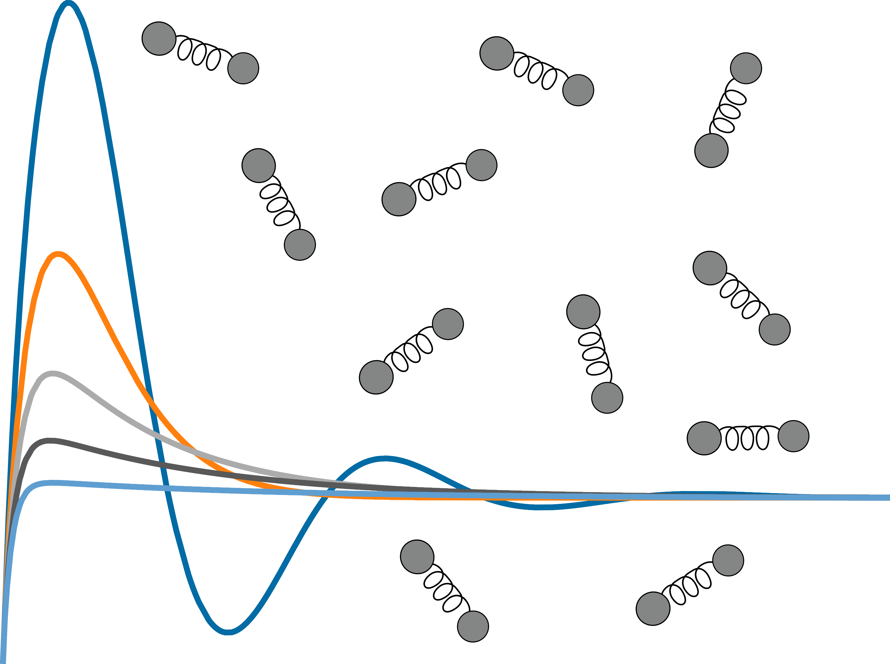
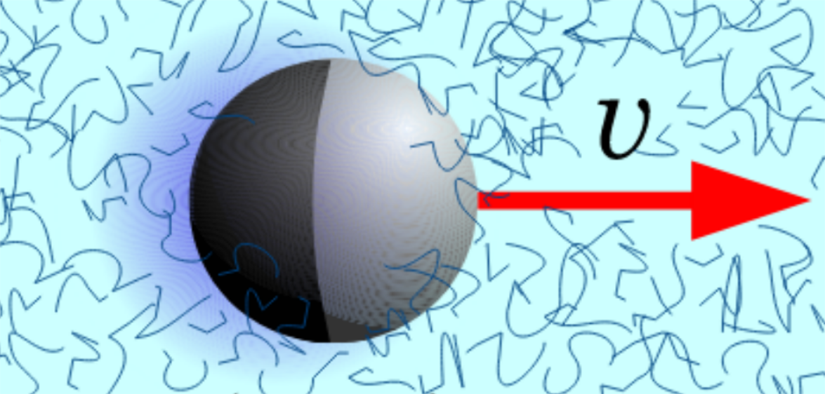
Development of a Lattice Boltzmann-Based Oldroyd-B Model for Simulating Viscoelastic Fluids
Cameron Nash Stewart
November 19, 2018
Supervisor: Michael Kuron
Examiner: Prof. Dr. Christian Holm

Slide 2
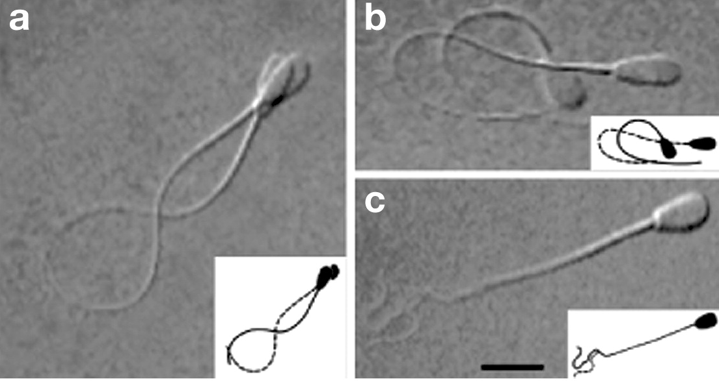
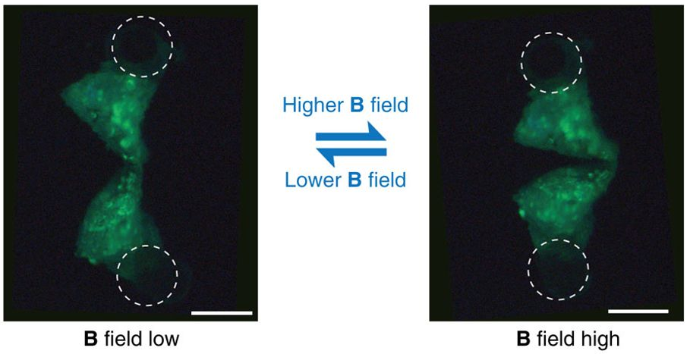
Swimmers in Complex Fluid
Qiu et al. Nat. Commun. (2014)
Fauci, Dillon Annu. Rev. Fluid. Mech. (2006)

Slide 3
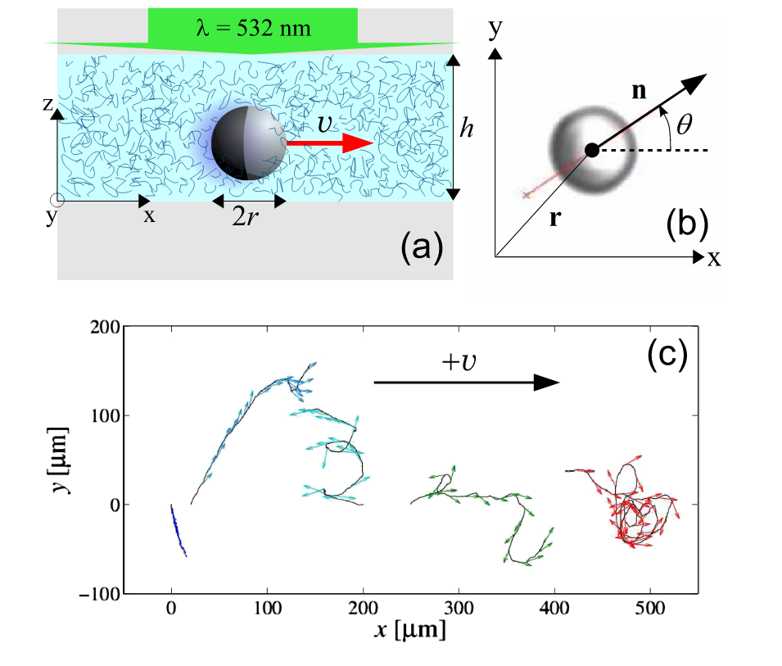
Our Inspiration
Gomez-Solano et al. Phys. Rev. Lett. (2016)

Slide 4
Continuum Model
Incompressible Navier-Stokes Equations
How can we model polymer stresses?

Slide 5
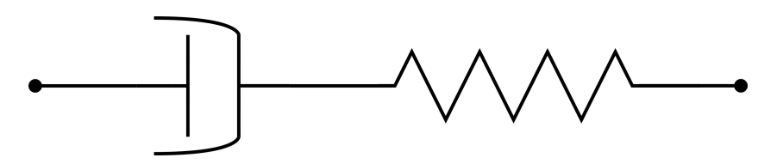
Linear Maxwell Model
Maxwell Model:

Slide 6
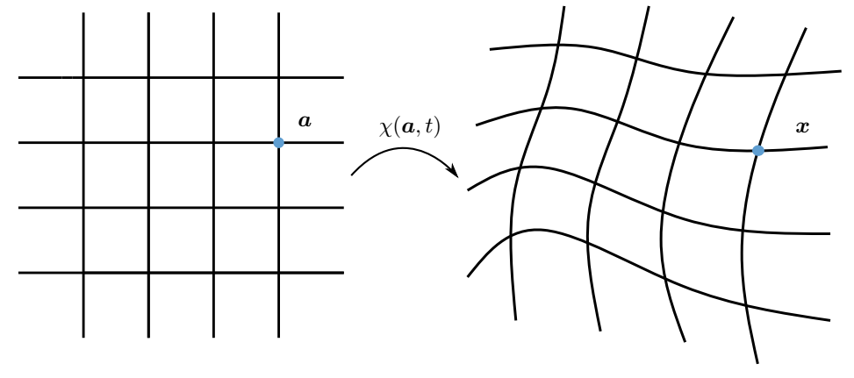
Generalization to Three Dimensions

Slide 7
Differential Equations

Slide 8
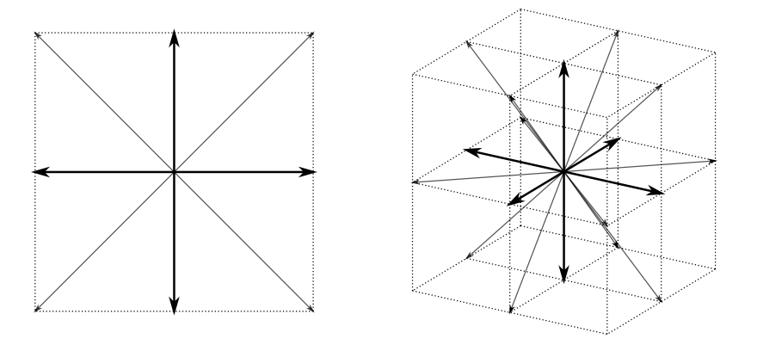
Lattice Boltzmann

Slide 9
Oldroyd-B Scheme

Slide 10
Oldroyd-B Scheme

Slide 11
Oldroyd-B Scheme
Su et al. Phys. Rev. E (2013)

Slide 12
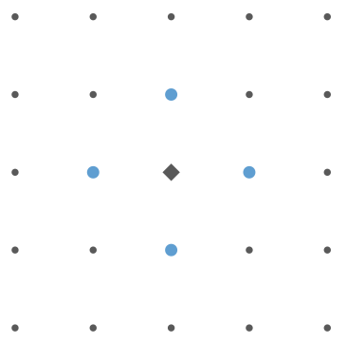
Velocity and Stress Derivatives

Slide 13
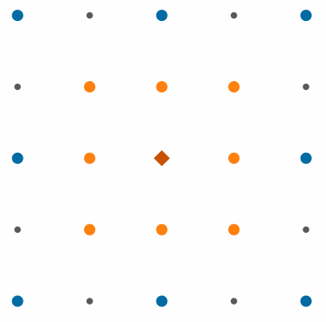
Stress Advection

Slide 14
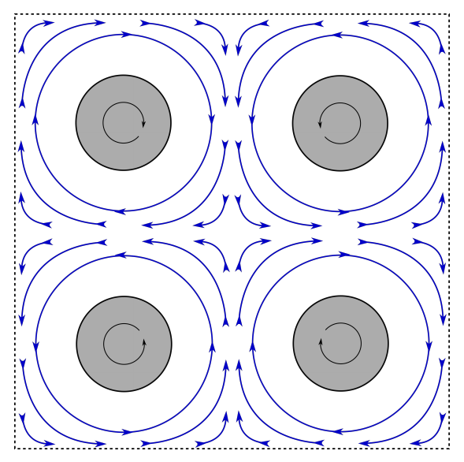
Four-Roll Mill
Sol’n near Central Point:

Slide 15
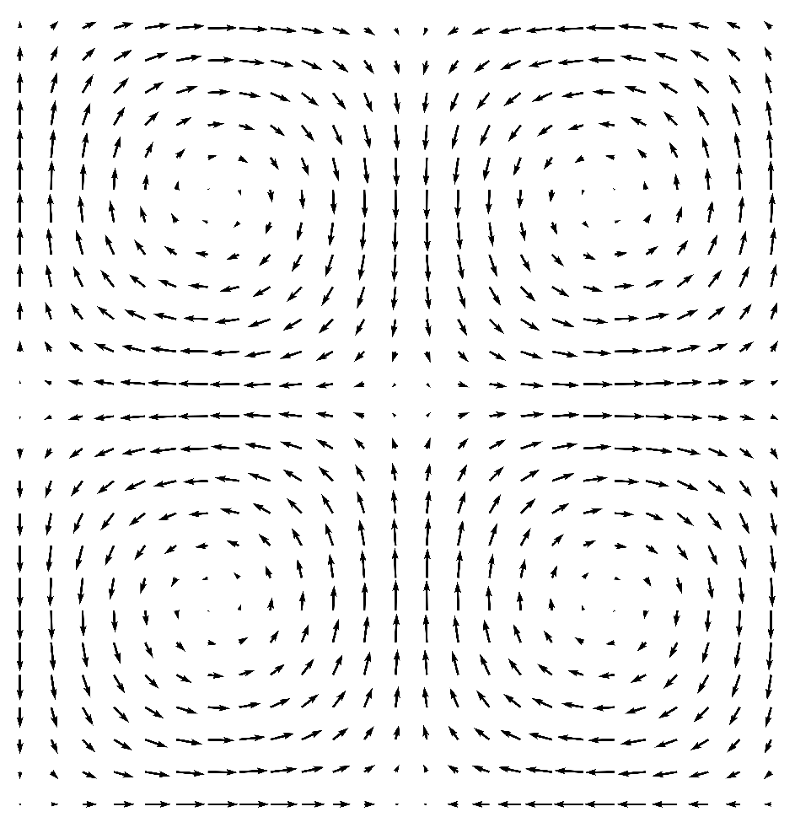
Four-Roll Mill
Sol’n near Central Point:

Slide 16
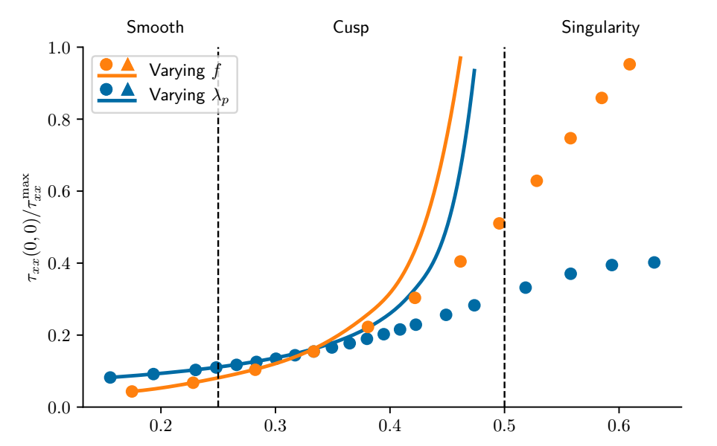
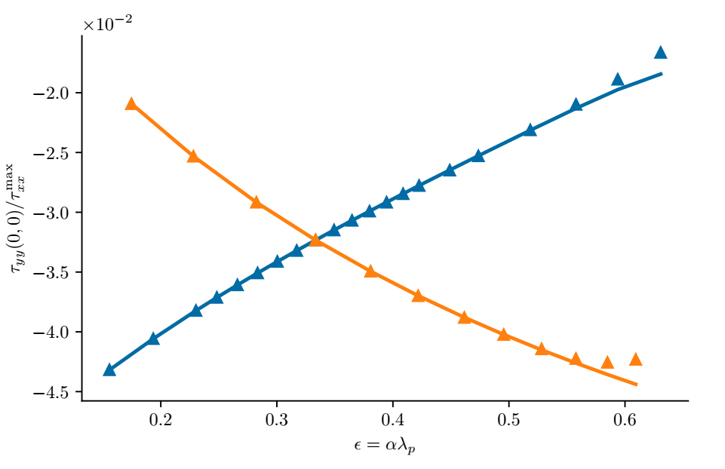
Center Point Stress

Slide 17
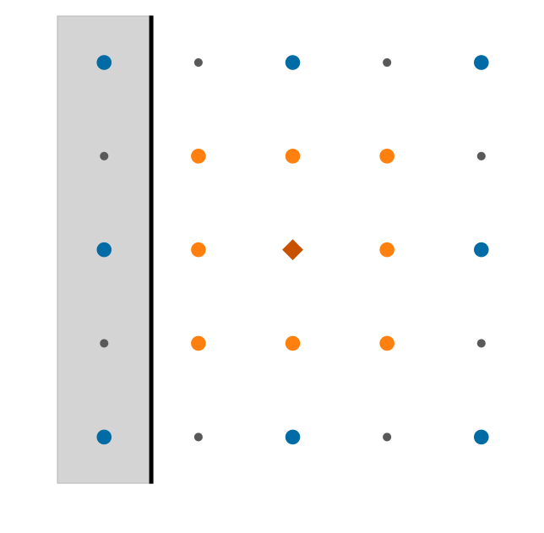


Boundaries

Slide 18
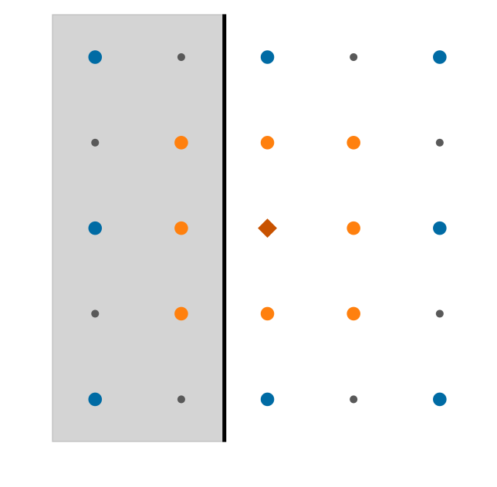
Boundaries

Slide 19
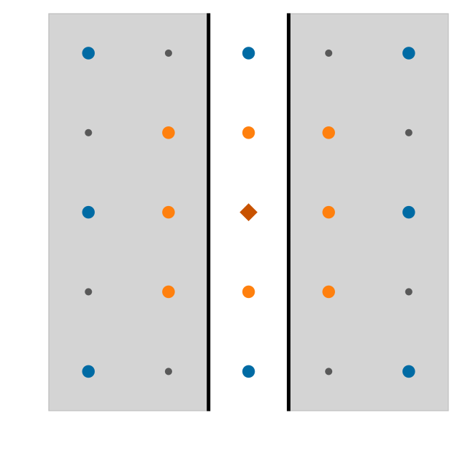
Boundaries

Slide 20
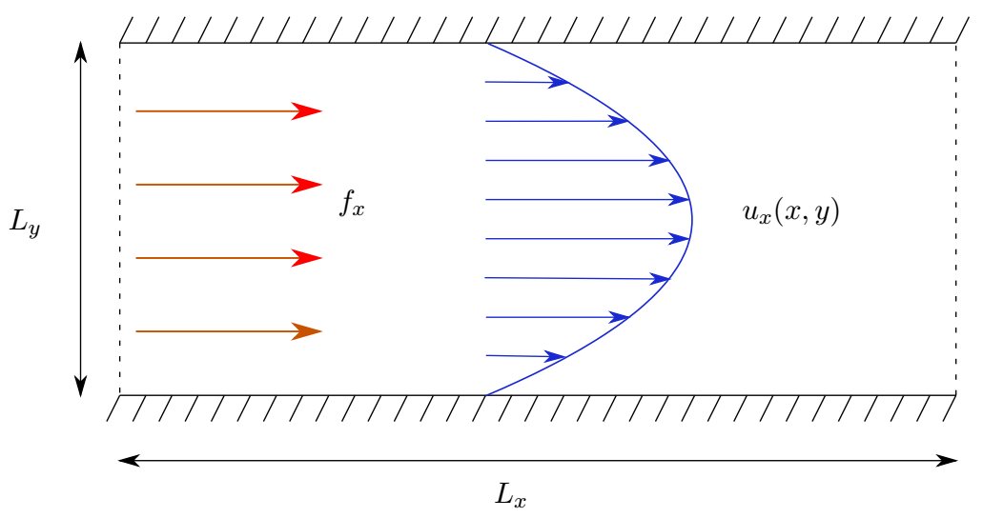
Poiseuille Flow

Slide 21
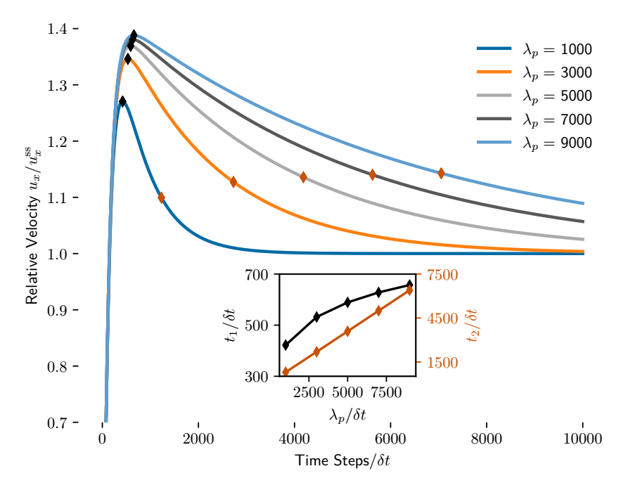
Velocity Overshoot

Slide 22
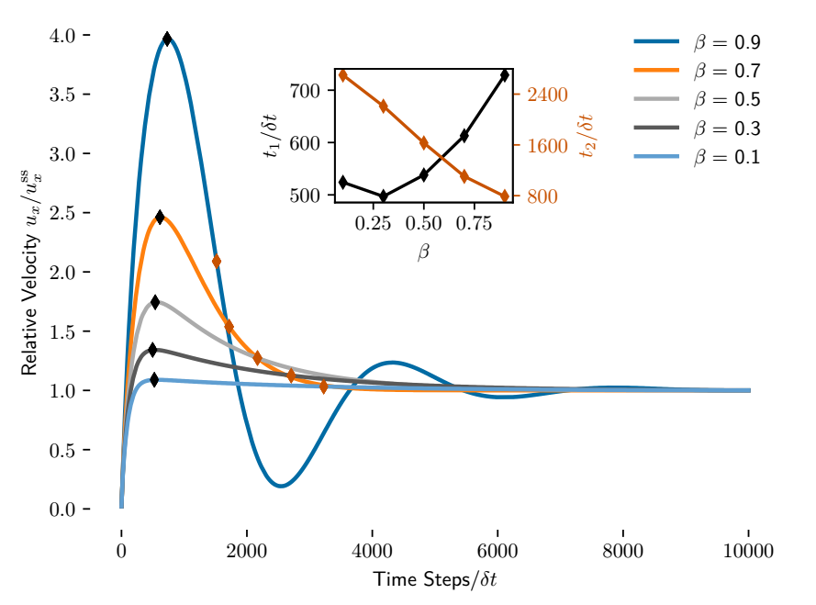
Velocity Overshoot

Slide 23
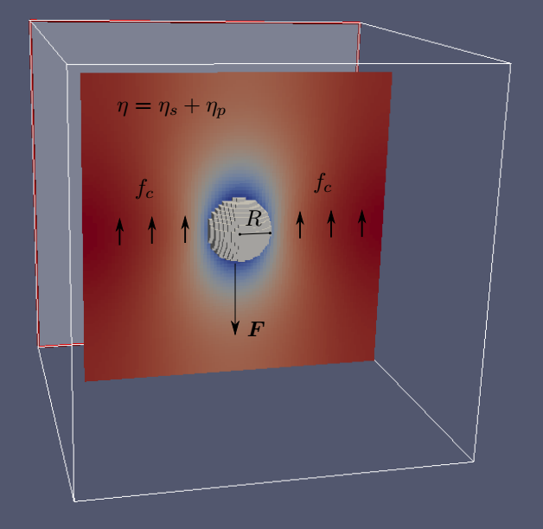
MD with Moving Boundary Conditions

Slide 24
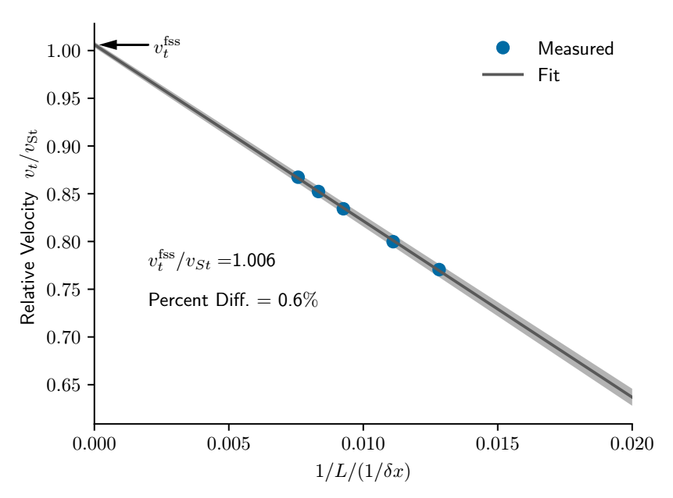
Stokes’s Law with Finite-Size Scaling

Slide 25
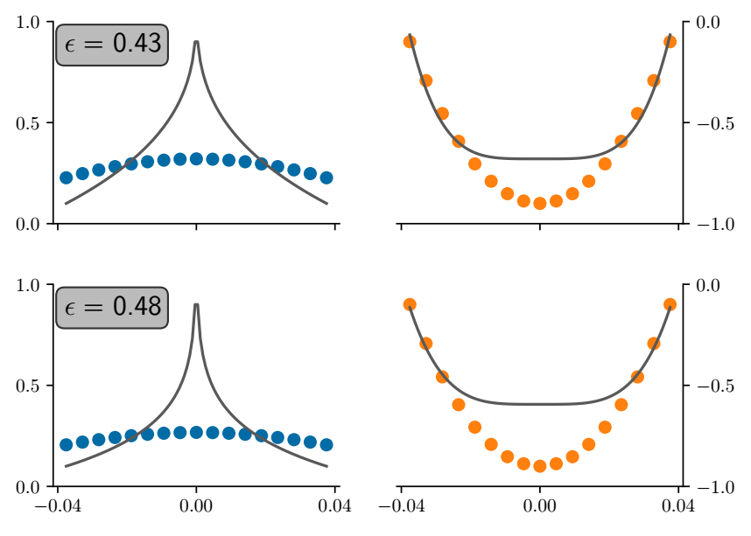
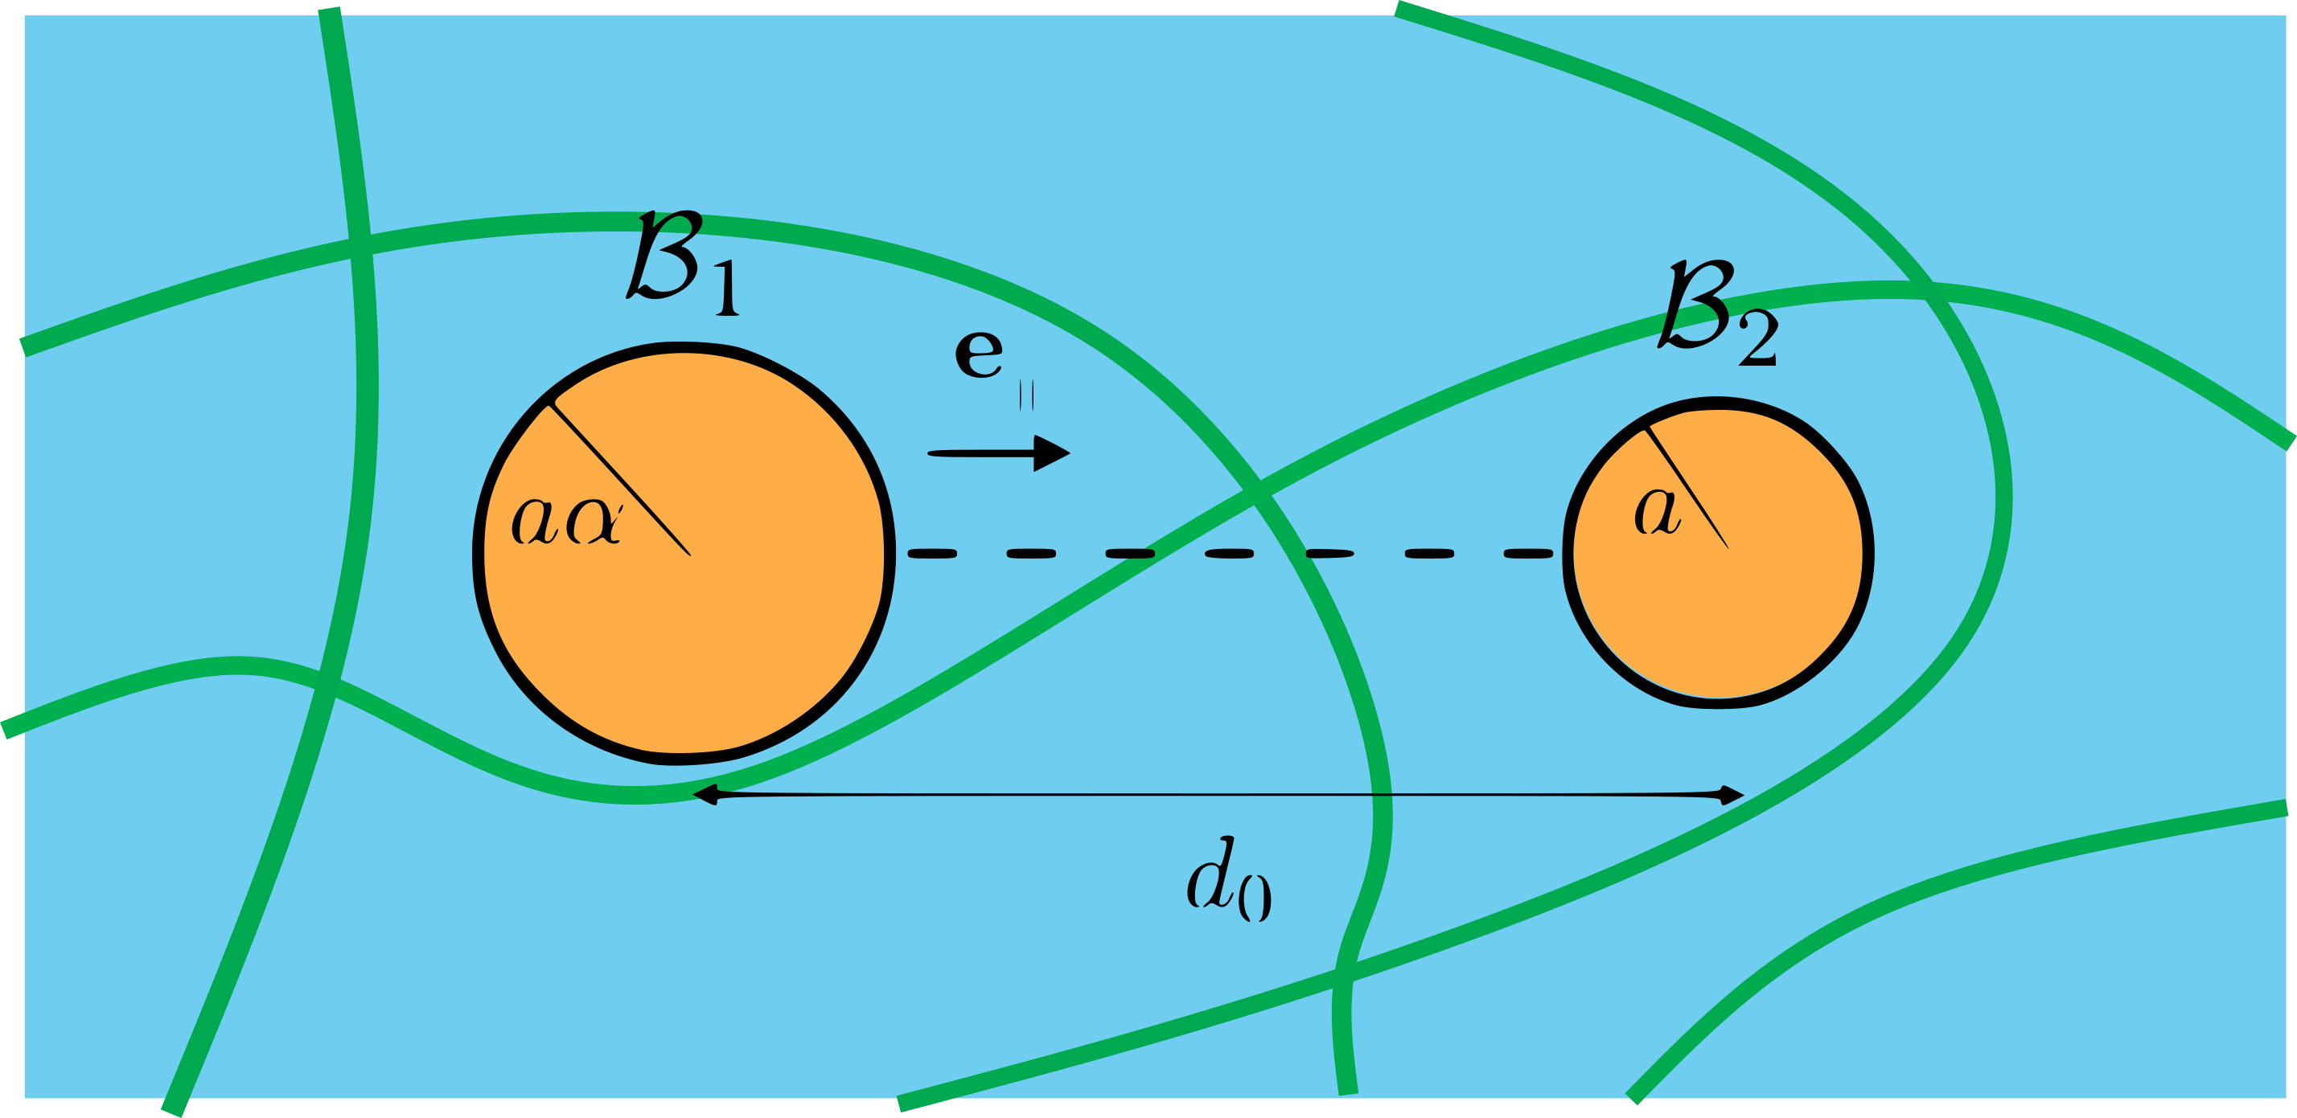
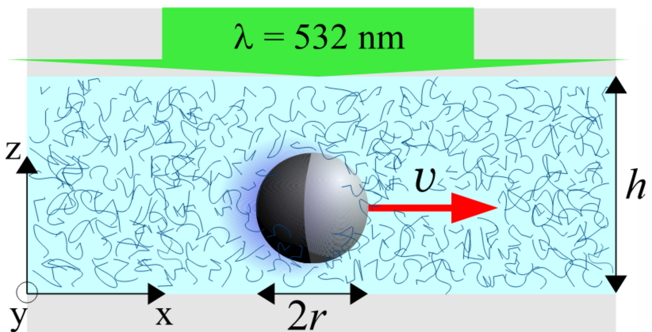
Conclusion and Outlook
Datt et al. https://arxiv.org/abs/1809.04268
Qiu et al. Nat. Commun. (2014)
Yasuda et al. https://arxiv.org/abs/1805.08348

Slide 26
Thank You!

Slide 27
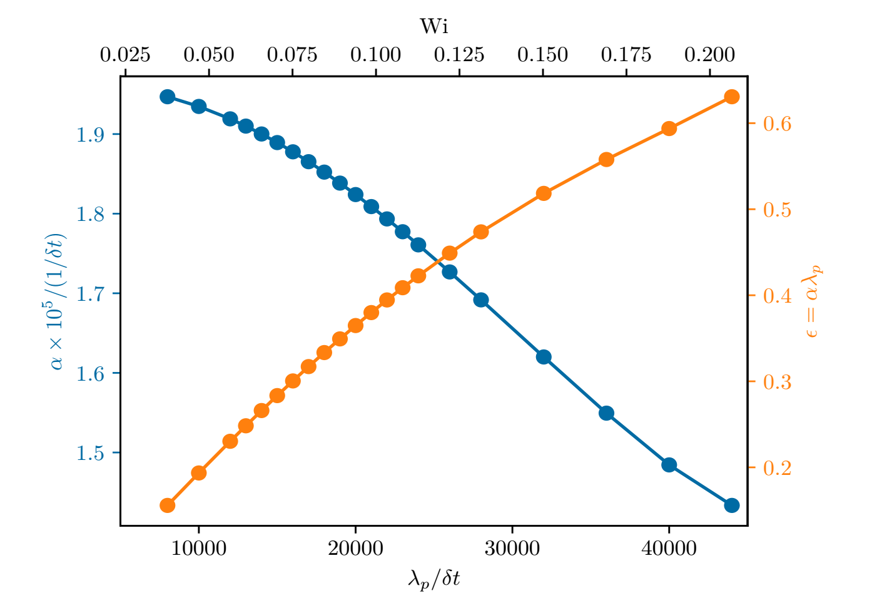
Mill Parameters

Slide 28
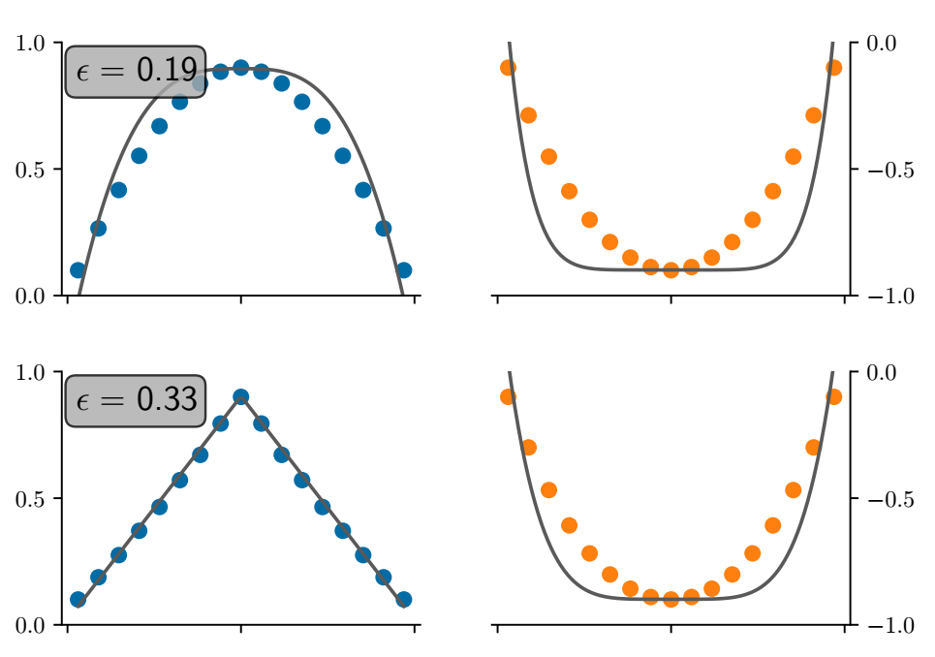


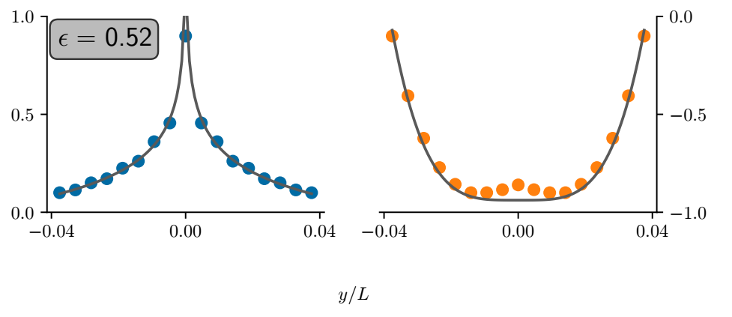
Center Line Stress

Slide 29
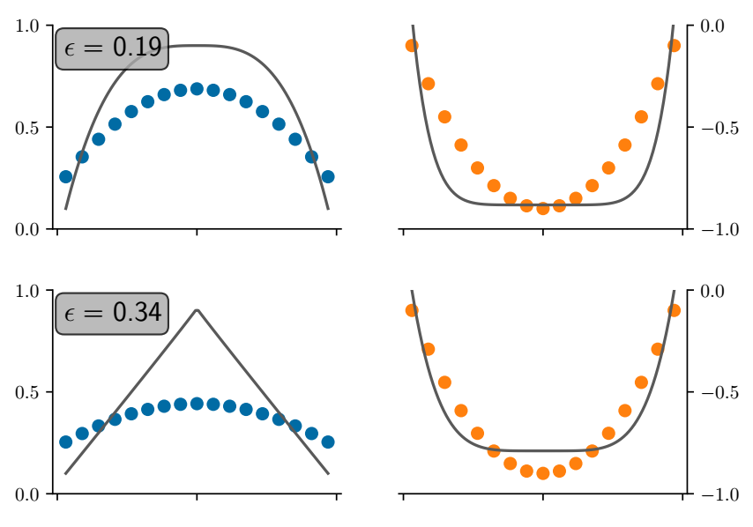
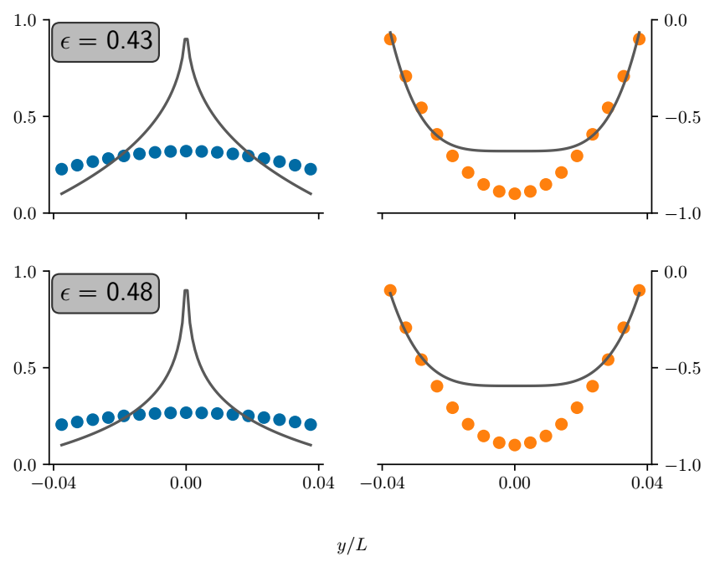
Center Line Stress Compressible

Slide 30
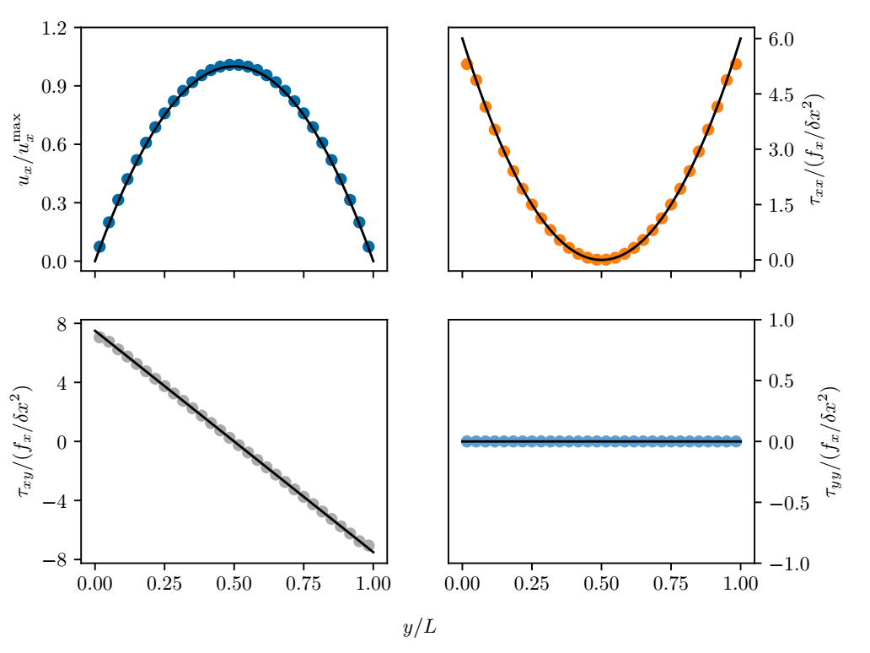
Pouiseuille Steady State

Slide 31
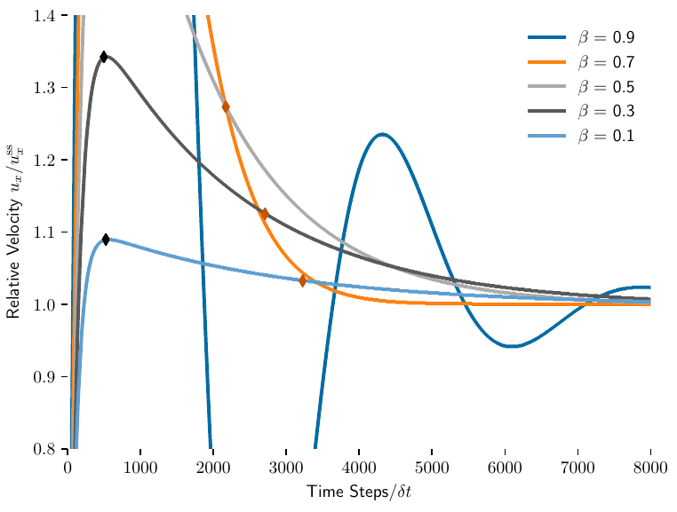
Velocity Overshoot: Enhanced

