Slide 1

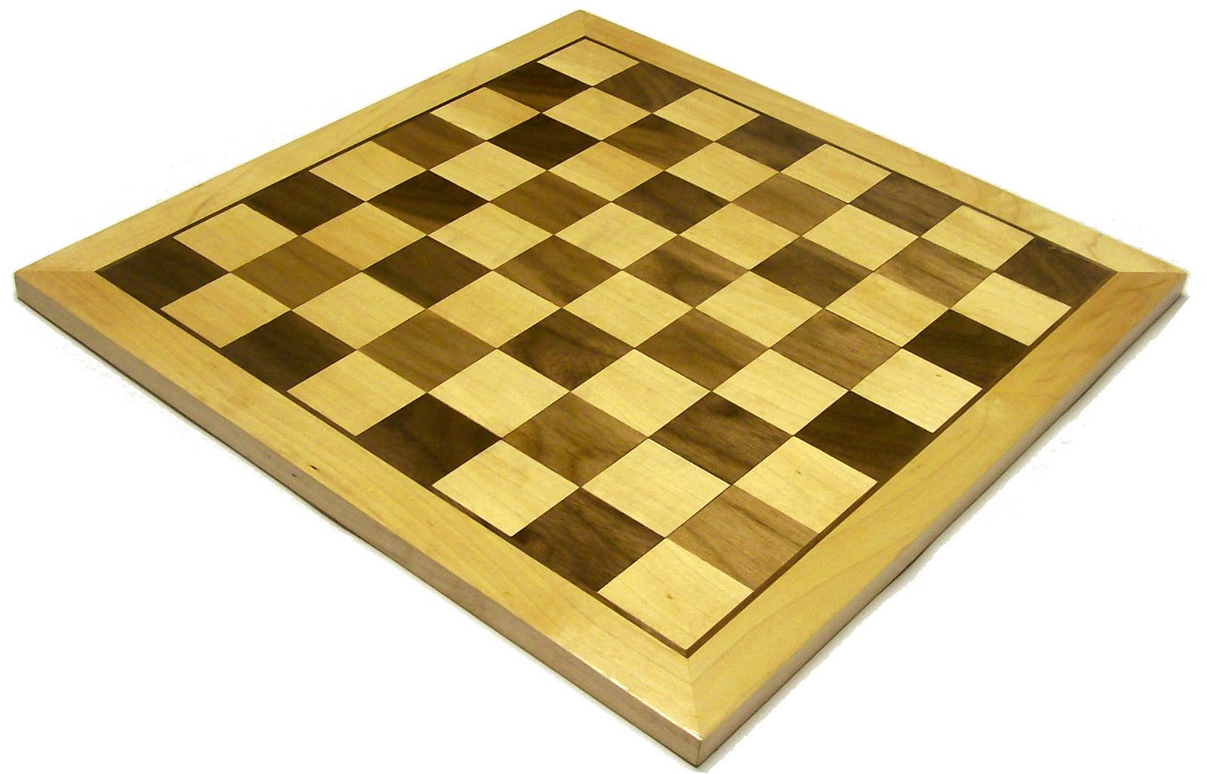
Solving a Knight’s Tour problem with Warnsdorf’s algorithm.
By Cameron Dziurgot

Slide 2
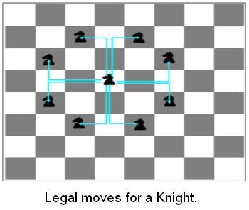
What is a Knight’s Tour?
Visiting each space on a chess board, using a knight move, without visiting a space twice.

Slide 3
Difference between open and closed knight’s tour.
Inefficient way to solving the tour: Brute force, a.k.a. depth first search.
Warnsdorf’s rule: heuristic.

Slide 4
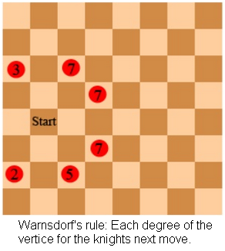
How it works:
Start at an position on the board
Your next move is to the position with the most available next moves

Slide 5
Translation to code:
Chess board represented by 2D array
Loop that checks the number of degrees for each knight move from current position.
Marks in 2D array move numbers as it works its way through the board.

Slide 6
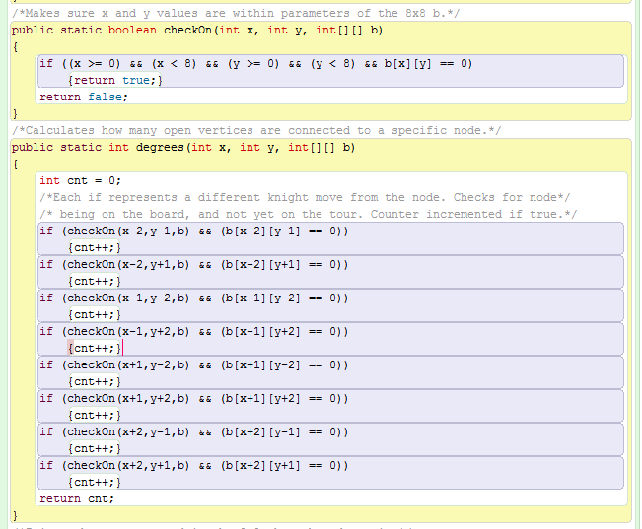

Slide 7
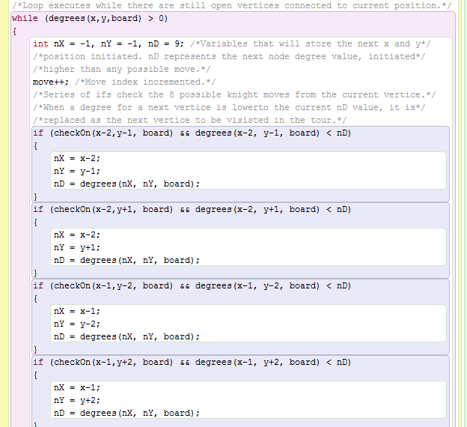

Slide 8
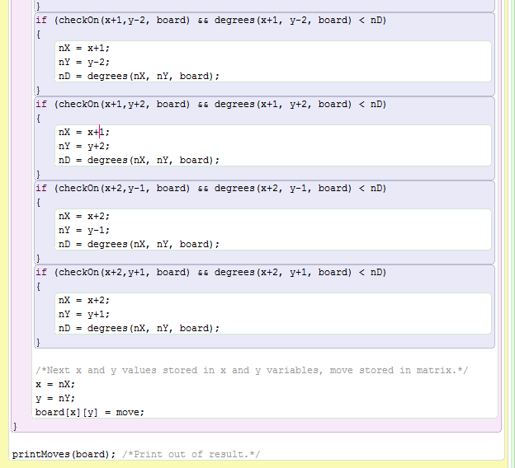

Slide 9
