Slide 1

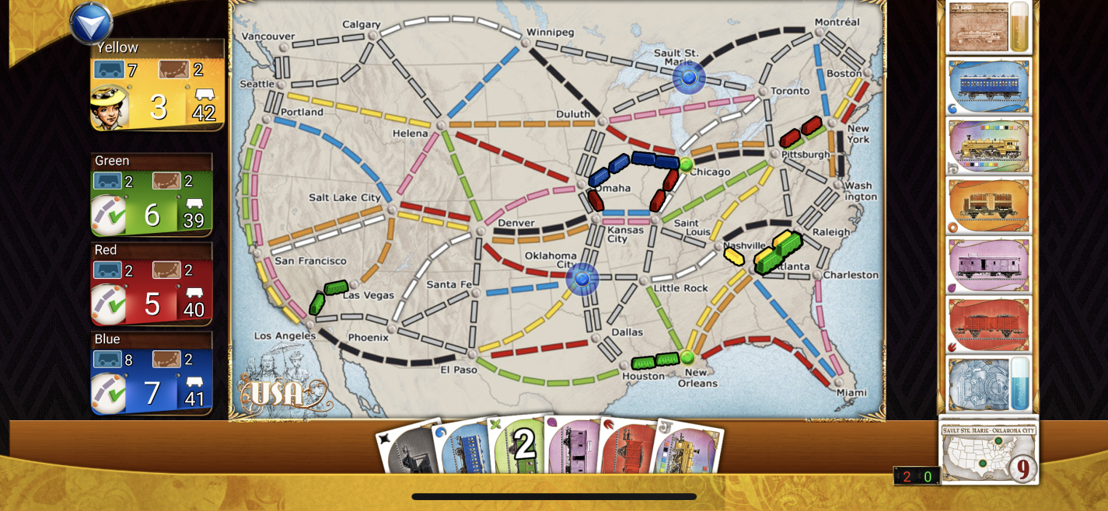
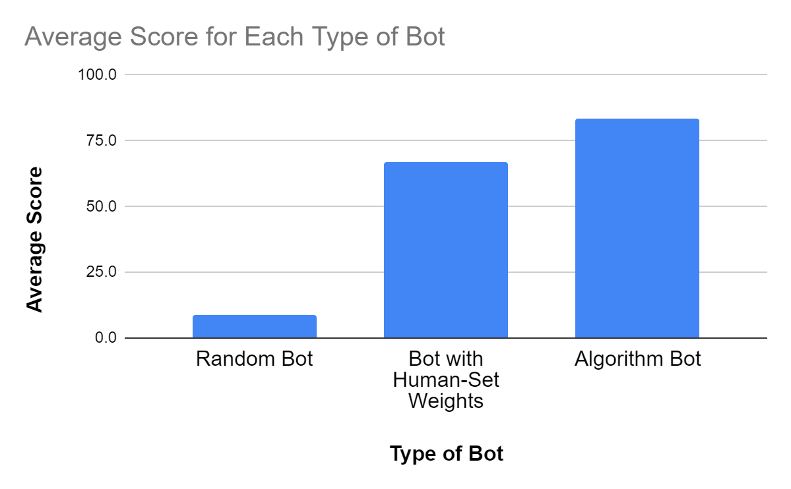
QR Code
to Video
Creating a Bot to Play Ticket to Ride
Cameron Ake (pd. 4)
Yilmaz Systems Lab 2024
Introduction
Results
Ticket to Ride is a popular board game of strategy, where players attempt to connect cities cross-country by playing cards on connections. Due to the complicated nature of the game, existing strategies to create bots such as reinforcement learning require too much computation, and existing bots that players can play against play suboptimally and are thus not enriching to play against.
The algorithm selected a “favorite” bot, a bot that it found outperformed the bots that had different weights for their strategic preferences. This bot often scored over 100 points, but it performed worse against completely random bots, potentially due to it “expecting” better gameplay from other bots. Aside from that difficulty, the bots also took unreasonable amounts of time to play games.
Fig. 1: A Ticket to Ride board during a game.
Methods
Conclusion
To create strong bots in a feasible manner computationally, I used a genetic algorithm and a series of heuristic functions. Each heuristic function had a weight that signified how much the bot cared about it (in other words, some bots aimed to collect useful cards, while others aimed to play quickly). By pitting bots against each other and “breeding” the best-performing bots to make new, similar bots, I aimed to optimize the bot’s strategic priorities.
While the best bot created by the algorithm performed well against other bots that used heuristic functions, it was not particularly strong against random bots and performed noticeably worse than real players would. More exploration of the final bot playing against existing bots would be useful. In addition, adding more heuristics would help the bots to “learn” more strategy. All in all, though the produced bots were fairly suitable, they did not perform as well as hoped.
Fig. 2: Graph of average scores in testing vs. bot type.
Bots play game:
Assign each bot a probability of surviving/reproducing, based on its score in the game
Bots survive:
Select 10 of 20 bots to survive
Create children:
Child gets half of each parent’s parameters and shifts them a bit
repeat!
Bots breed:
Select pairs of bots to breed
Fig. 3: Diagram of my algorithm to create the best bot.

