Slide 1
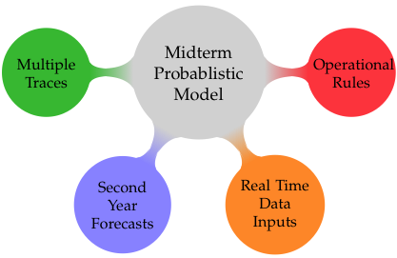
Probabilistic Midterm Model
Midterm operational forecast model for the CRB
Probabilistic version of the 24 Month Study
Many new features

Slide 2
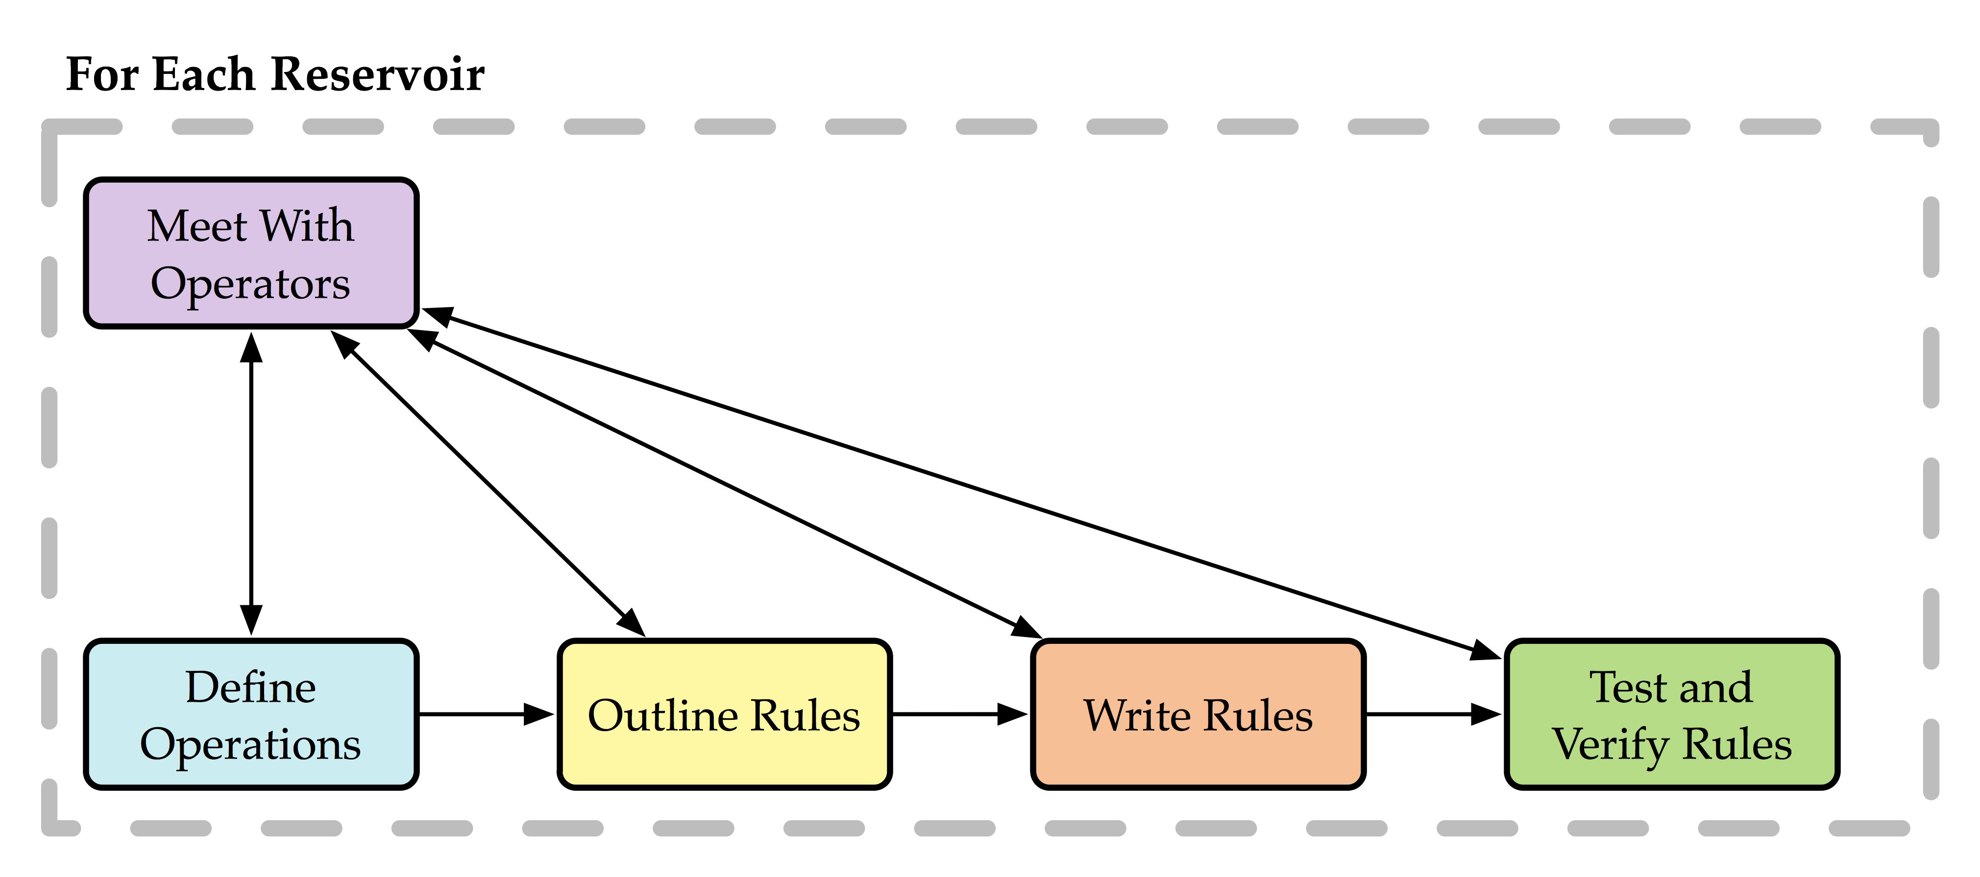
Operational Rules
Rules have been written in RiverWare for Fontenelle, Flaming Gorge, Navajo, and Lake Powell
Notes:
Schematic representation of model/rule development process

Slide 3
Challenges and Obstacles
Data inputs, especially those which are specific to the rules
Eg. Flaming Gorge Hydrologic classification, Powell Release Tier
Strategy for solving reservoirs, in advance
Eg. Flaming Gorge requires inflow inputs months in advance which require knowledge of Fontenelle’s releases
Second Year Forecasts and Ensemble Inputs
Is it possible to do better than Climatology?
Will a forecast skill in the out year translate into better management
Notes:
Rules need additional data beyond 24 month study – H. classification
Can’t solve traditionally – i.e. month by month, B/C operations need estimate/future information
Can forecast be shown to improve operations at all

Slide 4

Forecast Inputs
Use climate and snowpack information in the first year (Bracken et al. 2010).
In the second year snowpack and climate info is not available
Incorporate paleo data
Conditional resampling of analog paleo years (Markov Chain)
Climate indices
Time series dynamics
Data suggests embedding dimension of 3
Merge with interdecadal methods
Notes:
- In the first year, climate and snowpack data is available, so use that when we can to produce accurate forecasts
In the second year and further, a different approach is needed (Let me know if you need clarification on any of this).

