Slide 1
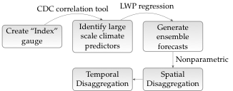

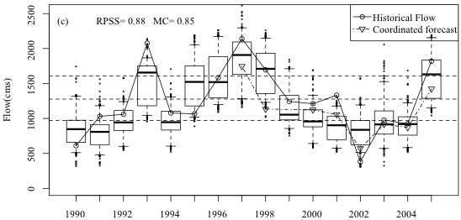
Multisite seasonal ensemble streamflow forecasting
C. Bracken, B. Rajagopalan, and J. Prairie (2010), A multisite seasonal ensemble streamflow forecasting technique, Water Resour. Res., 46, W03532, doi:10.1029/2009WR007965.

