Slide 1
Tea Recommendation System
Cameron Wilson

Slide 2
What is your Project?
Tea Recommendation System
A system that provides the user a recommended type depending on their imputed preferences.
The system contains a field for the user’s name, and two drop-down menus that allow the user to choose their preferences from a designated list.

Slide 3
Why this project?
Motivation
I enjoy tea
Was simple enough to categorize
Easily transferable to other topics (i.e. music, restaurants, friends)
Inspirations
Movie Recommendation System
Firstleaf: A wine recommendation company
08.ConcertRSVPJavaScript
Was recommended to me

Slide 4
How does it work?

Slide 5
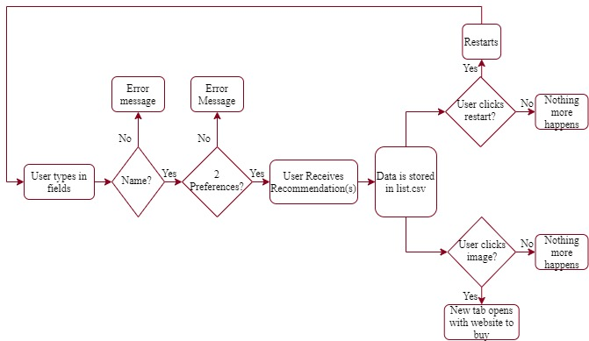
Physical Diagram
Source: app.diagrams.net

Slide 6
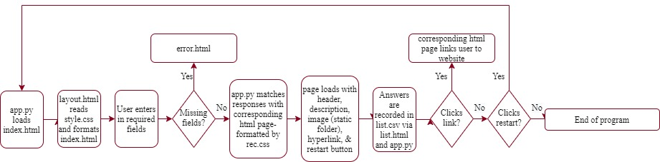
Software Diagram
Source: app.diagrams.net

Slide 7
Software Description
Overview
Mapping: Initial Categorization & Flow Chart
Setup:
Files
Folders
Virtual Environment
app.py
list.csv
HTML pages:
Layout
Index
Error
Recommendation Pages
Static File: Images & CSS
Flask run
Recommendation System!
Notes:
Environment: An "environment" in Python is the context in which a Python program runs. An environment consists of an interpreter and any number of installed packages. The Python extension for VS Code provides helpful integration features for working with different environments. (https://code.visualstudio.com/docs/python/environments#:~:text=An%20%22environment%22%20in%20Python%20is,for%20working%20with%20different%20environments.)

Slide 8
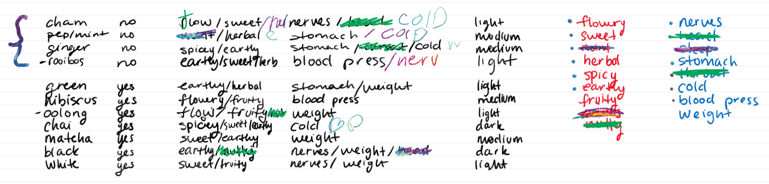
Software Description
Initial Categorization

Slide 9
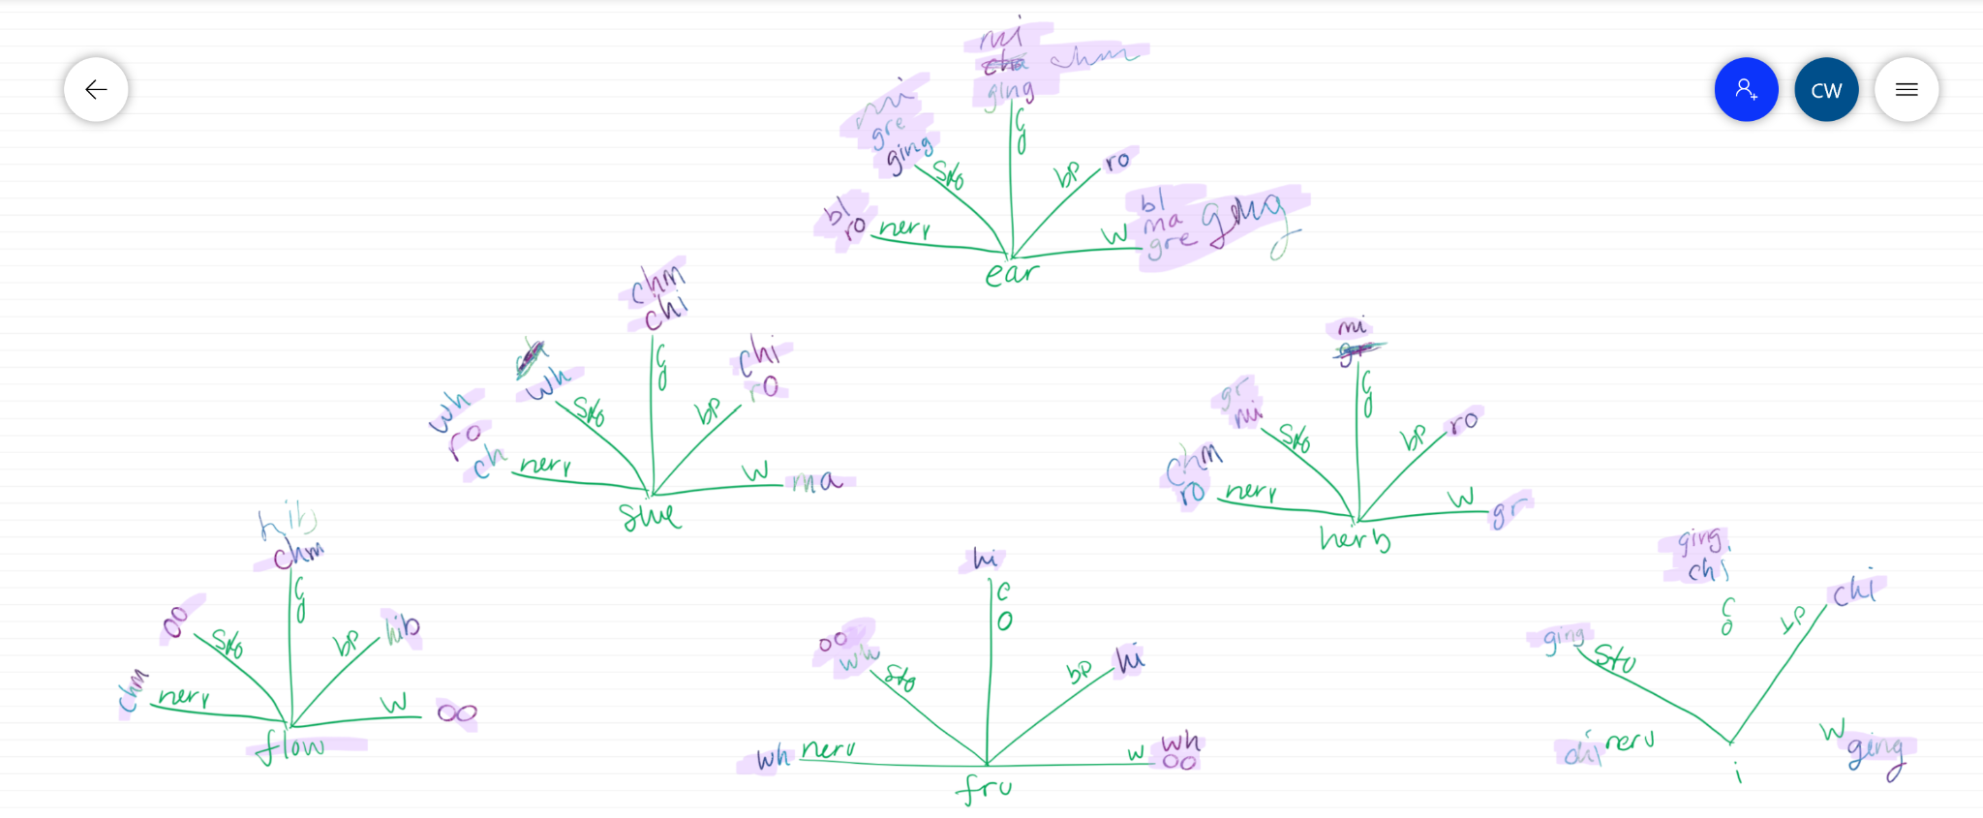
Software Description
2. Flow Chart

Slide 10
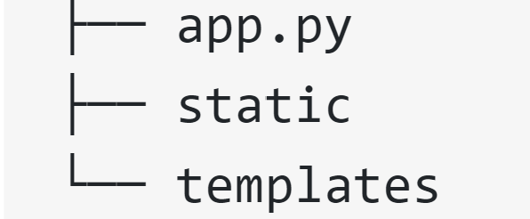
Software Description
3. File Setup
Source: Real Python

Slide 11
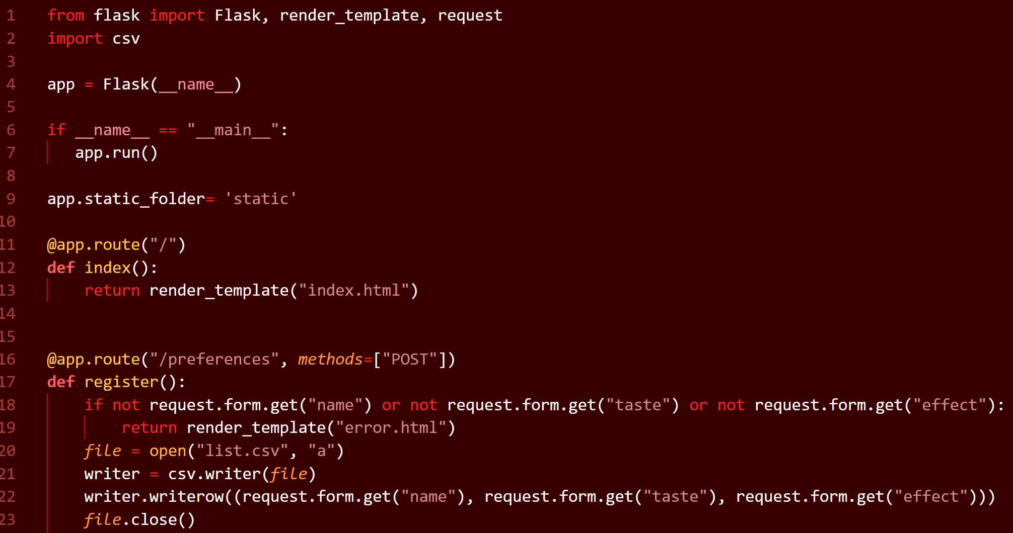
Software Description
4. templates/app.py

Slide 12
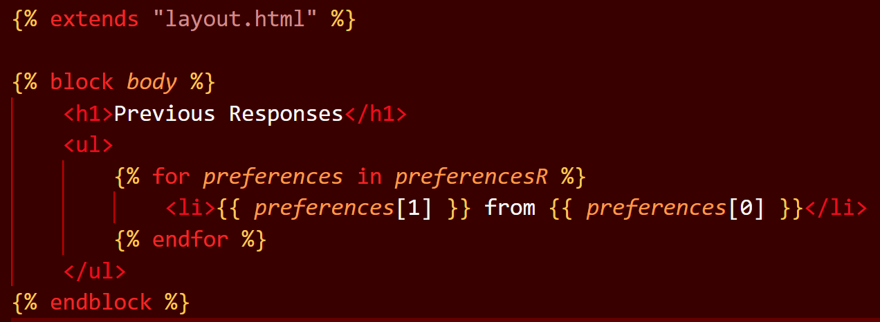
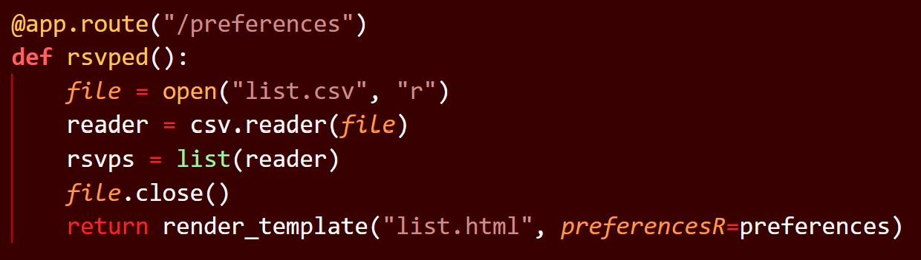
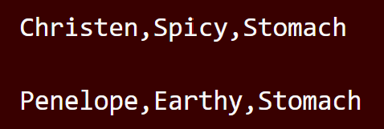
Software Description
5. templates/list.csv
1. list.html
2. app.py
3. list.csv

Slide 13
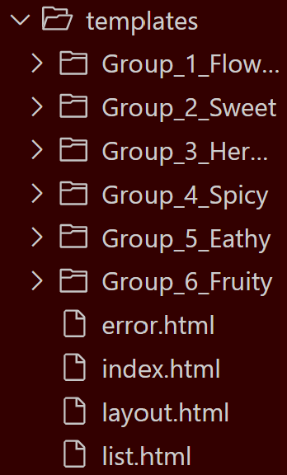
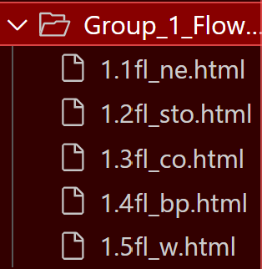
Software Description
6. templates/everything else

Slide 14
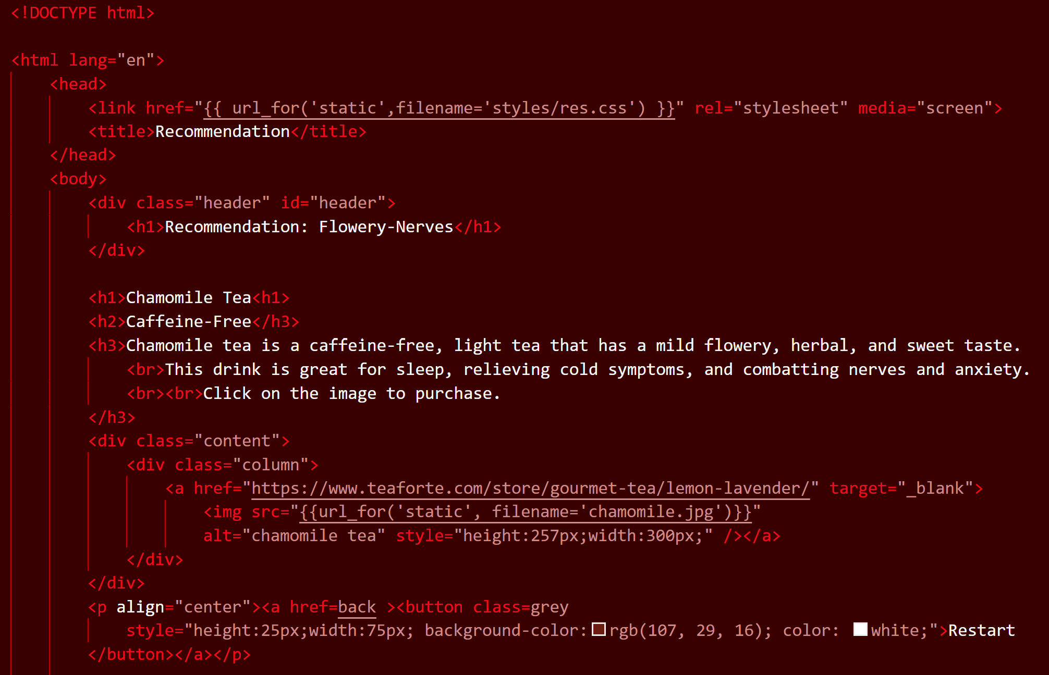
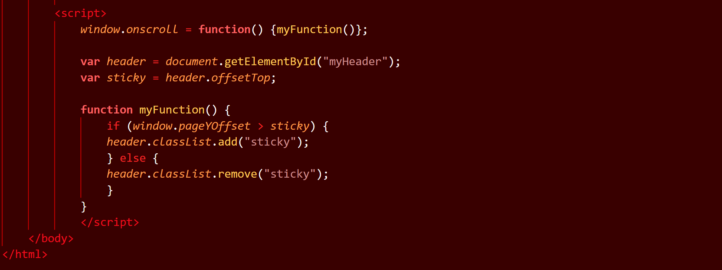
Software Description
7. templates/everything else

Slide 15
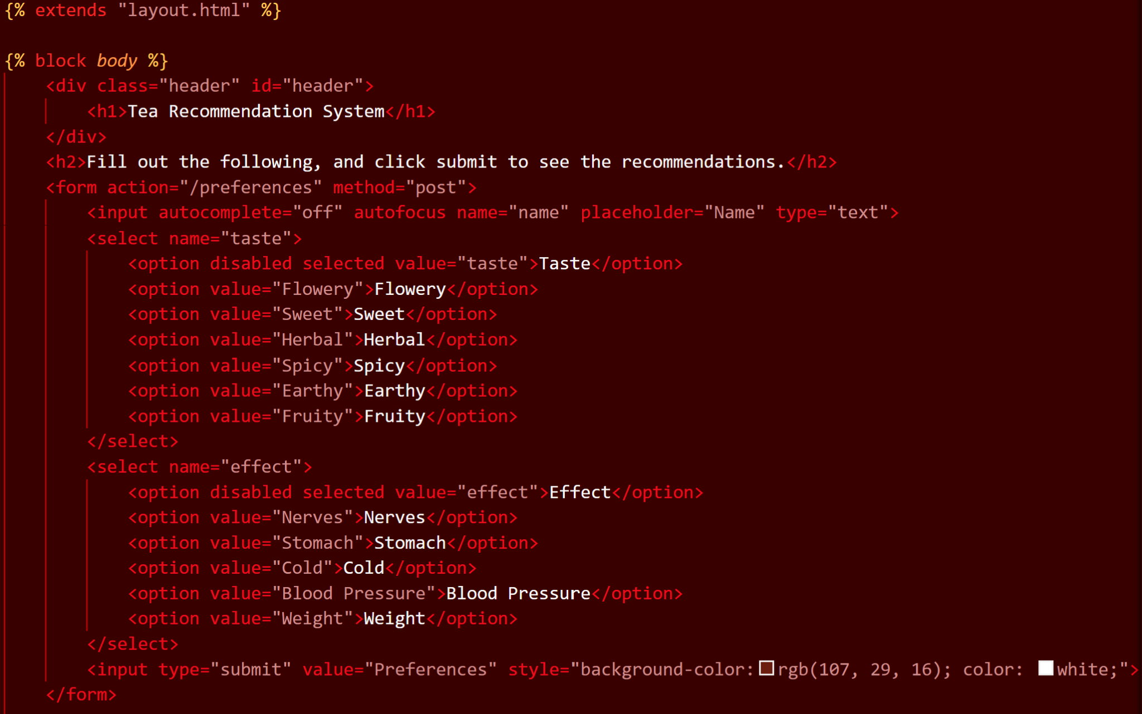
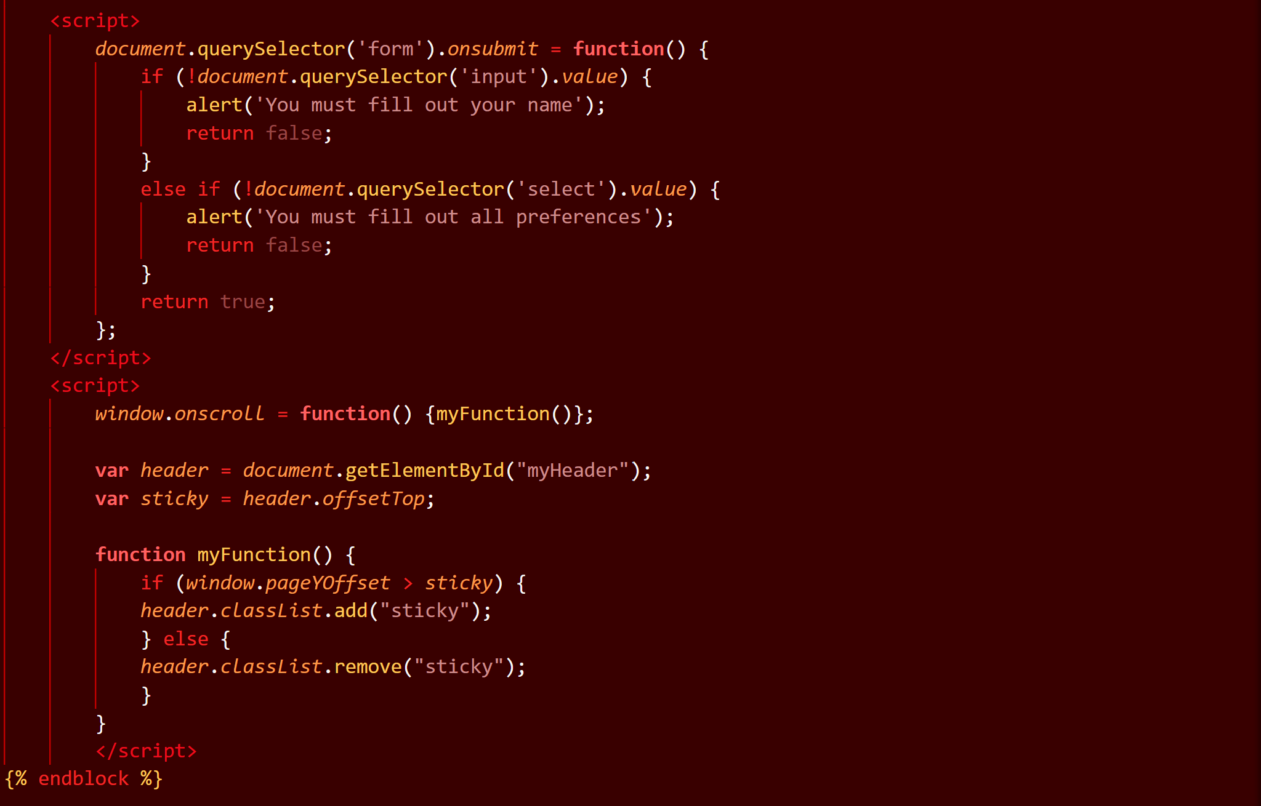
Software Description
8. templates/index

Slide 16
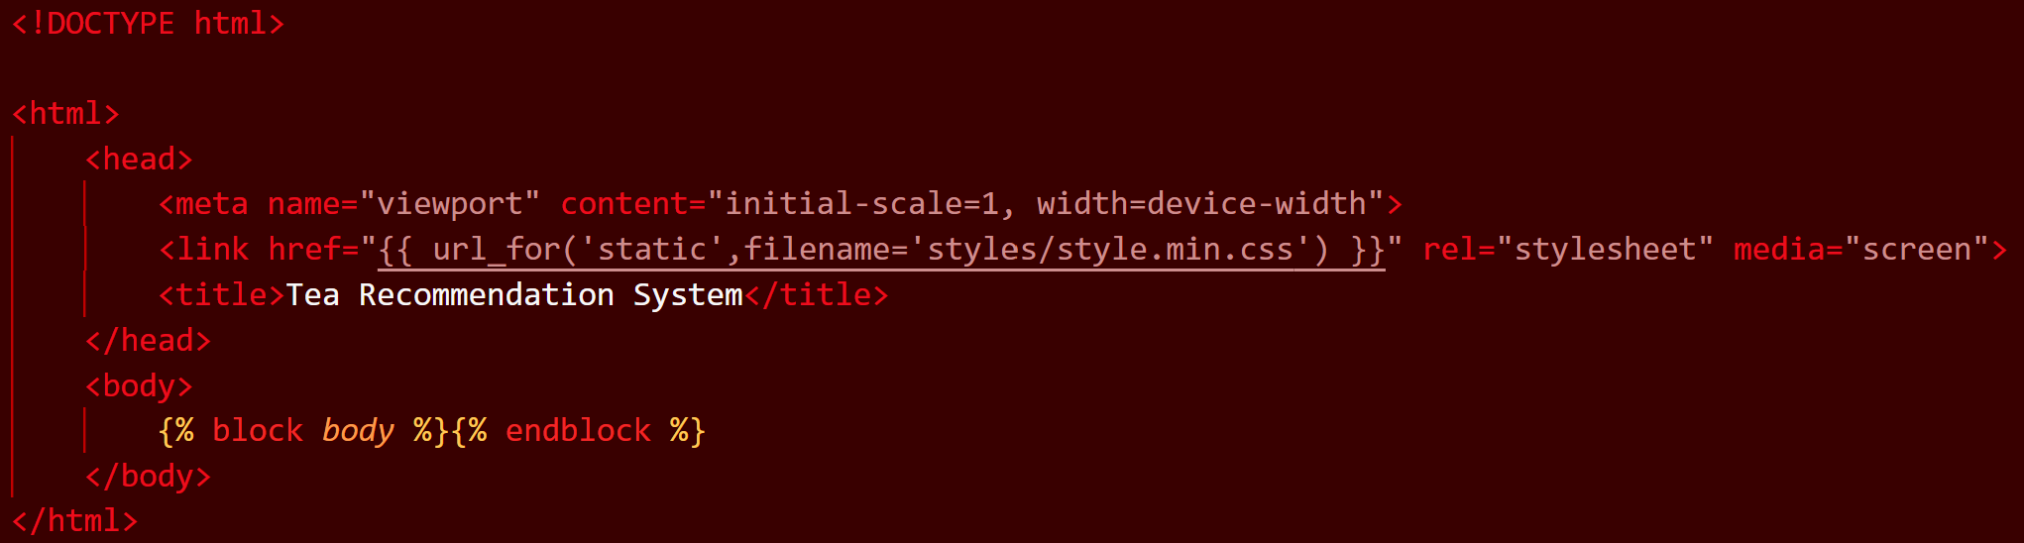
Software Description
9. templates/layout

Slide 17
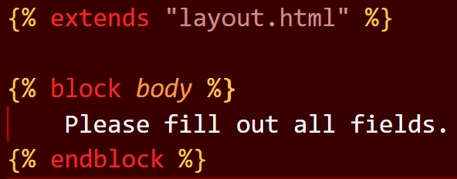
Software Description
10. templates/error

Slide 18
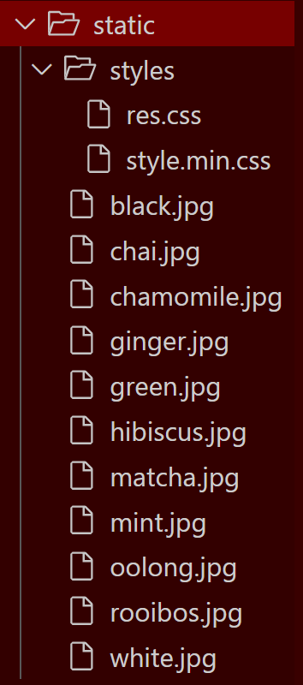
Software Description
11. static
<link href="{{ url_for('static',filename='styles/style.min.css') }}" rel="stylesheet" media="screen">

Slide 19
Demo!

Slide 20
Advantage
What works?
Physical construction
Overall flow + layout
Playability
Easy to use and understand
Software
Recommendation paths
Buttons
Dropdown Menus
Look
Pictures + Embedded links
Links
Overall organization

Slide 21
Improvement
What does not work?
Physical construction
Fixed Header
Playability
Scroll to Bottom
Software
Fixed Header
CSS Files

Slide 22
Future Implementation
Composition
More professional look
Menu bar
Additional Features
Rating System
Feedback
Personalization
SQLite Implementation
More Preferences + Recommendations
Recommendations via machine learning and or more extensive data

