Slide 1
RaspberryPi Forensics
Jace Conflenti and Cameron Taylor

Slide 2
Images
Raspbian GNU/Linux 8 (Jessie)
Partition 1: Boot (20.8 / 65.9 MB)
md5: af0f5c29bddfc6064f8bd811629304fd
sha1: f8a4aaf28eb488f70552ce31695c1f71e183823f
Partition 2: Root (3.9 / 7.7 GB)
md5: 11a9a53893742c0f0e3c6153ee01c227
sha1: 2d083569696839835f95cbc6d927c6331fbf3ed9
User Account: Pi
John The Ripper – no luck after 10 hours

Slide 3
Forensics – Bash History
sudo apt-get install
hostapd isc-dhcp-server
iptables-persistent
vi/python3 server.py
sudo iptables –D INPUT –s 192.168.42.0/24 –p tcp –dport 22 –m state –state NEW –j ACCEPT

Slide 4
Forensics – Software Installed
libnl-route-3-200
hostapd
isc-dhcp-server
netfilter-persistent
iptables-persistent

Slide 5
IP Visualizations
/var/log/syslog
192.168.42.10 (Pi)
.11 (LAPTOP-1PSQ78FE) – Client, testing
14:34 - 18:50
.12 (Rishabh-PC) - Partner
14:44 - 15:38
.13 (vishi) – Potential attacker
18:29 - 18:54
.14 (LAPTOP-NITL5) – Potential attacker
18:29 - 18:51 (1 second after vishi)

Slide 6
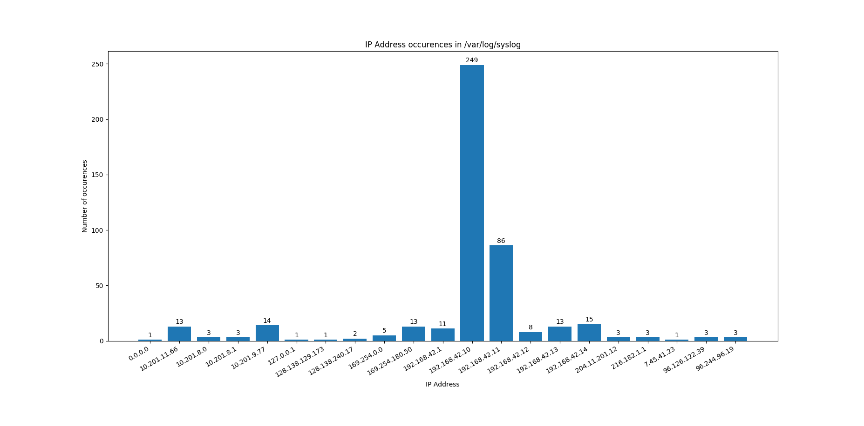

Slide 7
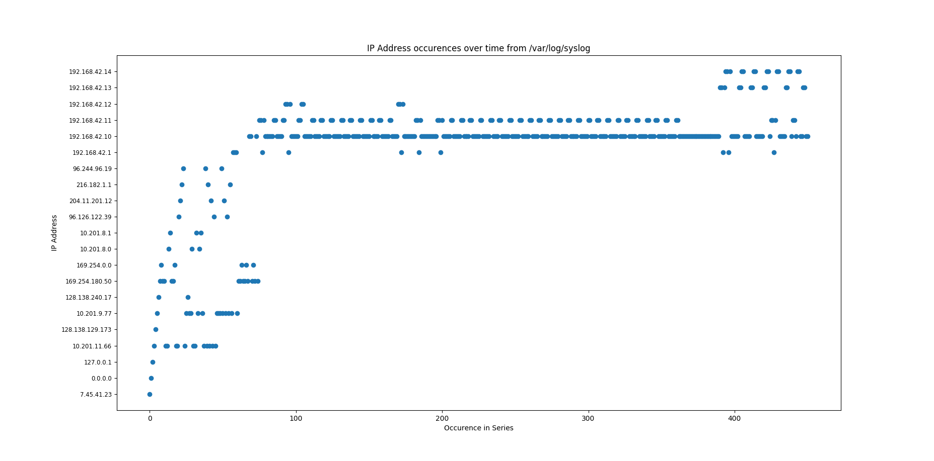

Slide 8
Code
Downloaded pygames
server -> server1 -> server2
comments, variable names, command line arguments
Fileserver used to download games
No client code
Server crashed with list request
Vulnerabilities
PUT
malware

