Slide 1
Quantum Key Distribution and BB84 Simulation
MA456 Final Project
by
Guthrie Cordone and Cameron Fabbri

Slide 2
Contents
Quantum Overview
Quantum Key Distributions
BB84
B92
Quantum Attack Methods
Trojan-Horse
Photon-Number Splitting
BB84 Simulation

Slide 3
Why Quantum?
Classical cryptography will become obsolete when a true quantum computer is built
Shor (1994): factoring, discrete log
Quantum key distributions proven to be “unconditionally secure” in principle
Shor (2000)

Slide 4
Quantum Overview
Photons used for quantum key exchange
Useful properties due to Heisenberg uncertainty principle (Gisin, 2007):
“One cannot take a measurement without perturbing the system.”
“One cannot duplicate an unknown quantum state.”
“One cannot simultaneously measure the polarization of a photon in the vertical-horizontal basis and simultaneously in the diagonal basis.”

Slide 5
BB84: Overview
First quantum key distribution protocol
Bennett and Brassard, 1984
Uses polarities of photons for key generation
Basis | Polarization Angle | Bit Value
Rectilinear (“+”) | 0° | 0
 | 90° | 1
Diagonal (“X”) | 45° | 0
 | 135° | 1

Slide 6
BB84: The Protocol
Alice chooses a random bit string and a random string of polarization bases
Alice sends Bob a string of photons with her chosen polarizations
Bob measures each photon with a random basis and generates a corresponding bit string
Bob announces to Alice that he has completed measuring her photons
Bob and Alice compare basis strings and remove bits generated with opposite bases
Bob and Alice give up a portion of the remaining bits to check for tampering by Eve
The remaining bits are used as a secret key

Slide 7
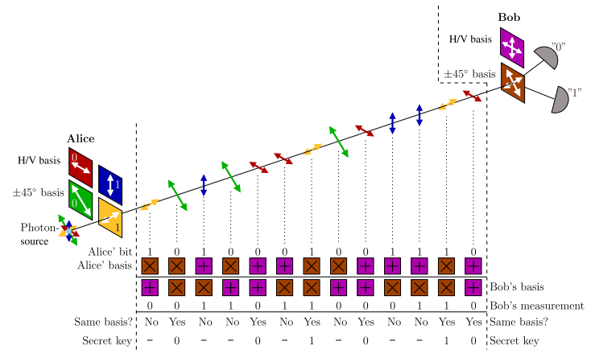
BB84: Diagram
Figure source: L. Lydersen 2011

Slide 8
B92 Protocol
Simplification of BB84
Bennett, 1992
Uses two polarizations instead of four
Basis | Polarization Angle | Bit Value
Rectilinear (“+”) | 0° | 0
Diagonal (“X”) | 45° | 1

Slide 9
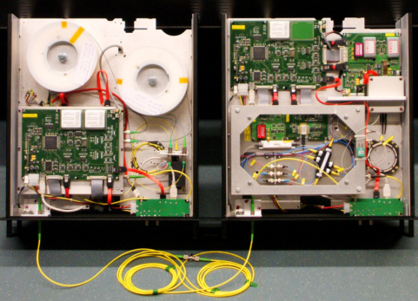
Quantum Attacks
Imperfect optical circuitry
Many Attacks
Trojan-Horse Attack
Photon-Number Splitting Attack
Clavis2 QKD system

Slide 10
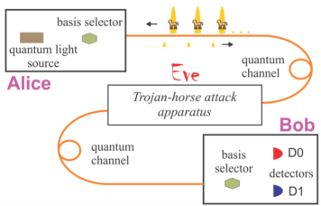
Trojan-Horse Attack
Attack Method
Eve sends bright pulse at Alice
Reflection gives away basis and polarization
How to Stop
Attenuator at output
Figure source: Jain et al 2014

Slide 11
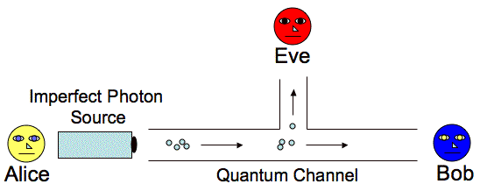
Photon-Number Splitting Attack
Attack Method
Detect number of photons per pulse sent by Alice
Capture stray photons and measure using Alice’s revealed basis
How to Stop
Decoy States protocol
SARG04 protocol
Diagram source: http://www.cse.wustl.edu/~jain/cse571-07/ftp/quantum/

Slide 12
Demo

