Slide 1
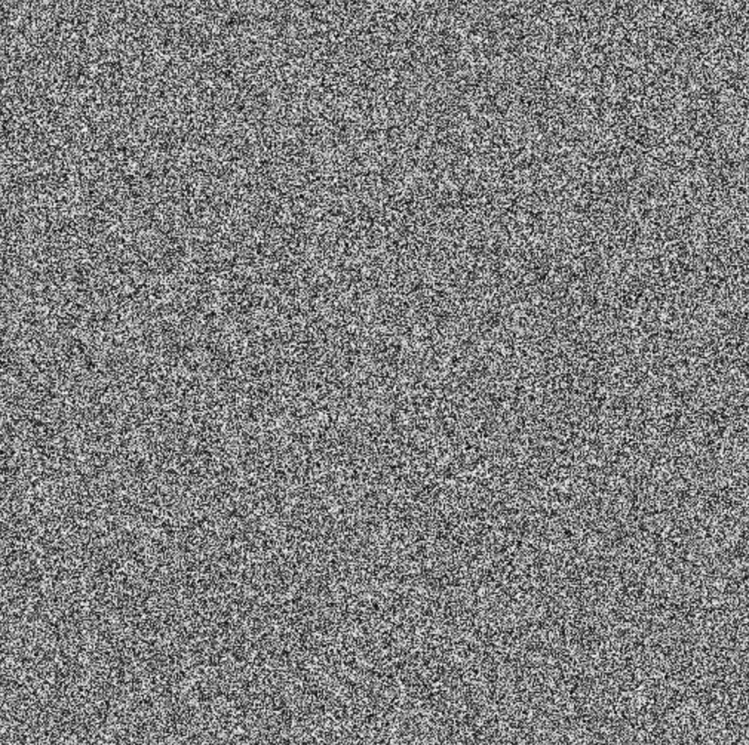


Generative Adversarial Networks (GANs)
Two player minimax game
  Discriminator D
  Generator G
D is trained to discriminate between a real image and a generated image
G is trained to generate an image that will fool D
Both G and D are neural networks
Conditional GANs generate images given conditional information such as a class label

Slide 2
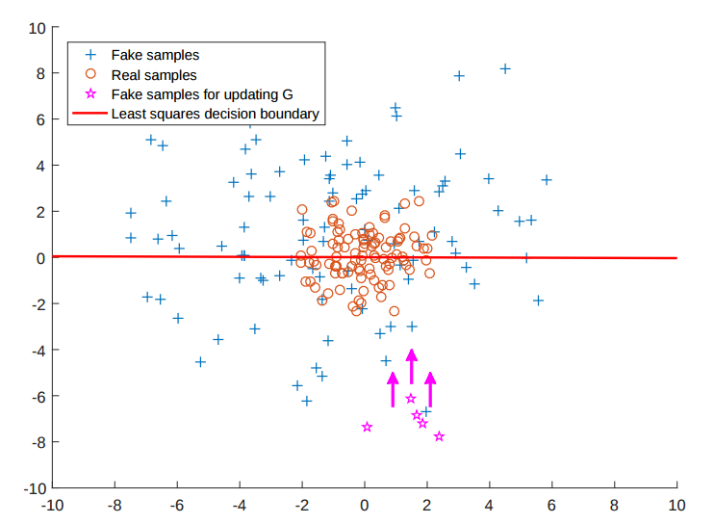
GAN Variations
Deep Convolutional GANs (DCGANs)
  Bridge the gap between GANs and Deep Learning
Least Squares GANs (LSGANs)
  Use a least squares loss for the
  discriminator → cite paper for plot
Energy-Based GANs (EBGANs)
  Model the discriminator as an energy
  function
Wasserstein GAN (WGAN)
  Minimize the Earth Mover distance between two distributions (generated and real)

Slide 3
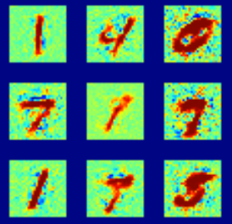
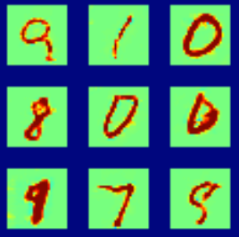
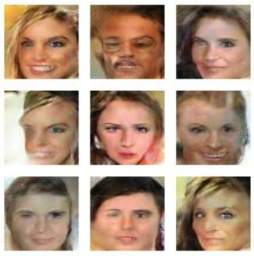
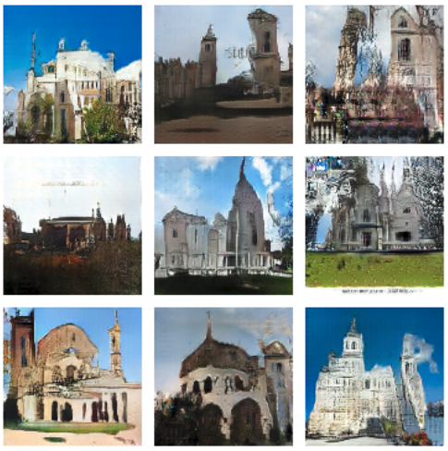
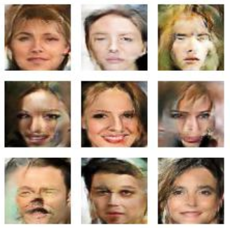
GAN Comparison Results
GAN
DCGAN
MNIST
GAN, DCGAN
CelebA
EBGAN, WGAN
LSUN
LSGAN
EBGAN
LSGAN
WGAN

Slide 4
GANs Towards Colorization
Tested two generators
  Pix2Pix
  Colorful Image Colorization
Pix2Pix generator is modeled as an encoder-decoder with skip connections
Combine L1 and L2 loss with GAN Variatons
Input
Image
Output
Image

Slide 5
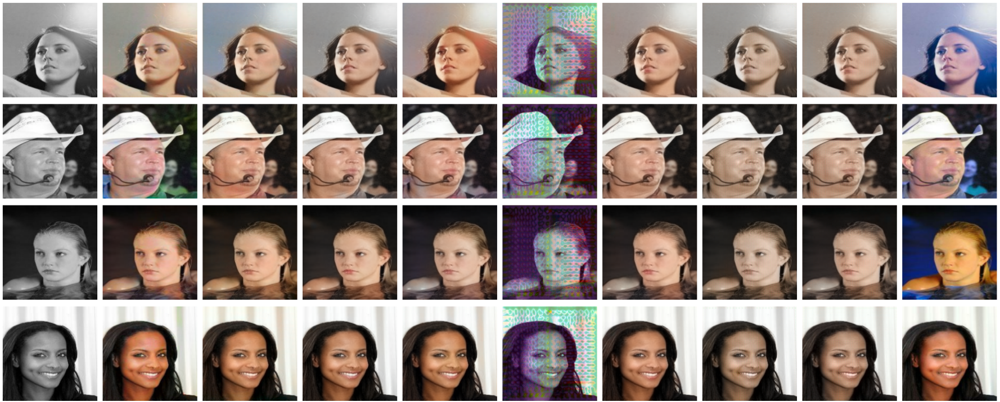
Results
GAN
LSGAN
EBGAN
WGAN
Input
L1
L2
L1
L2
L1
L2
L1
L2
True

Slide 6
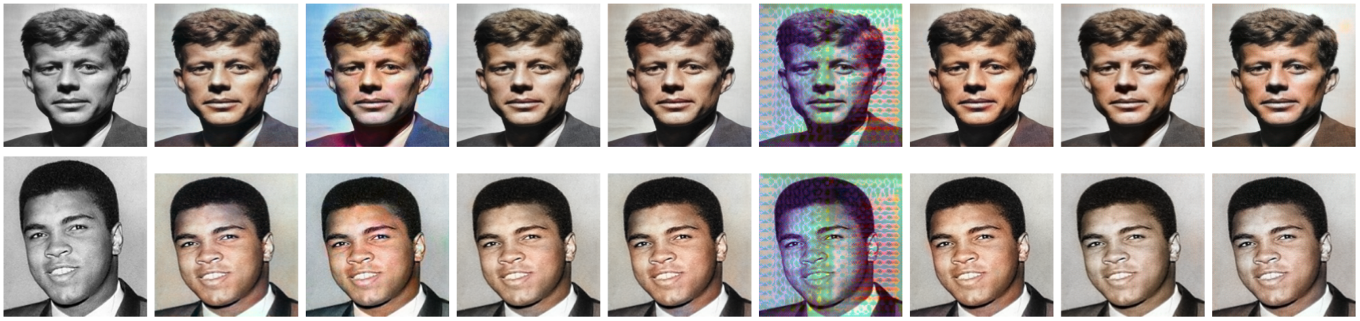
Legacy Grayscale Results
GAN
LSGAN
EBGAN
WGAN
Input
L1
L2
L1
L2
L1
L2
L1
L2

