Slide 1

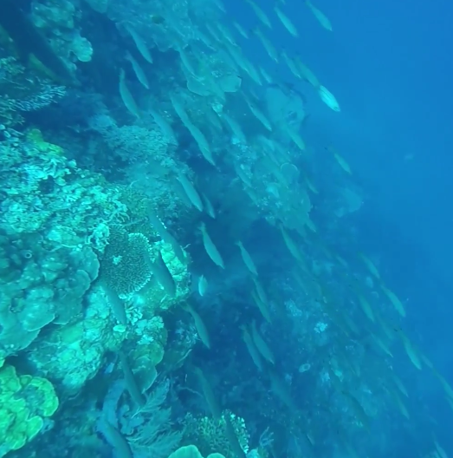
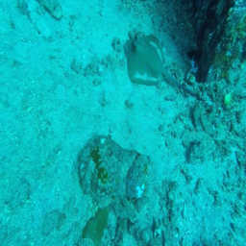
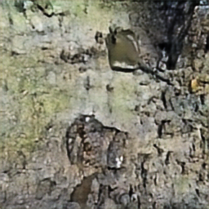
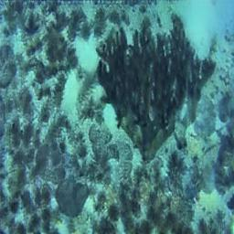
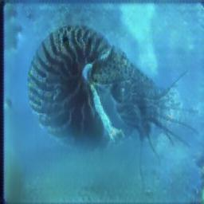
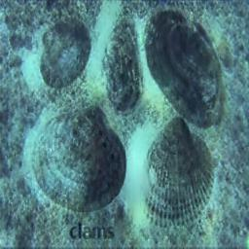
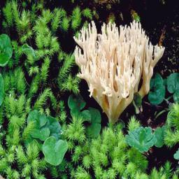
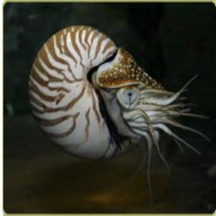
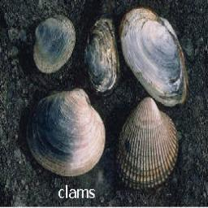
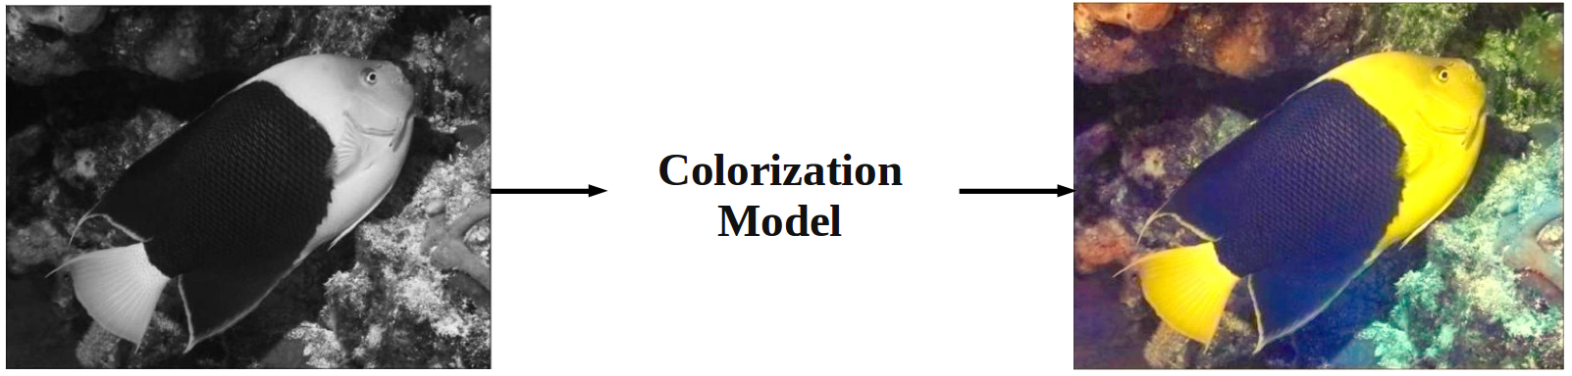
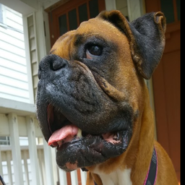
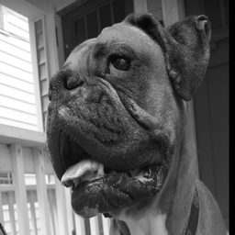

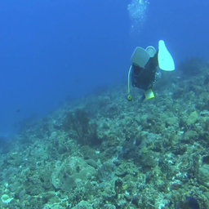
Adversarial Image Reconstruction for Autonomous Underwater Robots
Cameron Fabbri, Junaed Sattar; Department of Computer Science and Engineering, University of Minnesota
Abstract
Dataset Construction
Network Architecture
Autonomous underwater robots often heavily rely on visual input for decision making. However, due to many factors such as light refraction and particles in the water, the images are often times very noisy.
We propose a method using Generative Adversarial Networks (GANs) [3] to denoise underwater images such that they can either provide better features for an algorithm, or simply provide a more visually appealing image.
To solve the issue of acquiring training data, we use the recently proposed CycleGAN [1] in order to generate a dataset of image pairs. CycleGAN learns a mapping G: X → Y such that the images sampled from G(X) are indistinguishable from the images sampled from Y, as well as a mapping F: Y → X such that the images sampled from F(Y) are indistinguishable from the images sampled from X.
We construct two domains, X and Y, where X consists of underwater images taken from frames extracted from a diving video¹, and Y consists of non-underwater images taken from selected subsets from Imagenet [6]. CycleGAN is then used to generate a set of image pairs such that they appear to be underwater, as shown in Figure 3.
Our generator network is structured as a fully convolutional encoder decoder with skip connections, sometimes known as a “U-net”. Due to the structural similarity between the input and output, lower level features learned earlier in the network (e.g. edges and corners) that may be lost by the end of the network are in fact very important. In order to preserve these features, the activations in the encoder are concatenated onto the activations in the decoder, as shown in Figure 5.
Below show the details of our networks shown in the same format as [1]. We let Ck denote a Convolution-BatchNorm-ReLU layer with k filters of size 4x4 and stride 2. Convolutions in the encoder downsample by a factor of 2, while convolutions in the decoder upsample by a factor of 2. As an exception, activations in the decoder and discriminator are leaky ReLUs with slope 0.2, and the last convolution in the discriminator has a stride and kernel size of 1.
Encoder: C64-C128-C256-C512-C512-C512-C512-C512
Decoder: C512-C1024-C1024-C1024-C1024-C512-C256-C128-C3
Discriminator: C64-C128-C256-C512-C1
Figure 1: A sample underwater image. Light refraction and blue hue cause this image to experience a non-deterministic amount of noise.
Figure 5: Our (simplified) fully convolutional U-net architecture. Activations after each layer in the encoder are concatenated onto the activations in the decoder.
Related Work
Deep Colorization
Convolutional Neural Networks (CNNs) have been shown to work very well for many vision based tasks including but not limited to image colorization [5].
Issue of Ground Truth
For the task of colorizing a black and white image, training data is easy to acquire. Any color photo can be converted to grayscale because this process is deterministic: when using the LAB colorspace, every color photo only has one associated gray image.
The same is not true for underwater photos. Underwater images face two problems:
  A ground truth image does not exist
  Training data can not easily be generated given that a function (if one even exists) to convert a non-underwater image to appear underwater is multi-modal and nondeterministic.
Figure 4: Samples of image pairs from our dataset. The bottom row is ground truth, while the top row are the distorted images. Distorted images were generated using CycleGAN [5].
Method
We use Generative Adversarial Networks (GANs) to learn the task of image reconstruction. The GAN framework consists of two neural networks competing against each other. The generator G receives the corrupted as input and produces an image, while the discriminator attempts to differentiate between real and generated samples. The objective is shown by:
To give the network some sense of ground truth, we also consider the L1 loss as seen in (2). L1 is used as opposed to L2 because it produces less blur.
Despite the addition of L1 to the objective function, our outputs still experienced blur. To avoid this, the Image Gradient Difference Loss (GDL) [3] is added to the objective function. The GDL directly penalizes the differences of image gradient predictions, as shown in (3), where Y is the ground truth image, and Y’ is the generated image.
Our final objective combines these with a weight factor. In our experiments we set and .
Results
Our results currently only show using L2 as our loss function, which we will be using as a baseline when testing out our methods.
Figure 2: Image colorization example. Images taken from [5].
(1)
(2)
Ground Truth
Input
(3)
References
Natural images can be easily converted to grayscale in order to define a mapping.
[1] Zhu, Jun-Yan, et al. "Unpaired image-to-image translation using cycle-consistent adversarial networks." arXiv preprint arXiv:1703.10593 (2017).
[2] Goodfellow, Ian, et al. "Generative adversarial nets." Advances in neural information processing systems. 2014.
[3] Mathieu, Michael, Camille Couprie, and Yann LeCun. "Deep multi-scale video prediction beyond mean square error." arXiv preprint arXiv:1511.05440 (2015).
[4] Pathak, Deepak, et al. "Context encoders: Feature learning by inpainting." Proceedings of the IEEE Conference on Computer Vision and Pattern Recognition. 2016.
[5] Zhang, Richard, Phillip Isola, and Alexei A. Efros. "Colorful image colorization." European Conference on Computer Vision. Springer International Publishing, 2016.
[6] Deng, Jia, et al. "Imagenet: A large-scale hierarchical image database." Computer Vision and Pattern Recognition, 2009. CVPR 2009. IEEE Conference on. IEEE, 2009.
Underwater images have no ground truth, making it difficult to acquire training data.
(4)
1 https://www.youtube.com/watch?v=OSdrb1XNXZI
Interactive Robotics and Vision Laboratory
http://irvlab.dl.umn.edu/
Notes:
You can add your presentation notes here. This presentation template for research posters is fully editable so text, graphics and content can be updated to fit your own research needs.
Download moreposter presentation templatesfrom FPPT.com

