Slide 1
SPRING BATCH APPLIED
A CASE STUDY

Slide 2
Overview
Why Spring Batch
Sample Spring Batch Job
Restartability
Listeners
Conditional Flow
Flow and Step Reuse
Partitioning
Testing

Slide 3
Why Spring Batch?

Slide 4
Why spring batch
Existing Implementation
Java application that controls the flow programmatically
Download File
Stage File
Process Requests
Response File
Generate Reports
Upload Response and Reports

Slide 5
Why spring batch
Existing Implementation and isues
Start, Stop and Resume
Reprocess
Scalability
Readability of The Job Flow
Custom Reader and Writer
History

Slide 6
Why spring batch
Advantages of Spring Batch
Lots of ItemReaders and ItemWriters available out of the box
The ability to stop/start/restart jobs
All the Spring features like DI, AOP, testability, etc.
A collection of Tasklet implementations
The ability to skip and retry records
Java or XML based configuration
Transaction management
Scalability
Integration with Spring Integration
Spring Batch Admin

Slide 7
Sample Job

Slide 8
SAMPLE JOB
<job id="standardJob">
<step id="stageStep" next="job1.processFlow">
<tasklet transaction-manager=”transactionManager">
<chunk reader= "itemReader" writer= “itemWriter" commit-interval= “10”/>
<tasklet/>
<listeners>
<listener ref="doSomethingBeforeORAfter1" />
<listeners/>
<step/>
<decision id=”decision1" decider=”deciderBean1">
<next on=“FAILED” to= "job1.processFlow" />
<next on=“COMPLETED” to= "createResponseStep " />
<decision/>
<flow id="job1.processFlow" parent="processRequestsFlow"
next="createResponseStep" />
<step id="createResponseStep" parent="baseResponseStep" />
</job>

Slide 9
SAMPLE JOB
<bean id= "jobLauncher" class="org.springframework…SimpleJobLauncher">
<property name="jobRepository" ref="jobRepository"/>
<property name=”taskExecutor" ref=”threadPoolTaskExecutor"/>
</bean>
public void runJob(Object param1, Object param2) {
try {
Job job = getJob(param1, param2);
JobParameters jobParameters = getJobParameters(param1, param2);
_jobLauncher.run(job, parameters);
}
catch (JobExecutionAlreadyRunningException | JobRestartException | JobInstanceAlreadyCompleteExceptio |
JobParametersInvalidException e) {
<//handle exception
}
}

Slide 10
Restart ability

Slide 11
REstartablity
Restart/Resume
Job can be restarted
Restartability can be turned off
<job id="standardJob” restartable=”false” />
A failed job restarts from where it left off
A stopped job resumes where it was stopped

Slide 12
REstartablity
Application
The feature was used to stop the job, execute external async processs and resume the job
UI can be used to stop and resume the job
All the running jobs can be stopped gracefully during the deployment and resumed after the deployment
Rerun a failed job
Reprocess a file

Slide 13
REstartablity
Stopping a job
A job can be stopped by flow control
<step id="step1">
<stop on="completed" restart="step2" on="completed">
</step>
A job can be stopped by programmatically
Set<Long> executions = jobOperator.getRunningExecutions("sampleJob");
jobOperator.stop(executions.iterator().next());

Slide 14
Listeners

Slide 15
listeners
Listener Types
Intercepting Job Execution
JobExecutionListener
Intercepting Step Execution
StepExecutionListener
ChunkListener
ItemReadListener
ItemProcessListener
ItemWriteListener
SkipListener

Slide 16
Listeners
Application
JobExecutionListener is used to validate and setup required resources before running the job
StepExcutionListener adds information to a bag available in the execution context
Listeners provided mechanism for updating various counts on the request and response files
ItemListeners helped to log better when there was error on reading or writing an item
SkipListener logged the details of the error when the step skipped items during reading or writing

Slide 17
listeners
Sample Listener Config
<job id="sampleJob1">
<step id="loadData" parent="s1" next="processData"/>
<step id="processData" parent=”s2"/>
<listeners>
<listener ref= id="sampleListener">
</listeners>
</job>
public SampleListener implements interface JobExecutionListener {
void beforeJob(JobExecution jobExecution) {
//Do Something before job};
void afterJob(JobExecution jobExecution) {
//Do Something after job};
}

Slide 18
Conditional Flow

Slide 19
Conditional FLOW
Decider
Our Use Cases
Skip steps based on injected property value
Alternate flow to handle re-processing requests

Slide 20
Conditional FLOW
Decider Implementation
import org.springframework.batch.core.job.flow.JobExecutionDecider;
public class PropertyBasedJobDecider
implements JobExecutionDecider {
private Boolean stepEnabledProperty;
@Override
public FlowExecutionStatus decide(JobExecution jobExecution,
StepExecution stepExecution) {
return TRUE.equals(stepEnabledProperty) ? COMPLETED : FAILED;
}
}

Slide 21
Conditional FLOW
Use a decider in the job flow
…
<decision id="processDecision" decider="processStepDecider">
<end on="FAILED" />
<next on="COMPLETED" to="processStep" />
</decision>
<step id="processStep"…

Slide 22
Conditional FLOW
Step Listener ExitStatus
Our use cases
Repeat steps for multiple request files
Abort job for fatal errors

Slide 23
Conditional FLOW
Step Listener implementation
import org.springframework.batch.core.StepExecutionListener;
public class StagingListener implements StepExecutionListener {
@Override
public ExitStatus afterStep(StepExecution stepExecution) {
Boolean filesLeft = (Boolean)stepExecution
.getExecutionContext().get("filesLeft");
return new ExitStatus(filesLeft ? "CONTINUE" : "COMPLETE");
}
}

Slide 24
Conditional FLOW
Step listener in the flow
…
<step id="stageRequestsStep">
<tasklet…
<listeners>
<listener ref="stagingListener" />
</listeners>
<next on="CONTINUE" to="stageRequestsStep" />
<next on="COMPLETED" to="processStep" />
</step>
<step id="processStep"…

Slide 25
Flow and step re-use

Slide 26
Flow and Step Re-use
External Flows
Re-use common sections of job flow
<flow id="processRequestsFlow">
<decision…
<step id="groupRequests"…
<step id="masterProcessRequestsStep"…
</flow>
<job id="standardJob">
<flow id="job1.processFlow" parent="processRequestsFlow"
next="createResponseFile" />
<step id="createResponseFile"…
</job>

Slide 27
Flow and step re-use
Abstract Step
Re-use steps in multiple jobs
Keep job definition short and easy to read
<step id="baseStageStep" abstract="true">
<tasklet…
<listeners>
<listener ref="listener1" />
</listeners>
</step>

Slide 28
Flow and step re-use
Both
<job id="standardJob">
<step id="stageStep" parent="baseStageStep"
next="job1.processFlow" />
<flow id="job1.processFlow" parent="processRequestsFlow"
next="createResponseStep" />
<step id="createResponseStep" parent="baseResponseStep" />
</job>
<job id="customJob">
…

Slide 29
Partitioning

Slide 30
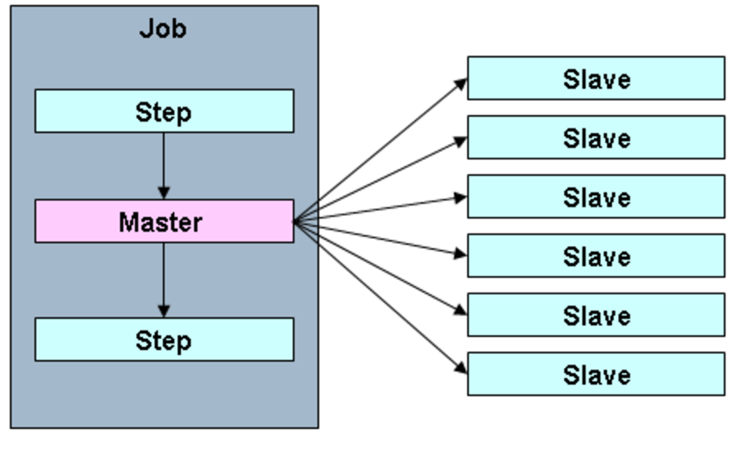
Partitioning
Parallel Processing
Let spring do the heavy lifting
Just write: partitioner, configure: master and slave steps
Configurable grid size, task executor and thread pool size
Master step directs slave execution
http://docs.spring.io/spring-batch/trunk/reference/html/scalability.html

Slide 31
Partitioning
Partitioner
import org.springframework.batch.core.partition.support.Partitioner;
public class RequestPartitioner implements Partitioner {
@Override
public Map<String, ExecutionContext> partition(int gridSize) {
Map<String, ExecutionContext> executionContextsByName = new HashMap<>();
…
executionContextsByName.put(slaveStepNameBase + stepIndex, stepContext);
…
Example
Slave1 - Request ID’s 1 through 100
Slave2 – Request ID’s 101 through 200
Slave3 – Request ID’s 201 through 300

Slide 32
Partitioning
Master Step
<step id="baseProcessRequestsStep.master" abstract="true">
<partition step="baseProcessRequestsStep.slave"
partitioner="requestPartitioner">
<handler grid-size="${request.partitioner.grid-size}"
task-executor="processRequestsTaskExecutor" />
</partition>
</step>
<bean id="processRequestsTaskExecutor" class="org.springframework.scheduling.concurrent.ThreadPoolTaskExecutor"...
http://docs.spring.io/spring-batch/trunk/reference/html/scalability.html

Slide 33
Partitioning
Slave Step
<step id="baseProcessRequestsStep.slave">
<tasklet>
<chunk reader="processRequestsReader"
writer="processRequestsWriter"
commit-interval="${process.commit-internal}"/>
</tasklet>
</step>
http://docs.spring.io/spring-batch/trunk/reference/html/scalability.html

Slide 34
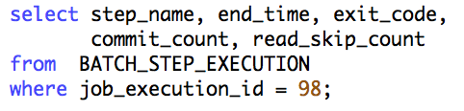
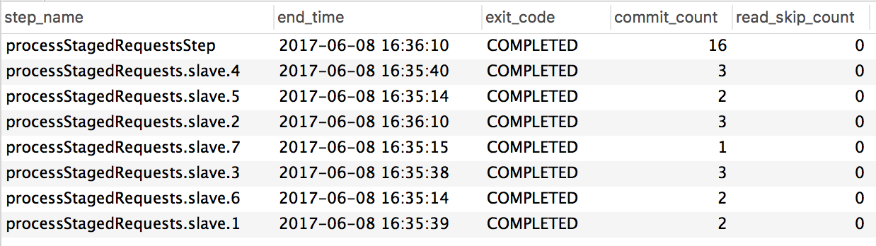
Partitioning
Stats!
http://docs.spring.io/spring-batch/trunk/reference/html/scalability.html

Slide 35
Partitioning
Parallel Processing
Lessons learned
DB connection pool size
DB connection max wait time
Bonus
Step scope task executor provides thread pool per master step execution
http://docs.spring.io/spring-batch/trunk/reference/html/scalability.html

Slide 36
Testing

Slide 37
End to end – OR – Mock
Both!
Complex business logic
Branch coverage
Spock
End to End
spring-batch-test
<dependency>
<groupId>org.springframework.batch</groupId>
<artifactId>spring-batch-test</artifactId>
<version>${spring-batch.version}</version>
<scope>test</scope>
</dependency>

Slide 38
End to End
spring-batch-test: JobLauncherTestUtils
Did I set all this stuff up right?
Test each batch step independently
Minimize code under test
Ease of extension
Mock execution context
JobExecution execution =
jobTestUtils.launchStep("step1", jobParameters, jobContext);

Slide 39
End to End
spring-batch-test: JobLauncherTestUtils
When launchStep doesn’t get the job done
Repeat step executions
Job flow logic
JobExecution execution =
jobTestUtils.launchJob(jobParameters);

Slide 40
End to End
spring-batch-test: AssertFile
Steps that create files
AssertFile - line by line file comparison
AssertFile.assertFileEquals(new FileSystemResource("expected.txt"),
new FileSystemResource("output.txt"));

Slide 41
End to End
Integration Test Example
@RunWith(SpringJUnit4ClassRunner.class)
@ContextConfiguration(locations = {"classpath:beans/test-config.xml"})
@Sql(scripts="classpath:response_data.sql",
config=@SqlConfig(dataSource="dataSource",
transactionManager="transactionManager"))
public class ResponseStepIT {
private JobLauncherTestUtils _jobLauncherTestUtil;
@Test
public void testResponseStep() {
JobExecution execution = _jobLauncherTestUtil
.launchStep("responseStep", jobParameters, executionContext);
assertEquals(ExitStatus.COMPLETED, execution.getExitStatus());
AssertFile.assertFileEquals(new FileSystemResource(expectedFile),
new FileSystemResource(outputFile));
}
}

Slide 42
Questions
mkhair@trustwave.com
churd@trustwave.com

Slide 43
THANK YOU

