Slide 1
Cash Stash
Personal Finance Manager
5 Men & a Buck
COMP3700

Slide 2
Outline
Architectural Design
Detailed Design
  Use case: Create a Budget
  Detailed System Sequence Diagram
  Collaboration Designs and GRASP Principles
  Design Class Diagram and Design Pattern(s)
Project management
Lessons learned
Notes:
Cameron

Slide 3
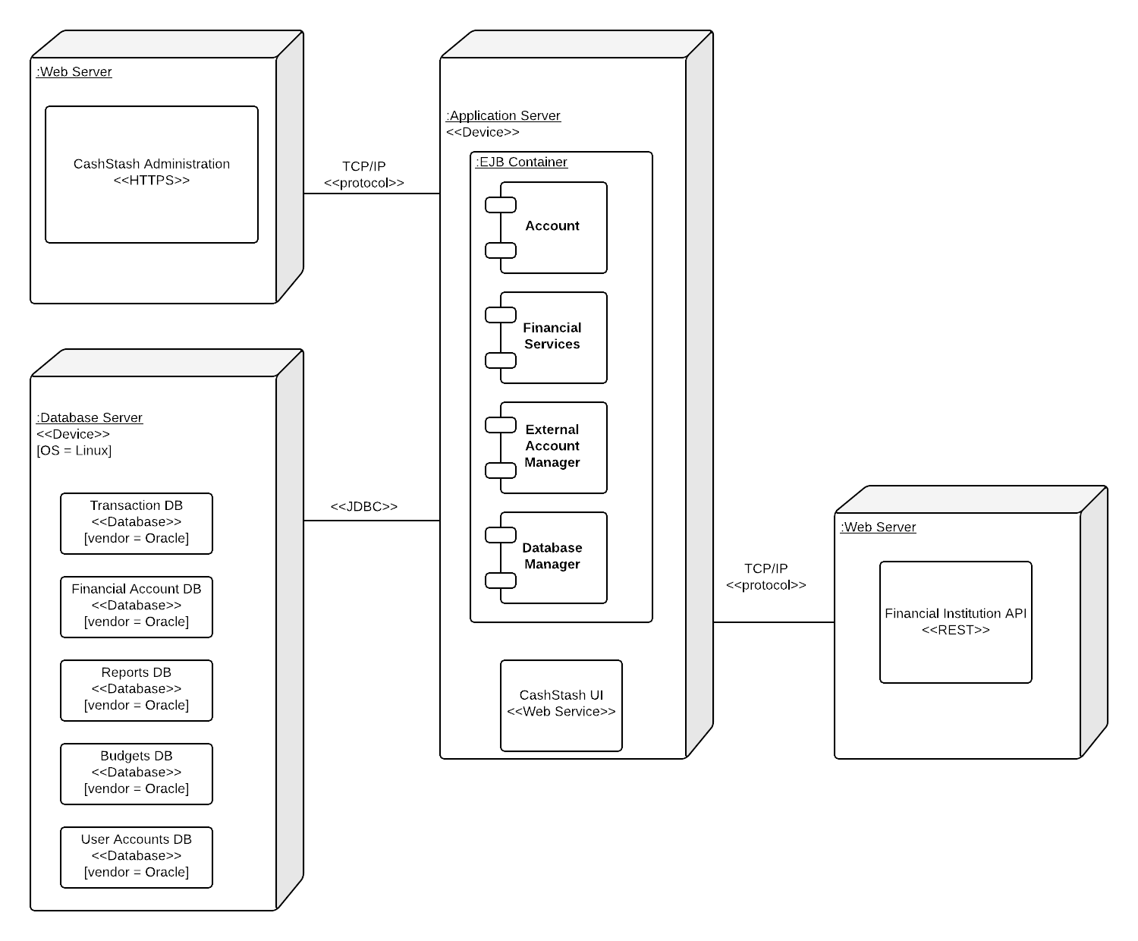
Architectural Design
Repository Model, 3-Tier Architecture
Notes:
Cameron

Slide 4
Architectural Design
Repository Model, 3-Tier Architecture
  Rationale
    The sub-systems are able to compute different figures and statistics based on a user’s financial account transactions.
    Since all sub-systems will have to draw from the same source of data, the repository model fits best.
  Advantages
    Efficient way to share large amounts of data.
    The sub-systems of this model see data as a black-box, they are not concerned with how it is produced.
    The repository schema provides a uniform, published model for the sharing of data between sub-systems.
  Disadvantages
    The sub-systems must agree on the repository schema, which often leads to compromises.
    The evolution of repository data is expensive and difficult to maintain.
    Management policies have no specific scope within the application.
    The repository can be difficult to distribute efficiently in some cases.
Notes:
Cameron

Slide 5
Use case: Create Budget
User | System
1. Click “Create Budget” Button
 | 2. Display “New Budget” Screen
3 Provide monthly income and define categories with percent of monthly income for the budget
4. Fill out Budget form
 | 5. Verify Budget data
 | 6. Calculate budget
5.1 If missing information, display error
5.2 If sum of percentages defined for categories is less than 0
or greater than 100, display error
Notes:
Sean

Slide 6
Use case: Create Budget
Scenario
  John Doe logs in.
  John Doe chooses the create budget option.
  System displays the budget settings screen.
  John Doe creates budget categories and assigns percentage or fixed amount values to each category.
  John Doe chooses the save option.
  System verifies the budget settings.
  System saves the budget.
  System displays the main screen.
Notes:
Sean

Slide 7
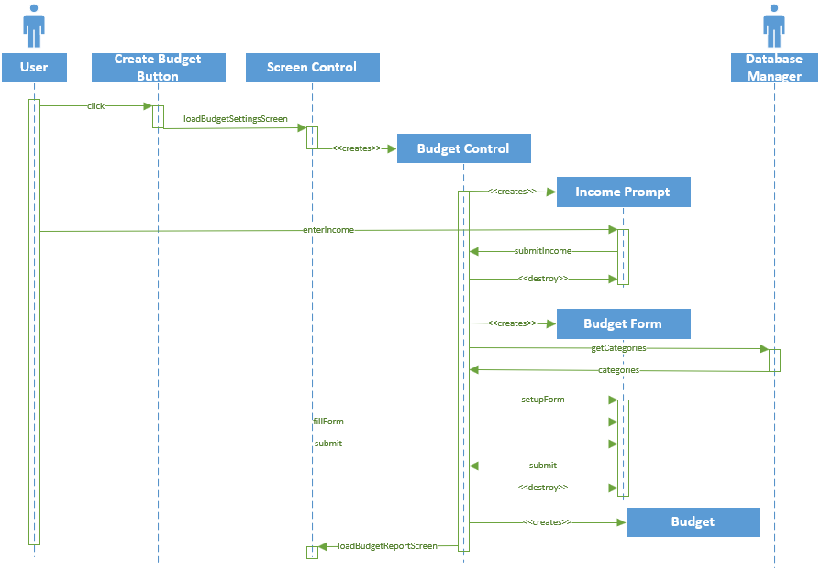
Detailed System Sequence Diagram
Notes:
Sean

Slide 8
Detailed System Sequence Diagram
Boundary Objects
  Create budget button
Controller Objects
  All objects with Control in the name
Entity Objects
  User
Non-trivial Interactions
  Loading transactions when Report control is instantiated
Notes:
Sean

Slide 9
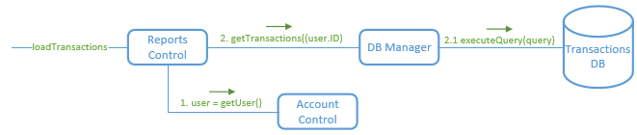
Collaboration Designs
GRASP Patterns
  This diagram is lowly coupled since reports control has minimal interaction with the other classes.
  Information expert and high cohesion were also a factor in the design by delegating the getUser task to the Account Control (which is responsible for manipulating account object data) and assigning any DB queries to the DB Manager.
Notes:
Sean
Diagram Summary: This diagram represents the process of loading transactions from the application’s transactions DB for generating reports.

Slide 10
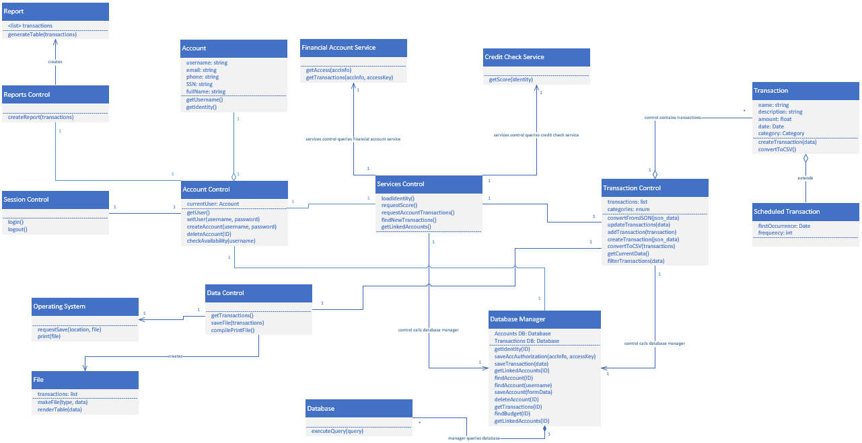
Design Class Diagram
Notes:
Daniell

Slide 11
Design Class Diagram
Design Patterns
  The design class diagram relies heavily on the singleton design pattern.
  This pattern was chosen with the control objects in mind.
  Each control object will be responsible for most of operations being performed throughout the system and will interact with object instances as needed.
  This represents the singleton design pattern well because the control classes will only have one instance that is instantiated at the start of the application and destroyed at the end of the program.
Notes:
Daniell
Controllers have 1 instance only

Slide 12
Project management
Communication Methods
  GroupMe
    Used for meeting availability times and checking the status of member assignments.
  GitHub
    Central repository for all diagrams, Project deliverables, and any files generated during the process.
  Team Meetings
    Weekly meetings were held 2-3 times per week to check the work of each team member, ensure consistency of notation, and answer any questions team members had.
Notes:
Cameron

Slide 13
Project management
Iterations
  Phase 1
    1 initial iteration - 2 additional iterations were included as the team worked through the design phase and needed to revise some of the analysis portions to coincide with the design
  Phase 2
    2 iterations took place – the second was required only to apply consistency in collaboration diagrams
Notes:
Daniell

Slide 14
Project management
Roles
Each team member contributed to every part of the project
  Increased efficiency, tasks were completed quicker.
  Required additional time to review each members contribution and ensure consistency between diagrams.
Member | Role
Cameron Kubik | Team Leader
Sean Ramuchak | Designer
Daniell Yancey | Requirements Eng.
Dylan McCardle | Programmer
Notes:
Cameron start - All

Slide 15
Project management
Plans
  Task deadlines were imperative for completing each phase by the deadline.
  Team meetings were used to review work completed the previous days and to assign new tasks to members.
  The project would not have been completed on time if it were not for members taking plans seriously and deadlines being met consistently.
Notes:
Dylan

Slide 16
Lessons learned
What went right
  Project communication, planning, and execution
What went wrong
  Early on, the team had a member go MIA.
  This put a lot of extra work on the team and moved deadlines up that were difficult to meet at times.
What would you do differently
  Ideally, the team would be in the same physical building or room while working on the project.
    This would increase collaboration
    Questions would be answered quicker
Notes:
Cameron

Slide 17
Lessons learned
How good is your work
  The team feels confident in the analysis, design, and implementation of the financial management application produced.
  Phases 1 and 2 were reviewed by all members before submitting to ensure everyone was in agreement on the quality of the contribution they made.
Notes:
Cameron

