Slide 1
Salt Reduction Advocacy Slide Deck
Speaker name and title
Date

Slide 2
Hypertension is the leading risk factor for preventable deaths worldwide
Hypertension Leads to Nearly 10.7 Million Deaths Globally Per Year: More Deaths Than Any Other Condition

Slide 3

Excessive Salt Increases Blood Pressure
1/3 of hypertension cases are attributed to excess salt consumption

Slide 4

Salt Intake Worldwide is Excessive
99.2% of adults worldwide are above the WHO recommendation of 5g of salt per day

Slide 5

Salt Reduction Saves Lives
3 million deaths annually are attributed to excess sodium consumption

Slide 6

1.6 MILLION
Lives could be saved each year by reducing sodium intake by 30%
Reducing Population Salt Consumption is Effective
PREVENTS hypertension among children and adults without hypertension
REDUCES blood pressure and PREVENTS heart attacks and strokes among adults with hypertension

Slide 7

$19
Reducing Salt Consumption is Cost-Effective
Salt reduction is a WHO best buy and one of the most cost-effective ways to improve population health
Could be saved for every $1 spent on salt reduction efforts

Slide 8
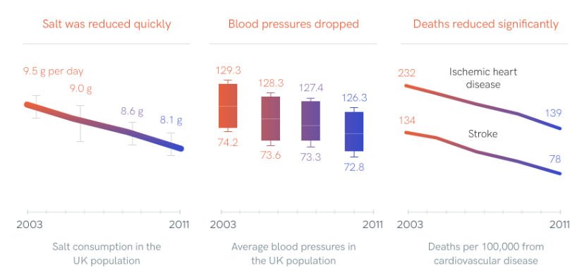
Salt Reduction Interventions are Effective
CASE STUDY The United Kingdom
Notes:
He FJ et al. Salt reduction in England from 2003 to 2011: its relationship to blood pressure, stroke and ischaemic heart disease mortality. 2014.

Slide 9
Dietary Sources of Salt Vary by Country
Three major sources of excess dietary salt
Added to packaged foods during manufacturing
Added by restaurants, vendors, canteens
Added in home preparation, at table (discretionary salt)
China
United States
Notes:
Shufa, Popkin data
Harnack et al. Sources of Sodium in US Adults from 3 Geographic Regions. Circulation. 2017

Slide 10



Intervention Strategies Depend on the Sources of Salt
PACKAGED FOOD
AWAY FROM HOME FOOD
HOME
Front of Pack Labeling
Industry Reformulation
Food Procurement Policies
Interventions that Address Restaurants and Vendors
Behavior Change Campaigns
Promotion of Salt Substitutes

