Slide 1


Making the List: Why Now is the Time to Declare That Antihypertensive Combination Therapies are Essential
Notes:
https://www.resolvetosavelives.org/

Slide 2
Outline
WHO Essential Medicines List & Why It Matters
Global Burden of Hypertension & Key Gaps
Rationale for Fixed Dose Combinations (FDC) for Hypertension as an Essential Medicine
Guidelines
Efficacy
Cost
Resources

Slide 3
WHO Essential Medicines List (EML)
Initiated in 1977: 204 products; 2017: 433 products
Definition: Essential medicines are those that satisfy the priority healthcare needs of the population
Criteria:
Disease prevalence,
Public health relevance,
Clinical efficacy and safety
Comparative cost/cost-effectiveness within class
Informs national-level priorities (National EML)
Guides drug donations/priorities by United Nations agencies

Slide 4
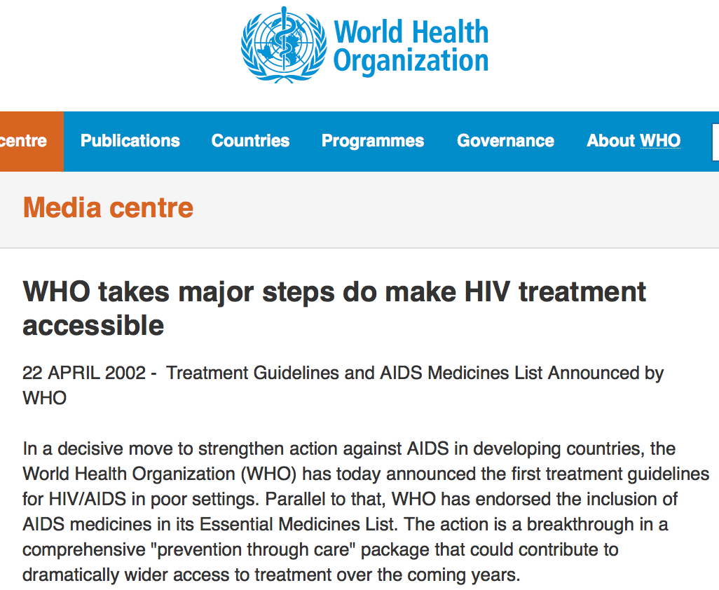

Slide 5
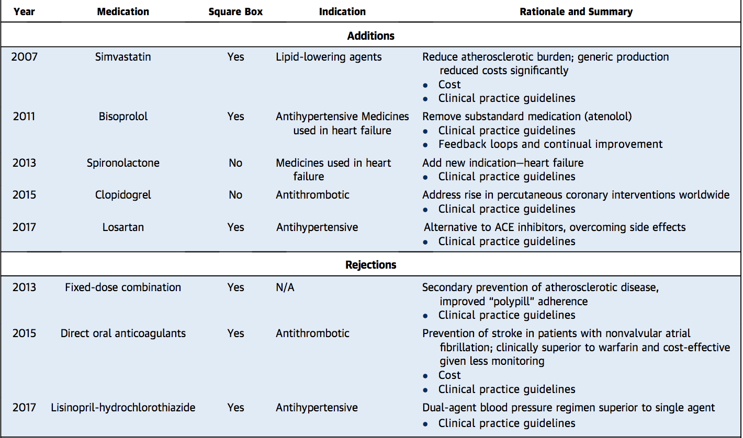
WHO EML: Cardiovascular Disease
Kishore SP, Blank E, Heller DJ, Patel A, Peters A, Price M, et al. Modernizing the World Health Organization List of Essential Medicines for Preventing and Controlling Cardiovascular Diseases. J Am Coll Cardiol. 2018;71(5):564-74.

Slide 6
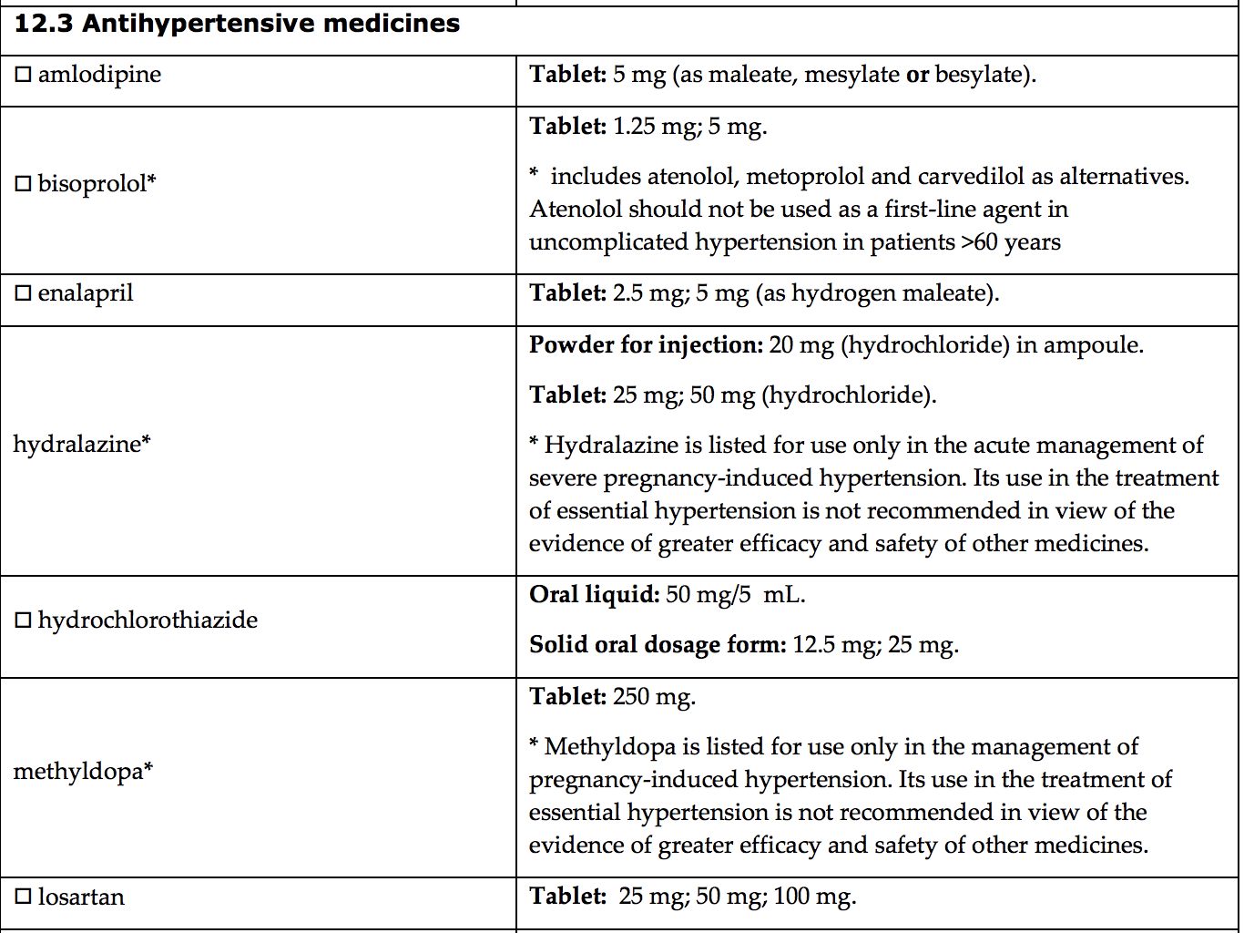
WHO EML: Hypertension
WHO Essential Medicines List. 2017. Available: https://www.who.int/medicines/news/2017/20th_essential_med-list/en/

Slide 7
WHO EML: Square Box Notations
The square box symbol is primarily intended to indicate similar clinical performance within a pharmacological class.
The listed medicine should be the example of the class for which there is the best evidence for effectiveness and safety.
In some cases, this may be the first medicine that is licensed for marketing; in other instances, subsequently licensed compounds may be safer or more effective.
Where there is no difference in terms of efficacy and safety data, the listed medicine should be the one that is generally available at the lowest price, based on international drug price information sources.

Slide 8
Translation of WHO EML to National EML¹
NEML increases availability but still imperfectly
Availability poor in public sector
Medicines on NEML have lower prices
Anti-hypertensives (hydrochlorothiazide, amlodipine and enalapril) are 1.3 – 3.7x less expensive
Variation on composition of sub-national EMLs and procurement models (e.g. India: 153 to 1390 medicines)
 | Listed on NEML | Not Listed on NEML
Availability² | 62% (40% in public sector) | 27% (6% in public sector)
1 Wirtz VJ, Kaplan WA, Kwan GF, Laing RO. Access to Medications for Cardiovascular Diseases in Low- and Middle-Income Countries. Circulation. 2016;133(21):2076-85.
2 Bazargani YT, Ewen M, de Boer A, Leufkens HG, Mantel-Teeuwisse AK. Essential medicines are more available than other medicines around the globe. PLoS One. 2014;9(2):e87576.

Slide 9
Global Burden of Hypertension
Leading cause of cardiovascular disease: 10 million deaths annually
Systolic Blood Pressure (SBP) > 140 mmHg OR
Diastolic BP (DBP) > 90 mmHg
Reducing BP reduces CV events^{1,2,3}
1.4 B with HTN Globally. < 15% of these are controlled (<8% in LMIC)⁴
510 M individuals treated for HTN (37% of need)
In LMIC, 70% of patients on treatment are not controlled⁵
6/10 treated receive monotherapy⁵
~75% of individuals on treatment require ≥ 2 HTN drugs^{2,6}
1 Ettehad D, Emdin CA, Kiran A, et al. Lancet 2016;387:957–67.
2 Law MR, Morris JK, Wald NJ. BMJ (Clinical research ed.) 2009;338:b1665.
3 Xie X, Atkins E, Lv J, et al. Lancet 2016;387:435–43.
4 Mills KT, Bundy JD, Kelly TN, et al. Circulation 2016;134:441–50.
5 Chow CK, Teo KK, Rangarajan S, et al. JAMA 2013;310:959–68.
6 Wald DS, Law M, Morris JK, Bestwick JP, Wald NJ. American Journal of Medicine 2009; 122: 290–300.

Slide 10
Fixed-dose combinations (FDC) for Hypertension
Potential Advantages
Combination more effective than increased monotherapy doses (5x)
Reduced variation in treatment response
Simplified logistics for supply chain management
Greater ability to train and task-share
Fewer steps in protocol-based treatment
Improved treatment adherence: simpler dosing and reduced pill burden
Reduced aggregate costs
Potential Disadvantages
Patients must not have contraindications for either component
If adverse events occur, may not be clear which medication caused
Challenge in individualizing drug titration
Chobanian AV, Bakris GL, Black HR, et al. Hypertension 2003;42:1206–52.
Krause T, Lovibond K, Caulfield M, McCormack T, Williams B. BMJ (Clinical research ed.) 2011;343:d4891..
Indian guidelines on hypertension (I.G.H.) - III. 2013. The Journal of the Association of Physicians of India 2013;61: 6–36.
Seedat YK, Rayner BL, Veriava Y. Cardiovascular journal of Africa 2014;25:288–94..
Hackam DG, Khan NA, Hemmelgarn BR, et al. Canadian Journal of Cardiology 2010;26:249–58.

Slide 11
FDCs Definitely Indicated for Patients on Multiple Medications and Recommended as 1st Line Treatment for All Patients
Simplifies protocol
Recently endorsed in 2018 European Society of Cardiology/ European Society of Hypertension guidelines
7.5.2.4 Rationale for single-pill combination therapy as usual therapy for hypertension
Kaiser Permanente Northern California does this, and has achieved very high control rates (85-90%)
FDC Contraindications
Renovascular HTN
Severe renal impairment
Pediatric HTN
ESC/ESH Guidelines for the management of arterial hypertension. European Heart Journal 2018;39:3021–3104.

Slide 12
Making the List: FDC for Hypertension as WHO Essential Medicines
Guidelines
Efficacy
Cost

Slide 13
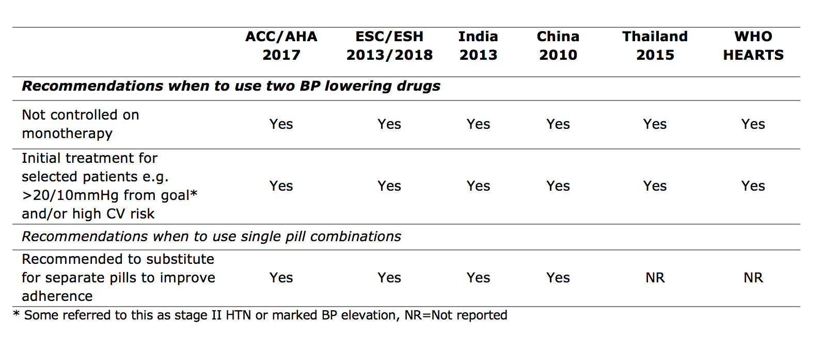
Guidelines: International Support for FDC
For patients needing >1 BP lowering drug, fixed dose combination (FDC) is recommended ^{14,17-19}
ACC/AHA 2017 – [ARB or ACEI] [Thiazide/Thiazide Like] [CCB]
Indian guidelines on hypertension (I.G.H.) - III. 2013. Journal of the Association of Physicians of India 2013;61:6–36.
Mancia G, Fagard R, Narkiewicz K, et al. Journal of hypertension 2013;31:1281–35.
Whelton PK, Carey RM, Aronow WS, et al. Journal of the American College of Cardiology 2017:24430.
Jaffe MG, Frieden TR, Campbell NRC, et al. J Clin Hypertens (Greenwich) 2018;20:829–36.

Slide 14
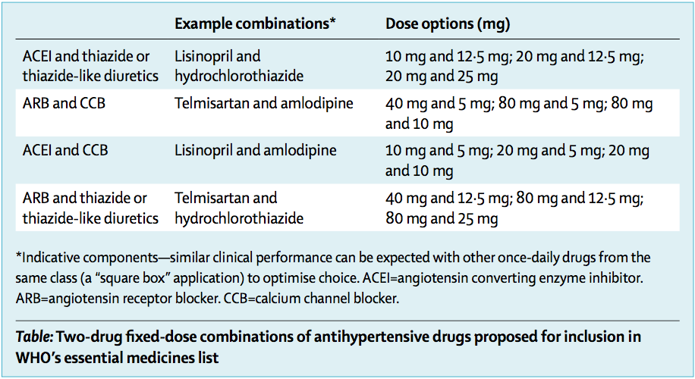
Guidelines: Focus on 4 Combinations
Each qualified with a square box
Ensures pharmacological class therapeutic equivalence; provides choice to nations while focusing options
Kishore SP, Salam A, Rodgers A, Jaffe MG, Frieden T. Lancet 2018:392:1072–1088.
Salam A, Kanukula R, Esam H, et al. An application to include blood pressure lowering drug fixed dose combinations to the model essential medicines list for the treatment of essential hypertension in adults.

Slide 15
Efficacy: FDC for Hypertension (Control)
14 randomized controlled trials (5,120 participants) for initial dual vs monotherapy (at least 4 weeks) indicates a 27% (95% CI 15–41%) improvement in blood pressure control without an increase in withdrawals due to adverse events¹
42 trials (10,968 participants) showed that combining drugs from four classes produced additive BP lowering effects²
Effect was approximately five times greater compared to doubling the dose of monotherapy²
Improving global rates by just 25% with dual therapy would increase the number of patients with controlled HTN by 80 million,¹ preventing two million strokes and heart attacks and more than 600,000 cardiovascular deaths over 5 years
1 Salam A, Kanukula R, Esam H, et al. An application to include blood pressure lowering drug fixed dose combinations to the model essential medicines list for the treatment of essential hypertension in adults.
2 Magrini N, Robertson J, Forte G, et al. Tough decisions on essential medicines in 2015. Bulletin of the World Health Organization 2015;93:283–84.

Slide 16
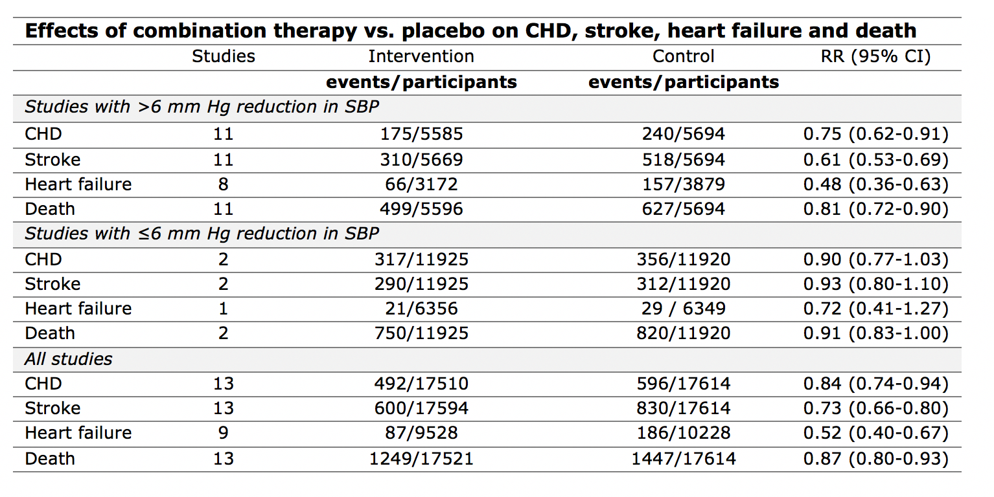
Efficacy: FDC for Hypertension (Cardiovascular Outcomes)
Salam A, Kanukula R, Esam H, et al. An application to include blood pressure lowering drug fixed dose combinations to the model essential medicines list for the treatment of essential hypertension in adults.
Notes:
Among these trials, there was a 25% reduction in CHD, a 39% reduction in stroke, a 52% reduction in heart failure and a 19% reduction in mortality (all p<0.001).

Slide 17
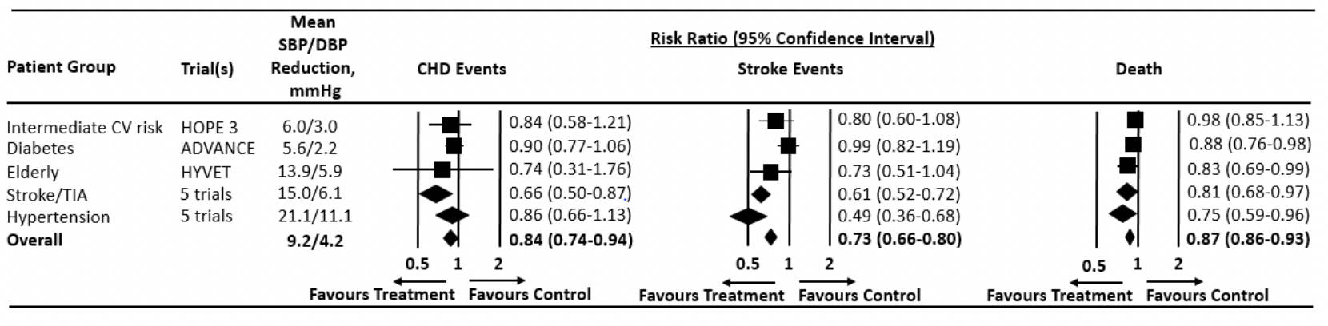
Efficacy: FDC for Hypertension (Sub-populations)
Salam A, Kanukula R, Esam H, et al. An application to include blood pressure lowering drug fixed dose combinations to the model essential medicines list for the treatment of essential hypertension in adults.

Slide 18
Example: Telmisartan + Amlodipine FDC
Telmisartan
Long-acting angiotensin receptor blocker (ARB)
Available as a generic
Amlodipine
Calcium channel blocker (CCB)
Available as generic
Widely available in LMICs
Combination reduces incidence of pedal edema
Most common amlodipine associated adverse event
Salam A, Kanukula R, Esam H, et al. An application to include blood pressure lowering drug fixed dose combinations to the model essential medicines list for the treatment of essential hypertension in adults.

Slide 19
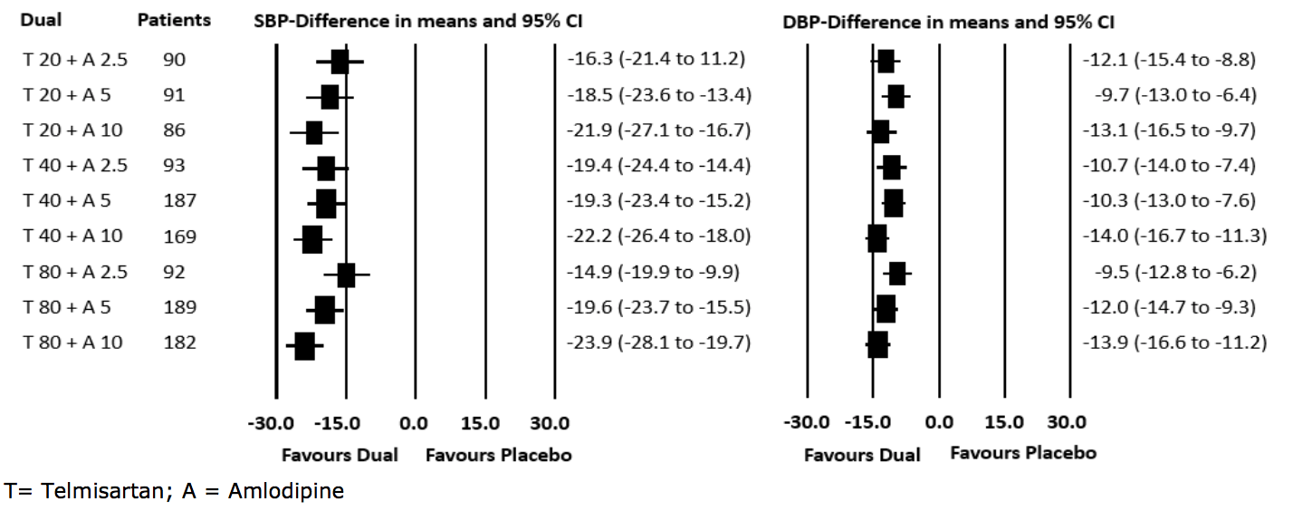
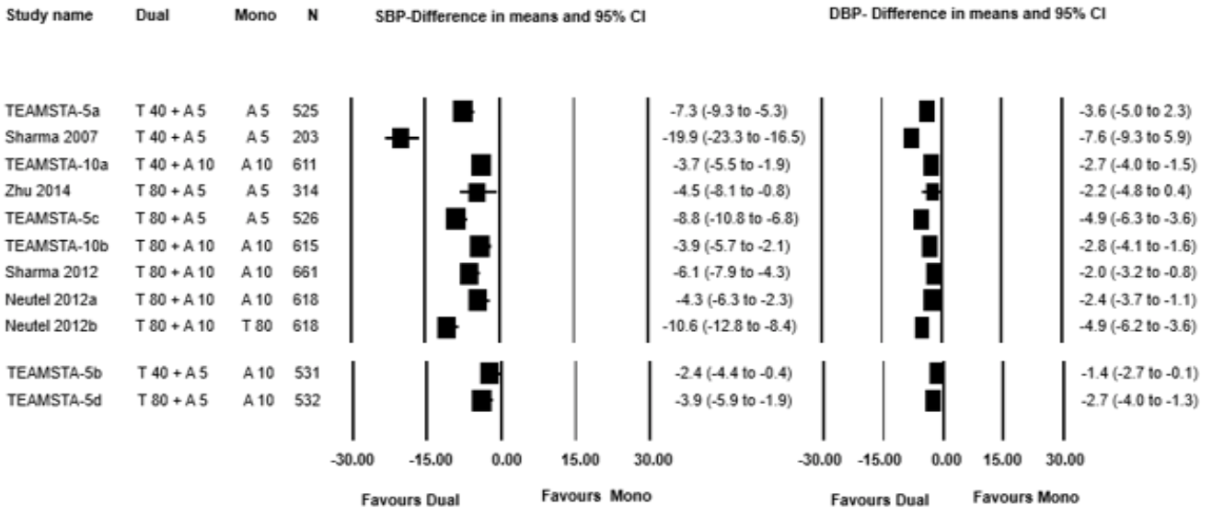
Telmisartan + Amlodipine FDC
Vs Placebo:
Vs Mono:
Notes:
1) One RCT reported data for BP lowering efficacy of various dual combinations of telmisartan/amlodipine compared to placebo. 2) Six RCTs reported data for BP lowering efficacy of dual combinations compared to one of the component drug (monotherapy). 3) One RCT (n=481) assessed the effects of telmisartan 80mg/amlodipine 5mg compared to olmesartan 40 mg/hydrochlorothiazide 12.5 mg in 481 hypertensive patients. Both the dual combinations were equally efficacious (BP reduction 12.7/9.1 vs. 12.8/10). 4) Neldam et. al analysed patient-level data for three double-blind RCTs to assess BP lowering efficacy of telmisartan/amlodipine combination therapy with respective monotherapies at week(s) 1, 2 and 4. Patients on combination therapy had a greater reduction in BP and improvement in BP control at these earlier time-points during the treatment period.

Slide 20
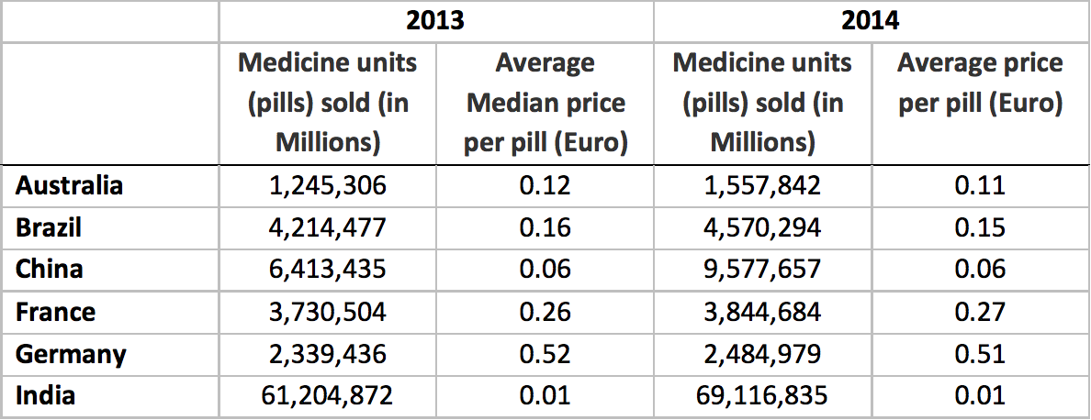
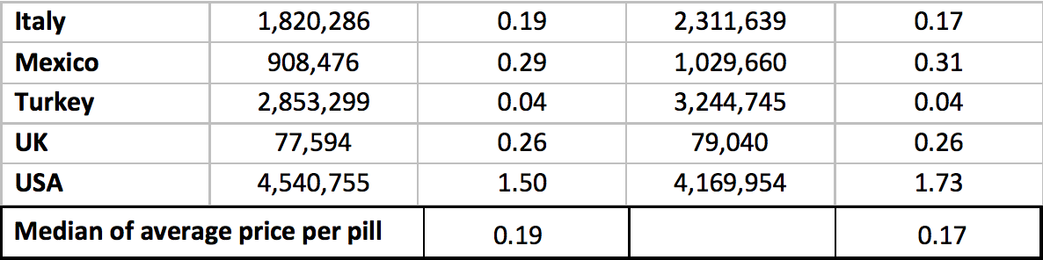
Cost: Global Analysis – ARB + CCB FDC (Quintiles IMS)
Salam A, Kanukula R, Esam H, et al. An application to include blood pressure lowering drug fixed dose combinations to the model essential medicines list for the treatment of essential hypertension in adults.
Notes:
Utilized Quintiles IMS data on 13-14 sales of CCB + ARB combo in 11 countries.
Median price per pill was 0.19 and 0.17 in Euros in 13 and 14, respectively.
The USA had the highest unit price, about 170 times higher than the lowest unit price was from India.

Slide 21
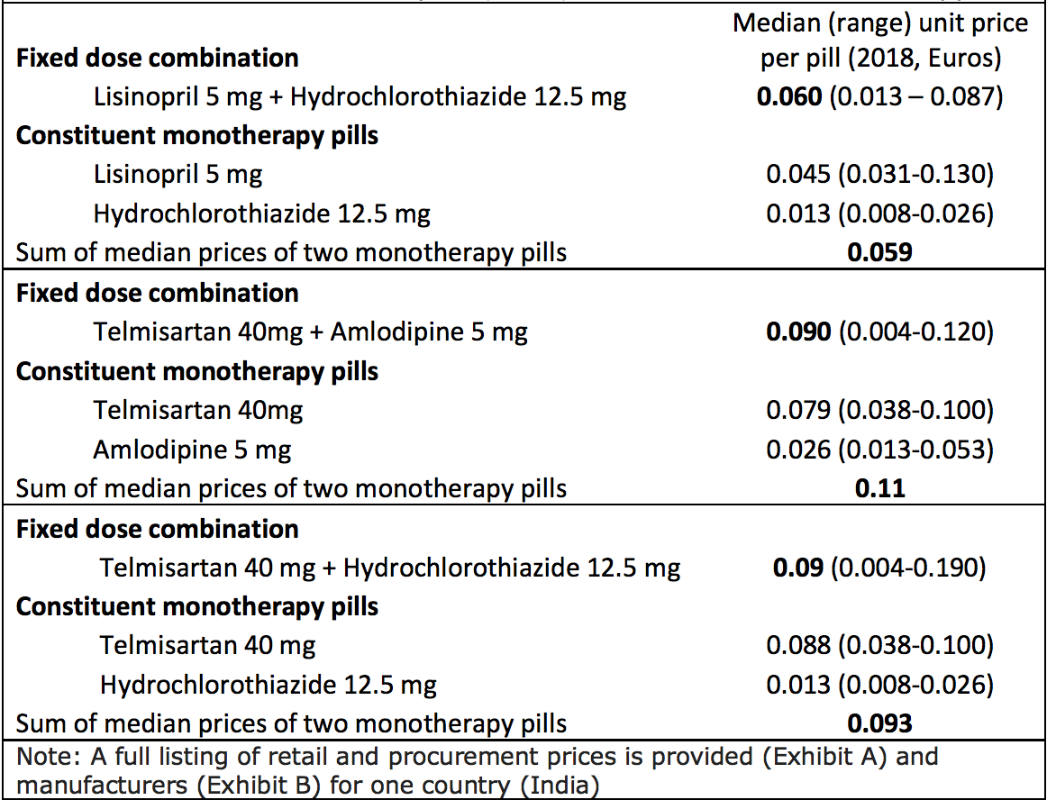
Cost of FDC Is Similar to or Lower than Cost of Monotherapy with Constituent Pills (India)
Salam A, Kanukula R, Esam H, et al. An application to include blood pressure lowering drug fixed dose combinations to the model essential medicines list for the treatment of essential hypertension in adults.
Notes:
We conducted systematic searches in MedInd and MIMS-India databases to obtain private- sector retail prices of various FDC brands marketed in India. We also obtained prices of the respective constituent single pills/monotherapies. We found that retail prices of FDCs were similar if not lower compared to the price of constituent monotherapies.
2004 medical expenditure panel survey in US demonstrated lower prescription costs for 23 of 27 FDC medications examined compared to individual drugs (mean decrease monthly $20.89; 95% CI $20.10 - $21.68)
Pharma claims data in Japan demonstrated annual savings of $112 for patients when switching from separate drugs to FDC therapy

Slide 22
Additional Cost Considerations for FDC
FDCs have been used as evergreening strategies in efforts by originator companies to reduce price erosion once a molecule comes off patent
When combinations first hit the market or are scarce, they attract a price premium
Retail drug prices need to be contextualized within the potential cost savings from improved hypertension control
Notes:
FDC’s have been used as evergreening strategies in efforts by originator companies to reduce price erosion once a molecule comes off patent.
When combinations first hit the market or are scarce, they attract a price premium.
Retail drug prices need to be contextualized within the potential cost savings from improved HTN control
Meta-analysis included 44,336 patients across 7 observational studies; mean pooled difference 1357.01 USD; 95% CI 1935.49 – 778.53 USD

Slide 23


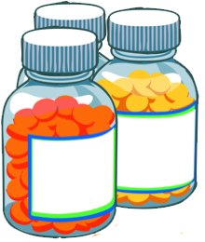

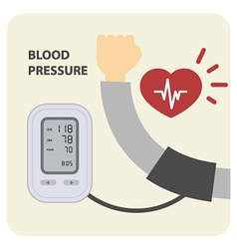
FDCs Improve Every Key Component of Hypertension Control
Protocol
Medication Supply
Community-Based Treatment
Patient-Centered Care
Information
Systems
Simpler treatment algorithm
Fewer stockouts
Enhanced task sharing
Lower pill burden
Better control rates

Slide 24
Resources
Expert Committee on the Selection and Use of Essential Medicines application:
http://www.who.int/selection_medicines/committees/expert/22/fixed-dose_combination_antihypertensives/en/
Fixed dose combinations for hypertension (Lancet 2018)
https://www.thelancet.com/journals/lancet/article/PIIS0140-6736(18)31814-2/fulltext

Slide 25
Acknowledgements
Abdul Salam, George Institute for Global Health
Anthony Rodgers, George Institute for Global Health
Marc G Jaffe, Resolve To Save Lives
Tom Frieden, Resolve To Save Lives
Phillip Groden, Icahn School of Medicine at Mount Sinai
Norm Campbell, University of Calgary

