Slide 1

Final Critique
Cameron Willment

Slide 2
Background Research
Original idea was for a peer to peer renting app
Saw that many apps already exist
Learned about the problems they faced
Taxes
Enough users
liability

Slide 3
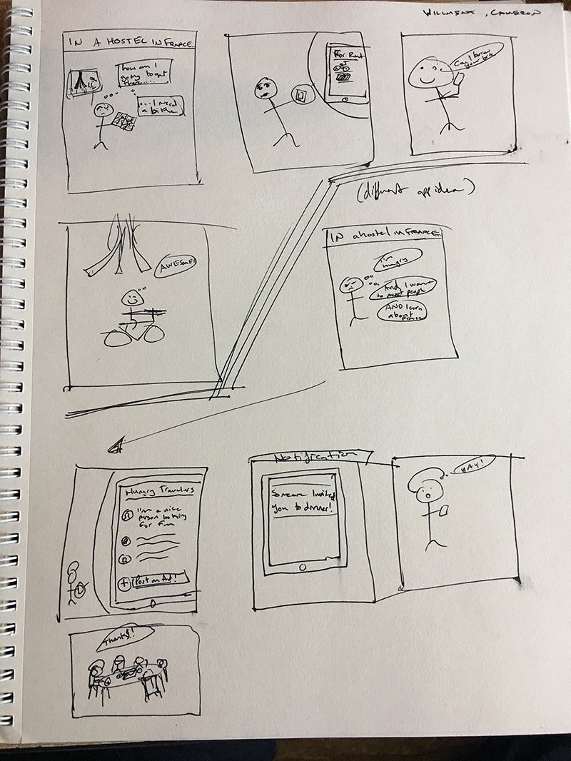
Storyboards
Got me thinking about my user
Forced me to see how they would use it
How is it helping them?
Received good ideas/feedback

Slide 4
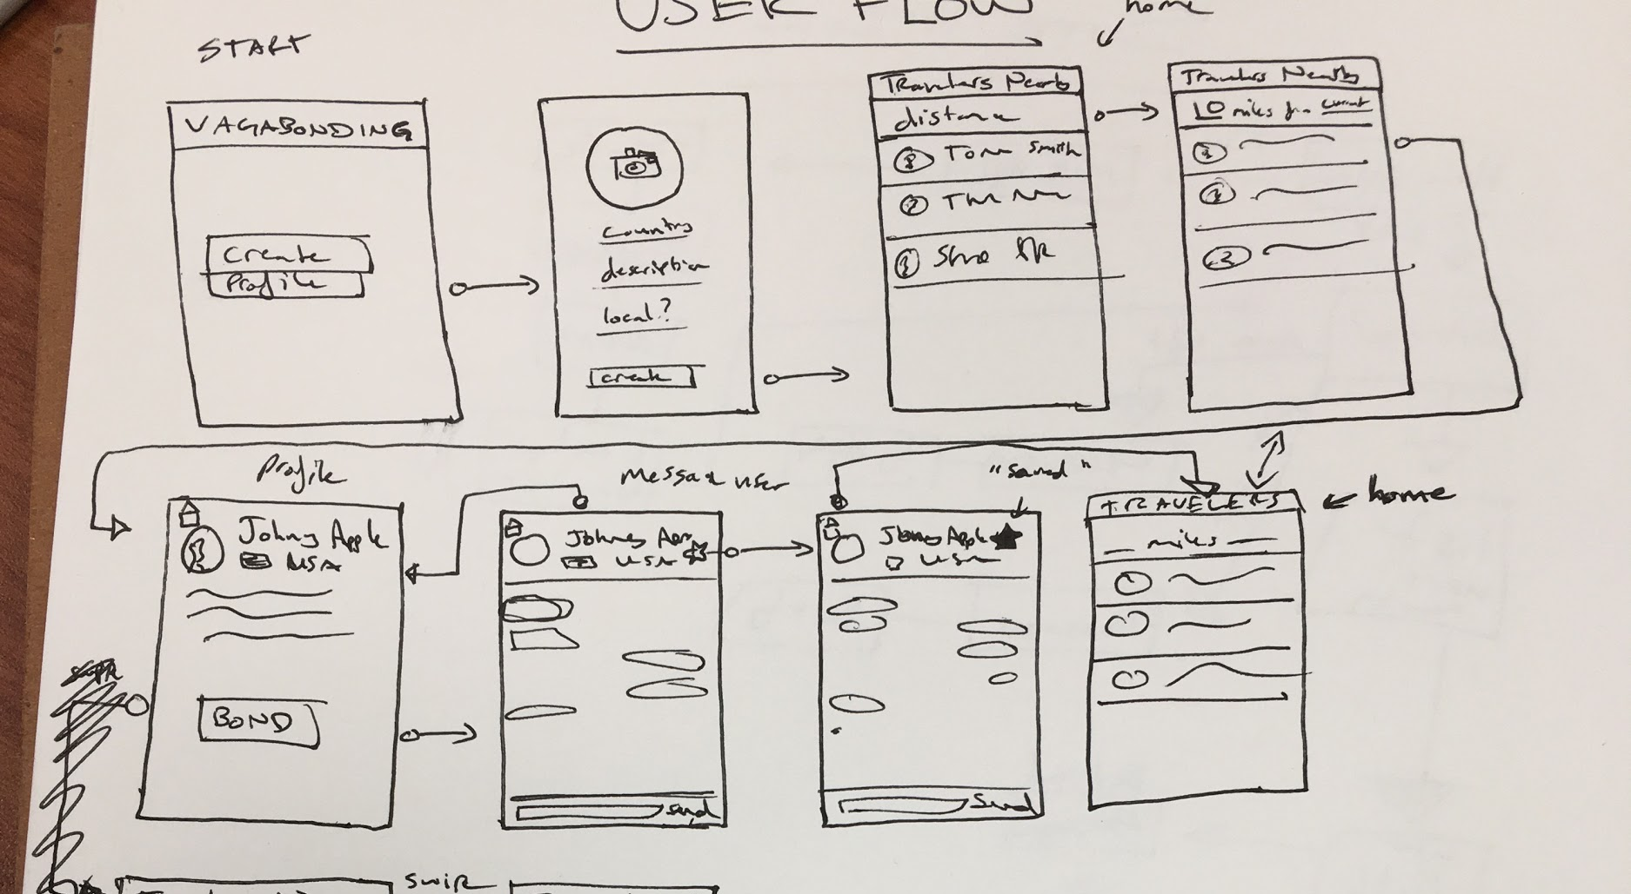
User Flow
Made me think about how about how the user will navigate the app
What order should things be in?
What does the user want to see when they open the app?
Make it a Mensch!

