Slide 1
CS 290– Web Development.

Slide 2
Agenda
MoreExpress.js
Create an interface to add countries from our site
Create interface to put in a dollar amount, select a country and get result.
REST API

Slide 3
Before we start
Add Postman plugin to your chrome
Or HTTPRequester for Firefox
npm install body-parser
This will help us parse input requests more easily.
Start mongodb

Slide 4
What did we accomplish last class?

Slide 5
If we want to use a webpage to insert a country into the database, what do we need to do?
Think of what the webpage needs to do
What needs to happen in the backend

Slide 6
The backend
Create a method addCountry in our db.js whose job it is to add a country to the collection
Map a post request in our server.js that calls addCountry

Slide 7
Quiz
What is the command to find info in mongo collection
What is the command to insert?

Slide 8
Code for db.js
First we need a function stub
exports.addCountry = function(req,res) {
//read the request parameters for country details
//add the country to database
}

Slide 9
read the request parameters
In addCountry, add the code below to read parameters passed in the request object
var newrec={};
newrec.country=req.body.country;
newrec.notation=req.body.notation;
newrec.currency=req.body.currency;
newrec.comission=req.body.comission;
newrec.multiplier = req.body.multiplier;
var country = newrec.country;
console.log(JSON.stringify(newrec));
//alsotry console.log(req.body);

Slide 10
Configure addCountry in server.js
First, lets include body-parser
var bodyParser = require('body-parser');
Next, tell express to use body parser
var urlencodedParser = bodyParser.urlencoded({ extended: false })
Next, configure url /add to addCountry
app.post('/add', urlencodedParser ,function (req,res) { mydb.addCountry(req,res);
});

Slide 11
Alternative
You are more likely to see the following syntax on forums. This does it at a global level and is less favorable.
var bodyParser = require('body-parser');
app.use(bodyParser.urlencoded({ extended: false }));
app.post('/add', function (req,res) { mydb.addCountry(req,res);
});

Slide 12
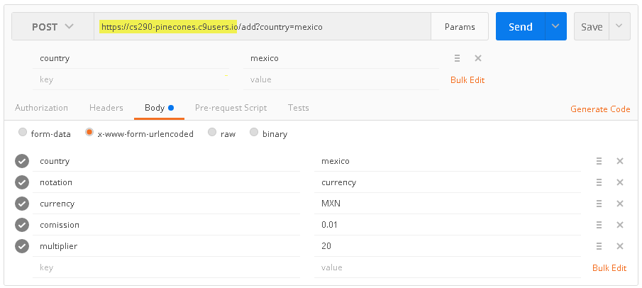
Lets run and test
Anyone get any syntax errors on run?
Lets create a postman post request like one below

Slide 13
On send, do you see the console log messages from addCountry?
Try console.log(req.body) and check that out too

Slide 14
Next lets add it to the database
Lets review our populateDB code for syntax

Slide 15
Add the following code to add newrec to the database
db.collection('rates', function(err, collection) {
collection.insertOne(newrec, function(err, result) {});
});

Slide 16
*
Ideally you are doing error handling and your code should look more like this
db.collection('rates', function(err, collection) {
if(!err) {
collection.insertOne(newrec, function(err, result) {
if(!err) {
console.log("Successfully inserted: "+newrec.country);
}
else { console.log("Error:"+err); }
});
} else {
console.log("Error connecting to rates:"+err);
}
});

Slide 17
Run
Run our program again
If no errors in console, run the post command again
Do you see successful message in the console?
Do you see your record in mongo?
Yes? What happens when you Send a second query from postman?

Slide 18
Check before you insert
One of the most common questions before inserting new data is: Is this an insert or is it an update? In other words, does this record already exist?
Few different ways to do this

Slide 19
Do a find (or select in sql parlance).
For example, find({country:"mexico"})
If it returns success, then you know its an update, else its an insert

Slide 20
Sample code
db.collection('rates',function(err,collection){
collection.findOne({'country':country}, function(err, item) {
if(!err) {
if(item) {
//record exists
} else {
//record does not exist
collection.insertOne(newrec, function(err, result) {
if (err) {
res.send({'error':'An error has occurred'});
} else {
console.log('Success: ' + JSON.stringify(result));
res.send(result);
}
});
}
}
})
});

Slide 21
Using Schema
You can also define db schemas (constraints in sql) that disallow you from entering duplicate entries.
Insert Mexico
If(errorType==cannot insert duplicate)
Record exists, so lets update it
More common approach in SQL

Slide 22
Upsert
Simply run a update query but specify {upsert:true}
Mongo will try to update a record with country:Mexico, if it can't find it - it will create one for you

Slide 23
Replace the current insert code you have with this one
db.collection('rates',function(err,collection){ collection.update({"country":country},newrec,{upsert:true}, function(err, result) {
if (err) {
console.log("Error"+err);
} else {
console.log('Success: ' + JSON.stringify(result));
}
});
});

Slide 24
Before you run
Clean up your collection, remove all records with country:Mexico (or just the extra ones)
Test it. Make sure you are not adding duplicate entries

Slide 25
So far so good?

Slide 26
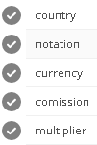
Create the frontend
Now lets create the front end page
Create a page add-country.html under client
Create a form with five input fields, a submit and a reset button
On submit, make a ajax post call to /add
Capture the confirmation response from /add
Confirm to user that new country was added or updated
Clear all input fields on the form

