Slide 1
CS 290 – Web Development.

Slide 2
Agenda
Breaking down HTTP
XML Files
JSON
AJAX

Slide 3

Questions from last class?

Slide 4
Since you have no questions…
What's the output here?
<script>
var CounterObj = function() {
var ctr = 0;
this.incr = function() {return ++ctr;};
};
var Aobj = new CounterObj();
var Zobj = new CounterObj();
alert(Aobj.incr());
alert(Aobj.incr());
alert(Zobj.incr());
</script>

Slide 5
What's the network traffic like - the back and forth between your browser and the server - when you try to access a page?
Notes:
Image on next slide

Slide 6
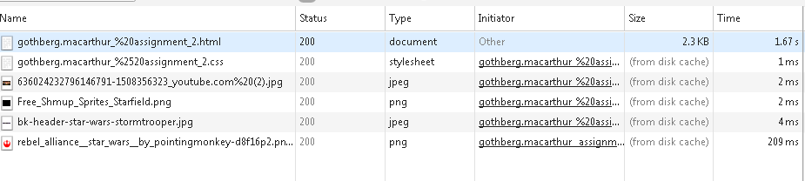
Here's a sample of n/w traffic
This is for a single, simple page. Let's look osucascades for example

Slide 7
A deeper look
So what is happening behind the scenes?
Notes:
So you put in a URL - browser reaches out to the server
Server sends out an html
Browser then asks for other images/css/js etc associated with the html
Done?
Let's look at it behind the scenes by clicking on the original GET request

Slide 8
A deeper look
Components of a simple GET request
The basic request with the url
The request header
Browser info
Connection info
Any Cookies
Type of response expected
Response Header
Info about the response.

Slide 9
Codes
200
302
404
500
Typically
1xx: Informational
2xx: Success Codes
3xx: Redirects
4xx: Problem
5xx: Server Error

Slide 10
Types of HTTP Request
Besides GET and POST
Method | Description
HEAD | Same as GET but returns only HTTP headers and no document body
PUT | Uploads a representation of the specified URI
DELETE | Deletes the specified resource
OPTIONS | Returns the HTTP methods that the server supports
CONNECT | Converts the request connection to a transparent TCP/IP tunnel
Source: W3Schools

Slide 11
Still with me?

Slide 12
How to represent data
List seven larges cities in oregon.
Method 1: Some string structure
Portland,Salem,Eugene,Gresham,Hillsboro,Beaverton,Bend
Pseudocode to parse this data:
MyList=“Portland,Salem,Eugene,Gresham,Hillsboro,Beaverton,Bend”
Split MyList based on commas and add each element to the array ArrayMyList
For each element in ArrayMyList
Print element value
Wow Me Question: In Javascript, how would you split that string into an array?

Slide 13
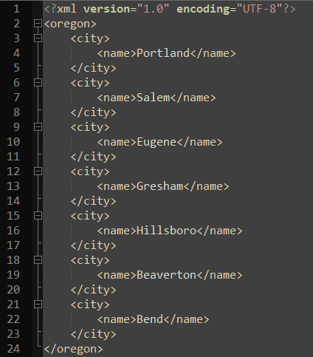
Or Use an XML File
An XML file listing seven cities in Oregon
Note the first line declaring the contents of this file to be XML.
Note how each node has a corresponding closing node.
HTML, is kind of an html. <h1>…</h1>
Pseudocode to print city names from this file:
For each node named city:
print city.name

Slide 14
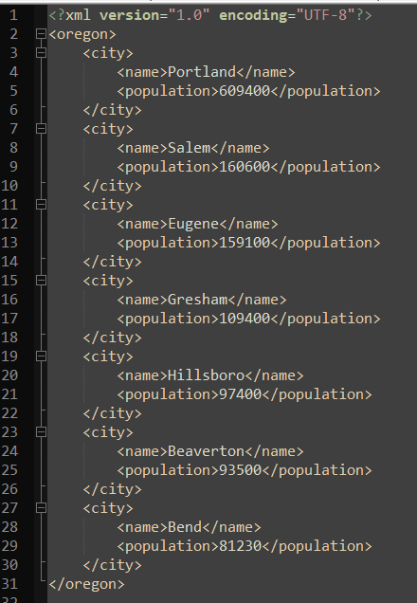

XML Files
Adding population node corresponding to each city.
Does our old code still work?
One of the biggest advantage of using standardized structure.

Slide 15
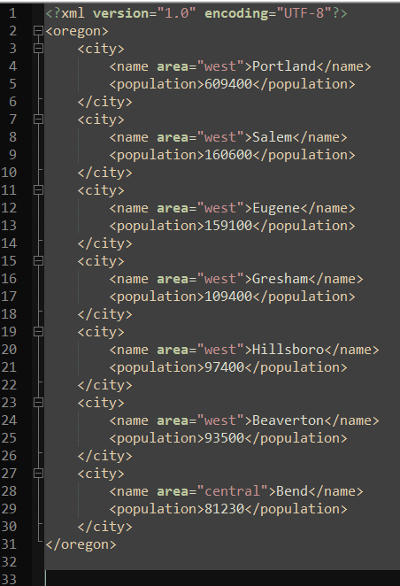
XML: Node Values and Attributes

Slide 16
JSON
Javascript Object Notation
Lightweight – far less verbose than XML
Javascript derived notation
Many languages now have libraries/packages to readily create/parse JSON
Unlike XML, JSON has a defined data types. Their implementations however may slightly differ depending on the libraries/language.

Slide 17
Simple JSON
{"oregon":[
{"ranking":"1", "name":"Portland"},
{"ranking":"2", "name":"Salem"},
{"ranking":"3", "name":"Eugene"},
{"ranking":"4", "name":"Gresham"},
{"ranking":"5", "name":"Hillsboro"},
{"ranking":"6", "name":"Beaverton"},
{"ranking":"7", "name":"Bend"},
]}

Slide 18
JSON Data Types
Number: a signed decimal number that may contain a fractional part and may use exponential E notation, but cannot include non-numbers like NaN.
String: a sequence of zero or more Unicode characters. Strings are delimited with double-quotation marks and support a backslash escaping syntax.
Boolean: either of the values true or false
Array: an ordered list of zero or more values, each of which may be of any type. Arrays use square bracket notation with elements being comma-separated.
Object: an unordered collection of name/value pairs where the names (also called keys) are strings. Since objects are intended to represent associative arrays, it is recommended, though not required, that each key is unique within an object. Objects are delimited with curly brackets and use commas to separate each pair, while within each pair the colon ':' character separates the key or name from its value.
null: An empty value, using the word null
Source: Wikipedia

Slide 19
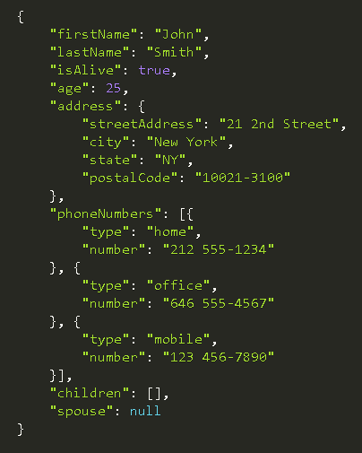
JSON Example
Number
String
Boolean
Array
Object
Null
Example Source: Wikipedia

Slide 20
Questions
Stop for presentations

Slide 21
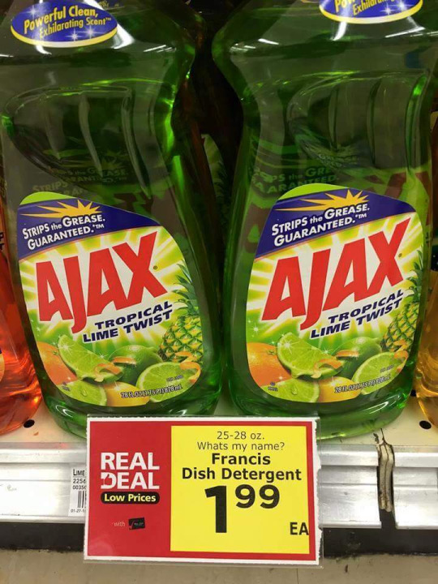
AJAX. What is it good for?
Old school (synchronous full page refresh)
Click a link, wait for page to load, submit a form, wait for page to load..
Today (asynchronous partial refresh)
As you use a webpage, actions are triggered which gather additional information from the server and respond without requiring you to refresh the page.
More complicated, but much more usable

Slide 22
How asynchronous partial refresh works
Web page UI
Your AJAX code
Web server
Type or click
Request action
Update UI
Send message to server
User sees the action started
Server sends back some data
Update UI
User sees the action is done

Slide 23

Steps:
A click, or something user typed – starts an action
A JS function is called [e.g. makeRequest()], which “asynchronously” calls a server based service
UI may reflect this so user knows action has started
Server eventually replies: a callback JS function is invoked [e.g. receiveServerAnswer()]
Callback function processes the results and updates front end accordingly.

Slide 24
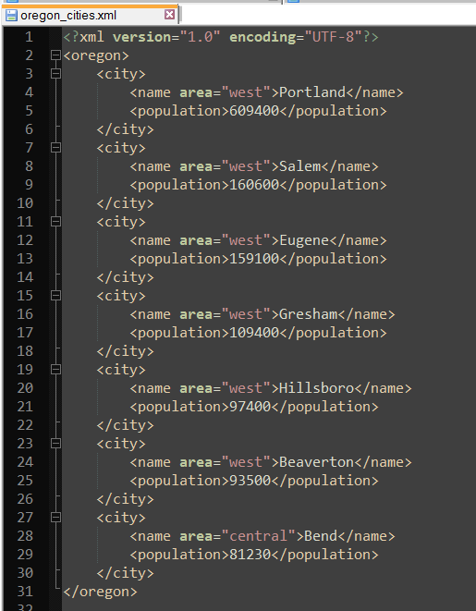
Reading XML Files
http://people.oregonstate.edu/~kotharim/oregon_cities.xml
http://people.oregonstate.edu/~kotharim/read_oregon_cities.php?count=4

Slide 25
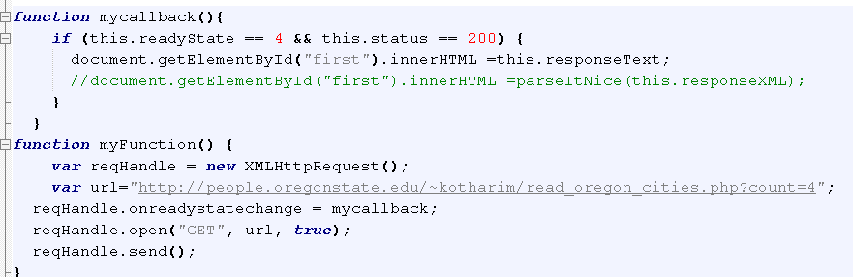
Creating an AJAX Reqeuest
http://people.oregonstate.edu/~kotharim/ajax-read-oregon.html
Notes:
Talk about the XMLHttpRequest object

Slide 26
Same Origin Policy
In general, you can only load data from the same web site that your main html came from
This is called the "same origin policy"

Slide 27
An AJAX Post request
To DO - example of passing an argument
Remember to also look at the n/w traffic
@Students: You can copy the source of this page into your account and then experiment with both, GET and POST AJAX calls.
http://people.oregonstate.edu/~kotharim/ajax-read-oregon.html

Slide 28
Questions?

Slide 30

Questions?

