Slide 1
CS 290– Web Development.
Notes:
GIve the workflow preprocessor example to talk about Disk I/O

Slide 2
Questions
Define AJAX?

Slide 3
What is same source or single source policy in AJAX?

Slide 4
What is a callback?
What is asynchronous I/O? Blocking and Non-Blocking tasks?

Slide 5
What is a web server?
On people.oregonstate.edu, how does it know that http://people.oregonstate.edu/~kotharim/ajax-read-oregon.html should use the file /nfs/chernobyl/u1/k/kotharim/public_html/ajax-read-oregon.html

Slide 6
When you go to http://people.oregonstate.edu/~kotharim you see a directory listing of all files
Lets create an index.html file there
Now when you visit the above url..

Slide 7
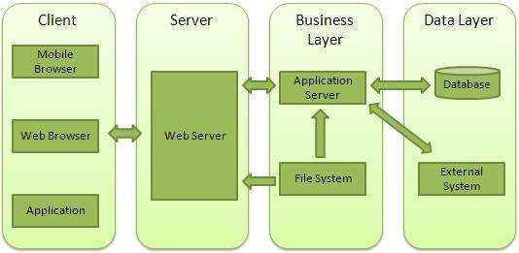

Slide 8
How does your browser differentiate between web content and regular files, including css, js,json,xml or just text
Notes:
You would think its just the extension but your browser looks beyond that.
If you had a file name webpage.xml - you can have HTML in it. Simple include <!Doctype HTML> up top.
Your browser will look at the doc type and determine that the rest of this content is to be parsed as HTML.
Said that - don't put html in a file with extension .xml, unless on purpose.

Slide 9
What is a port? What does it mean to have a listener at a particular port?
What port do most websites run on?
Notes:
Most websites run on port 80
443 is the default https port.
That does not mean those are the ports you have to run your site on.. If you have a web service running on a different port, you simply put in
http://url-to-your-site:port#

Slide 10
Node.js
Officially:
Node.js is a platform built on Chrome's JavaScript runtime for easily building fast and scalable network applications. Node.js uses an event-driven, non-blocking I/O model that makes it lightweight and efficient, perfect for data-intensive real-time applications that run across distributed devices.

Slide 11
Asynchronous and Event Driven All APIs of Node.js library are asynchronous that is, non-blocking. It essentially means a Node.js based server never waits for an API to return data. The server moves to the next API after calling it and a notification mechanism of Events of Node.js helps the server to get a response from the previous API call.

Slide 12
How to play with Node.js
You can download Node and set it up
You can follow the steps described in the book
You can use a cloud based service like c9.
We are taking this route for simplicity and to avoid getting distracted by setup issues. I encourage students with some experience in the area try downloading (node, apache, both) and setting up on your own computer.
Another upside in C9, is the ability to share projects. This is how you will be submitting further assignments PLUS it makes it easy to seek troubleshooting help from me.

Slide 13
Lets get started
Login to your c9 projects
Delete the package.json file and all files/folders under the client folder
Open the current server.js file and remove all its contents
If you don't see one, create one in the root folder
Enter code below
var http = require("http");
var server=http.createServer(function(req,res) { res.writeHead(200,{'content-type':'text/plain'});
res.end("Hello World!")
;})
server.listen(process.env.PORT);
console.log('server listening at:'+ process.env.PORT);

Slide 14
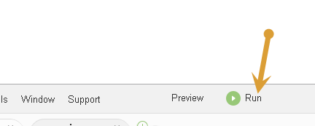
Save your file
Click Run
Look for the console messages in the lower window.
Click on the link where it says your code is running
Everyone see your message show up?
Anyone wanna explain what that code does?

Slide 15
What we did
Line 1 adds an http server module.
Think of it like <#include> in C
In a barebones environment you may have to write your own http implementation. Here, we are using the http module.
This is also a strength of node.js, there are numerous modules available and new ones keep coming. The list is gonna be YUGE

Slide 16
Line 2 instantiates the new server.
It passes it an anonymous function object that will respond to all requests.
Line 3 writes the http header declaring a success response and type of content being returned
How do you check a page's response headers?
Line 4 is that response
All said and done, line 5 binds our server to port 8080 (this can be any open port #).

Slide 17
Question
Changing the code slightly below, should I now see Hello World in large fonts?
var http = require("http");
var server=http.createServer(function(req,res) { res.writeHead(200,{'content-type':'text/plain'});
res.end("<h1>Hello World!</h1>")
;})
server.listen(process.env.PORT);
console.log('server listening at:'+ process.env.PORT);
Notes:
Clue: Remember what we talked about a few slides back. How does your browser determine that your page is serving html content

Slide 18
So far so good?

Slide 19
Lets connect Mongodb
Create a folder named 'data'
Run the command below
mongod --smallfiles
Now lets try and connect to the database
Create a new file called db.js
Include (require) the mongodb package
var mongo = require('mongodb');
Save and Run

Slide 20

Installing a package in node.js
Back on your command line, run the following command
npm install mongodb
Your output should look similar to
Run your code again. You should not have errors now.

Slide 21
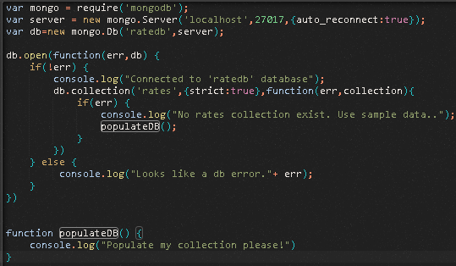
Connecting to Mongodb
Next add the following code to your db.js
Notes:
Note The syntax for open. Point out the callback.
Point out strict tells you to return an error if collection does not exist
var mongo = require('mongodb');
var server = new mongo.Server('localhost',27017,{auto_reconnect:true});
var db=new mongo.Db('ratedb',server); //create a new db
db.open(function(err,db) {
if(!err) {
console.log("Connected to 'ratedb' database");
db.collection('rates',{strict:true},function(err,collection){
if(err) {
console.log("The rates collection doesn't exit. Lets populate it..");
populateDB();
}
})
}
else {
console.log("Looks like a db error."+ err);
}})
function populateDB() {
console.log("Populate my collections please!")
}

Slide 22

So far so good?

Slide 23
Design our db
Problem: We want to create an interface that stores daily exchange rates between USD and foreign currencies, and gives you a buy/sell rate.
So what sort of data do we need to save?

Slide 24
var countries = [
{
country: "India",
notation: "Rs",
currency: "Rupees",
commission:"0.02",
multiplier:"65"
},
{
country: "Thailand",
notation: "thb",
currency: "Baht",
commission:"0.02",
multiplier:"35.5"
}
];

Slide 25
db.collection('rates', function(err, collection) {
collection.insert(countries, {safe:true}, function(err, result) {
if(err) console.log("ERROR");
else console.log("Collection populated.")
});
});
Note, we are handling one error condition (on insert) but we are ignoring the one on the first line.
Just keeping my code simple. In production ready code, its best to handle all possible points of failure.. Even if 75% of them will never occur. The problem is, you don't know which 25% will occur.
Notes:
db.collection('rates', function(err, collection) {
collection.insert(countries, {safe:true}, function(err, result) {
if(err) console.log("ERROR");
else console.log("Collection populated.")
});
});

Slide 26
Add a display all function
exports.findAll = function(req,res) {
console.log("in findall");
var cursor =db.collection('rates').find( ).toArray(function (err, result) {
if(!err) {
//console.log('Found:', result);
for(var i=0;i<result.length;i++) {
res.write("Currency for "+result[i].country+" is "
+result[i].currency+"<br/>");
}
}
res.end();
});
};
exports is global var that points to module.exports. This tells node findAll is available outside this code
if you overwrite exports (e.g. exports=10), then this code will fail.
You can alternatively use module.exports
Notes:
exports.findAll = function(req,res) {
console.log("in findall");
var cursor =db.collection('rates').find( ).toArray(function (err, result) {
if(!err) {
//console.log('Found:', result);
for(var i=0;i<result.length;i++) {
res.write("Currency for "+result[i].country+" is " +result[i].currency+"<br/>");
}
}
res.end();
});
};

Slide 27
Now lets configure this in our server.js
Add the line below to server.js
var mydb = require("./db");
Run
You should see the 'creating content' message
Stop and Run again
This time you should not see that message
Next: Lets map a URI route

Slide 28
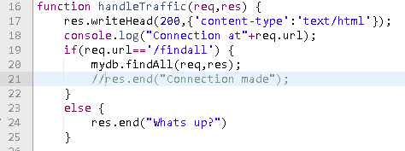
Rewire server.js
Update relevant sections in server.js to look like above
Notes:
//point out that urls can be case-sensitive, as is the case here. By tradition most servers are configured to ignore case sensitiveness in the url (not the arguments)
var server = http.createServer(function(req,res) { handleTraffic(req,res);});
function handleTraffic(req,res) {
res.writeHead(200,{'content-type':'text/html'});
console.log("Connection at"+req.url);
if(req.url=='/findall') {
mydb.findAll(req,res);
//res.end("Connection made");
}
else {
res.end("Whats up?");
}
}

Slide 29
Next
Coming up, we'll take a deep dive into events in both, browser and node.js. We'll follow that up with Express which makes life in Node.js much easier.
Practice task:
Create a db function that accepts a country name as parameter and returns info about that.
Configure server.js so if you hit the url /country/India - it will return India's information.

Slide 30
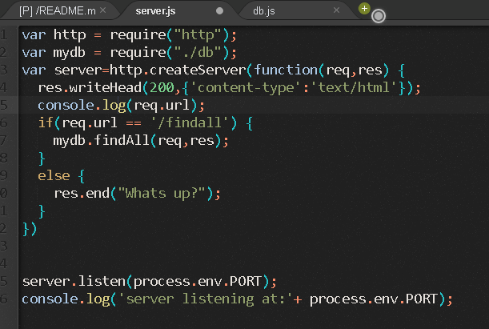
If you're getting errors, compare your server.js to mine below

