Slide 1
CS 290 – Web Development.

Slide 2
Agenda
HTML
CSS

Slide 3

Questions from last class?

Slide 4
Let’s start with HTML
HyperText Markup Language
<question>
What is a Markup Language?
</question>

Slide 5
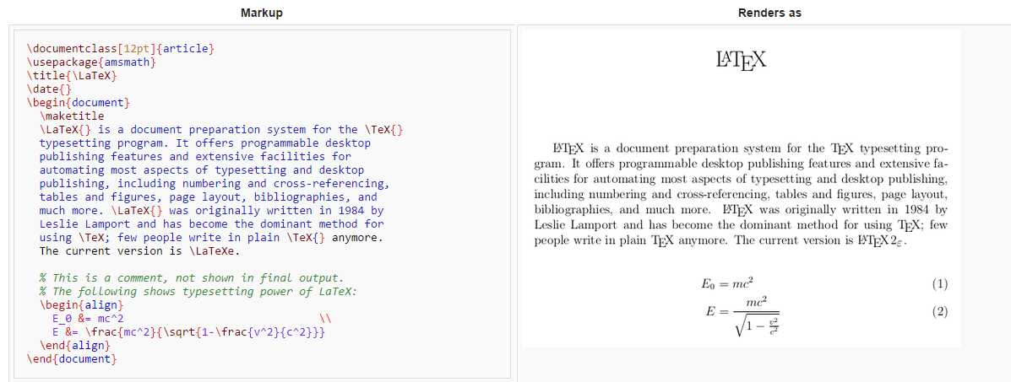
Another example of Markup Language
An example in LaTeX
Source: Wikipedia

Slide 6
So what is Markup language?
It’s a way to annotate a document that is easily distinguishable from the text, but adds meaning to the text.
It can be structural (XML), presentational (HTML), descriptive or procedural.
HTML has both, presentational and descriptive markups.

Slide 7
Lets start with basic HTML
Two parts of a basic HTML page?

Slide 8
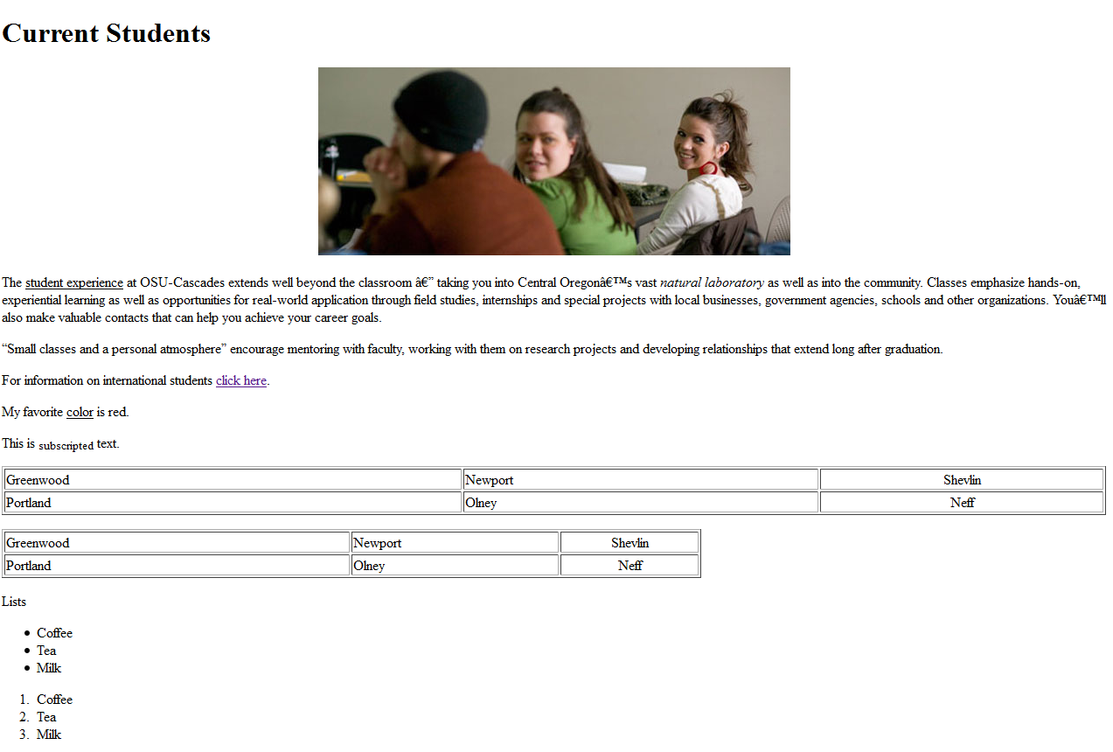
Content body
Besides text, what sort of formatting do we see on this page?

Slide 9
Text formatting
<b>bold</b> or <strong>STRONG</strong>
<i>italics</i> or<em>emphasize</em>
<u>underline</u> or <ins>insert</ins>
<h1>I am HUGE</h1>
<h2>Not HUGE but still pretty Yuge</h2>
<h3>Not Huge or Yuge, but pretty big</h3>

Slide 10
Lists
<ul>
<li>item A</li>
<li>item B</li>
<li>item C</li>
</ul>
<ol>
<li>item one</li>
<li>item two</li>
<li>item three</li>
</ol>

Slide 11
Tables
<table>
<tr><td>row 1, col 1</td>
<td>row 1, col 2</td></tr>
<tr><td>row 2, col 1</td>
<td>row 2, col 2</td></tr>
<tr><td colspan="2">row 3, cols 1-2</td>
</tr>
</table>
what is a <th> tag?

Slide 12
Images
<img src=“south_sister.jpg“ title=“South Sister”>
<img src="subfolder/a_gif_image.gif“ title=“Funny Rabbit”>
<img src="http://www.osucascades.edu/sites/default/files/current-2013.jpg" alt="current students" title="current students" height="215" width="540">
Images can be in folders.
Widely-supported image formats
gif (good for logos) – why?
jpg (good for photos)
png (general-purpose)

Slide 13
iFrames
Blah blah blah
<iframe src="otherpage.html"></iframe>
bottom of my page
<b>here's content of <i>otherpage.htm</i></b>

Slide 14
Head v/s Body
Sometimes you want to put invisible stuff on the page that gets loaded before the visible stuff
Examples: style information, scripts, etc
This goes in the HEAD
Everything else goes in the BODY

Slide 15
HTML 5
Anyone google it?

Slide 16
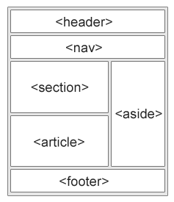
HTML 5 Page Layout Elements
<article>
<aside>
<details>
<figcaption>
<figure>
<footer>
<header>
<main>
<mark>
<nav>
<section>
<summary>

Slide 17

Questions

Slide 18
CSS – Cascading Style Sheets
What is “cascading”?

Slide 19
Example
<table>
<tr><td>text in black and</td></tr>
<tr><td style="color:#0000FF">blue</td></tr>
</table>

Slide 20
First, lets talk colors
Colors are specified using HexaDecimal numerals.
The format used is #Red-Green-Blue, or #RRGGBB.
Black: #000000
White: #FFFFFF
#FF0000
#0000FF
#aBcDeF
#6495ED
What color is the corn flower?

Slide 21
Colors
Colors can also be declared using color names
Blue
Green
Black
White
Brown
Azure
Aliceblue
Cornflowerblue (#6495ED)
http://www.w3schools.com/colors/colors_names.asp

Slide 22
Specifying more than one style
Text in black and
<span style="color:#0000FF;background-color:#FFa030">blue</span>
<div style="background-color:#ff0000">for comparison</div>
You can set lots of style attributes; just separate them with semicolons.
Question: What’s a div tag?

Slide 23
Fonts
<div style="font-family:sans-serif; font-weight:bold; font-size: 16pt">Big 'n bold</div>
These days, most reputable web developers prefer CSS "font-weight:bold" instead of <b>. Later in this lecture, we'll discuss the reason why.

Slide 24
Changing the border
<div style="border: 2px solid #00FF00">Text with a border</div>
You can draw a border around elements, also. Experiment. See what happens when you change "2px" to "5px". Then see what happens if you change your 5px border from "solid" to "inset" or "outset".

Slide 25
Padding
<div style="border: 2px solid #00FF00; padding: 20px 10px 5px 0px">Text with a border</div>
This pads 20px of space above the text but inside the border, 10px of space to the right inside the border, 5px of space below the text inside the border, and 0px of space to the left.

Slide 26
Margins
<div style="border: 2px solid #00FF00; margin: 20px 10px 5px 0px">Text with a border</div>
This adds 20px of space above the text and outside the border, 10px of space to the right outside the border, 5px of space below the text outside the border, and 0px of space to the left.
(Margin does not work well with span. Span is not a block. It's just a little region of text.)

Slide 27
<table style="border: 1px solid black; background-color:#ffffaa">
<tr><td style="font-weight:bold">Name</td>
<td style="font-weight:bold">Children</td></tr>
<tr><td>Eddie</td><td><ul>
<li style="color:#808080 ; background-color:#1111AA">Alice</li>
<li style="color:#808080 ; background-color:#1111AA ">Bob</li>
</ul></td></tr>
<tr><td>Esteban</td><td><ul>
<li style="color:#808080 ; background-color:#1111AA ">Carmen</li>
<li style="color:#808080 ; background-color:#1111AA ">Daniela</li>
</tr>
</table>

Slide 28
Another way to do that
<style>
.hdr { font-weight: bold; }
.kid { color: #808080; background-color:#1111AA }
</style>
<table style="border: 1px solid black; background-color:#ffffaa">
<tr><td class="hdr">Name</td>
<td class="hdr">Children</td></tr>
<tr><td>Eddie</td><td><ul>
<li class="kid">Alice</li>
<li class="kid">Bob</li>
</ul></td></tr>
<tr><td>Esteban</td><td><ul>
<li class="kid">Carmen</li>
<li class="kid">Daniela</li>
</tr>
</table>

Slide 29
Many roads to one destination
<style>
table {border: 1px solid black; background-color:#ffffaa;}
th { font-weight: bold; }
li { color: #808080; background-color:#1111AA }
</style>
<table>
<tr><th>Name</th> <th>Children</th></tr>
<tr><td>Eddie</td><td><ul>
<li>Alice</li>
<li>Bob</li>
</ul></td></tr>
<tr><td>Esteban</td><td><ul>
<li>Carmen</li>
<li>Daniela</li>
</tr>
</table>

Slide 30
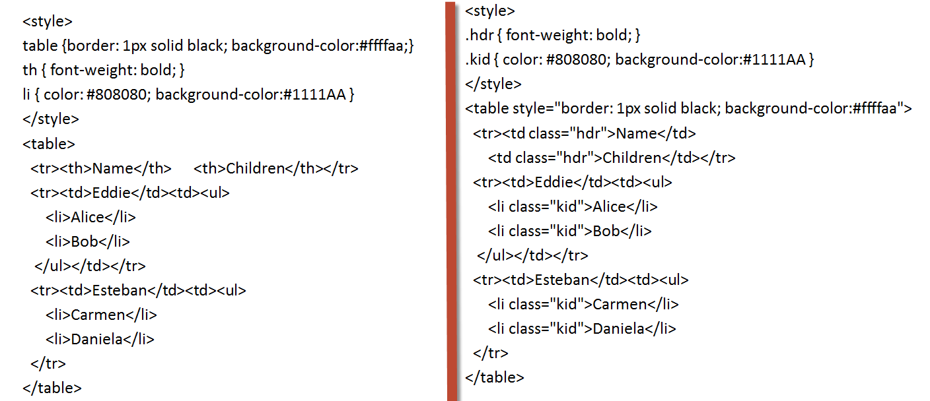
Lets compare the two

Slide 31
Couple tags together
<style>
body, th, td, li { font-family: sans-serif }
table {border: 1px solid black; background-color:#ffffaa;}
th { font-weight: bold; }
li { color: #808080; background-color:#1111AA }
</style>
<table>
<tr><th>Name</th> <th>Children</th></tr>
<tr><td>Eddie</td><td><ul>
<li>Alice</li>
<li>Bob</li>
</ul></td></tr>
<tr><td>Esteban</td><td><ul>
<li>Carmen</li>
<li>Daniela</li>
</tr>
</table>

Slide 32
Or Couple them based on attributes
<style>
body, th, td, li { font-family: sans-serif }
table {border: 1px solid black; background-color:#ffffaa;}
th { font-weight: bold; }
table tr li { color: #808080; }
li {background-color:#1111AA;}
</style>
<table>
<tr><th>Name</th> <th>Children</th></tr>
<tr><td>Eddie</td><td><ul>
<li>Alice</li>
<li>Bob</li>
</ul></td></tr>
<tr><td>Esteban</td><td><ul>
<li>Carmen</li>
<li>Daniela</li>
</tr>
</table>

Slide 33
Or by defining a class
<style>
body, th, td, li { font-family: sans-serif }
table {border: 1px solid black; background-color:#ffffaa;}
th { font-weight: bold; }
table tr li { color: #808080; }
li {background-color:#1111AA;}
.thiskidistrouble {color: #FF0000; font-size: 16pt;}
</style>
<table>
<tr><th>Name</th> <th>Children</th></tr>
<tr><td>Eddie</td><td><ul>
<li>Alice</li>
<li class="thiskidistrouble">Bob</li>
</ul></td></tr>
<tr><td>Esteban</td><td><ul>
<li>Carmen</li>
<li>Daniela</li>
</tr>
</table>

Slide 34
Or Perhaps, by element-id
<style>
body, th, td, li { font-family: sans-serif }
table {border: 1px solid black; background-color:#ffffaa;}
th { font-weight: bold; }
table tr li { color: #808080; }
li {background-color:#1111AA;}
#thiskidistrouble {color: #FF0000; font-size: 16pt;}
</style>
<table>
<tr><th>Name</th> <th>Children</th></tr>
<tr><td>Eddie</td><td><ul>
<li>Alice</li>
<li id="thiskidistrouble">Bob</li>
</ul></td></tr>
<tr><td>Esteban</td><td><ul>
<li>Carmen</li>
<li>Daniela</li>
</tr>
</table>

Slide 35


Slide 36

CSS – It’s Complicated
In general…
Later rules overrule earlier rules
So rules in the HTML file override rules in the <style> tags
And rules in the <style> tags override rules in the linked stylesheet file
And stylesheet files specified later in the HEAD will override those specified earlier in the HEAD
And rules associated with id override rules associated with class
And rules associated with class override rules associated with tags
And some rules (though not all) are inherited by default depending on how tags are nested inside one another
And that's not even taking into account advanced CSS rules such as media selectors and @import, which we won't get into yet

Slide 37
So what to do?
First of all, as much as possible, keep it simple.
Try to use only a single .css file
Try to select based on tag name and class name instead of selecting based on id
Try not to put style into tags directly
Second, test your page in a browser that can explain to you how rules override each other.
Such as Google Chrome

Slide 38
Questions?

