Slide 1
CS 494 – Web Development.

Slide 2
Agenda
More CSS
HTML Forms

Slide 3

Questions from last class?

Slide 4
Announcement about late assignments
Need project partners by Monday
Need project ideas by following Monday.
Presentations

Slide 5
Question
p {background:darkseagreen;} | <p style="background:orchid"> Some text </p>
.pines {background:orchid;} p {background:darkseagreen;} | <p class="pines"> Some text </p>
What color is the Paragraph background?

Slide 6
Back to CSS – breaking down a page
From a browsers perspective, what are the various elements of the page we created in our last class?

Slide 7

Something like this

Slide 8
Life in a box
Every element on the page is a box.
There’s variety in the boxes but two primary ones are
Block:
Start on a new ‘line’
Width larger than actual content
Inline-block
Start where the last one left off
Width relative to actual content

Slide 9
The Display property
Each element has a default display property.
P, Div, Section: display:block
Span: display:inline
Example
http://jsfiddle.net/moulik/v8v64pLh/

Slide 10
Display
Another way to look at these
display:none
visibility:hidden
Block | Inline | Inline-Block
Starts on a new line Can specify margins Can specify width height | Starts on same line Can specify left/right margins but not top/bottom Cannot specify height/width Cans specify padding and border | Starts on same line Can specify margins Can specify width height

Slide 11
Whats inside the box?
Every element on a page is a box.
Every box has a:
Width
Height
Border
Padding
Margin

Slide 12
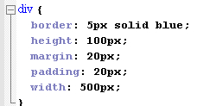
The true size of a box
Take the below example, what is the true width of this box
500? 510? 550? 590? 700?

Slide 13
Width is calculated by adding up
margin-right + border-right + padding-right + width + padding-left + border-left + margin-left
Height is calculated by adding up
margin-top + border-top + padding-top + height + padding-bottom + border-bottom + margin-bottom

Slide 14
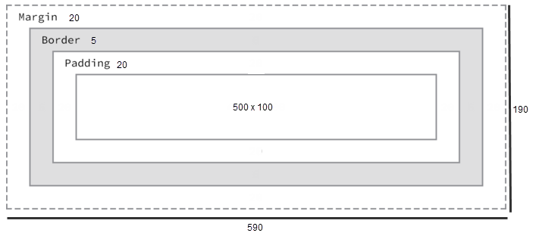
Question: How is background color distributed?

Slide 15
A sidenote on borders
Borders can be many different types: solid, dotted, double, dashed…
You can also control specific sides. For example: border-bottom: 1px solid red;
You can use border radius properties for curved edges and other shapes.
Try out
border-radius: 10px;
border-radius: 50%;
border-radius: 15px 50px;

Slide 16
2+5*2 = ???
Other types of box calculations
The default type added every property. Also referred to as ‘content-box’; the width specified is your content width.
padding-box: includes padding as part of the width specified.
border-box: includes border width as part of the width specified.

Slide 17
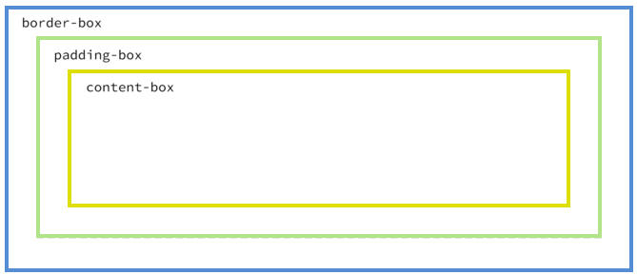

Slide 18
Positioning
Now that we have a box, what are the two next things.
What goes inside it
Where do you place it

Slide 19
Positioning
Absolute: Specify exactly where its placed
Relative: specify relative to objects before it
Float: Place an element to the left or right and let other elements wrap around it, after it.

Slide 20
Absolute
.parent {
background-color: lightgreen;
display:block;
height:200px; width:400px;
}
.child{
background-color: cornflowerblue;
display:block;
position: absolute; right: 20px; top: 20px;
}
<div class="parent">
<div>Clouds and Thunder</div>
<div class="child">Absolute</div>
<div>Sunshine Sunshine</div>
</div>

Slide 21
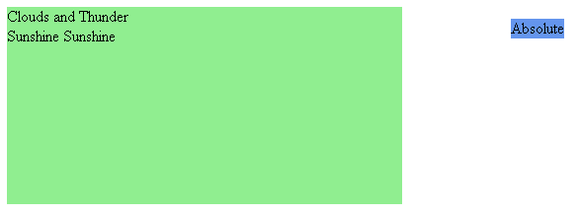
Absolute

Slide 22
Relative
.parent {
background-color: lightgreen;
display:block;
height:200px; width:400px;
}
.child{
background-color: cornflowerblue;
display:block;
position: relative; left: 20px; top: 50px;
}
<div class="parent">
<div>Clouds and Thunder</div>
<div class="child">Absolute</div>
<div>Sunshine Sunshine</div>
</div>

Slide 23
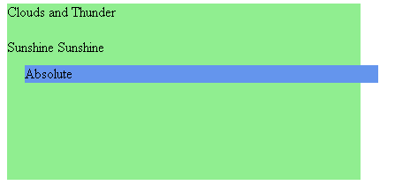
Relative

Slide 24
A Detour
Let's place an image and some text together.
<div>
<img src="http://osucascades.edu/sites/osucascades.edu/files/academic-building-highlight.jpg" width="200"/>
<p>A float is a box that is shifted to the left or right on the current line. The most interesting characteristic of a float (or “floated” or “floating” box) is that content may flow along its side (or be prohibited from doing so by the “clear” property). Content flows down the right side of a left-floated box and down the left side of a right-floated box.</p>
<p>A float is a box that is shifted to the left or right on the current line. The most interesting characteristic of a float (or “floated” or “floating” box) is that content may flow along its side (or be prohibited from doing so by the “clear” property). Content flows down the right side of a left-floated box and down the left side of a right-floated box.</p> </div>

Slide 25
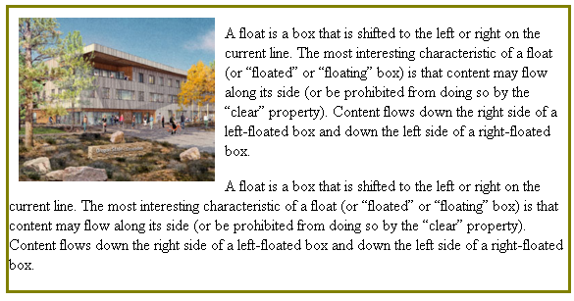
Float

Slide 26
Float
Definition according to w3c
A float is a box that is shifted to the left or right on the current line. The most interesting characteristic of a float (or “floated” or “floating” box) is that content may flow along its side (or be prohibited from doing so by the “clear” property). Content flows down the right side of a left-floated box and down the left side of a right-floated box.

Slide 27
Float
div {
border: 3px solid olive;
}
img {
float: left; margin:10px;
}
<div>
<img src="http://osucascades.edu/sites/osucascades.edu/files/academic-building-highlight.jpg" width="200"/>
<p>A float is a box that is shifted to the left or right on the current line. The most interesting characteristic of a float (or “floated” or “floating” box) is that content may flow along its side (or be prohibited from doing so by the “clear” property). Content flows down the right side of a left-floated box and down the left side of a right-floated box.</p>
<p>A float is a box that is shifted to the left or right on the current line. The most interesting characteristic of a float (or “floated” or “floating” box) is that content may flow along its side (or be prohibited from doing so by the “clear” property). Content flows down the right side of a left-floated box and down the left side of a right-floated box.</p> </div>

Slide 28
Float
Behind the scenes
Floated elements are taken out of the normal flow and placed as far left (or right) they can be placed within the parent element.
If floating two elements to the left, they will take be placed adjacent to each other as long as they can fit in.
*Experiment on fiddle

Slide 29
Float
/*CSS*/
header,
section,
aside,
footer {
background:green;
text-align:center;
margin:20px;
height:50px;;
}
<!– HTML -->
<header>
HEADER
</header>
<section>
Section ONE
</section>
<aside>
Aside ONE
</aside>
<footer>
FOOTER
</footer>

Slide 30
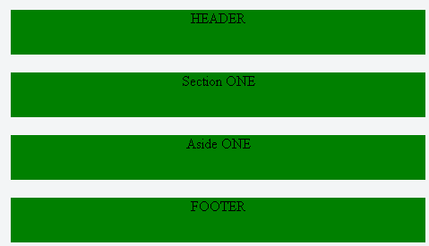

Slide 31
Float
/*CSS*/
header,
section,
aside,
footer {
background:green;
text-align:center;
margin:20px;
height:50px;;
}
section {
float: left;
}
aside {
float: right;
}
<!– HTML -->
<header>
HEADER
</header>
<section>
Section ONE
</section>
<aside>
Aside ONE
</aside>
<footer>
FOOTER
</footer>

Slide 32
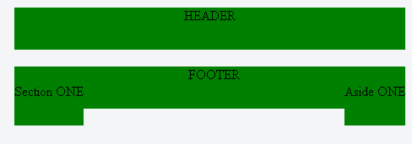

Slide 33
Float
/*CSS*/
header,
section,
aside,
footer {
background:green;
text-align:center;
margin:20px;
height:50px;;
}
section {
float: left;
}
aside {
float: right;
}
footer {
clear:both;
}
<!– HTML -->
<header>
HEADER
</header>
<section>
Section ONE
</section>
<aside>
Aside ONE
</aside>
<footer>
FOOTER
</footer>

Slide 34
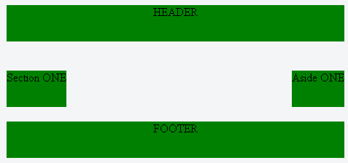

Slide 35
Still with me?
What did we start the lecture with?

Slide 36
A note about fonts
A variety of things you can control with fonts.
font-family
font-size (2em, 14px, percentage)
font-style (italic)
font-weight (bold, 200, 500)
line-height (1.5 x font-size)
Also there’s text-align text-decoration text-indent text-shadow text-transform letter-spacing word-spacing
*note on when to use em v/s px

Slide 37
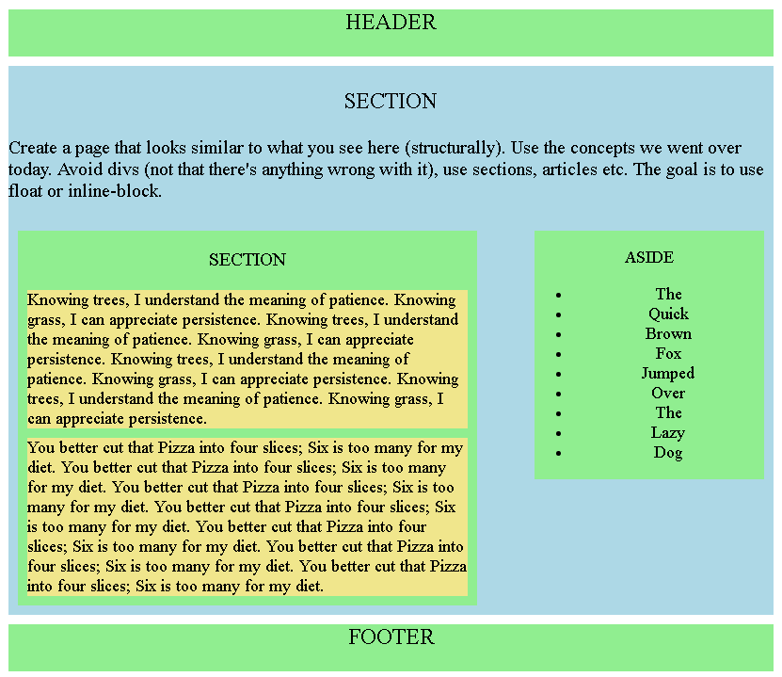
In Class

Slide 38
Forms
What are forms used for?
To pass data to the server.
What sort of data can forms communicate?
…

Slide 40
How does this work?
Browser
Web server
Server-side
Programs
Type URL
Request for webpage
HTML for webpage
Show webpage
User fills out form on the webpage
Send values entered
Do something with these values, please

Slide 41
A simple form
At the very least – a form must have a submit button.
<form action=“someurl" method="GET">
<input type="submit">
</form>
When the user clicks on the submit button, the form gathers all the input and sends to the server. (But this very minimal form has no input fields!)

Slide 42
So lets add some fields
Examples:
http://www.w3schools.com/html/tryit.asp?filename=tryhtml_textarea
http://www.w3schools.com/html/tryit.asp?filename=tryhtml_radio
http://www.w3schools.com/html/tryit.asp?filename=tryhtml_checkbox
http://www.w3schools.com/html/tryit.asp?filename=tryhtml_select2
Getting it all together
http://www.w3schools.com/html/tryit.asp?filename=tryhtml_form_mail

Slide 43
Form - action
The action attribute specified who the form input is submitted to.
<html>
<body>
<h2>Send e-mail to Moulik:</h2>
<form action="read_form_input.php" method="get">
<br/>Name:<input type="text" name="name" value=""><br/>
<br/>Email:<input type="text" name="email" value=""><br/>
<br/>Message:<br/><textarea rows="10" cols="30" name="comment"></textarea>
<input type="submit" value="Send"><input type="reset" value="Reset">
</form>
</body>
</html>

Slide 44
Try the form – check out the url
With GET, the values in a form are displayed on the url

Slide 45
POST
<html>
<body>
<h2>Send e-mail to Moulik:</h2>
<form action="read_form_input.php" method=“post">
<br/>Name:<input type="text" name="name" value=""><br/>
<br/>Email:<input type="text" name="email" value=""><br/>
<br/>Message:<br/><textarea rows="10" cols="30" name="comment"></textarea>
<input type="submit" value="Send"><input type="reset" value="Reset">
</form>
</body>
</html> http://people.oregonstate.edu/~kotharim/simple_form_post.html

Slide 46
GET v/s POST
GET | POST
Parameter/Values are part of the URL | NOT
Can be bookmarked or seen as part of browser history | NOT
Caching – Web Server may not resubmit request to the application | Cannot be Cached.
Length is limited to what can fit into a URL | No such limit
7607 character maximum size. | 8Mb Max
Only ASCII characters are allowed | Binary data can also be passed
Get or Post: When to use which one?

Slide 47
Get v/s Post: When to use
GET | POST
Retrieving data such as a list of items | Retrieving data specific to a user, that may not be cached or shown in browser history. For example: Retrieve all grades for a student with userid:anderson
Check to see response times | Submitting information to the server, securely.
You want info in the url so you can share that link. E.g. search query | Performing action. Example, purchase online.
 | Logging in/out

Slide 48
Question
Why do we have two different protocols?

Slide 49
So why does this difference exist?
Technically, your browser might not connect directly to servers. You connect via proxy servers.
Proxy
Servers
Web server
Database
Browser
SMTP server
Programs

Slide 50
So why does this difference exist?
If two people GET the same URL, the proxy server can GET the URL once and give the data to both.
Browser
Proxy
Servers
Web server
Database
SMTP server
Programs
Programs
Browser
Programs

Slide 51
So why does this difference exist?
Or, a proxy server can preemptively GET certain URLs as many times as desired, even when nobody is logged on.
It can cache this data and omit a GET call later!
Proxy
Servers
Web server
Database
SMTP server
Programs

Slide 52
So why does this difference exist?
Search engines are also allowed to GET any URL at any time, or as many times as desired (subject to certain restrictions).
Web server
Database
SMTP server
Programs
Search engines

Slide 53
So GET can be called arbitrary times
GET can be called…
1 time when 1 user wants data
1 time when 2 users want data
1 time when 300 users want data
Many times when 0 users want data (preemptive caching)
0 times when 1 user wants data (if it was cached)
Many times when search engines want data

Slide 54
POST is not allowed to be cached
A proxy server will always forward the POST request exactly 1 time when each user's browser tries to POST.
A proxy server may not cache POST data.
So if you send passwords via POST, proxy servers are not allowed to keep copies of passwords going by!
And search engines are also not supposed to automatically perform POST operations, either.

Slide 56

Questions

Slide 57
Extra: Form & Input Attributes

Slide 58
Extra – Form & Input Attributes
Input Type | Example
date datetime-local | <input type="date" name="bday" min="1979-12-31“max="2000-01-02">
file | <input type="file" name="pic" accept="image/*"> <input type="file" name="pic" accept=".JPG,.png">
image | <input type="image" src="img_submit.gif" alt="Submit" width="48" height="48">
url | <input type=“url” name=“story”/>
tel | <input type="tel" pattern='\d{3}[\-]\d{3}[\-]\d{4}‘ name=“ph_number” />
password | <input type=“password” name=“oh_so_curious” />
hidden | <input type=“hidden” name=“some_hidden_field” />

Slide 59
Fine-Tuning Input elements
accept | Example
autocomplete | on|off
min,max,maxlength
pattern
required
readonly
Value

Slide 60
Form – Elements besides input
textarea | <textarea rows="10" cols="30" name="comment"></textarea>
button | <button type="button">Next…</button>
select | <select> <optgroup label="German Cars"> <option value="bmw">BMW</option> <option value="audi">Audi</option> </optgroup> <optgroup label="Japanese Cars"> <option value="Honda">Honda</option> <option value="Subaru">Subaru</option> </optgroup> </select>
option/optgroup
fieldset
label

Slide 61
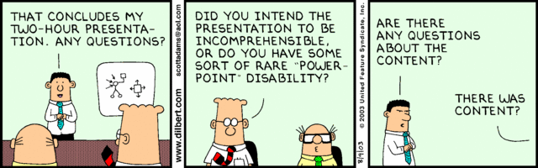
Questions?

