Slide 1
Data Science Hiring Recommendation
Cameron Gallien

Slide 2
Objectives
Candidates:
Full-time data scientist
Could potentially lead a team in the future
Currently a small company expanding rapidly
Compensation:
Competitive range to get top talent
Difference for US-based and off-shore

Slide 3
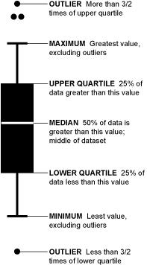
Box & Whisker Plots
Box and Whisker plots provide a five number summary of a data set
Outliers – Extremely high and extremely low values (these are shown as dots above and below the plot)
Minimum – lowest value in the data set (aside from outliers)
Lower Quartile- 25th Percentile (25% of values fall below this number, 75% fall above this number)
Median – the “middle” value of the data or the 50th percentile (50% of values fall above and below)
Upper Quartile – 75th Percentile (75% of values fall below this number, 25% fall above this number)
Maximum – highest value in the data set (aside from outliers)
Photo source: (box-plot-explained.gif (197×356) (wp.com))

Slide 4
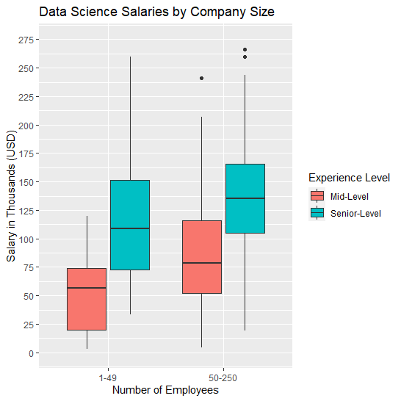
Salaries by Company Size & Experience Level
If only hiring one data scientist, would most likely need either mid-level or senior-level.
Entry-level - too inexperienced for role.
Executive level – would only be needed if leading a team.
Because of the current company size & future outlook, only data for small-sized (1-49 employees) and medium-sized (50-250 employees) companies were considered.
Salaries tend to be higher as company size increases, but with the direction the company is headed it may be smart to compensate based on projected size.

Slide 5
Salaries by Company Size & Experience Level
Mid-Level median pay:
1-49: $56,738
50-250: $78,791
Sr-Level median pay:
1-49: $108,604
50-250: $135,500
Significant leap between Mid-level and Sr-level.
Sr-Level has a smaller difference between small & medium company sizes.

Slide 6
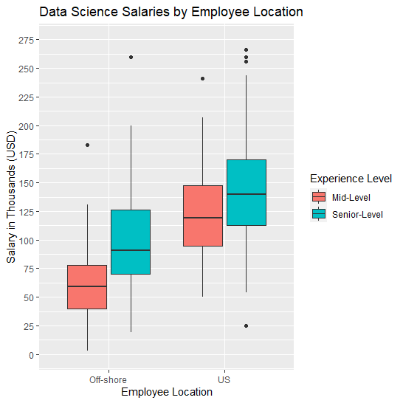
Salaries by Employee Location & Experience Level
Mid-Level median salaries:
Off-shore: $59,303
US-based: $120,000
Sr-Level median salaries:
Off-shore: $90,696
US-based: $140,000
Off-shore hire would significantly lower the salary range for a candidate ($50-60,000), but there are additional challenges.
Time zone difference
Potential language barrier

Slide 7
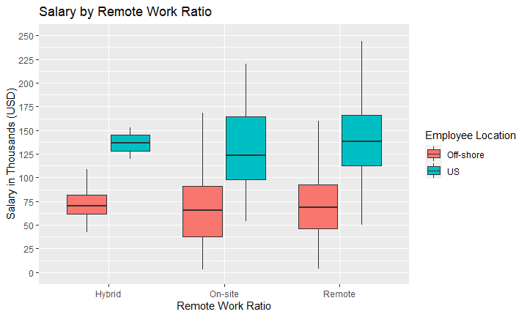
Salaries by Remote Work Ratio
Very minimal difference in salary between remote/hybrid/on-site employees.
May be smart to widen search to all types of candidates under these circumstances.

Slide 8
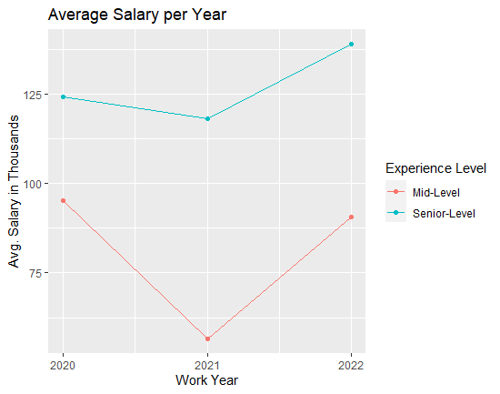
Current Salary Trends
Competitive salary range required to obtain top talent.
Both Mid & Sr-Level salaries have increased over last year, but only Sr-Level salaries have increased since 2020.
Mid-Level salary difference:
2 yr: 4.8% decrease ($95.36k -> $90.74k)
1 yr: 60.3% increase($56.59k -> $90.74k)
Sr-Level salary difference:
2 yr: 11.8% increase ($124.26k -> $138.97k)
1 yr: 17.5% increase ($118.29k -> $138.97k)

Slide 9
Recommendations
Medium-Sized Company Salary Range
Currently a small company but expanding rapidly.
Should project for the future and pay along a medium-sized company scale.
Senior-Level Experience:
If candidate could potentially lead a team in the future, it would be sensible to hire a candidate who would be well-qualified.
Higher salary range than mid-level, but could save money by hiring off-shore candidate.
Executives were excluded as they would be over-qualified for the role as the only hire, and entry-level as they would be under-qualified to work on their own.
Remote Work Ratio:
Minimal difference between salaries of remote/hybrid/on-site employees.
Would make sense to keep options open to attract more candidates.

Slide 10
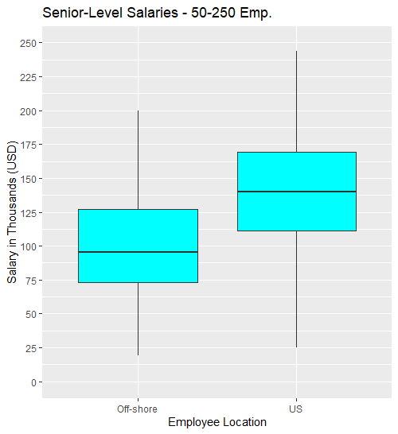
Recommended Salary Range
Recommended range would be between the median & upper quartile of comparable data science salaries. This would avoid paying too much, while staying competitive.
Off-shore:
Median: $95,202
Upper Quartile: $126,947
US-based:
Median: $140,000
Upper Quartile: $170,000
Recent salary increases due to the recession should shift this range.
Applying the 11.8% Sr-Level salary increase over the last 2 years gives us the following range:
Off-Shore: $106,436 - $141,927
US-Based: $156,520 - $190,060

Slide 11
Final Recommendation
Final Recommendation: Off-Shore, Senior-Level Data Scientist with a salary range of $106,436 - $141,927/yr.
Senior-Level provides enough experience to potentially lead a team or work on their own.
Hiring off-shore would save approximately $50,000/yr. in salary.
Off-Shore does come with challenges, so a salary range for US-based is included.
When going with an off-shore candidate, remote work ratio does not come into play.

