Slide 1


Weighted Graph Traveling Salesman Problem
By: Cameron Harmon

Slide 2


Decision Problem: Is there a Hamiltonian Circuit with a total cost less than a given total cost K?
Optimization Problem: Find the shortest path possible that visits each vertex once and can return to the starting vertex

Slide 3
3 vertices
Input:
3 3
a b 3
b c 4
a c 5
Exact Output: 12
a b c a
Execution Time: 13616 nanoseconds
Approximate Output:
12
a b c a
Execution Time: 9437 nanoseconds
4 vertices
Input:
4 6
a b 11
a c 56
a d 6
b c 55
b d 3
c d 14
Exact Output: 84
a b d c a
Execution Time: 27651 nanoseconds
Approximate Output:
120
a d b c a
Execution Time: 8256 nanoseconds
5 vertices
Input:
5 10
a b 82
a c 84
a d 10
a e 57
b c 75
b d 44
b e 69
c d 32
c e 42
d e 12
Exact Output: 221
a b c e d a
Execution Time: 552410 nanoseconds
Approximate Output:
221
a d e c b a
Execution Time: 11982 nanoseconds

Slide 4
Logistics and routing: Used by delivery, GPS and ride-sharing services to minimize travel costs.
Workplace: Used to efficiently plan work areas for most optimal productivity. Shorter distances between necessary areas result in improved work environment.
Importance:
Real World Applicable Uses for TSP

Slide 5
Given a proposed solution, with total weight k, can you find a better solution?
Doing so requires implementation of the algorithm, which runs in O(n^2) time at best with approximation, and at worst O(n^2 * 2^n) if exactness is desired.
Sum up the weights of each graph given the proposed solution and the algorithms. Compare the results.
Certifying the process above by summing the weights is done in O(n) time (summation).
Certifier Process (polynomial explanation)

Slide 6
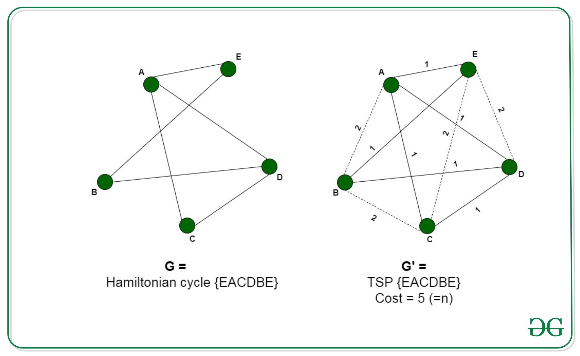
Reduction: Hamiltonian Cycle Problem
Given an instance of the Hamiltonian Cycle Problem: Graph G(V,E)
Construct an instance of TSP: Add all missing edges to Graph G(V,E), creating Graph G’(V’,E’). Assign a weight of 1 to edges that exist in G and a weight of 2 to edges that do not exist.
Interpret the Solution of TSP: If the TSP solution’s weight equals the number of V in G, G contains a Hamiltonian Cycle. If it exists, it will appear in G’ as well. Otherwise, any solution of TSP in G’ will have greater weight than the number of V.
Polynomial time: The dominant complexity is O(n^2). O(n) to initialize G’, O(n^2) to iterate through all pairs of vertices, and O(1) to check if that edge exists in G.

Slide 7
This pseudocode implements the Held-Karp algorithm to solve the Traveling Salesman Problem.
The function `held_karp_tsp(graph)` initializes a dictionary `C` to store the shortest path cost and its associated path, then iterates over all possible subsets of cities to compute the shortest paths.
Each subset is processed to determine the minimal cost path that visits all cities exactly once.
Finally, the algorithm calculates the optimal solution by considering all paths that return to the starting city and returns the minimal cost path.
function held_karp_tsp(graph):
C = {}
n = len(graph)
for k in range(1, n):
C[(1 << k, k)] = (graph[0][k], [0, k])
for subset_size in range(2, n):
for subset in combinations(range(1, n), subset_size):
bits = sum(1 << bit for bit in subset)
for k in subset:
prev = bits & ~(1 << k)
C[(bits, k)] = min(
(C[(prev, m)][0] + graph[m][k], C[(prev, m)][1] + [k])
for m in subset if m != k)
opt, path = min(
(C[(bits, k)][0] + graph[k][0], C[(bits, k)][1] + [0])
for k in range(1, n))
return opt, path

Slide 8
This pseudocode implements the Nearest Neighbor algorithm to solve the Traveling Salesman Problem (TSP).
The function `nearest_neighbor_tsp(graph)` initializes a `visited` list to track visited cities and starts from the first city.
It iteratively selects the nearest unvisited city, adds it to the path, and updates the total travel weight.
After visiting all cities, it returns to the starting city, calculates the final path cost, and returns the total weight and path.
function nearest_neighbor_tsp(graph):
n = len(graph)
visited = [False] * n
path = [0]
current = 0
total_weight = 0
while len(path) < n:
next_node = min(
(graph[current][v], v)
for v in range(n) if not visited[v])[1]
path.append(next_node)
total_weight += graph[current][next_node]
visited[next_node] = True
current = next_node
total_weight += graph[path[-1]][0]
path.append(0)
return total_weight, path

Slide 9
Dominant section of Exact:
Dominant section of Approximate:
# Fill in the remaining subproblems
for subset_size in range(2, n):
for subset in itertools.combinations(range(1, n), subset_size):
bits = 0
for bit in subset:
bits |= 1 << bit
for k in subset:
prev = bits & ~(1 << k)
res = []
for m in subset:
if m == 0 or m == k:
continue
res.append((C[(prev, m)][0] + graph[m][k], C[(prev, m)][1] + [k]))
C[(bits, k)] = min(res)
for _ in range(n - 1):
next_node = min((w, v) for v, w in enumerate(graph[current]) if not visited[v])[1]
total_weight += graph[current][next_node]
visited[next_node] = True
path.append(next_node)
current = next_node

Slide 10
for _ in range(n - 1):
This outer loop iterates n-1 times, visiting all nodes except the starting node.
next_node = min((w, v) for v, w in enumerate(graph[current]) if not visited[v])[1]:
This inner line finds the nearest unvisited neighbor, which involves iterating through all neighbors and checking the visited list. The inner line therefore takes O(n) time.
Overall Dominant Term: The combination of loops leads to a time complexity of O(n^2).
for subset_size in range(2, n):
Iterates over all possible subset sizes, resulting in O(n) iterations.
for subset in itertools.combinations(range(1, n), subset_size):
Generates all combinations of a specific size, resulting in O((n-1)/subset_size) combinations. In the worst case (when the subset size is n-1), this will be O(2^(n-1)).
for k in subset:
Iterates through each city in the subset, resulting in O(n) iterations.
for m in subset:
Another loop over the cities in the subset, also resulting in O(n) iterations.
Overall Dominant Term: The combination of all these loops gives a time complexity of O(2^n * n^2).

Slide 11

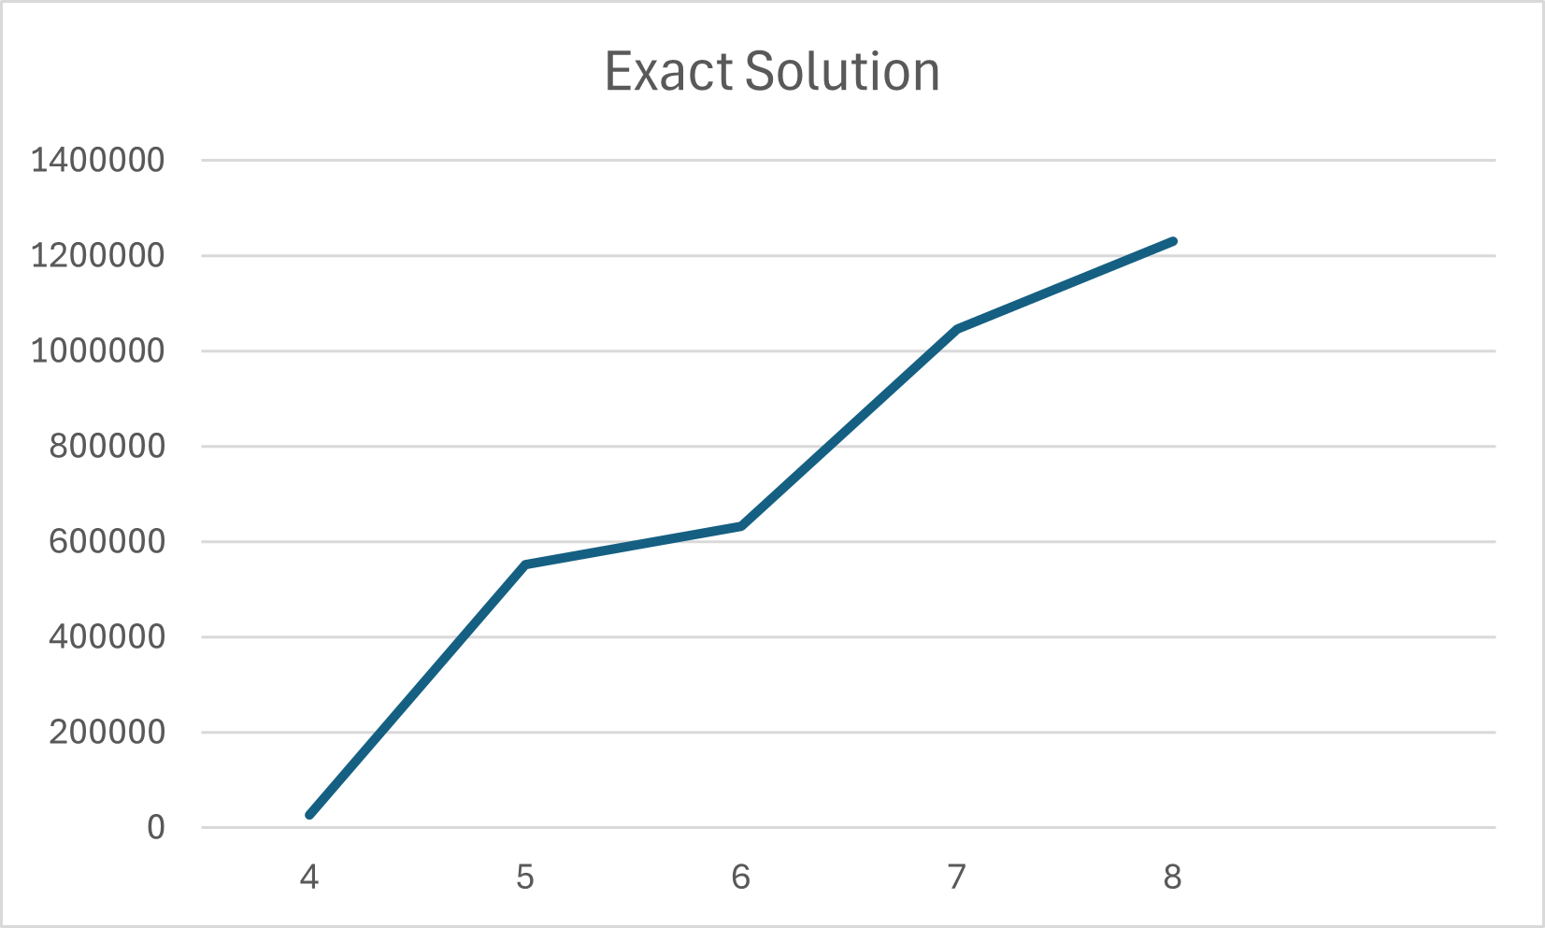

Slide 12
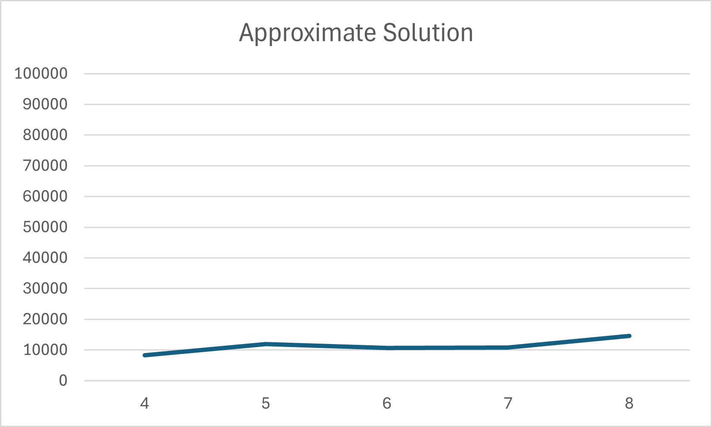

Slide 13
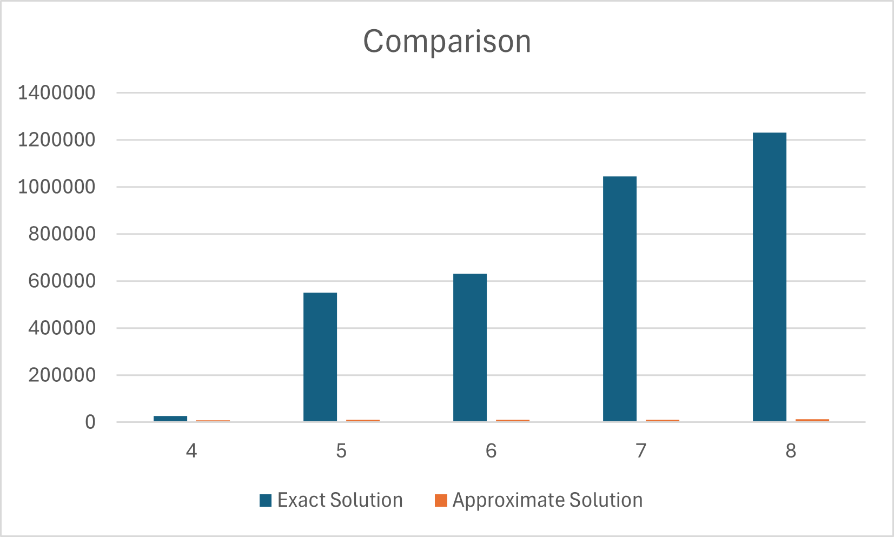

Slide 14
References:
https://en.wikipedia.org/wiki/Travelling_salesman_problem#Dynamic_programming
https://en.wikipedia.org/wiki/Held%E2%80%93Karp_algorithm
https://en.wikipedia.org/wiki/Nearest_neighbour_algorithm
https://www.geeksforgeeks.org/proof-that-traveling-salesman-problem-is-np-hard/

