Slide 1
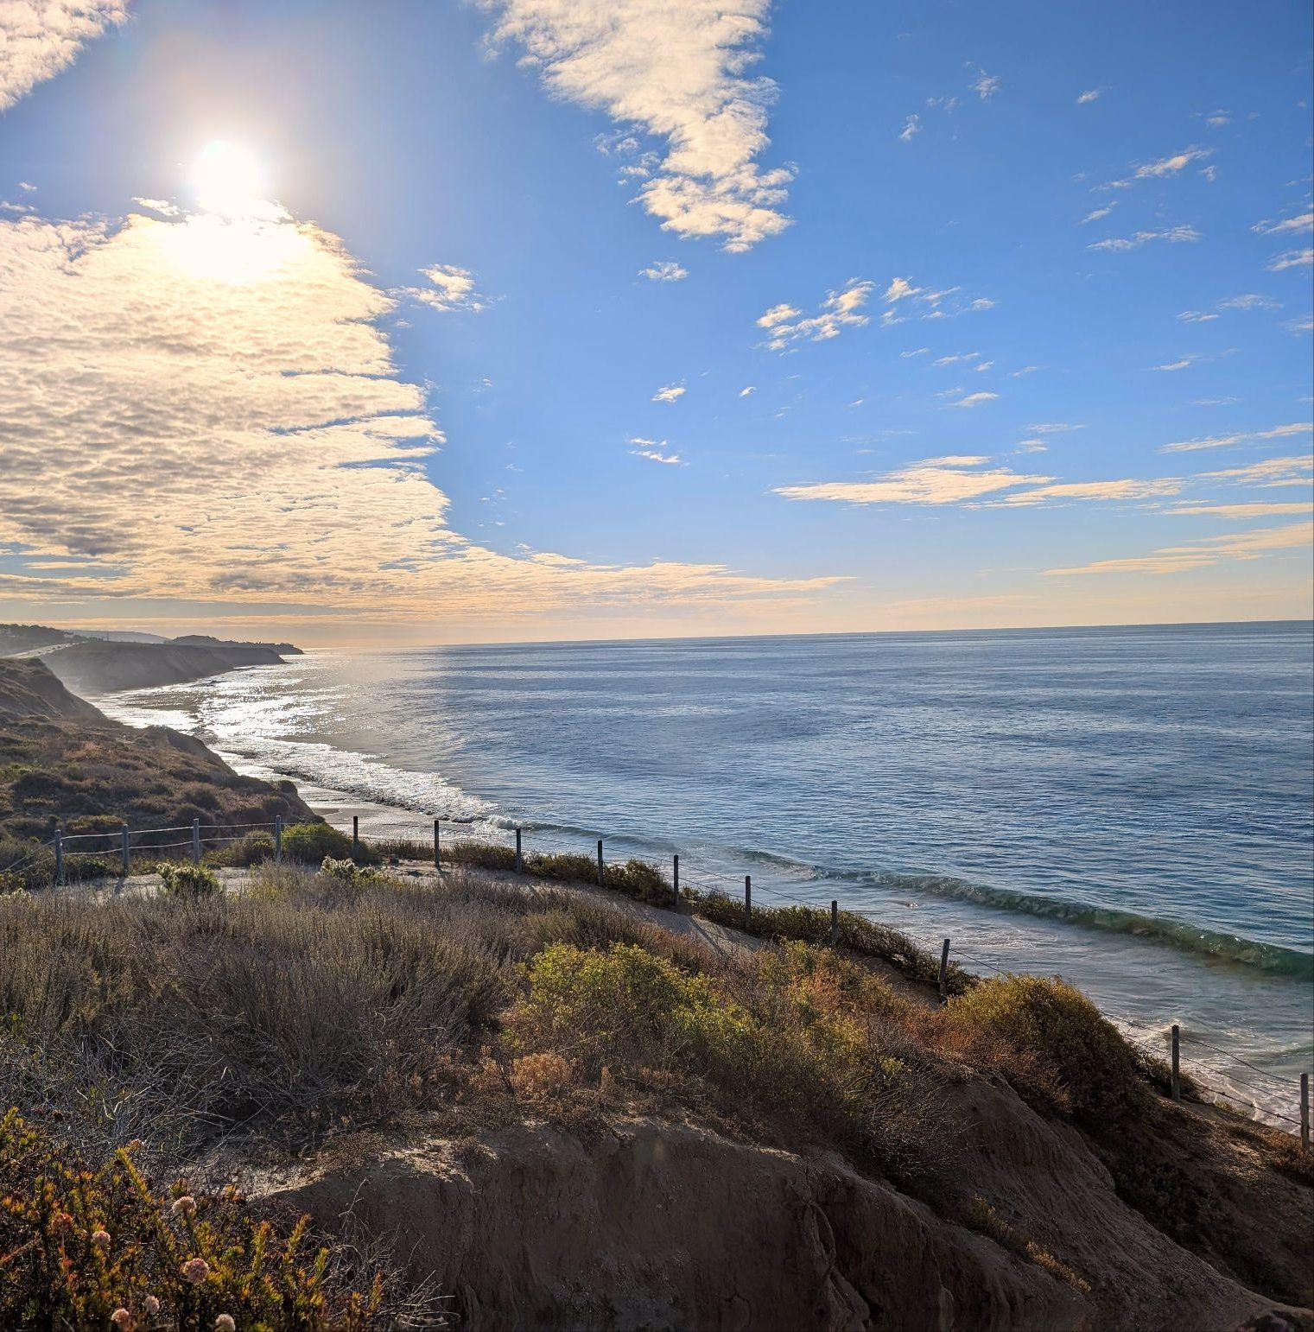
How is Our Ocean Changing?
Module 1.1
Crystal Cove State Park
Newport Beach, California
Notes:
Link to Module 1.1 Outline
BEFORE YOU START TEACHING
Review the Teacher Facilitation Guide for an overview of content and the curriculum as well as helpful facilitation suggestions.
IMPORTANT: Prior to Module 1.1, please make sure students have filled out the pretest. The pretest will take about 30 minutes to complete.
Review CLEAR Framework to support students in prompting LLMs (see Slide 14-15; Lo, 2023; Teacher Facilitation Guide on Artificial Intelligence Literacy & Ethics.
Throughout the program, students will be working in teams of three (preferably).
It may be helpful to ensure that each team has at least one team member who is comfortable with new technological tools, so we recommend selecting the student teams before the start of module 1.1.
Make sure that you have a way to project a video with sound.
The science journal is intended to be a digital notebook. However, if you decide to print copies for students, they may need a writing instrument (pen, pencil, etc.).
___________________________________________________
Open the slideshow to Slide 1 and welcome students into the classroom and inform them that over the next few weeks, they will help pilot a new curriculum.

Slide 2
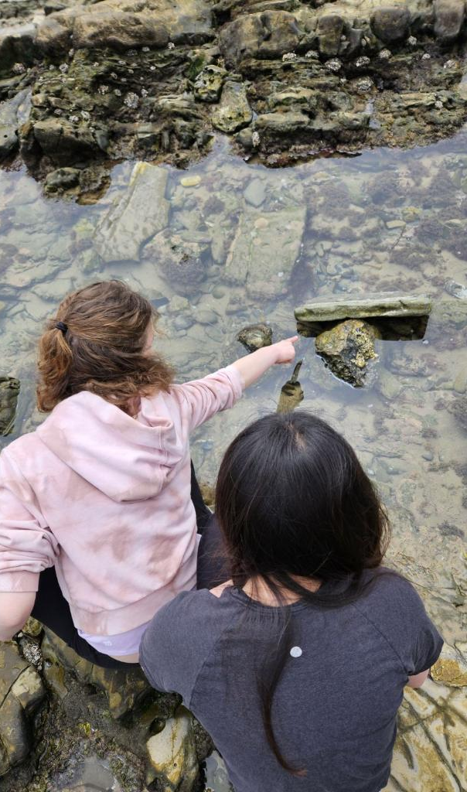
Agents for Inclusive Science Communication (AISciComm)
About the AISciComm Program:
This research project explores how climate change is affecting Southern California’s ocean and how different tools such as generative AI models can help us investigate scientific questions.
We aim to evaluate if using an AI-guided approach can help improve our science communication skills and AI literacy.
Module 1.1 How is Our Ocean Changing? Slide 2
Crystal Cove State Park
Newport Beach, California
Notes:
Advance to Slide 2, where students will be introduced to Agents for Inclusive Science Communication (AISciComm), the program that they will help pilot.

Slide 3




Who is Involved?
AISciComm is a collaborative effort between the following organizations.
Inside the Outdoors
Orange County Department of Education
University of California, Irvine
University of North Carolina of Chapel Hill
Module 1.1 How is Our Ocean Changing? Slide 3
Notes:
Afterwards move on to Slide 3, and showcase who is involved in creating the program and who they will be working alongside.
Inside the Outdoors
Orange County Department of Education
University of California Irvine
University of North Carolina at Chapel Hill
This pilot program will consist of both teacher-led lessons and lessons co-facilitated with the collaborating partners. The focus will be on how climate change impacts Southern California’s ocean and the values that local communities place on the ocean system. Students will explore systems and systems modeling, gathering information through community interviews as well as generative AI and search engine research. This year, students will help support and test two modules (five lessons) of the program, rather than the entire curriculum with the goal of receiving feedback for future iterations of the program.

Slide 4
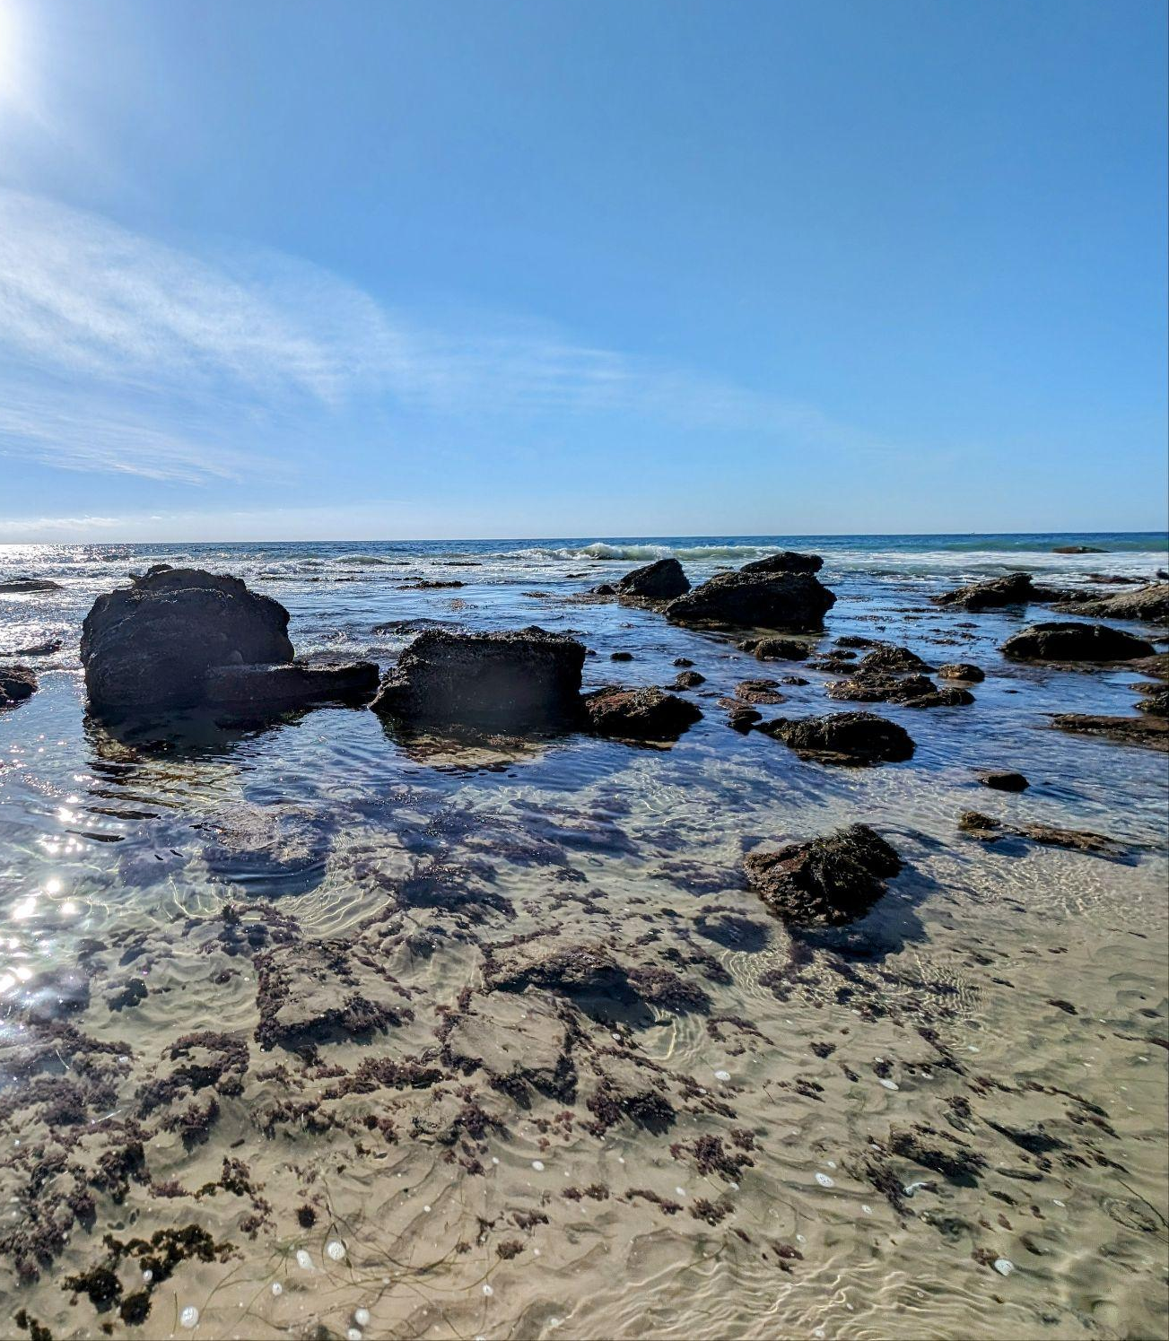
Module Overview
During module 1.1, you will:
Consider how climate change is impacting Southern California’s ocean.
Identify values that local communities place on the ocean.
Explore research methods using generative AI and search engines.
Module 1.1 How is Our Ocean Changing? Slide 4
Crystal Cove State Park
Newport Beach, California
Notes:
Once students have been introduced to the program, advance to Slide 4 and share an overview of module 1.1.

Slide 5
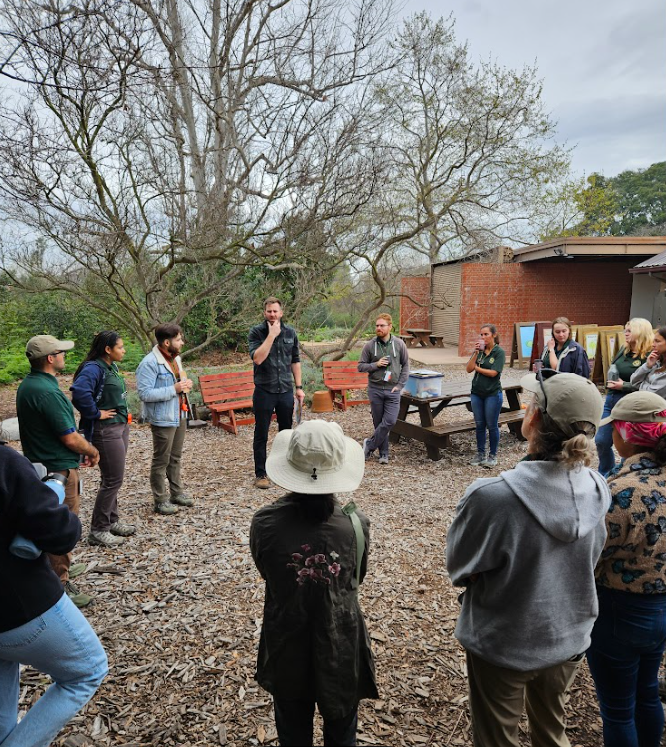
Divide into your project teams!
Break up into teams of three to four students.
This will be your collaborative team for the entirety of the AISciComm project.
Module 1.1 How is Our Ocean Changing? Slide 5
Shipley Nature Center
Huntington Beach, California
Notes:
On Slide 5 ask students to get into groups of three (preferably). These will be the groups that they work with through the remainder of their project.
If you prefer, pre-select which students will be working together.

Slide 6
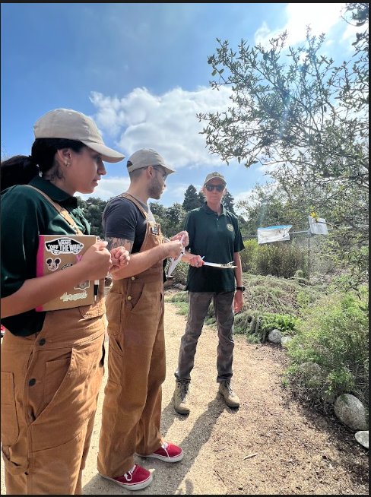
Introducing your Science Journal
Science Journals will be used for the following during this program….
Instructional tasks
Reflections
Brainstorming documents
Link to science journal
Module 1.1 How is Our Ocean Changing? Slide 6
Shipley Nature Center
Huntington Beach, California
Notes:
Advance to Slide 6, where students are introduced to their digital Science Journal. Their Science Journal will be used as a central document to share instructional tasks, capture their reflections, and provide brainstorming documents throughout the lessons.

Slide 7
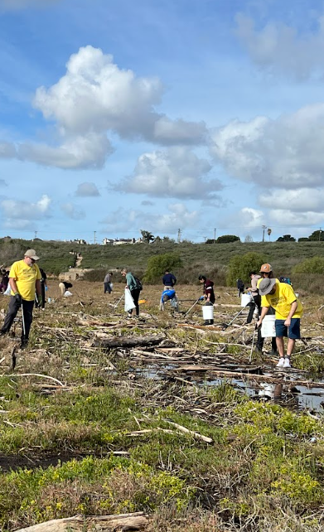
Discuss
Begin by discussing the following questions with your team.
How do you interact with the ocean? What values do you place on the ocean?
How does your community interact with the ocean? What values do they place on the ocean?
What impact do you think climate change will have on the way communities interact with the ocean?
Beach Clean Up
Newport Beach, California
Module 1.1 How is Our Ocean Changing? Slide 7
Notes:
Advance to Slide 7 and tell students that their first team task is to reflect on some initial questions. Invite students to reflect in their groups on the following questions:
How do you interact with the ocean? What values do you place on the ocean?
How does your community interact with the ocean? What values do they place on the ocean?
What impact do you think climate change will have on the way communities interact with the ocean?
As students discuss in their groups, walk around and observe the topics being discussed. If needed, provide additional probing questions to keep the conversation going.
Do you think the oceans are important to you or the people you know? Why or why not?
What activities might you or the people you know do at the ocean?
Could the activities people do change over time with climate change? How?
What have you heard happen to our ocean communities due to climate change events (e.g. rising sea levels, extreme weather)?

Slide 8
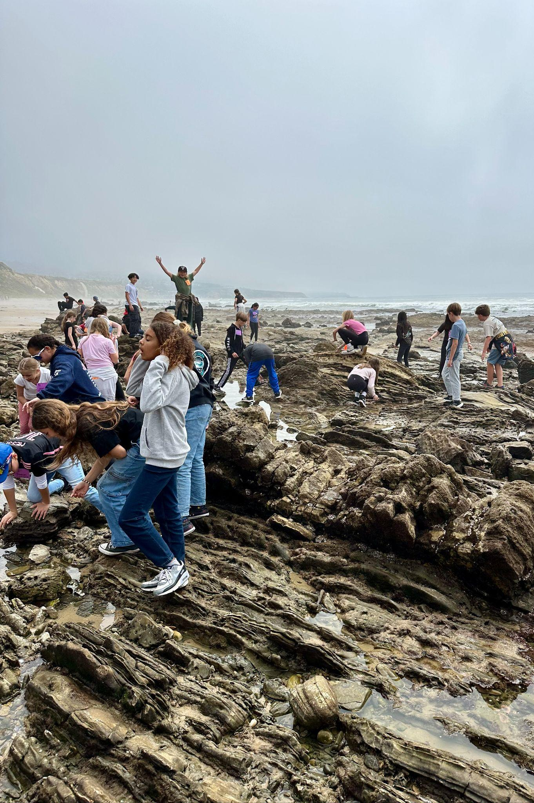
Share
When you’re done discussing with your team, share your thoughts with the class.
What did you and your team discuss?
How is the ocean important to you or others in your community?
What types of challenges may the ocean face?
Module 1.1 How is Our Ocean Changing? Slide 8
Crystal Cove State Park
Newport Beach, California
Notes:
As time winds down, invite students to gather back together for a class discussion. Advance to Slide 8 and share the following questions.
What did you and your team discuss?
How is the ocean important to you or others in your community?
What types of challenges may the ocean face?

Slide 9
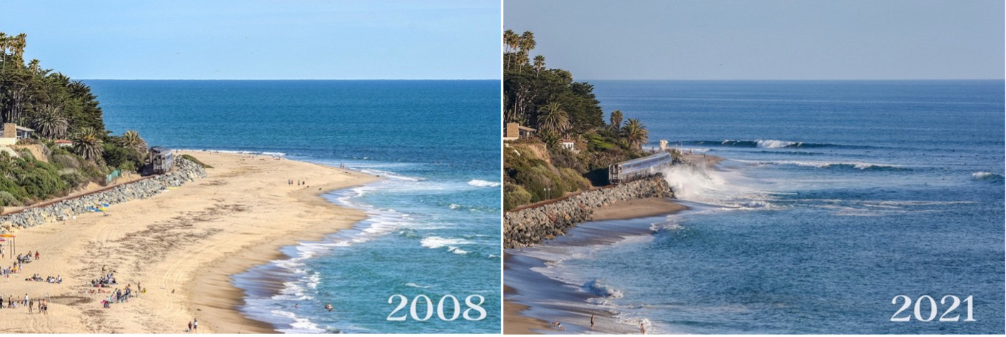
Let’s Investigate!
Our goal today is to research how Southern California’s ocean may be impacted due to climate change.
To research this, you will use two tools
Gemini - a generative artificial intelligence tool
Google - a search engine
Module 1.1 How is Our Ocean Changing? Slide 9
Cottons Point, San Clemente https://engineering.uci.edu/news/2023/6/californias-beaches-are-eroding-heres-how-save-them
Notes:
Advance to Slide 9 to give students an overview of the day, researching how Southern California’s ocean may be impacted by climate change through Gemini (a generative AI tool) and Google (a search engine).
Explain to students that in order to investigate how climate change is impacting the ocean, they will be exploring two types of tools, a search engine like Google, and a generative AI tool like Gemini.
Since they are already familiar with searching for information through platforms like Google, tell students that they will begin by learning more about generative artificial intelligence (or genAI).

Slide 10
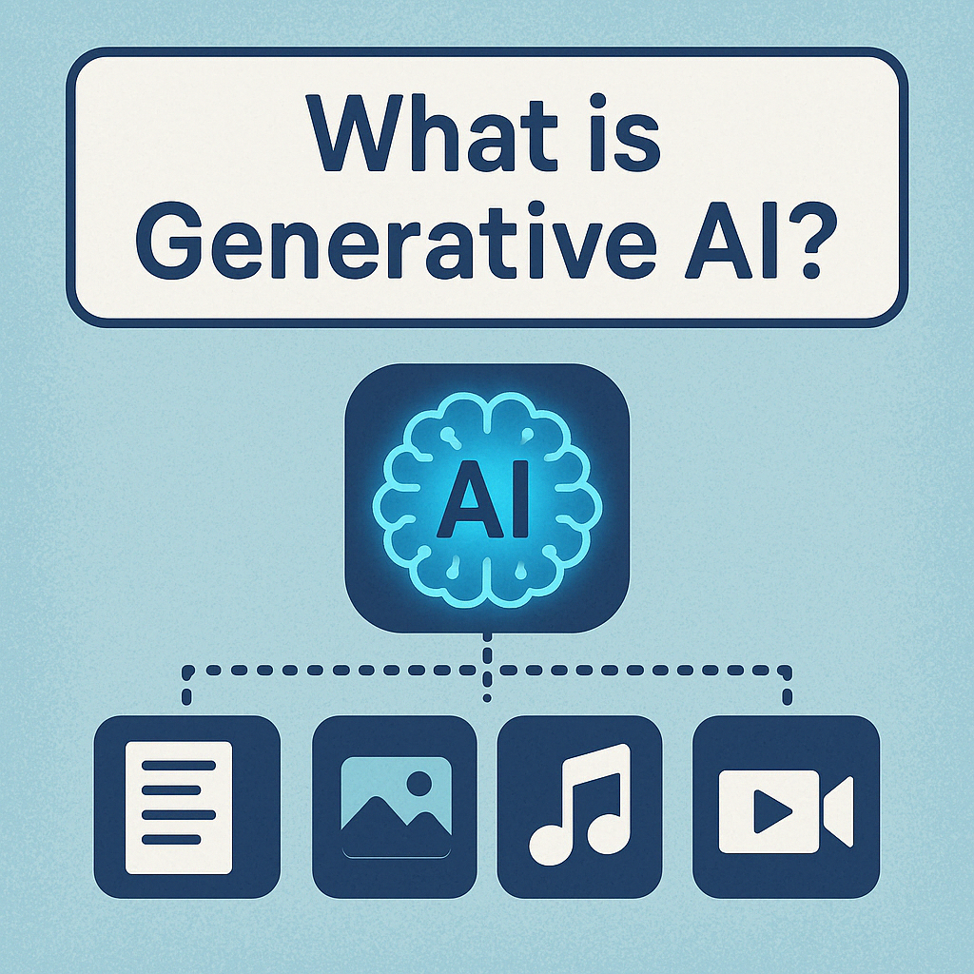
Generative AI
As a class, answer the following questions.
Do you know any platforms that are considered Generative AI? What are they?
What do these platforms do? What can they generate?
Image created with ChatGPT Prompt: Generate an image that answer the question “what is generative AI?” with icons, including text, images, music, and video.
Module 1.1 How is Our Ocean Changing? Slide 10
Notes:
To gauge what students may know about generative AI, advance to Slide 10 and ask:
Do you know any platforms that are considered Generative AI? What are they?
What do these platforms do? What can they generate?
Students may share examples like ChatGPT, Bing, MagicSchoolAI, etc. as potential platforms and share that they can provide text, images, or simply, answers.

Slide 11
What is generative artificial intelligence (GenAI)?
Generative AI is a type of machine intelligence that can create (or generate) new content, such as text, images, music, or video.
Image created with ChatGPT Prompt: Generate an image that answer the question “what is generative AI?” with icons, including text, images, music, and video.
Module 1.1 How is Our Ocean Changing? Slide 11
Notes:
Advance to Slide 11, and share that Generative AI is a type of machine intelligence that can create (or generate) new content, such as text, images, music, or video.

Slide 12

Large Language Models: One form of Gen AI
Notes:
Watch the video from 00:00 - 01:12 to provide an overview of large language models. https://www.youtube.com/watch?v=LPZh9BOjkQs&t=1s&ab_channel=3Blue1Brown
Advance to Slide 12 and inform students that they will interact specifically with Large Language Models (LLM), a form of generative AI that can generate text. To understand how LLMs work, they will explore it by watching a video. [0:00 - 1:12; watch the video from the beginning to the 1:12 mark]

Slide 13

Reflecting on Large Language Models
After you’ve watched the video on LLMs, answer the following questions with your team.
What are large language models? What makes them “large”?
If we were to build a chatbot model that sounds like you, what types of data could the chatbot be trained on?
Image created with ChatGPT Prompt: Create an illustrated image of a large language model receiving large amounts of data
Module 1.1 How is Our Ocean Changing? Slide 13
Notes:
After students have watched the video, move on to Slide 13 and ask the following questions:
What are large language models? What makes them “large”?
Large Language Models are trained on a very large amount of text data often pulled from the Internet. If a human was to read the text used to train the current version of ChatGPT, it’d take about 3500 years.
If we were building a chatbot model to sound like you, what types of data could the chatbot be trained on?
The chatbots would be trained on your daily conversations and written text, so it can predict the words to sound like you.
Explain to students that their team's task is to search for information on how climate change is impacting the ocean in Southern California using a large language model (e.g., Gemini) and Google search.

Slide 14
Create effective prompts for LLMs
When prompting GenAI, make sure you use a CLEAR prompt that:
Concise: uses only essential words
Logical: has a logical structured order to your prompt
Explicit: provides exact instructions about your desired result
Adaptive: provides room to further the conversation or make improvements to your question
Reflective: provides space to interpret the result and make sense of it. Does the provided answer make sense?
Module 1.1 How is Our Ocean Changing? Slide 14
Notes:
Before they begin searching, advance to Slide 14, where students will see the CLEAR framework, a framework used to effectively create question prompts for generative AI. Share that an effective question follows the CLEAR framework and is:
Concise: uses only essential words
Logical: has a logical and structured order to your prompt
Explicit: provides exact instructions about your desired result
Adaptive: provides room to further the conversation or make improvements to your question
Reflective: provides space to interpret the result and make sense of it. Does the provided answer make sense?
See Teacher Facilitation Guide (Under Content Review and Core Concepts) for guiding questions on CLEAR Framework.

Slide 15
Create effective prompts for LLMs
Can you come up with a prompt that shows the CLEAR principles?
Concise: uses only essential words
Logical: has a logical structured order to your prompt
Explicit: provides exact instructions about your desired result
Adaptive: provides room to further the conversation or make improvements to your question
Reflective: provides space to interpret the result and make sense of it. Does the provided answer make sense?
Example: How does climate change affect sea levels, and what does that mean for people living near the coast?
Module 1.1 How is Our Ocean Changing? Slide 15
Notes:
To see an example of a question that uses the CLEAR framework, advance to Slide 15.

Slide 16
Tips to keep in mind.
While you use Gemini and search on Google, keep the following tips in mind.
Consider the accuracy of the source. Is the information provided accurate or outdated?
Check additional sources and make sure that the sources are reputable.
If the response is unclear, ask for clarification and examples.
Test varying prompts or search terms to make sure that the answers are consistent.
Module 1.1 How is Our Ocean Changing? Slide 16
Notes:
Advance to Slide 16 and share a final few tips that students should keep in mind while searching for information:
Consider the accuracy of the source. Is the information provided accurate or outdated?
Check additional sources and make sure that the sources are reputable.
If the response is unclear, ask for clarification and examples.
Test varying prompts or search terms to make sure that the answers are consistent.

Slide 17
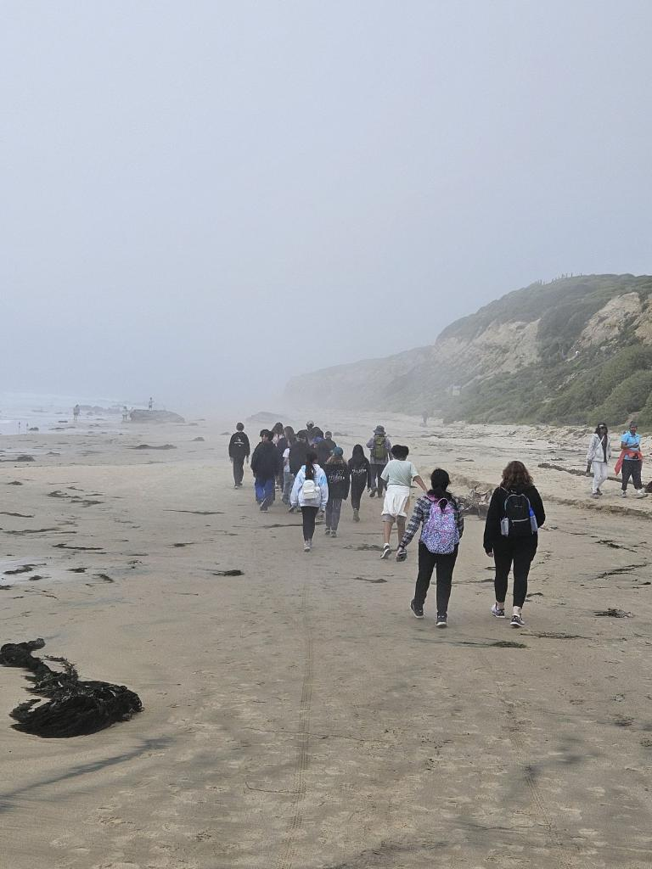
It’s research time!
As you research, keep the following questions in mind.
How has climate change impacted the ocean in Southern California over time?
How might climate change impact the way your community interacts with the ocean?
Module 1.1 How is Our Ocean Changing? Slide 17
Crystal Cove State Park
Newport Beach, California
Notes:
Advance to Slide 17 and invite students to start using both generative AI (Gemini) and Google to investigate how climate change is impacting the ocean.
Remind students to keep the following questions in mind during their search:
How has climate change impacted the ocean in Southern California over time?
How might climate change impact the way communities connect with the ocean?
If student teams have not done so, invite them to test both platforms using similar questions to investigate the similarities and differences in responses.

Slide 18
Share
Share your experiences with the class. Use the following questions to guide your ideas.
What platforms did you use?
Was the way you searched for information different depending on the platform? How?
What type of responses did you get?
How did you evaluate if the information provided was accurate and reliable?
What do you think are the strengths and weaknesses of a generative AI platform like Gemini and a search engine like Google?
Module 1.1 How is Our Ocean Changing? Slide 18
Notes:
As students finish their information search, bring the class back together to share what they have learned.
Move forward to Slide 18 and invite students to share their experiences on the differences in the interactions and outputs between using Gemini versus Google.
Consider the following questions to facilitate student discussion:
What platforms did you use?
Was the way you searched for information different depending on the platform? How?
What type of responses did you get?
How did you evaluate if the information provided was accurate and reliable?
What do you think are the strengths and weaknesses of a generative AI platform like Gemini and a search engine like Google?

Slide 19

Reflect
In your science journal (p.2), take a couple of minutes to reflect on your experiences during Module 1.1
How has your understanding of how climate change affects Southern California’s ocean changed after completing Module 1.1?
What information are you missing that can help you construct a model of how climate change is impacting Southern California’s ocean?
What other sources or people could help you learn more information about what you want to know?
Image created with ChatGPT Prompt: Create an image about SoCal beaches.
Module 1.1 How is Our Ocean Changing? Slide 19
Notes:
Advance to Slide 19 and invite students to add to their science journal, reflecting on what else they might need to know in order to develop a model that shows how climate change is affecting Southern California’s ocean.
As you finish up for the day, thank the students for their time and ask them to reflect on these questions on Module 1.1: How is Our Ocean Changing? Student Reflection (p. 2) of their Science Journals:
How has your understanding of how climate change affects Southern California’s ocean changed after completing Module 1.1?
What information are you missing that can help you construct a model of how climate change is impacting Southern California’s ocean?
What other sources or people could help you learn more information about what you want to know?

Slide 20
Thank you!
If you have any questions, please feel free to reach out.
Erick Valdez
Inside the Outdoors
evaldez@ocde.us
Ha Nguyen, Ph.D.
Assistant Professor, UNC
ha.nguyen@unc.edu
Module 1.1 How is Our Ocean Changing?
Slide 20
Notes:
Advance to Slide 20. Thank the students for their time today. Recap with students that today, they used generative AI and search engines to gather information. Their goal by the end of their time with this project will be to construct a model showing how climate change is impacting Southern California’s ocean. To do so, their next step is to gather additional information by using a different source of data collection, such as interviews.

